Slide 1
IRONHACK PROJECT 1
BLACKJACK GAME

Slide 2
Game description/pseudocode
Plan
Python code

Slide 3
Player’s cards =21
Blackjack
Start
Player receives 2cards
Yes
No
No
Player wants extra card?
Dealer reveal his cards
Player cards <21
Player reveal 3rd card
Dealer takes two folded cards
Yes
Player cards >21
Dealer cards < 17
Dealer opens 1 more card
Dealer cards <21 Compare dealer vs player cards
Dealer cards >21 player wins
Finish

Slide 4
Conditions (if, elif, else)
Loops(for, while)
Functions
Sum
Pop, append
shuffle
Random library

Slide 5
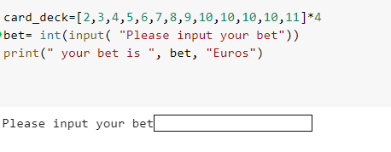

Slide 6
The dealer starts shuffling the cards and giving hands.

Slide 7
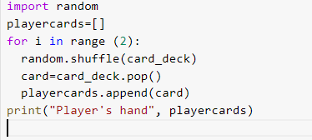
Player’s hand

Slide 8
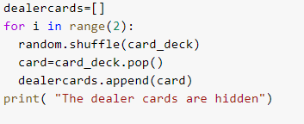
Dealer’s Hand

Slide 9
Player’s hand
Sum player’s cards =21
Sum player’s cards <21

Slide 10

Case 1

Slide 11
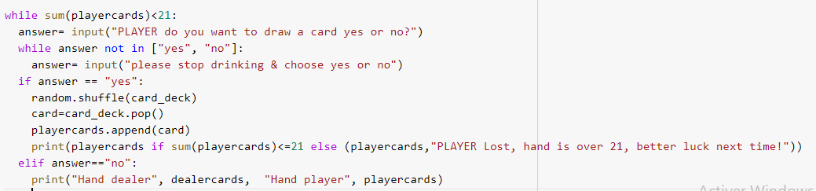
Case2

Slide 12

Dealer’s hand> Player’s Hand
Dealer’s hand< Player’s Hand<17
The Dealer reveals his hand
Dealer’s hand= Player’s Hand

Slide 13

Case 1

Slide 14
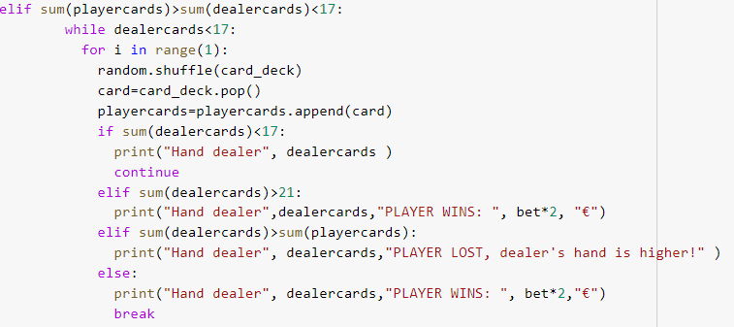
Case 2

Slide 15

Case 3

Slide 16
Thank you!

