Slide 1
IRONHACK PROJECT2
DATABASES (API, My SQL)

Slide 2
https://data.worldbank.org/
Data collecting
Python
Plan
Data processing
MySQL
Results

Slide 3
Africa Western and Central
East Asia & Pacific (excluding high income)
Regions
Middle East & North Africa
Latin America & Caribbean (excluding high income)

Slide 4
Sanitation
Uneployment
Indicators
Public health expenditures
Electricity access
Life expectancy

Slide 5


In Python
API World Banque
DATA
Tables
(indicators, regions, year 2019
Import Data as csv file

Slide 6
In MySQL
Creating a new database
Import csv files
Creating new tables with normalized indicators
Joining colums indications
PK=fK= regions
Index calculation

Slide 7
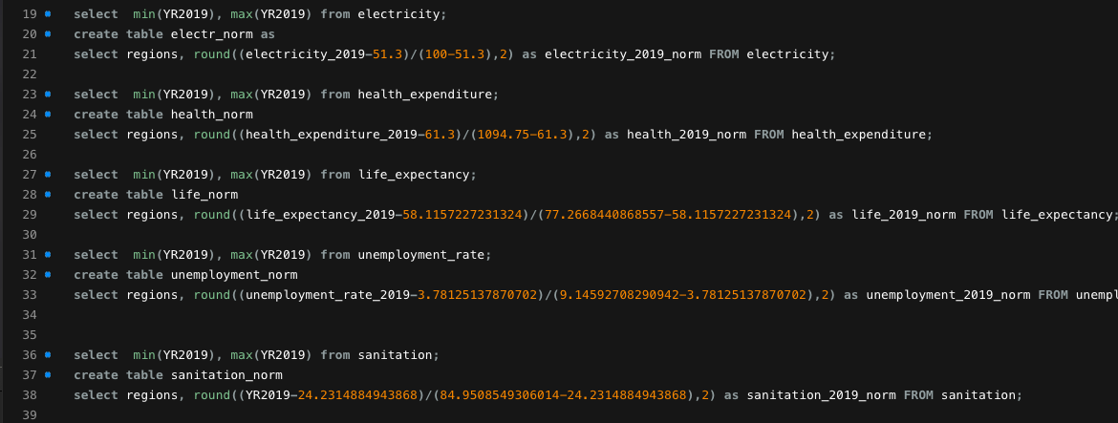
Creating new tables with normalized indicators

Slide 8
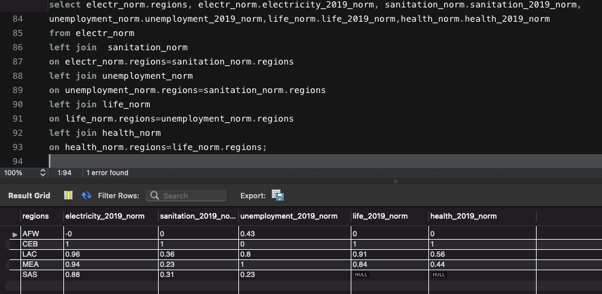
Joining colums indications
PK=fK= regions

Slide 9
Index calculation
Poverty_index_relief= ∑ (coef*indicators)/5
Electricity access (+1)
Sanitation( +1)
Life expectancy(+1)
Health expenditure(+1)
Uneployment(-1)
Coef.

Slide 10
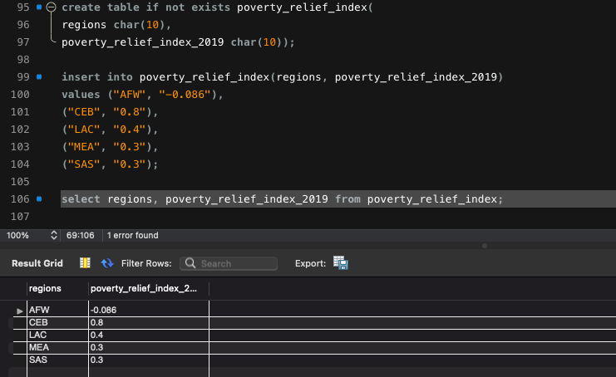

Slide 11
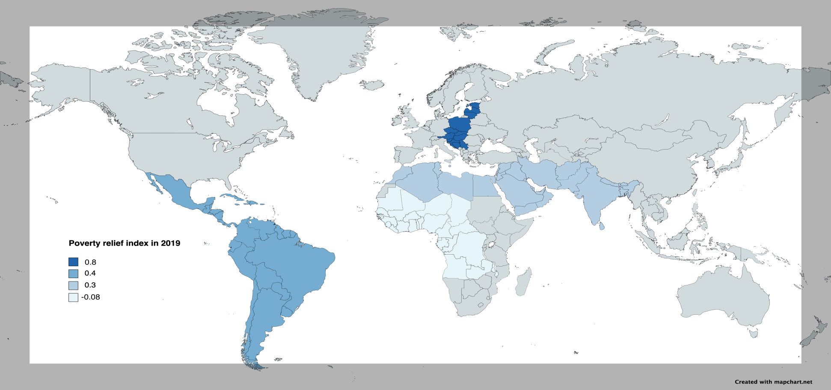
Results

