Slide 1
COMP 2613 Intermediate Java Programming
Part-time Studies
British Columbia Institute of Technology
Written by Henry Chan (hchan@apache.org)

Slide 2
Prerequisites
COMP 2613 is an intermediate Java programming course
The prerequisites are:
COMP 1409 Intro. to OO Programming with Java
COMP 1451 Understanding Programming
or prior programming experience in C++ or C# plus an understanding of the java programming language, core frameworks, and object-oriented programming
Basic understanding of Microsoft Windows
A good understanding of problem solving

Slide 3
Attendence
In the dropbox, you’ll seen an attendance folder
At the beginning of each class, I’ll ask you to submit a file there to prove you are here
i.e. Day1, submit ant.txt
i.e. Day2, submit boy.txt
i.e. Day3, submit cool.txt
i.e. Day4, submit <guess what letter it will start with>.txt ;)
Of course you won’t know the secret textfile name until the start of each class.

Slide 4
Evaluation
Assignments x 10 20%
Mid term exam 20%
Final exam 20%
Final Project 40%
You must achieve a mark of 60% in order to pass the course
You must achieve a grade of 60% on the final exam to pass the course
You must achieve a grade of 60% on the final project to pass the course

Slide 5
Assignments
Must be completed individually (but talking
With your classmates is encouraged. Be social)
Must be handed in before the due date and time
Starting with Assignment#6, you have the option of working in a team of up to 3 people. Warning: the amount of work in the second half of this class can get pretty intensive compared to the first half
Assigment#1 – Assignment#10 … see the download via Git (more on Git in 4 slides)
If at anytime you need help, please post your question to D2L or email me: hchan@apache.org

Slide 6
Structure
Each lecture is about 1-1.5 hours.
After that, it is “Lab” time. I strongly encourage you to use Lab time to understand more about your assignments or even the tools you are about to use. This is also a good chance for you to get to know your classmates and potential form a group for the 2nd half of this course
You have ONE final project. Its pretty much the summation of all your assignments. I want to provide guidance for you to create a project that you can use as part of your portfolio to show your future employer what you can do. Think project and portfolio!!

Slide 7
Software
JDK 1.7
Eclipse
Git
Maven
Windows Builder (plugin for Eclipse – optional)
Browser (I like FF ;))

Slide 8
What you already know!
How to analyze a problem and formulate a solution
Fundamentals of procedural programming
Constants, variables, decisions, repetition
Object-oriented programming
Java language syntax
How to write a Java program that uses multiple classes
Java's primitive data types
What the main method is
Arrays
Casting
Classes
Objects
Instantiation
Inheritance
Encapsulation
Overloading
Overriding
Constructors
Methods
What static & final mean
public, protected, private
this & super, instanceof
null

Slide 9
Hello World in Eclipse
Download Eclipse
Download JDK1.7
Start Eclipse (take note of the workspace directory)
While you are waiting for the download take a look at:
https://github.com/hchan/comp2613
After Eclipse and JDK are downloaded …
Start Eclipse -> Prefences-(type JRE)
Modify both Installed JREs
And Execution environment to point to your JDK download

Slide 10
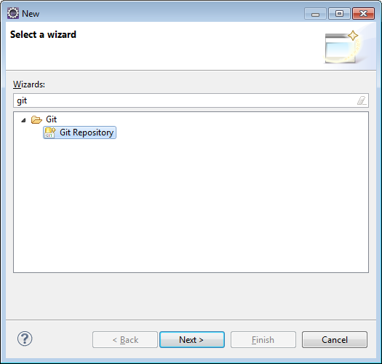
Make a Git Repository

Slide 11
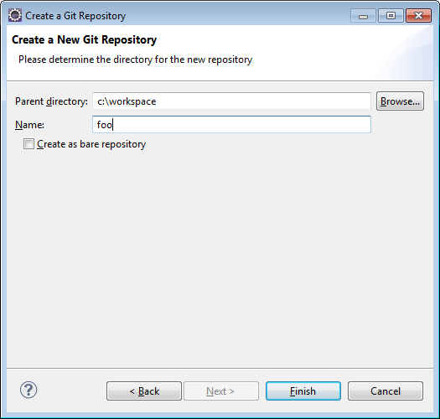
Think of a dummy project name
Project name: foo
Important: Git parent directory should
Be your workspace i.e. c:\workspace
Enter your projectname
Finish

Slide 12
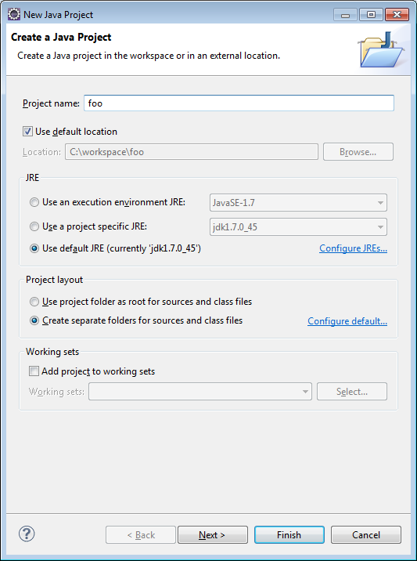
Create a New Java Project

Slide 13
Add Hello World
New Class HelloWorld

Slide 14
Browser – visit github.com
Create an account
Create a repository called foo
Copy and paste the .git URL to …

Slide 15
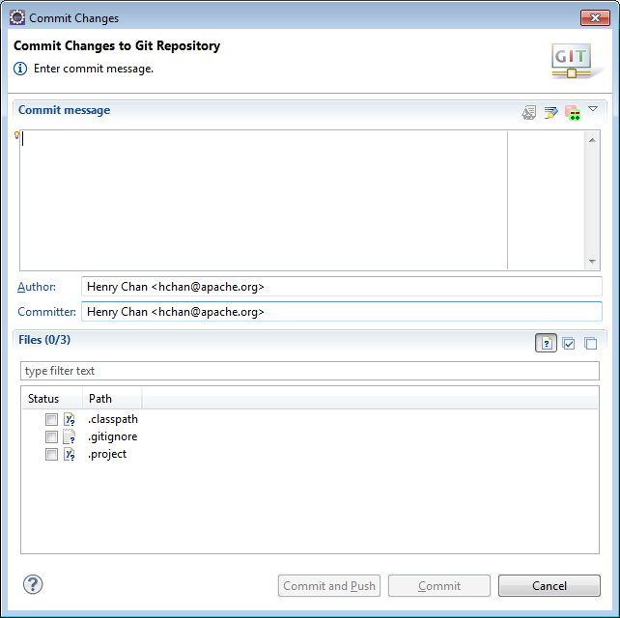
Commit and Push your Hello World

Slide 16
Homework
Assignment#1
Import
https://github.com/hchan/comp2613
Errors with import – don’t worry too much – Day 2 ;)
Read https://github.com/hchan/comp2613/blob/master/egitTutorial.docx
Do Assignment#1
Read the doc, from your Imported Workspace;)
Play around with committing files
Kill your Eclipse project and reimport it

Slide 17
Java Packages
A Java package is a mechanism for organizing Java classes into namespaces
For your project, please use the package name: ca.bcit.comp2613.<your project name in lowercase>
Package names in convention are lowercase
Naming conventions: http://java.about.com/od/javasyntax/a/nameconventions.htm

Slide 18
Core API (java.lang)
http://docs.oracle.com/javase/7/docs/api/java/lang/package-summary.html
Object
String
StringBuffer/StringBuilder
Strings are immutable which means they can’t change,
But StringBuilder’s are. Really not that important in this day and age anymore. Bottleneck is in String creation.
See StringDemo

Slide 19
Debugging
Add breakpoints, view variables
Welcome to Eclipse shortcuts - “F3”
String == String vs String.equals
See DebuggingDemo

Slide 20
Working with model objects + Searching
A model object represents the data tier
Almost no logic in it but, some developers like to add override the toString method for a tad bit of presentation logic
ArrayList are good choices to store many objects.
Searching is simply done through iterating through the ArrayList
See TeacherDemo

Slide 21
Jar files
What are they?
Java Archives – libraries. I think Sun borrowed the idea of “unix tar” and applied it to jar
Did we use any right now? Sure -> rt.jar
Kinda hard to avoid using “Core Java classes”
But there are times when the “String” class or another Core Java Class just isn’t flexible enough to do what you want. What do you do then? Download a library (set of Jars). More on this later in a later lecture. Pronounced as Maven. Oh if used Perl before (its similar to CPAN), or PECL/PEAR (if you’re a Python user), or RubyGems (for Ruby users). If you come from a C/C++/C# background … (err… um, Makefile + wget – okay bad joke)

Slide 22
Exporting Jars + Command Line
Eventually one day, you’ll want to export your project outside of eclipse. Your final export, will most likely be a Jarfile (or warfile, or earfile – outside the scope of this class)
A few ways to do this. One is via your IDE … Export->Java->Runnable Jar (demo)
But, to be honest, the de facto way is with Maven (more on this in a later lecture)
Demo (just a note, at a first glance, Eclipse’s Export function looks pretty easy … but as your project grows in complexity and dependency, Maven is the way to do it)
BTW, in this class, whether it be assignments, midterm, final or final project, I NEVER, EVER, EVER want you to send me a .zip, .jar file to me via email or dropbox. That’s just so last decade … ;)
Hint … how / where do you think you will submit your final exam

Slide 23
More about Egit (Eclipse Git)
In Day1, we create a Git repository first and then created a Java project
You can do it in reverse order too (java project first and then git repostiory)
Create Java Project with project name zzz
Team->Share Project->Git
(there is one big gotcha with this … double directory names)
Another way (yet with another pro and con):
Create Java Project name with zzz
Run “git init (the power of the command line!!)” on that directory, or copy and paste an empty .git folder (same from repository blank) to that directory (very hacky)
Team->Share Project->Git

Slide 24
Homework
Assignment#2
http://docs.oracle.com/javase/7/docs/api/java/lang/package-summary.html
http://docs.oracle.com/javase/7/docs/api/java/lang/String.html
http://docs.oracle.com/javase/7/docs/api/java/lang/StringBuffer.html

Slide 25
Core API Classes (cont)
Most Core API classes can be found in rt.jar
In particular, I’d like to focus on
java.math
java.util

Slide 26
BigInteger
java.math belongs
maxValue: (2^32)^Integer.MAX_VALUE
Unless you are dealing with really large numbers use Integer
Not as exciting as its sibling … BigDecimal

Slide 27
BigDecimal
Immutable, arbitrary-precision signed decimal numbers
Pop Quiz … how much tax do you pay on $4.99?
See BigDecimalExample

Slide 28
java.util
Collections (another topic for
perhaps another lecture)
java.util.Random used to generate Random Objects
java.util.UUID (RandomExample)
java.util.Date represents a specific instant in time
java.util.GregorianCalendar (DateAndGregorianCalendarExample)
Date is simpler than GregorianCalendar
A lot of methods in Date are Deprecated

Slide 29
java.util (cont)
java.util.Timer and java.util.TimerTask
java.util.Timer is a utility class that can be used to schedule a thread to be executed at certain time in future. Java Timer class can be used to schedule a task to be run one-time or to be run at regular intervals.
A TimerTask that can be scheduled for one-time or repeated execution by a Timer.
Think of this pair as Batman and Alfred
See MyTimerTaskExample

Slide 30
Annotations
Metadata – if you were to walk away from this lecture and were asked what annotations meant tomorrow – one word: metadata.
Information for the compiler — Annotations can be used by the compiler to detect errors or suppress warnings.
Compile-time and deployment-time processing — Software tools can process annotation information to generate code, XML files, and so forth.
Runtime processing — Some annotations are available to be examined at runtime.

Slide 31
Pre-defined Annotations
Built in Annotations
@Override - Checks that the method is an override. Causes a compile error if the method is not found in one of the parent classes or implemented interfaces.
@Deprecated - Marks the method as obsolete. Causes a compile warning if the method is used.
@SuppressWarnings - Instructs the compiler to suppress the compile time warnings specified in the annotation parameters
AnnotationExample

Slide 32
Annotations - Interesting so far?
Did it really do anything so far besides giving me a warning (compiler) or error (like using Override but spelling toString as toStrin)?

Slide 33
Building custom annotations
In all honesty … you probably won’t be doing this
But if you’re curious … http://docs.oracle.com/javase/tutorial/java/annotations/declaring.html

Slide 34
Other examples of annotations
In Frameworks
JPA (Oh … you’ll be seeing this later on)
Junit (See MyTestCase and MyTestCase.launch)
Spring (and we’ll see this later on too)
Various Web Service Stacks
Various parsers

Slide 35
Enums
An enum type is a special data type that enables for a variable to be a set of predefined constants.
What many green traffic lights are in the Array below?
String[] trafficLights = {“green”, “Green”, “GREEN”, “red”};
See TrafficLightDemo and TrafficLightFixedDemo

Slide 36
Enums with properties
What if you want MORE information on an Enum
Such as a description?
See CountryEnumDemo

Slide 37
Errors and Exceptions
An Error "indicates serious problems that a reasonable application should not try to catch."
while
An Exception "indicates conditions that a reasonable application might want to catch.“
Most likely you will never write or catch an Error
See ErrorDemo

Slide 38
Exceptions
Come in two flavours
Checked
You should catch it or let bubble up (aka exception propagation)
See SimpsonsDemo
Unchecked
It bubbles to the top
Unchecked Exceptions extend RuntimeException
See SimpsonsWithPossibleRuntimeExceptionDemo

Slide 39
Why have unchecked exceptions?
http://docs.oracle.com/javase/tutorial/essential/exceptions/runtime.html
Here's the bottom line guideline: If a client can reasonably
be expected to recover from an exception, make it a
checked exception. If a client cannot do anything to recover
from the exception, make it an unchecked exception.

Slide 40
Homework
Assignment#3
Scan BRIEFLY:
http://docs.oracle.com/javase/7/docs/api/java/util/package-summary.html
http://docs.oracle.com/javase/7/docs/api/java/math/package-summary.html
Read
http://docs.oracle.com/javase/tutorial/java/annotations/
http://docs.oracle.com/javase/tutorial/java/javaOO/enum.html
http://docs.oracle.com/javase/tutorial/essential/exceptions/

Slide 41
Generics
A generic type is a generic class or interface that
Is parameterized over types
See GenericDemo

Slide 42
Collections
A collections framework is a unified architecture for representing and manipulating collections. All collections frameworks contain the following:
Interfaces: These are abstract data types that represent collections. Interfaces allow collections to be manipulated independently of the details of their representation. In object-oriented languages, interfaces generally form a hierarchy.

Slide 43
Collections (cont)
Implementations: These are the concrete implementations of the collection interfaces. In essence, they are reusable data structures.
Algorithms: These are the methods that perform useful computations, such as searching and sorting, on objects that implement collection interfaces. The algorithms are said to be polymorphic: that is, the same method can be used on many different implementations of the appropriate collection interface. In essence, algorithms are reusable functionality.

Slide 44
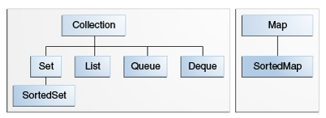
Collections (cont)
Notice that Map doesn’t extend Collection <sigh/>

Slide 45
Collections (cont)
Lots of implementing classes of java.util.Collection
http://docs.oracle.com/javase/7/docs/api/java/util/Collection.html

Slide 46
Collections (cont)
List
Set
Map
See CollectionsDemo

Slide 47
Collections (cont)
java.util.Vector, java.util.Hashtable – avoid if possible
Because it is synchronized (meaning threadsafe but slower)
Iterator – if you want to remove something from a List,
Use Iterator
See: DeleteFromCollection

Slide 48
Collections (cont)
Comparable and Comparator
Comparable is implemented by a class in order to be able to comparing object of itself with some other objects. The class itself must implement the interface in order to be able to compare its instance(s). The method required for implementation is compareTo().

Slide 49
Collections (cont)
Comparator is capable if comparing objects based on different attributes. e.g. 2 men can be compared based on `name` or `age` etc. (this can not be done using comparable. )
The method required to implement is compare(). Now let's use another way to compare those TV by size. The common use of Comparator is sorting. Both Collections and Arrays classes provide a sort method which use a Comparator.
See: ComparatorAndComparableDemo

Slide 50
Homework
Assignment#4
Read:
http://docs.oracle.com/javase/tutorial/java/generics/
http://docs.oracle.com/javase/tutorial/collections/interfaces/index.html

Slide 51
Java File IO and libraries
Bit of recap from last week
Java collections (pretty useful and powerful)
The java.util package comes with the JRE (rt.jar)
There is a package for Java IO
java.io
I *could* talk about certain classes in java.io
Examples java.io.File, java.io.FileInputStream,
java.io.FileOutputStream, java.io.FileReader,
java.io.FileWriter
But I’ll let you read about those classes yourselves ;)

Slide 52
BETTER than java.io
To be fair, there are many Java libraries out there
There are even other libraries outside
Of core java that do collections and java.io
I’m going to choose Apache Commons IOUtils
A few reasons why …
java.io is kinda low-level (if you really want
to do low-level stuff, do it in C)
Want to introduce you to Maven

Slide 53
Maven
Apache Maven is a software project management and comprehension tool. Based on the concept of a project object model (POM), Maven can manage a project's build, reporting and documentation from a central piece of information.
In short, it’s a tool to help you manage libraries
Perl has CPAN
PHP has PEAR/Pecl
Ruby has RubyGems
C/C++/C# … Makefiles + wget

Slide 54
Maven – How to via Eclipse
Create a New Java project (or just use
Your existing one)
Left click on Project root ->Configure->
Convert to Maven Project
Accept the defaults
Modify pom.xml to get it compatible
With Java1.7 …
If in doubt, copy my pom.xml and put it in the
root folder

Slide 55
Maven – cont
Change the maven compiler setting
http://stackoverflow.com/questions/3539139/what-causes-a-new-maven-project-in-eclipse-to-use-java-1-5-instead-of-java-1-6-b
<plugin>
<artifactId>maven-compiler-plugin</artifactId>
<version>3.1</version>
<configuration>
<source>1.7</source>
<target>1.7</target>
</configuration>
</plugin>
Right click, Maven-Update Project

Slide 56
Add a library from Maven
Aka as adding a dependency
Visit: http://mvnrepository.com/
Search for Commons IO
Select a version
Copy and paste the dependency
<dependency>
<groupId>commons-io</groupId>
<artifactId>commons-io</artifactId>
<version>2.4</version>
</dependency>
Note: <dependency> should be a child
Of <dependencies>
Root->Maven->Update Project – this should get rid of the compile errors

Slide 57
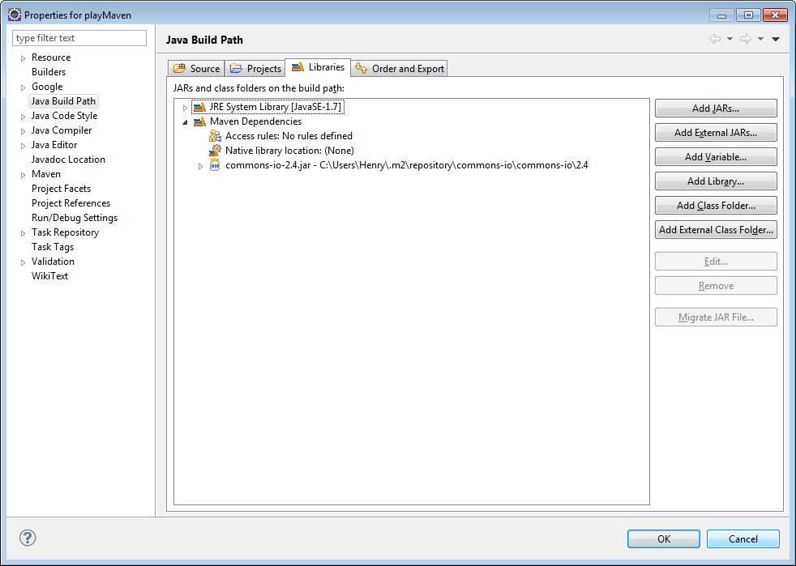
Maven – check your build path

Slide 58
Maven – good to go, let’s use Commons IO
Create a new class with a main()
In the body, type: FileUti… (CTRL-Space)
If code completion, finds it you are gold!
See: FileUtilsDemo
Lots of other APIs in FileUtils (CTRL-Space)
Is your friend!
F3 -> if you want to read the source code of FileUtils
… or you can just use java.io package directly

Slide 59
Java .properties
.properties is a file extension for files mainly used in Java related technologies to store the configurable parameters of an application.
We can use java.util.Properties …
But like java.io (or rather Commons IO), there are
Open source libraries that are easier (and more
Powerful for you to learn)

Slide 60
Commons Configuration
http://mvnrepository.com/artifact/commons-configuration/commons-configuration/1.10
<dependency>
<groupId>commons-configuration</groupId>
<artifactId>commons-configuration</artifactId>
<version>1.10</version>
</dependency>
Maven again!!
See: PropertiesDemo

Slide 61
Logging
Java comes with a logging framework called
java.util.logging
But keeping to the theme of Maven …

Slide 62
Log4j
http://mvnrepository.com/artifact/log4j/log4j/1.2.17
<dependency>
<groupId>log4j</groupId>
<artifactId>log4j</artifactId>
<version>1.2.17</version>
</dependency>
See Log4jDemo

Slide 63
Jackson – Java objects to JSON
JSON (Javascript object notation) is a common
Way to send messages outside of the javaworld
You’ve seen the toString method for data model (aka
POJO (plain, old, java objects), but what does JSON look
Like?

Slide 64
Jackson cont
<dependency>
<groupId>com.fasterxml.jackson.dataformat</groupId>
<artifactId>jackson-dataformat-xml</artifactId>
<version>2.4.0</version>
</dependency>

Slide 65
Jackson cont
See: JacksonDemo
Feel free to use Jackson instead of toString()

Slide 66
Homework
Assignment 5
Download various Java libraries
And try them out ;)
Study for midterm!!!!!!!
Hint – I put easter eggs in my
Comp2613 project repo … hint: Wow
Next class – half the class (beginning of the class will
Be a lecture on Swing) and the other half will be the midterm

Slide 67
All about building Swing apps
Download Windows Builder Plugin
http://download.eclipse.org/windowbuilder/WB/release/R201309271200/4.3/
See: ca.bcit.comp2613.coursematerial.day06. TeacherSwingApplication

Slide 68
Homework
Assignment6
See if you can run my application first. If so, copy and paste as much from my app to yours, but obviously changing your “model”class

Slide 69
Any questions so far
This is where the class becomes more
Hands-on – I’ll be speaking less, and
You’ll be coding in class more ;)
Spend rest of class working on homework
Oh what’s homework? (see next slide)

Slide 70
This is where the course becomes … “your” project
Each project may use different Swing widgets. Experiment and have fun.

Slide 71
Bit of Review
Git – love it or hate it. No matter how good of a programmer you are – if you can’t hand-in/merge your code, you’re not very useful to the team as a programmer. Unsubmitted code is useless code (not a learning outcome for this course – then again it was the same jury that voted that Swing *IS* a learning outcome for this course and this course is a *core* course for the CST program)
Another popular SCM is SVN. Anyone want to see a demo? The combo of SVN/Git use probably constitutes > 75% of all the combined repositories in the open source world. Git has more features by far than SVN. Also Git has pretty popular Hosting Site. Its called GitHub ;) There is *NO* such thing as SVNHub. Git FTW (For The Win)? Also GitHub has something called GitPages (you’ll be using this later on, but anyone want to see it)?
You also learned a bit about Comparators. In hindsight, Comparators are pretty much useless (same jury that decided Swing was core to this course, that decided Comparators should be a learning outcome). I’ve been programming Java for over 10years. I’ve only used Comparators *maybe* 3 or 4 times ever? Comparison on the server is best done with a DB. On the client-side, use jQuery.
Code conventions. My bad, I didn’t really talk about this too much. I seem to see quite a bit of package names with mixed case. Proper convention is lowercase. Also try to use a FULLY qualified package name. i.e. “ca.bcit.xxxx” Take a look at some libraries (say … under Maven dependencies) and see what names they use.
Package name such as “a00788076” is a poor name.
Also member variables should NOT start with “_” (underscore)
(you’d be surprised that some students *AND* teachers break the above 2 points)

Slide 72
Bit of Review (cont)
Code conventions. My bad, I didn’t really talk about this too much. I seem to see quite a bit of package names with mixed case. Proper convention is lowercase. Also try to use a FULLY qualified package name. i.e. “ca.bcit.xxxx” Take a look at some libraries (say … under Maven dependencies) and see what names they use.
Package name such as “a00788076” is a poor name.
Also member variables should NOT start with “_” (underscore)
(you’d be surprised that some students *AND* teachers break the above 2 points)
Maven … serves 2 (maybe more) purposes
Helps with downloading dependencies. If you are building a mini-application like HelloWorld – who needs libraries right? In the real world, some projects have hundreds of jar dependencies (it gets quite messy when one library has dependencies on another library which has dependency on another library). In the beginning of time (the obsolete days), people would download one library at a time and import it into their project. Those days are long gone
Maven is also a pretty powerful “package” up tool. You’ll actually be packaging up your Final Project with Maven as a deliverable to me (or as a demo to your future employer so s/he can see your work)

Slide 73
Bit of Review (cont)
File IO … kinda important in Java. At the end of the day, try to keep use a library to do as much File IO for you. In hindsight, I just realized, I don’t do that much FileIO myself period with Java. All my logging to a file is done via Log4J. When I really need to persist large chunks of data, I use a DB.
Log4j … a very common logging tool used in the real world. Quite important ;)
Java <-> JSON conversion (Jackson). The more I think about it, the more important it is. I know I spent more time talk about useless things like Comparators. But in truth, JSON (and XML) is a pretty important concept in the real world. Look at Google (or Wowhead if you are a Warcraft gamer) for example. Type in a search world, and turn on the trace (say Firebug). What do you see going through as HTTP traffic? - answer: JSON. JSON serialization (serialization is just a fancy word for binding or transformation or conversion) is FUNDAMENTAL in any work you do with Web2.0 Single Page Applications (if you never heard of AJAX, good idea to read up about it – probably more important than this course outline period ;))
Even if you never intend on using Java + Web together, JSON is a GREAT reporting format). Format you say? Some of you may have used that obfuscated printf (System.out.printlnf or in some other language like C). This is obsolete. Remember toString() ? What if you add another member variable to your class. Do you have to update your toString() method

Slide 74
Most common question I’ve been asked so far
Will it be on the Final?
2 part answer to that. Let’s say you ace the final (which is quite possible in my class) and eventually achieve a certification (in the form of paper) from BCIT. My question back: what asset do you have to show to your future employer besides that piece of paper?
Second part of that question (in case you didn’t like my first part). If you read my hints carefully and snoop around the course repository, all your questions to the final will be found.
What’s the real asset of this course?
I believe that BCIT should try helping students build a portfolio. A piece of paper at the end says something, but a portfolio says something MUCH MUCH more.
It would be great if you could walk away from each course with a finished product that you can demo to your employer.
My attempt (and I apologize profusely if I did a bad job at this), is for you to build a project you can show your future employer. S/he will download your application (via GitHub + GitHub Pages) and be able to
Play around with it
See your DB Schema (via the H2 Console) – Yup if you want to show your DB skills, this is a good place to do it!!!
See your code
See your comments / documentation (index.html (yup!!), changes.html). Show off your HTML / documentation skills here if you want ;)

Slide 75
Anything you want to ask?
Politics?
Java questions?
Here’s your chance to ask

Slide 76
Homework
Assignment 7

Slide 77
Homework
Assignment8

Slide 78
JDBC / JPA / ORM
There is the long version and then the short version
Vanilla JDBC Java DataBase Connectivity – if you can avoid programming with vanilla JDBC directly, that’s a good thing
See VanillaJDBC (in the obsolete package)
Vanilla JDBC (Java DB Connectivity) was the original programming strategy (oh, its not that old – only 15 years old – sarcasm intended) on how to connect to the DBs
SOMEHOW – this JDBC one day lecture got slipped into this course. My GUT feel is that someone decided to recycle their Vanilla JDBC material (material written 10+ years ago) and use this as filler material.
The GOOD news is that, the curriculum states that JDBC should be taught … but not how - pronounced as: gotta love loopholes ;)
ORM is EASIER to learn because it doesn’t require you to write SQL (or so that’s the theory …)
ORM -> Object Relational Mapping. Means transforming a Java Data Model

Slide 79
JPA – Annotation heavy
ORM in Java == JPA (Java Persistence API) … that’s what tools are for right?
JPA is an API
Implementations: Spring Data and Hibernate
ORM is also used in other languages such as Ruby (ActiveRecords), C++ (nHibernate – which borrows a lot from Java’s Hibernate), PerlORM, Python (Django/built-in ORM)
ORM – is a binding from Java Objects to a Relational DB Table
Have we seen any other type of Java Bindings? Hint Jackson. Java<->JSON. Hint: Java<->XML is any common type of binding. Not a learning outcome for this course, but extremely important. How common / important is this type binding? On a scale from 1 to 10 where 1 is useless (like Swing) and 10 is useful, its about a 8 or 9. Something like learning Comparator (which is an learning outcome is a 3 out of 10). Learn your Java <-> Bindings!

Slide 80
First, add the following dependencies
If all fails, copy my pom.xml
<dependency>
<groupId>org.springframework.boot</groupId>
<artifactId>spring-boot-starter-data-jpa</artifactId>
</dependency>
<dependency>
<groupId>com.h2database</groupId>
<artifactId>h2</artifactId>
</dependency>
<dependency>
<groupId>mysql</groupId>
<artifactId>mysql-connector-java</artifactId>
<version>5.1.30</version>
</dependency>
<dependency>
<groupId>org.hsqldb</groupId>
<artifactId>hsqldb</artifactId>
<version>2.2.8</version>
</dependency>

Slide 81
Also in pom.xml
<parent>
<groupId>org.springframework.boot</groupId>
<artifactId>spring-boot-starter-parent</artifactId>
<version>1.0.2.RELEASE</version>
</parent>
And then Maven Update

Slide 82
Modify our model Classes
Annotate with @Entity (pretty important)
Add a @Id to the primary key
Add @ManyToMany relationship
See day08.model.Teacher

Slide 83
Create a Repository Interface
See day08.TeacherRepository

Slide 84
Create a TestDriver
Note that the TestDriver *must* be a parent package of both the repository class (next slide) and of the model package
A lot of the magic is in: @EnableAutoConfiguration
See: TestDriverWithInMemoryDB
Run it …
What just happened? Well, first thing is that it created an in memory database
Then a Table called Teacher
And then an insert
Prove it!!! … Sorry, no can do - that was an in memory DB
Actually – I’m lying (I can prove it if I block my program from exiting and viewing the H2 DB from a browser … see H2Config)

Slide 85
I know – let’s use MySQL!
Via your browser, goto: freemysqlhosting.net
(alright, I know, I know … its not hosted by BCIT) … but damn it – BCIT doesn’t use MySQL, they use a funny creature called SQL Server
Alright, after you register, you’ll get a
Hostname for your DB
Username / password
Database name
Convert that information you have above to an applicationContext.xml as is follows:

Slide 86
application.xml and hibernate.properties
If all fails, copy my application.xml (in root directory)
<beans xmlns="http://www.springframework.org/schema/beans"
xmlns:jpa="http://www.springframework.org/schema/data/jpa" xmlns:xsi="http://www.w3.org/2001/XMLSchema-instance"
xsi:schemaLocation="http://www.springframework.org/schema/beans
http://www.springframework.org/schema/beans/spring-beans-2.5.xsd
http://www.springframework.org/schema/data/jpa
http://www.springframework.org/schema/data/jpa/spring-jpa-1.0.xsd">
<bean id="dataSource" class="org.springframework.jdbc.datasource.DriverManagerDataSource">
<property name="driverClassName" value="com.mysql.jdbc.Driver" />
<property name="url"
value="jdbc:mysql://sql3.freemysqlhosting.net/sql340330" />
<property name="username" value="sql340330" />
<property name="password" value="dR5!xA3!" />
</bean>
</beans>
hibernate.properties:
hibernate.show_sql=true
hibernate.format_sql=true
#hibernate.hbm2ddl.auto=validate | update | create | create-drop
#hibernate.hbm2ddl.auto=update
hibernate.hbm2ddl.auto=update

Slide 87
Create another Test Driver for MyDB
See: day08.TestDriverWithMySQLDB

Slide 88
Run TestDriverWithMySQLDB
No errors right?
But where did my data go?
Well … let’s take a look at the MySQLDB directly

Slide 89
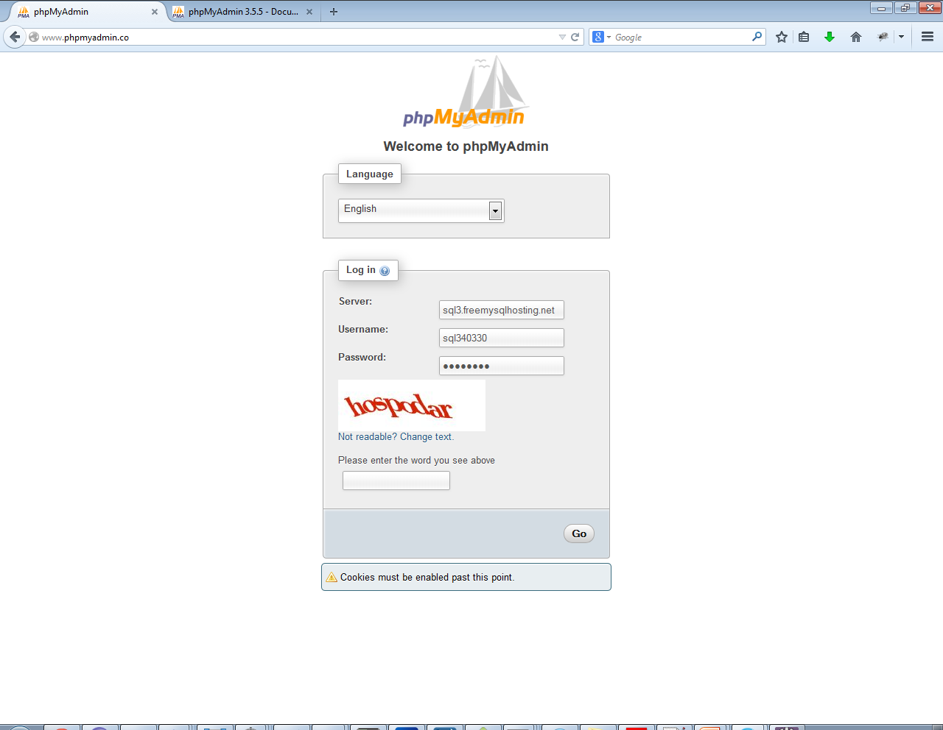
Browser view http://www.phpmyadmin.co/

Slide 90
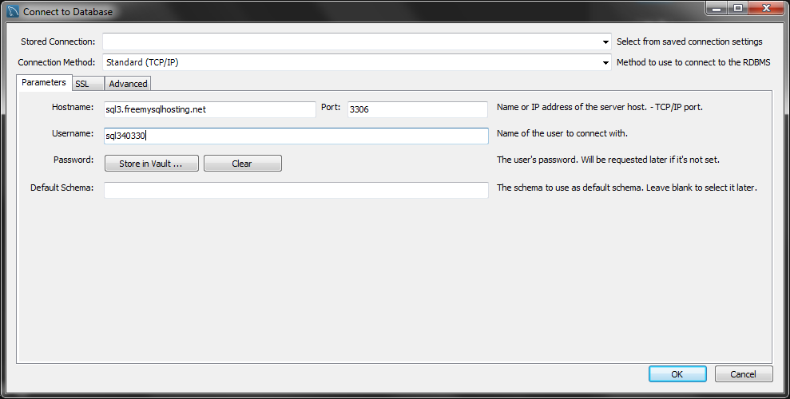
MySQL Workbench (the defacto client for MySQL)
http://dev.mysql.com/downloads/
Find the MySQL Workbench download
Start up workbench
Database->connect to Database

Slide 91
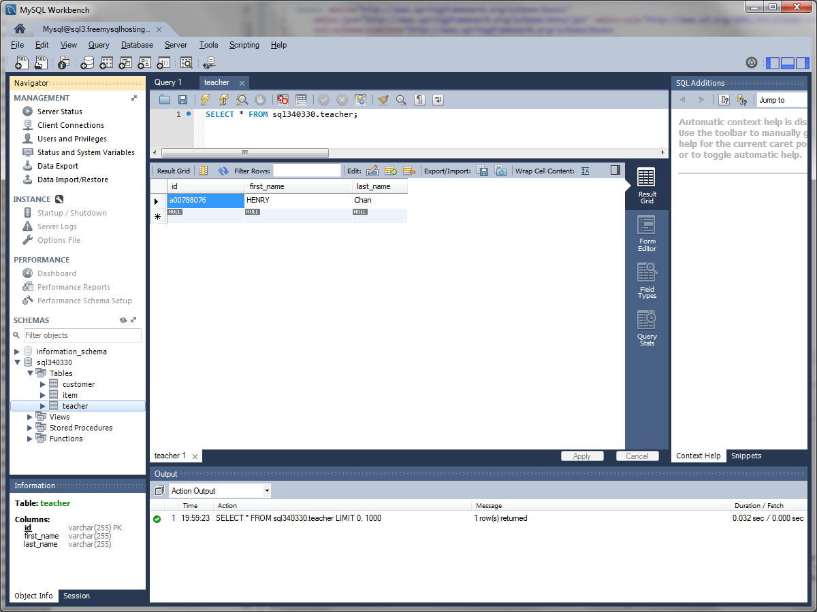
And see if your new row is inserted

Slide 92
DB relationships (cont)
See: TestDriverInsertsWithMySQLDB
See: TestDriverSearchesWithMySQLDB

Slide 93
What can go wrong?
When playing around with power magic, you can get burned pretty fast. Or if you’re a fan of spiderman: With great power, comes great responsibility. JPA / Spring Data / Hibernate is one of the most powerful features (if not the most powerful feature) of JavaEE. If you learn to master this, you’ll see other design patterns (which are annotations-based) come to play.
Make sure to commit your code often when it is in a stable state
If you Java Model class is out of sync with the DB, then go to your DB and drop the tables
Play around with the hibernate.hbm2ddl.auto field in hibernate.properties

Slide 94
Power of Spring
So unknowingly, you have also tapped in to the power of Spring (we’re using Spring Data for JPA). We’ve also covered Spring IOC (Inversion Of Control – the annotation magic)
It is a piece of a much larger soln (beyond the scope of this course). But if you understand Spring Data, the rest of the features the Spring will be “familiar”
One of the features that Spring Data already uses is Connection Pooling … and then there is Paging (getting the first 10 results of Page1)
Spring is definitely one of the largest frameworks within Java.
One of the buzzes these days is to convert JPA -> REST Services. And then use BackboneJS, or AngularJS or EmberJS, etc to consume the REST Service. Old way in Java was to do HTML rendering on the server side. Newer way embraces the “JS” families.
Most of the features of Spring are beyond the scope of this course, but Spring Data / Spring IOC are skills that you have at least *touched* on.

Slide 95
Homework
Assignment8

Slide 96
So how was that intro to databases?
When I first took my database course, I was quite confused
Believe it or not, this is one of the most commonly used features in Java
Now to finally tie in our database to our Swing application? ;)
See da09.TeacherSwingApplication

Slide 97
Homework
Assignment 9

Slide 98
Network Programming
OK, this is a somewhat filler lecture. Course outline has a mandate to cover network programming.
The Final exam, final project will have nothing to do with today’s SHORT lecture on Network Programming.
Network Programming … UDP / TCP … very cool. But realistically, you won’t be using those protocols directly. In short, if want to do something in low-level, … try not to do it in Java please.
http / https are by far the most common protocols used in Java
See HttpComponentsDemo (still not very important, so let’s keep this short to cover the NEXT slide)

Slide 99
There’s a tool (library) for that
<dependency>
<groupId>org.apache.httpcomponents</groupId>
<artifactId>httpclient</artifactId>
<version>4.3.3</version>
</dependency>
See HttpComponentsDemo

Slide 100
What now?
Not going to lie, the previous class was pretty *tough*. There’s the technical code part, the *magic of annotations* and just the new train of thought with Java ORM
Show of hands … how many people were
Very confused about Database ORM
Semi-confused
Heck – easy stuff
Also the lecture about Databases is by FAR one of the most important lectures. Without databases, you will have NO Web Service, no Web app. The concepts of DB alone is a course by itself.
If no other questions, I’m going to repeat the last class again (and possibly again in the next class if I see a lot of blank faces)
If you understand ORM inside out, feel free to work on your assignment or take off early

Slide 101
Homework
Assignment 10 (yup)

Slide 102
MVC (Model-View-Controller)
You already used it ;)
Which was the Model? (hint model clases)
View? (JButton, JFrame, JTable, JLabel)
Controller? (all the code for button clicks)
Admittedly, the separation of Controller and View is quite weak in Swing, but this design pattern is used throughout software engineering
Admittedly, MVC (a somewhat 2000’ish design pattern) isn’t always the best design pattern, but very commonly used. Pretty good, but not always the best.
Lots of other ones out there like MVP, MVVM, and now there’s a category called MVW – whatever!

Slide 103
Packaging it up
Refer to pom.xml
maven-jar-plugin
(makes the main jar and puts in the in target folder)
You should specify the main class here
i.e: <mainClass>ca.bcit.comp2613.coursematerial.day09.TeacherSwingApplication</mainClass>
maven-dependency-plugin
Copies the jars (<goal>copy-dependencies</goal>) to the target/lib folder
maven-antrun-plugin
Zip it up and puts the final artifact in the root folder
BONUS point: right now the zipfile is creating without a directory. If you can modify my pom.xml with an exploding directory, you get a bonus point
To run this: Run As…Maven build… (Goals: package) -> Run

Slide 104
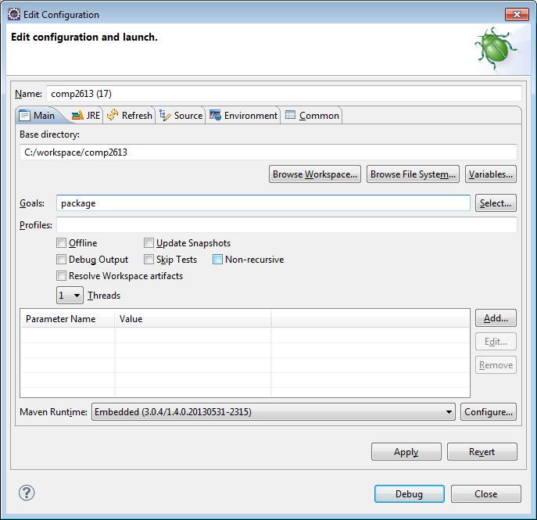
Maven Run As…Maven build… (Goals: package) -> Run

Slide 105
Great I got a zip file – now what?
Well you can send that zip file to a friend via email (tho it might be a bit large) …
Or you can publish it to the web…

Slide 106
GitHub Pages
So we are already using GitHub …
Now let’s use https://pages.github.com/
To use GitHub Pages, just create a branch called gh-pages
Your project page will be: http://<yourGitUserName>.github.io/<yourProjectName>
This is where I (taking the hat of a customer instead of your instructor) will be marking your final project
Before that, make sure you created your zip file in root and write an index.html that will have an anchor reference to it (you can refer to my index.html)
After that, just create a gh-pages branch and push
OPTIONAL: modify you github webpage URL

Slide 107
Homework
Final Project
Package it up ;)
Note: I will be marking off of your GitHub page
Include an index.html (which may have links to changes.html … a description of how to view the in-memory DB via your browser http://localhost:8082), a link to zip artifact they can download
Think of index.html as part of your show-off page. They will most likely take a look at your final product (run the zip file, maybe look at your DB schema and quite possibly look at your coding style). This alone says a few important things about you
I know how to use Git (important, because no matter HOW good of a programmer you are, if you can’t hand-in / merge your code to your future technical leader / project manager via a SCM, your code is as good as **useless (no joke)** to the team)
I finished at least one product that communicates to a DB (and can show them the DB Schema)
I have a link to well documented source code (or at least, let’s hope so ;))
Optional: put your GitHub / GitHub Pages URL on your resume … or you can wipe it out completely. Believe it or not, some employers ask if you have a GitHub account.
Create a GitHub Tag (tags are a good thing ;))
Study for the Final Exam (hint: For The Horde)

Slide 108
Homework Optional Cont
Optional (and I would REALLY, REALLY, REALLY appreciate it you did this …):
Goto: http://www.ratemyprofessors.com/AddRating.jsp?tid=1906738
Quis custodiet ipsos custodes? – A latin phrase (commonly taught by philosophers such as Socrates and Plato) used to describe the situation when a system with ultimate authority (such as a political system or even teaching system) becomes corrupt. The translation is: “Who guards the guardians?” … in our case, who makes sure the teachers are teaching the right way or even teaching relevant information? For those JLU (Justice League Unlimited) fans: https://www.youtube.com/watch?v=4UBQ5y7eZeU (minute: 1:45)
and rate me (and the course) – much appreciated. If there is anything about the way I teach or course you would like to see changed, post your feedback via the above link. All negative or positive comments are appreciated. FYI, rating me (or any other teachers at BCIT) will most likely *NOT* effect their salary / status in any way. The reverse is also true … if you take any of my other classes in the future, your comments will not affect your score for that class. Its strictly a social networking site used to help teachers improve their course and raise awareness for other students. I *know* some of you have either suffered or breezed through this course. Think of your comments as a way to help shape this course and help students in the future – pay it forward. For the Horde!!! I mean – for BCIT!!!
Hint – if you have the extra time, you might want to rate other teachers you had at BCIT and/or search by teachers in case you are interested in taking their courses. Its also great fun to read about some of the comments of professors who got a score of < 1.5 (out of 5). Kinda funny ;) Some of those comments were BRUTAL. Eeesh, I hope I’m not going to be one of those profs!

Slide 109
The End
Thank-you very much for attending.
I really hope you learned something in this course
Henry Chan hchan@apache.org
http://people.apache.org/~hchan/

