Slide 1
Reverse Engineering in ORM
By Henry Chan
hchan@apache.org

Slide 2
The database sample
sakila-db.zip (in this Git Repo)
Who wrote it? I don’t know
Where did I get it? I stole it!
From where?
http://dev.mysql.com/doc/sakila/en/
http://downloads.mysql.com/docs/sakila-db.zip
Ah – so it’s a demo DB from MySQL eh? Yup!

Slide 3
Sakila
What’s inside the example zip?
A .mwb file (MySQL WorkBench)
Open it up with MySQL WorkBench and you’ll see the the ERD (Entity Relational Diagram)
Sakila was mean to be run on localhost. If you have MySQL installed locally on your machine, you can run sakila-schema.sql
Since I’m using freemysqlhosting, I’m going to change the schema to sql345717 and Database->Forward Engineer
Make sure that ONLY Export MySQL Tables Objects is selected (next screen)

Slide 4
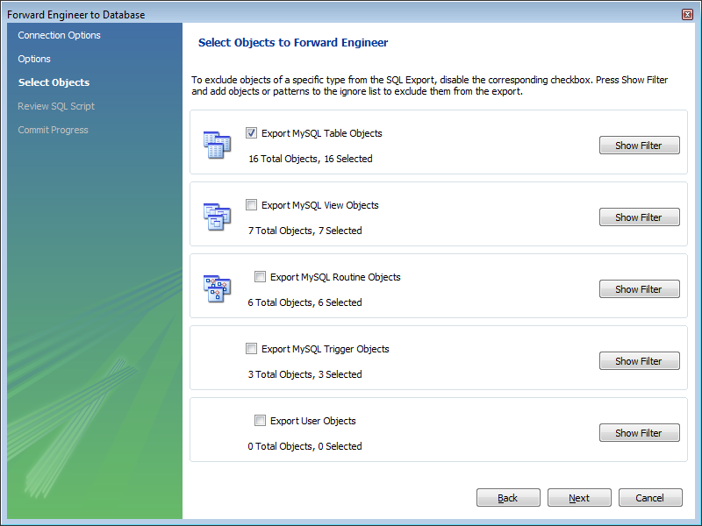
Forward Engineering …

Slide 5
Sakila (dml)
Next run the dml (sakila-data.sql)
I modified it slightly to comment out the MySQL triggers (damn freemysqlhosting doesn’t allow triggers). If you want to try it, you might want to change the schema name in that sql file
Make sure the data is there
Try a select <schema>.* from actor

Slide 6
Now for the Java side
Forward engineering done.
Now the reverse.
First – what does reverse engineering mean from an ORM perspective?
Well, if you have an existing schema/db, we are going to generate the model classes.
Forwarding engineering in ORM mean you generate the schema from the model classes

Slide 7
Download the plugin
Plugin name: Jboss Tools, Hibernate tools under Market place
What’s the relationship between Jboss and Hibernate (and Spring)? All are open source organizations. Tell you honestly, I find their relationship to be quite confusing too. Jboss and Spring have “families” of software components. Jboss is more than just Java (it also has strong ties to Red Hat). Spring is purely Java. Hibernate is purely Java (but just for DB ORM)

Slide 8
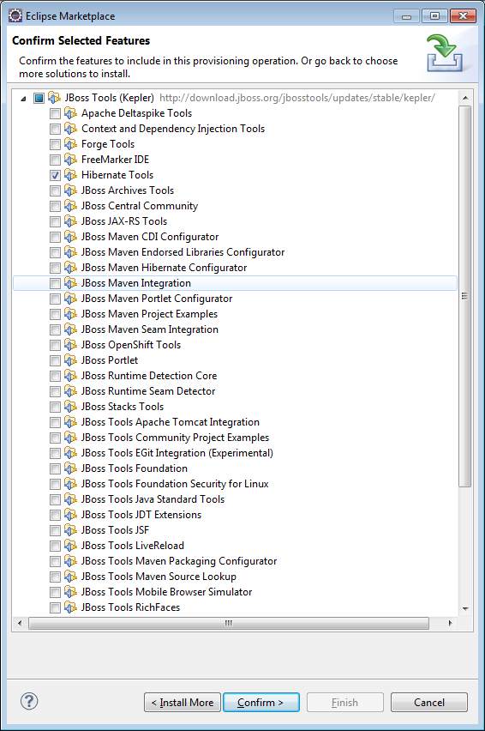
Plugin (Eclipse Marketplace)

Slide 9
Plugin is a bit buggy
Plugin uses an old version of slf4j … gotta match it with our pom.xml
God damn it! Might have to restart Eclipse too as the plugin may cache the class
<dependencyManagement>
<dependencies>
<dependency>
<groupId>org.slf4j</groupId>
<artifactId>slf4j-api</artifactId>
<version>1.5.11</version>
</dependency>
<dependency>
<groupId>org.slf4j</groupId>
<artifactId>jcl-over-slf4j</artifactId>
<version>1.5.11</version>
</dependency>
<dependency>
<groupId>org.slf4j</groupId>
<artifactId>log4j-over-slf4j</artifactId>
<version>1.5.11</version>
</dependency>
<dependency>
<groupId>org.slf4j</groupId>
<artifactId>jul-to-slf4j</artifactId>
<version>1.5.11</version>
</dependency>
<dependency>
<groupId>ch.qos.logback</groupId>
<artifactId>logback-classic</artifactId>
<version>0.9.20</version>
</dependency>
</dependencies>
</dependencyManagement>

Slide 10
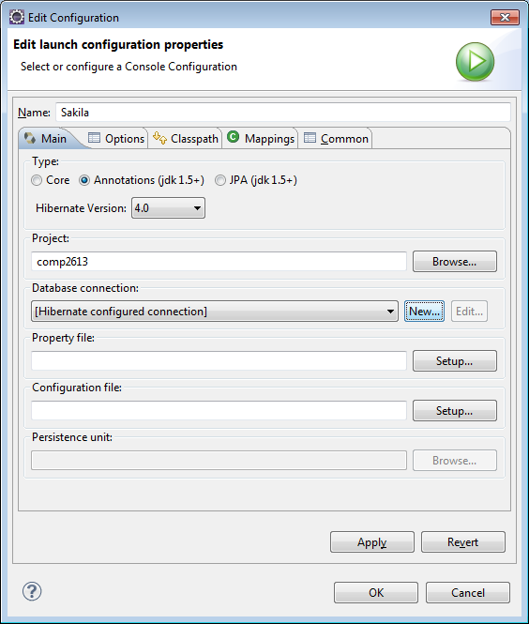
With the plugin…
You have a Hibernate View

Slide 11
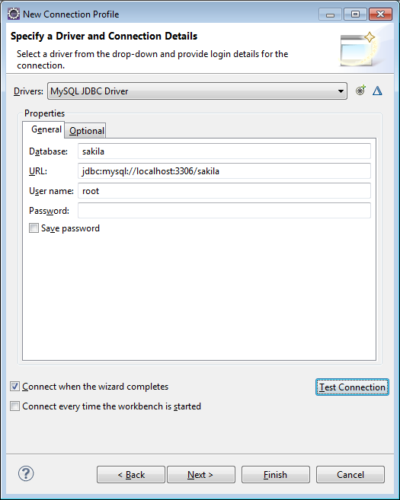
More of the Plugin…

Slide 12
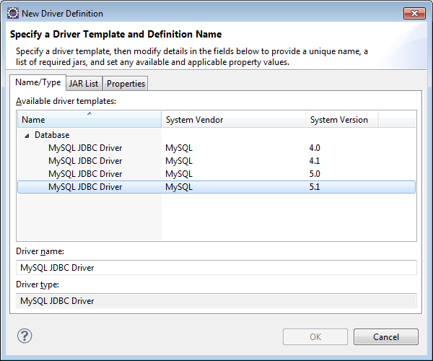
If the MySQL Driver doesn’t show up…

Slide 13
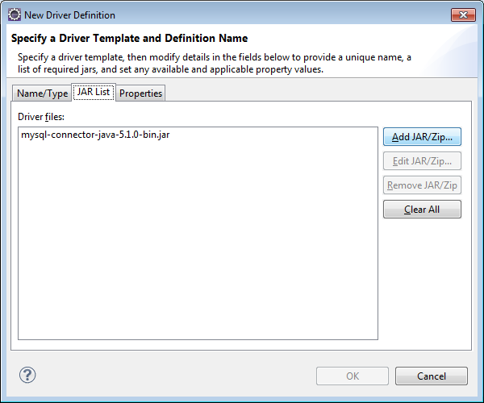
And then…

Slide 14
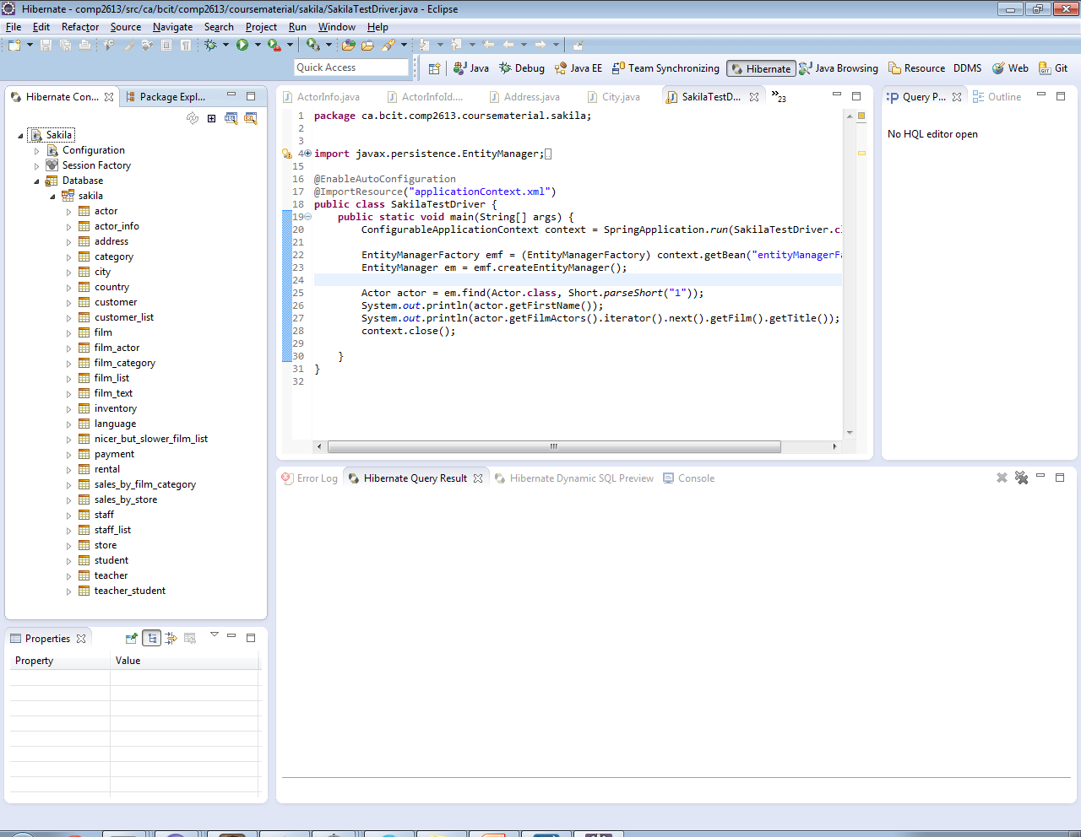
More of the Plugin…

Slide 15
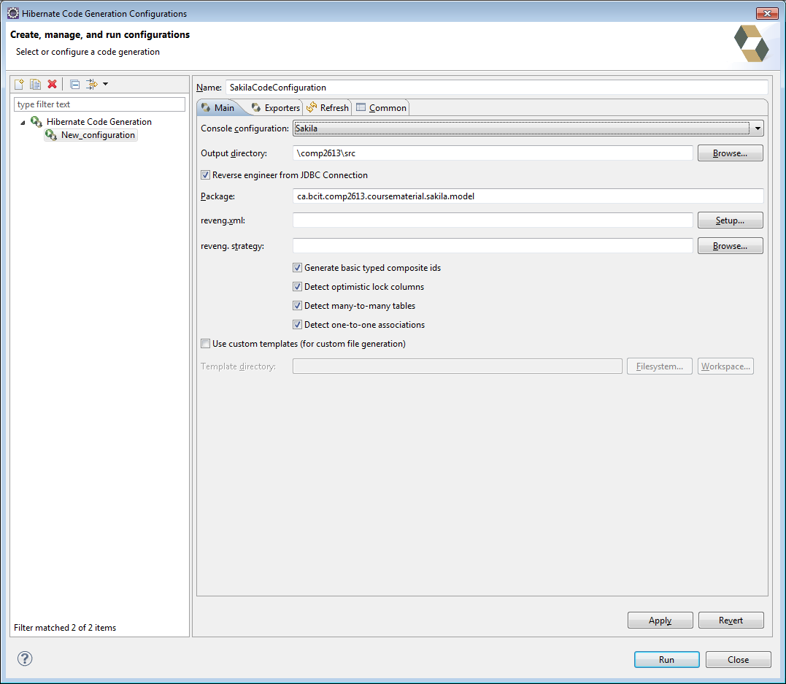
Now for the Reverse Engineering

Slide 16
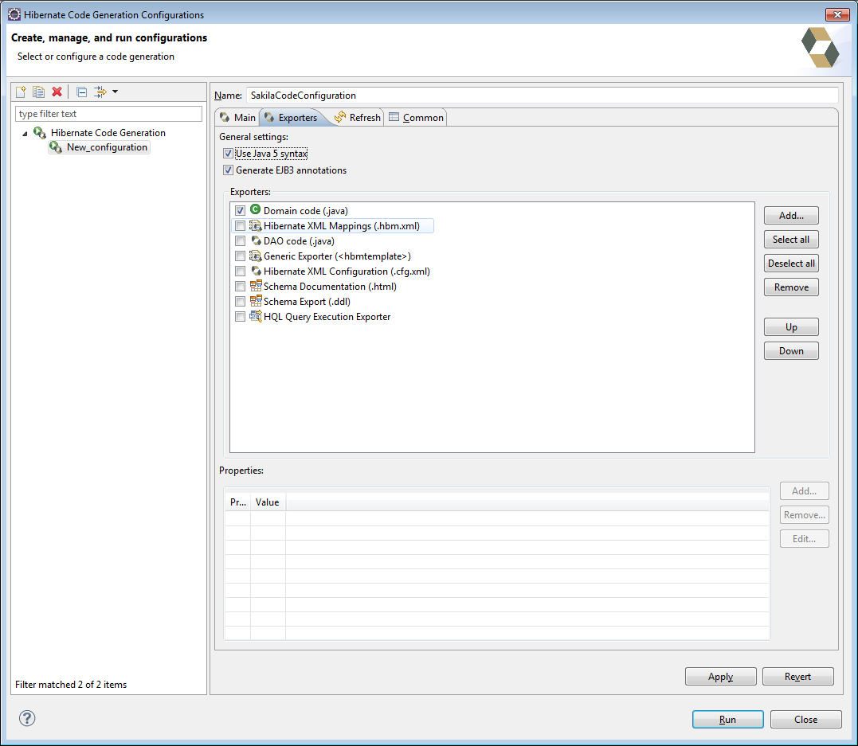
And …

Slide 17
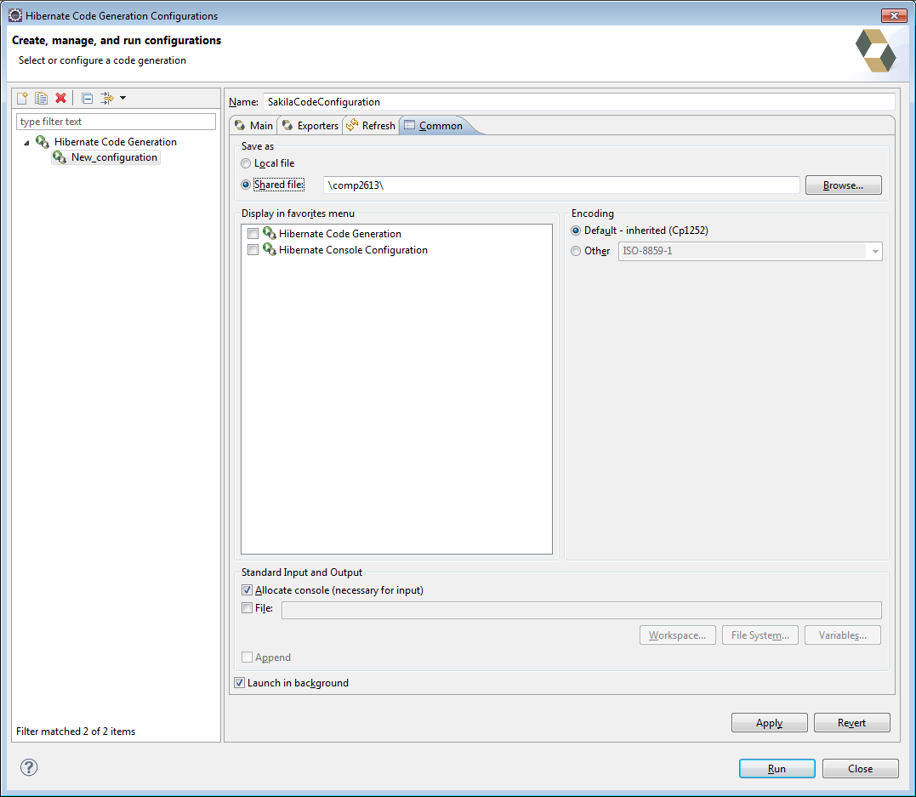
And…

Slide 18
Presto…
ca.bcit.comp2613.coursematerial.sakila.model has now been generated
See SakilaTestDriver.java

