Slide 1
COMP 2613 Intermediate Java Programming
Part-time Studies
British Columbia Institute of Technology

Slide 2
Introduction

Slide 3
Prerequisites
COMP 2613 is an intermediate Java programming course
The prerequisites are:
COMP 1409 Intro. to OO Programming with Java
COMP 1451 Understanding Programming
or prior programming experience in C++ or C# plus an understanding of the java programming language, core frameworks, and object-oriented programming
Basic understanding of Microsoft Windows
A good understanding of problem solving

Slide 4
Attendence
In the dropbox, you’ll seen an attendance folder
At the beginning of each class, I’ll ask you to submit a file there to prove you are here
i.e. Day1, submit ant.txt
i.e. Day2, submit boy.txt
i.e. Day3, submit cool.txt
i.e. Day4, submit <guess what letter it will start with>.txt ;)
Of course you won’t know the secret textfile name until the start of each class.

Slide 5
Evaluation
Assignments x 10 20%
Mid term exam 20%
Final exam 30%
Final Project 30%
You must achieve a mark of 60% in order to pass the course
You must achieve a grade of 50% on the final exam to pass the course

Slide 6
Assignments
Must be completed individually (but talking
With your classmates is encouraged. Be social, yet don’t cheat)
Must be handed in before the due date and time
Assigment#1 – Assignment#11 … see the download via Git (more on Git in 4 slides)

Slide 7
Software
JDK 1.7
Eclipse
Git
Maven
Scene Builder
Browser (I like FF ;))

Slide 8
What you already know!
How to analyze a problem and formulate a solution
Fundamentals of procedural programming
Constants, variables, decisions, repetition
Object-oriented programming
Java language syntax
How to write a Java program that uses multiple classes
Java's primitive data types
What the main method is
Arrays
Casting
Classes
Objects
Instantiation
Inheritance
Encapsulation
Overloading
Overriding
Constructors
Methods
What static & final mean
public, protected, private
this & super, instanceof
null

Slide 9
Hello World in Eclipse
Download Eclipse
Download JDK1.7
Start Eclipse (take note of the workspace directory)
While you are waiting for the download take a look at:
https://github.com/hchan/comp2613
After Eclipse and JDK are downloaded …
Start Eclipse -> Prefences-(type JRE)
Modify both Installed JREs
And Execution environment to point to your JDK download

Slide 10
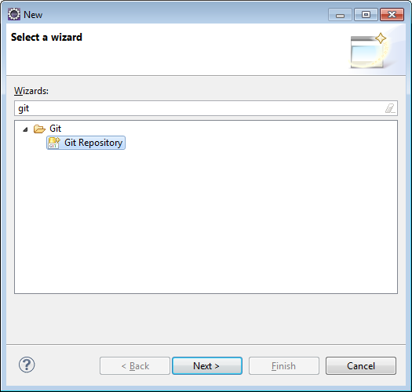
Make a Git Repository

Slide 11
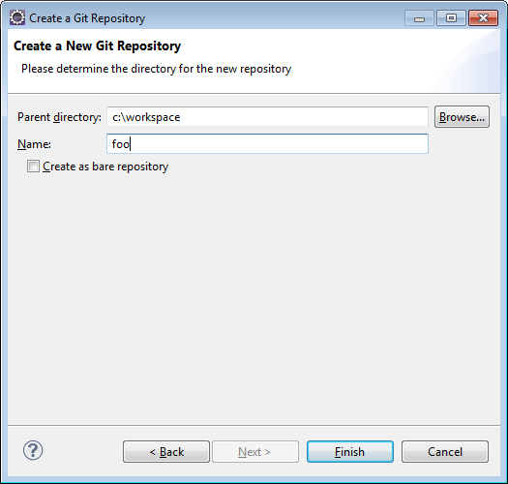
Think of a dummy project name
Project name: foo
Important: Git parent directory should
Be your workspace i.e. c:\workspace
Enter your projectname
Finish

Slide 12
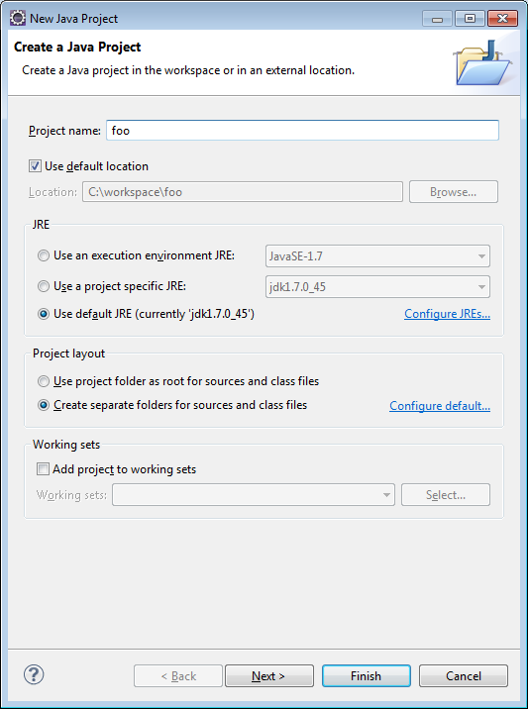
Create a New Java Project

Slide 13
Add Hello World
New Class HelloWorld

Slide 14
Browser – visit github.com
Create an account
Create a repository called foo
Copy and paste the .git URL to …

Slide 15
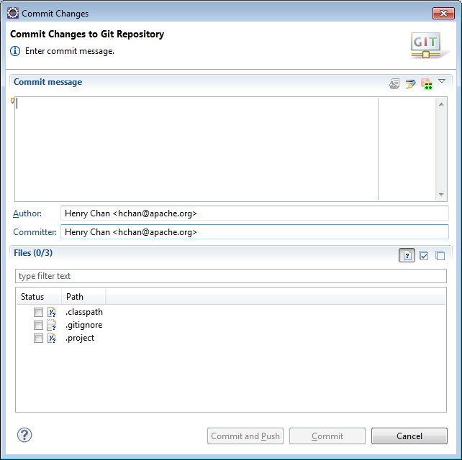
Commit and Push your Hello World

Slide 16
Homework
Assignment#1
Import
https://github.com/hchan/comp2613
Errors with import – don’t worry too much – Day 2 ;)
Read https://github.com/hchan/comp2613/blob/master/egitTutorial.docx
Do Assignment#1
Read the doc, from your Imported Workspace;)
Play around with committing files
Kill your Eclipse project and reimport it

Slide 17
Java Packages
A Java package is a mechanism for organizing Java classes into namespaces
For your project, please use the package name: ca.bcit.comp2613.<your project name in lowercase>
Package names in convention are lowercase
Naming conventions: http://java.about.com/od/javasyntax/a/nameconventions.htm

Slide 18
Core API (java.lang)
http://docs.oracle.com/javase/7/docs/api/java/lang/package-summary.html
Object
String
StringBuffer/StringBuilder
Strings are immutable which means they can’t change,
But StringBuilder’s are. Really not that important in this day and age anymore. Bottleneck is in String creation.
See StringDemo

Slide 19
Debugging
Add breakpoints, view variables
Welcome to Eclipse shortcuts - “F3”
String == String vs String.equals
See DebuggingDemo

Slide 20
Working with model objects + Searching
A model object represents the data tier
Almost no logic in it but, some developers like to add override the toString method for a tad bit of presentation logic
ArrayList are good choices to store many objects.
Searching is simply done through iterating through the ArrayList
See TeacherDemo

Slide 21
Jar files
What are they?
Java Archives – libraries. I think Sun borrowed the idea of “unix tar” and applied it to jar
Did we use any right now? Sure -> rt.jar
Kinda hard to avoid using “Core Java classes”
But there are times when the “String” class or another Core Java Class just isn’t flexible enough to do what you want. What do you do then? Download a library (set of Jars). More on this later in a later lecture. Pronounced as Maven. Oh if used Perl before (its similar to CPAN), or PECL/PEAR (if you’re a Python user), or RubyGems (for Ruby users). If you come from a C/C++/C# background … (err… um, Makefile + wget – okay bad joke)

Slide 22
Exporting Jars + Command Line
Eventually one day, you’ll want to export your project outside of eclipse. Your final export, will most likely be a Jarfile (or warfile, or earfile – outside the scope of this class)
A few ways to do this. One is via your IDE … Export->Java->Runnable Jar (demo)
But, to be honest, the de facto way is with Maven (more on this in a later lecture)
Demo (just a note, at a first glance, Eclipse’s Export function looks pretty easy … but as your project grows in complexity and dependency, Maven is the way to do it)
BTW, in this class, whether it be assignments, midterm, final or final project, I NEVER, EVER, EVER want you to send me a .zip, .jar file to me via email or dropbox. That’s just so last decade … ;)
Hint … how / where do you think you will submit your final exam

Slide 23
More about Egit (Eclipse Git)
In Day1, we create a Git repository first and then created a Java project
You can do it in reverse order too (java project first and then git repostiory)
Create Java Project with project name zzz
Team->Share Project->Git
(there is one big gotcha with this … double directory names)
Another way (yet with another pro and con):
Create Java Project name with zzz
Run “git init (the power of the command line!!)” on that directory, or copy and paste an empty .git folder (same from repository blank) to that directory (very hacky)
Team->Share Project->Git

Slide 24
Homework
Assignment#2
http://docs.oracle.com/javase/7/docs/api/java/lang/package-summary.html
http://docs.oracle.com/javase/7/docs/api/java/lang/String.html
http://docs.oracle.com/javase/7/docs/api/java/lang/StringBuffer.html

Slide 25
Core API Classes (cont)
Most Core API classes can be found in rt.jar
In particular, I’d like to focus on
java.math
java.util

Slide 26
BigInteger
java.math belongs
maxValue: (2^32)^Integer.MAX_VALUE
Unless you are dealing with really large numbers use Integer
Not as exciting as its sibling … BigDecimal

Slide 27
BigDecimal
Immutable, arbitrary-precision signed decimal numbers
Pop Quiz … how much tax do you pay on $4.99?
See BigDecimalExample

Slide 28
java.util
Collections (another topic for
perhaps another lecture)
java.util.Random used to generate Random Objects
java.util.UUID (RandomExample)
java.util.Date represents a specific instant in time
java.util.GregorianCalendar (DateAndGregorianCalendarExample)
Date is simpler than GregorianCalendar
A lot of methods in Date are Deprecated

Slide 29
java.util (cont)
java.util.Timer and java.util.TimerTask
java.util.Timer is a utility class that can be used to schedule a thread to be executed at certain time in future. Java Timer class can be used to schedule a task to be run one-time or to be run at regular intervals.
A TimerTask that can be scheduled for one-time or repeated execution by a Timer.
Think of this pair as Batman and Alfred
See MyTimerTaskExample

Slide 30
Annotations
Metadata – if you were to walk away from this lecture and were asked what annotations meant tomorrow – one word: metadata.
Information for the compiler — Annotations can be used by the compiler to detect errors or suppress warnings.
Compile-time and deployment-time processing — Software tools can process annotation information to generate code, XML files, and so forth.
Runtime processing — Some annotations are available to be examined at runtime.

Slide 31
Pre-defined Annotations
Built in Annotations
@Override - Checks that the method is an override. Causes a compile error if the method is not found in one of the parent classes or implemented interfaces.
@Deprecated - Marks the method as obsolete. Causes a compile warning if the method is used.
@SuppressWarnings - Instructs the compiler to suppress the compile time warnings specified in the annotation parameters
AnnotationExample

Slide 32
Annotations - Interesting so far?
Did it really do anything so far besides giving me a warning (compiler) or error (like using Override but spelling toString as toStrin)?

Slide 33
Building custom annotations
In all honesty … you probably won’t be doing this
But if you’re curious … http://docs.oracle.com/javase/tutorial/java/annotations/declaring.html

Slide 34
Other examples of annotations
In Frameworks
JPA (Oh … you’ll be seeing this later on)
Junit (See MyTestCase and MyTestCase.launch)
Spring (and we’ll see this later on too)
Various Web Service Stacks
Various parsers

Slide 35
Enums
An enum type is a special data type that enables for a variable to be a set of predefined constants.
What many green traffic lights are in the Array below?
String[] trafficLights = {“green”, “Green”, “GREEN”, “red”};
See TrafficLightDemo and TrafficLightFixedDemo

Slide 36
Enums with properties
What if you want MORE information on an Enum
Such as a description?
See CountryEnumDemo

Slide 37
Errors and Exceptions
An Error "indicates serious problems that a reasonable application should not try to catch."
while
An Exception "indicates conditions that a reasonable application might want to catch.“
Most likely you will never write or catch an Error
See ErrorDemo

Slide 38
Exceptions
Come in two flavours
Checked
You should catch it or let bubble up (aka exception propagation)
See SimpsonsDemo
Unchecked
It bubbles to the top
Unchecked Exceptions extend RuntimeException
See SimpsonsWithPossibleRuntimeExceptionDemo

Slide 39
Why have unchecked exceptions?
http://docs.oracle.com/javase/tutorial/essential/exceptions/runtime.html
Here's the bottom line guideline: If a client can reasonably
be expected to recover from an exception, make it a
checked exception. If a client cannot do anything to recover
from the exception, make it an unchecked exception.

Slide 40
Homework
Assignment#3
Scan BRIEFLY:
http://docs.oracle.com/javase/7/docs/api/java/util/package-summary.html
http://docs.oracle.com/javase/7/docs/api/java/math/package-summary.html
Read
http://docs.oracle.com/javase/tutorial/java/annotations/
http://docs.oracle.com/javase/tutorial/java/javaOO/enum.html
http://docs.oracle.com/javase/tutorial/essential/exceptions/

Slide 41
Generics
A generic type is a generic class or interface that
Is parameterized over types
See GenericDemo

Slide 42
Collections
A collections framework is a unified architecture for representing and manipulating collections. All collections frameworks contain the following:
Interfaces: These are abstract data types that represent collections. Interfaces allow collections to be manipulated independently of the details of their representation. In object-oriented languages, interfaces generally form a hierarchy.

Slide 43
Collections (cont)
Implementations: These are the concrete implementations of the collection interfaces. In essence, they are reusable data structures.
Algorithms: These are the methods that perform useful computations, such as searching and sorting, on objects that implement collection interfaces. The algorithms are said to be polymorphic: that is, the same method can be used on many different implementations of the appropriate collection interface. In essence, algorithms are reusable functionality.

Slide 44
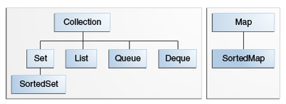
Collections (cont)
Notice that Map doesn’t exend Collection <sigh/>

Slide 45
Collections (cont)
Lots of implementing classes of java.util.Collection
http://docs.oracle.com/javase/7/docs/api/java/util/Collection.html

Slide 46
Collections (cont)
List
Set
Map
See CollectionsDemo

Slide 47
Collections (cont)
java.util.Vector, java.util.Hashtable – avoid if possible
Because it is synchronized (meaning threadsafe but slower)
Iterator – if you want to remove something from a List,
Use Iterator

Slide 48
Collections (cont)
Comparable and Comparator
Comparable is implemented by a class in order to be able to comparing object of itself with some other objects. The class itself must implement the interface in order to be able to compare its instance(s). The method required for implementation is compareTo().

Slide 49
Collections (cont)
Comparator is capable if comparing objects based on different attributes. e.g. 2 men can be compared based on `name` or `age` etc. (this can not be done using comparable. )
The method required to implement is compare(). Now let's use another way to compare those TV by size. The common use of Comparator is sorting. Both Collections and Arrays classes provide a sort method which use a Comparator.
See: ComparatorAndComparableDemo

Slide 50
Homework
Assignment#4
Read:
http://docs.oracle.com/javase/tutorial/java/generics/
http://docs.oracle.com/javase/tutorial/collections/interfaces/index.html

Slide 51
Java File IO and libraries
Bit of recap from last week
Java collections (pretty useful and powerful)
The java.util package comes with the JRE (rt.jar)
There is a package for Java IO
java.io
I *could* talk about certain classes in java.io
Examples java.io.File, java.io.FileInputStream,
java.io.FileOutputStream, java.io.FileReader,
java.io.FileWriter
But I’ll let you read about those classes yourselves ;)

Slide 52
BETTER than java.io
To be fair, there are many Java libraries out there
There are even other libraries outside
Of core java that do collections and java.io
I’m going to choose Apache Commons IOUtils
A few reasons why …
java.io is kinda low-level (if you really want
to do low-level stuff, do it in C)
Want to introduce you to Maven

Slide 53
Maven
Apache Maven is a software project management and comprehension tool. Based on the concept of a project object model (POM), Maven can manage a project's build, reporting and documentation from a central piece of information.
In short, it’s a tool to help you manage libraries
Perl has CPAN
PHP has PEAR/Pecl
Ruby has RubyGems
C/C++/C# … Makefiles + wget

Slide 54
Maven – How to via Eclipse
Create a New Java project (or just use
Your existing one)
Left click on Project root ->Configure->
Convert to Maven Project
Accept the defaults
Modify pom.xml to get it compatible
With Java1.7 …
If in doubt, copy my pom.xml and put it in the
root folder

Slide 55
Maven – cont
Change the maven compiler setting
http://stackoverflow.com/questions/3539139/what-causes-a-new-maven-project-in-eclipse-to-use-java-1-5-instead-of-java-1-6-b
<plugin>
<artifactId>maven-compiler-plugin</artifactId>
<version>3.1</version>
<configuration>
<source>1.7</source>
<target>1.7</target>
</configuration>
</plugin>
Right click, Maven-Update Project

Slide 56
Add a library from Maven
Aka as adding a dependency
Visit: http://mvnrepository.com/
Search for Commons IO
Select a version
Copy and paste the dependency
<dependency>
<groupId>commons-io</groupId>
<artifactId>commons-io</artifactId>
<version>2.4</version>
</dependency>
Note: <depency> should be a child
Of <dependencies>
Root->Maven->Update Project

Slide 57
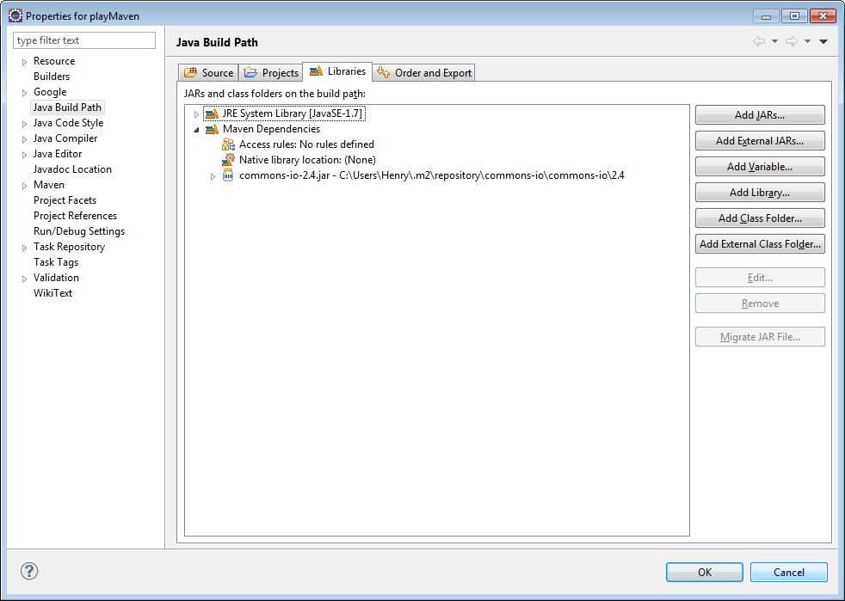
Maven – check your build path

Slide 58
Maven – good to go, let’s use Commons IO
Create a new class with a main()
In the body, type: FileUti… (CTRL-Space)
If code completion, finds it you are gold!
See: FileUtilsDemo
Lots of other APIs in FileUtils (CTRL-Space)
Is your friend!
F3 -> if you want to read the source code of FileUtils
… or you can just use java.io package directly

Slide 59
Java .properties
.properties is a file extension for files mainly used in Java related technologies to store the configurable parameters of an application.
We can use java.util.Properties …
But like java.io (or rather Commons IO), there are
Open source libraries that are easier (and more
Powerful for you to learn)

Slide 60
Commons Configuration
http://mvnrepository.com/artifact/commons-configuration/commons-configuration/1.10
<dependency>
<groupId>commons-configuration</groupId>
<artifactId>commons-configuration</artifactId>
<version>1.10</version>
</dependency>
Maven again!!
See: PropertiesDemo

Slide 61
Logging
Java comes with a logging framework called
java.util.logging
But keeping to the theme of Maven …

Slide 62
Log4j
http://mvnrepository.com/artifact/log4j/log4j/1.2.17
<dependency>
<groupId>log4j</groupId>
<artifactId>log4j</artifactId>
<version>1.2.17</version>
</dependency>
See Log4jDemo

Slide 63
Jackson – Java objects to JSON
JSON (Javascript object notation) is a common
Way to send messages outside of the javaworld
You’ve seen the toString method for data model (aka
POJO (plain, old, java objects), but what does JSON look
Like?

Slide 64
Jackson cont
<dependency> <groupId>org.codehaus.jackson</groupId> <artifactId>jackson-mapper-asl</artifactId> <version>1.9.2</version> </dependency> <dependency> <groupId>org.codehaus.jackson</groupId> <artifactId>jackson-core-asl</artifactId> <version>1.9.2</version> </dependency>

Slide 65
Jackson cont
See: JacksonDemo
Feel free to use Jackson instead of toString()

Slide 66
Homework
Assignment 5
Download various Java libraries
And try them out ;)

Slide 67
JavaFx
The De-facto way of Java desktop applications
Successor of AWT, Swing
http://www.oracle.com/technetwork/java/javafx/overview/faq-1446554.html#6
Use Scene Builder plugin for eclipse
http://www.eclipse.org/efxclipse/install.html
http://download.eclipse.org/modeling/tmf/xtext/updates/composite/releases/
http://download.eclipse.org/efxclipse/updates-released/0.9.0/site

Slide 68
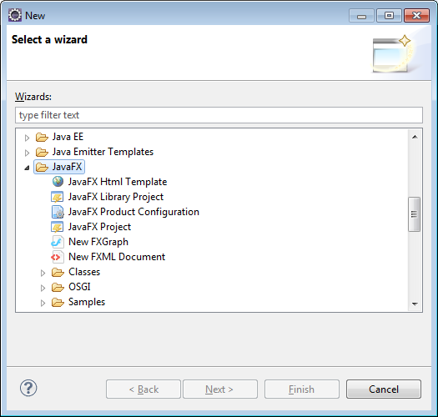
JavaFx (cont)
Tutorial: http://docs.oracle.com/javafx/scenebuilder/1/use_java_ides/sb-with-eclipse.htm

Slide 69
JavaFx (cont)
Or take a look at my Demo: JavaFXMainDemo
Note, if you have Scene Builder installed, you
Can view Teacher.fxml with “Open with Scene Builder”

Slide 70
Lots of bugs in my Application …
But that’s OK, because it’s a Demo
Your job is to do something similar with
your project. Start simple. Begin with just
One of your data models and create the table,
New, Save, Delete buttons
Re-use as much or little of my code as you want
Honestly, the BEST way to learn Java Fx is by
Digging into a project
http://download.oracle.com/otndocs/products/javafx/2/samples/Ensemble/index.html
If you don’t want to use Scene Builder, then don’t use it ;)
http://www.oracle.com/technetwork/java/javase/downloads/jdk7-downloads-1880260.html bottomlink

Slide 71
Homework
Assignment6
Prepare for midterm
Note it will *not* cover JavaFx
Hint: World of Warcraft rocks … great game
Read up on the races http://us.battle.net/wow/en/game/race/
It might help you on the midterm

Slide 72
This is where the course becomes … “you”
I guess I could spend another class or two showing JavaFx widgets (actually, I really can’t – I suck at JavaFx – I don’t write desktop apps)
Each project may use a different widget, experiment and have fun.

Slide 73
Homework
Assignment 6
Study for midterm

Slide 74
Any questions so far
Midterm
After midterm:
This is where the class becomes more
Hands-on – I’ll be speaking less, and
You’ll be coding in class more ;)
Spend rest of class working on homework
Oh what’s homework? (see next slide)

Slide 75
Homework
Assignment7

Slide 76
About Git timestamps / Post Midterm
Chemistry 12 … back in my days,
Bringing in a scientific calculator was forbidden
For the Final Exam. Why? Because you can
“program” all the formulas in there
Most ironic part … if you can figure out how
To program those formulas in and use them
Efficiently, you were probably smarter than the
Teacher (at least my teacher)
and deserved an A+ anyways.

Slide 77
More about Midterm thoughts
Another “keen” theory I have is that if you
Were so co-ordinated or careful in listening to
My hints in class, but your Java skills are so-so, then guess what … send your resume to be a project manager, not software developer
I used to consult for a government organization (information I can’t disclose to you) and our partner was another big organization (again I can’t disclose this info). There were sooo many times I headbanged against my keyboard telling my counterpart to just use my code. Communcation was a huge problem. If you had co-ordinated midterm answers, discussed where to have dinner, at exactly which restaurant and why your choice of celebration beer was better than his/hers, then that form of high-level communication via Gmail chat or whatever by itself during the beginning of last class is a talent by itself. High communication skills is a sign of a good project manager.
In case you haven’t guessed, I’m not trying to fail anyone in this course. I’m here to help you learn and to help you find your talents.

Slide 78
Java applets / Webstart
What is an applet?
It’s a way to show your java application
on a webpage … think of it like a plugin
Similar to Flash
Applets were the *OLDER* way to present
Java applications on the brower
When ran/deployed, they look pretty much
The same – hey its just Java Fx ;)
Syntax for Webstart is better Applets

Slide 79
There’s a plugin for that
Read: http://zenjava.com/javafx/maven/index.html
Use my pom.xml as reference (especially the configuration section)
Basic steps
Install plugin: see http://zenjava.com/javafx/maven/basic-config.html
mvn com.zenjava:javafx-maven-plugin:2.0:fix-classpath (hint anytime you see mvn … goal, in Eclipse its Run As…Maven build (fill in the Goal with that long string), Run

Slide 80
Cont (Maven, JavaFx)…
Generate a keystore … keystore …
A big can of worms … its all related with security,
And personally, it makes me sick, but without these
Instructions, it just won’t work
Anyways: mvn com.zenjava:javafx-maven-plugin:2.0:generate-key-store
Make sure you have a similar pom.xml config to mine for the certXXX stuff
Next, create your webstart page:
mvn com.zenjava:javafx-maven-plugin:2.0:web
Launch the file in your new “showcase” directory

Slide 81
Cont (Maven, JavaFx)
Security Errors … yeah, that’s the can of worms I was talking about. To fix them, see: http://hchan.github.io/comp2613/
Hey, do you think the above URL is kinda neat? Well, if you do, you’re only 5 steps away from having your own Github page

Slide 82
GitHub Pages
Read: https://pages.github.com/
The Eclipse way:
Make a new Branch called gh-pages
(Team->Switch To->New Branch … gh-pages)
Team->Merge->…master… (won’t need
It the first time tho)
Team->Push to upstream
Team->Switch To->master
Wait a few minutes (get a coffee)
From browser: http://hchan.github.io/comp2613/showcase/comp2613-0.0.1-SNAPSHOT.html

Slide 83
So what can go wrong? …
Lots
But above everything else, I *HATE* the
Security sandbox that Webstart / Applets have
Recap:
Lines of Java code I showed you in class
Today: 0
Xml lines: quite a few (pom.xml)
Html lines … well, take a look at (index.html)

Slide 84
Surprised / confused with git branches?
For some (may most … all?), this may be
The first time you are using Source Code Management
And branches. Google git branches it if you want
… its pretty cool.
Be patient … if anything, this is a skill (SCM/branches)
that can and will be used by large and small organizations.
Learn it well.
Other SCMs include Mercurial, Subversion, Perforce
Github’s special branch of gh-pages, just gave you
The bonus of a web project page ;)
Open-source FTW (For The Win)!

Slide 85
Homework
Assignment 8
Read up on Github/Maven/Java Web Start

Slide 86
JDBC / JPA / ORM
There is the long version and then the short version
Vanilla JDBC Java DataBase Connectivity – if you can avoid programming with vanilla JDBC directly, that’s a good thing
There’s a tool for that
ORM -> Object Relational Mapping. Means transforming a Java Data Model

Slide 87
JPA – Annotation heavy
Not going to lie, this is probably going to be the most difficult lecture to understand? Why? Magic - … powerful magic. Think Arthas (World of Warcraft) in high difficulty mode. It’s a leap of faith. Annotation magic at its greatest.
ORM in Java == JPA (Java Persistence API) … that’s what tools are for right?
JPA is an API
Implementations: Spring Data and Hibernate
ORM is also used in other languages such as Ruby (ActiveRecords), C++ (nHibernate – which borrows a lot from Java’s Hibernate), PerlORM, Python (Django/built-in ORM)

Slide 88
First, add the following dependencies
<dependency>
<groupId>org.springframework.boot</groupId>
<artifactId>spring-boot-starter-data-jpa</artifactId>
</dependency>
<dependency>
<groupId>com.h2database</groupId>
<artifactId>h2</artifactId>
</dependency>
<dependency>
<groupId>mysql</groupId>
<artifactId>mysql-connector-java</artifactId>
<version>5.1.30</version>
</dependency>
<dependency>
<groupId>org.hsqldb</groupId>
<artifactId>hsqldb</artifactId>
<version>2.2.8</version>
</dependency>

Slide 89
Also in pom.xml
<parent>
<groupId>org.springframework.boot</groupId>
<artifactId>spring-boot-starter-parent</artifactId>
<version>1.0.2.RELEASE</version>
</parent>
And then Maven Update

Slide 90
Modify our model Classes
Annotate with @Entity (pretty important)
Add a @Id (so-so important) to the primary key
Add @ManyToMany relationship
Right now, the ManyToMany annotation with the JoinTable, JoinColumn might be a tad bit confusing. Just try to “see and follow the pattern” with the Teacher/Student model. All see: http://en.wikibooks.org/wiki/Java_Persistence/ManyToMany
See day09.model.Teacher

Slide 91
Create a Repository Interface
See TeacherRepository

Slide 92
Create a TestDriver
A lot of the magic is in: @EnableAutoConfiguration
See: TestDriverWithInMemoryDB
Run it …
What just happened? Well, first thing is that it created an in memory database
Then a Table called Teacher
And then an insert
Prove it!!! … Sorry, no can do - that was an in memory DB

Slide 93
I know – let’s use MySQL!
Via your browser, goto: freemysqlhosting.net
(alright, I know, I know … its not hosted by BCIT) … but damn it – BCIT doesn’t use MySQL, they use a funny creature called SQL Server
Alright, after you register, you’ll get a
Hostname for your DB
Username / password
Database name
Convert that information you have above to an applicationContext.xml as is follows:

Slide 94
application.xml (as a direct child of the /src directory – no package)
<beans xmlns="http://www.springframework.org/schema/beans"
xmlns:jpa="http://www.springframework.org/schema/data/jpa" xmlns:xsi="http://www.w3.org/2001/XMLSchema-instance"
xsi:schemaLocation="http://www.springframework.org/schema/beans
http://www.springframework.org/schema/beans/spring-beans-2.5.xsd
http://www.springframework.org/schema/data/jpa
http://www.springframework.org/schema/data/jpa/spring-jpa-1.0.xsd">
<bean id="dataSource" class="org.springframework.jdbc.datasource.DriverManagerDataSource">
<property name="driverClassName" value="com.mysql.jdbc.Driver" />
<property name="url"
value="jdbc:mysql://sql3.freemysqlhosting.net/sql340330" />
<property name="username" value="sql340330" />
<property name="password" value="dR5!xA3!" />
</bean>
</beans>

Slide 95
Create another Test Driver for MyDB
See: TestDriverWithMySQLDB
You’ll most likely get a Caused by: com.mysql.jdbc.exceptions.jdbc4.MySQLSyntaxErrorException: Table 'sql340330.teacher' doesn't exist
If you get that error, you’ll have to modify hibernate.properties
Hibernate is *an* implementation to JPA that Spring Data uses. JPA == API. Spring Data == framework impl. Hibernate == framework within Spring Data.
Problem with so much Annotation magic is that every now and then something goes wrong. Fortunately, this hibernate.properties fix is easy

Slide 96
hibernate.properties (exists under /src)
hibernate.show_sql=true
hibernate.format_sql=true
#hibernate.hbm2ddl.auto=validate | update | create | create-drop
#hibernate.hbm2ddl.auto=update
hibernate.hbm2ddl.auto=create

Slide 97
Run TestDriverWithMySQLDB
No errors right?
But where did my data go?
Well … let’s take a look at the MySQLDB directly

Slide 98
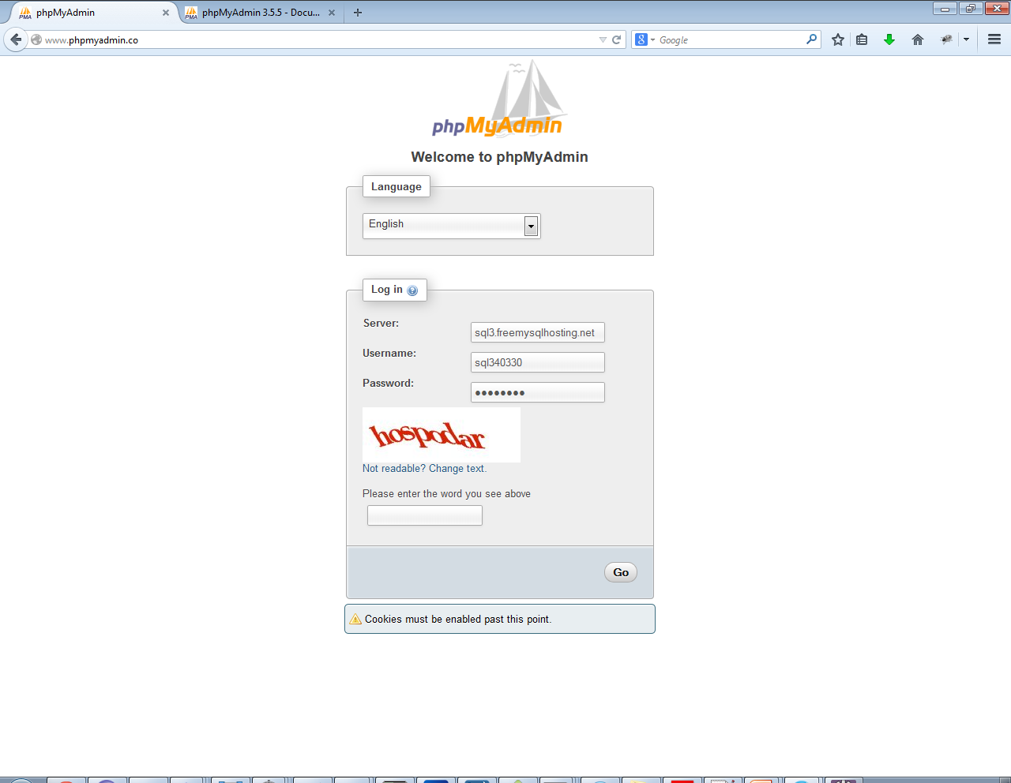
Browser view http://www.phpmyadmin.co/

Slide 99
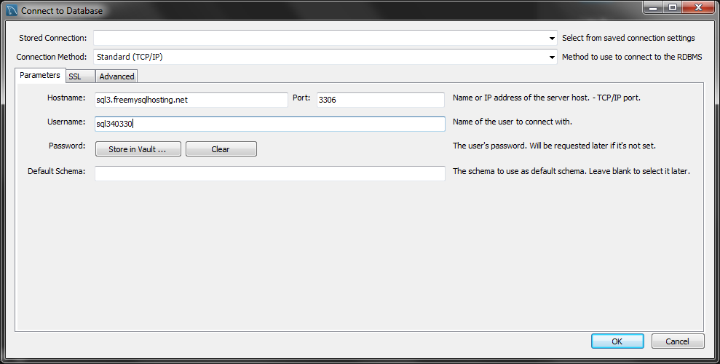
MySQL Workbench (the defacto client for MySQL)
http://dev.mysql.com/downloads/
Find the MySQL Workbench download
Start up workbench
Database->connect to Database

Slide 100
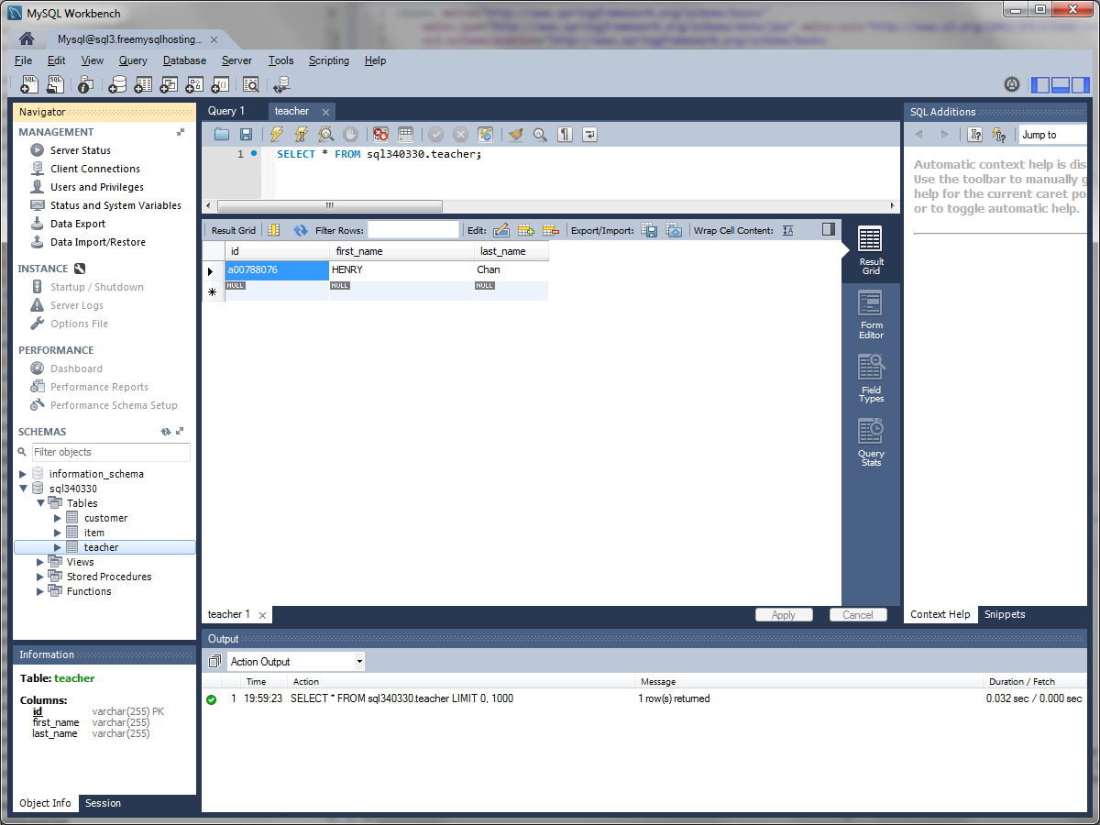
And see if your new row is inserted

Slide 101
DB relationships (cont)
See: TestDriverInsertsWithMySQLDB
See: TestDriverSearchesWithMySQLDB

Slide 102
What can go wrong?
When playing around with power magic, you can get burned pretty fast. Or if you’re a fan of spiderman: With great power, comes great responsibility. JPA / Spring Data / Hibernate is one of the most powerful features (if not the most powerful feature) of JavaEE. If you learn to master this, you’ll see other design patterns (which are annotations-based) come to play.
Make sure to commit your code often when it is in a stable state
If you Java Model class is out of sync with the DB, then go to your DB and drop the tables
Play around with the hibernate.hbm2ddl.auto field in hibernate.properties

Slide 103
Power of Spring
So unknowingly, you have also tapped in to the power of Spring (we’re using Spring Data for JPA). We’ve also covered Spring IOC (Inversion Of Control – the annotation magic)
It is a piece of a much larger soln (beyond the scope of this course). But if you understand Spring Data, the rest of the features the Spring will be “familiar”
One of the features that Spring Data already uses is Connection Pooling … and then there is Paging (getting the first 10 results of Page1)
Spring is definitely one of the largest frameworks within Java.
One of the buzzes these days is to convert JPA -> REST Services. And then use BackboneJS, or AngularJS or EmberJS, etc to consume the REST Service. Old way in Java was to do HTML rendering on the server side. Newer way embraces the “JS” families.
Most of the features of Spring are beyond the scope of this course, but Spring Data / Spring IOC are skills that you have at least *touched* on.

Slide 104
Homework
3 guesses on what the work is? ;)
Assignment9

Slide 105
Network Programming
OK, this is a somewhat filler lecture. Course outline has a mandate to cover network programming.
The Final exam, final project will have nothing to do with today’s SHORT lecture on Network Programming.
Network Programming … UDP / TCP … very cool. But realistically, you won’t be using those protocols directly. In short, if want to do something in low-level, … try not to do it in Java please.
http / https are by far the most common protocols used in Java
See HttpComponentsDemo (still not very important, so let’s keep this short to cover the NEXT slide)

Slide 106
What now?
Not going to lie, the previous class was pretty *tough*. There’s the technical code part, the *magic of annotations* and just the new train of thought with Java ORM
Show of hands … how many people were
Very confused about Database ORM
Semi-confused
Heck – easy stuff
Also the lecture about Databases is by FAR one of the most important lectures. Without databases, you will have NO Web Service, no Web app. The concepts of DB alone is a course by itself.
If no other questions, I’m going to repeat the last class again (and possibly again in the next class if I see a lot of blank faces)
If you understand ORM inside out, feel free to work on your assignment or take off early

Slide 107
Homework
Assignment 10

Slide 108
MVC (Model-View-Controller)
You already used it with JavaFx / FXML
Which was the Model?
View?
Controller?
Admittedly, MVC (a somewhat 2000’ish design pattern) isn’t always the best design pattern, but very commonly used. Pretty good, but not always the best.
Lots of other ones out there like MVP, MVVM, and now there’s a category called MVW – whatever!
Questions? If not, go back to your Assignment!
I’ll be here to answer questions for the rest of this lecture.
Advice: Check out your neighbor’s application. Strongly encouraged.

Slide 109
There’s a tool (library) for that
<dependency>
<groupId>org.apache.httpcomponents</groupId>
<artifactId>httpclient</artifactId>
<version>4.3.3</version>
</dependency>
See HttpComponentsDemo

Slide 110
Homework
You guessed it Assignment11
Hint for Final
What can go wrong with your application
When you demo it? How should you handle,
Fallback on what?

Slide 111
Food for thought…
Maybe after this course …
I REALLY hate Java…
Or I REALLY love it
But was that all you learned?
I had a hidden agenda all along

Slide 112
Well, what else did we learn?
Maven – although Maven is specific
To java, the concept is universal. Have
A repository of libraries somewhere and
Let a tool download them with their dependecies
And help you build artifacts

Slide 113
Git, Github
I strongly recommend you use Git for your
Other courses or personal projects or work. Revision
management is crucial in software engineering. Without
Git, how else would you go back to a previous revision
GitHub and GitHub pages ties you into the open
Source community. Open source is good. You now
Have an open source project on GitHub. Congrats.
If you never created a homepage before, well, use
GitHub pages. Great for letting employers see your
Project and let them see your coding style too! Again,
NOT java specific.

Slide 114
MVC
Hopefully, you learned a few design patterns
Like MVC. In later courses, you’ll learn MVP,
MVVM, and MVW. Again design patterns aren’t
Specific to Java

Slide 115
Your neighbor
I really tried to create an atmosphere
Where I *only* did 50% of the talking
Really hoped that you got to know the people
Sitting around you. Exchange phone numbers,
Emails with them.
Programs come and go. Friends are forever

Slide 116
And most of all …
Software engineering and banging your
head against your keyboard. This was a
put as much or as little as you want in this
Course. The project was yours from Day1.
I personally grew quite attached to my first
Software engineering project. For me it was
Fun. I programmed it in C. I don’t use C anymore,
But it was the build your own, manage your own
aspect that still keeps me motivated in this field.

Slide 117
Thank-you + Optional Homework
Thank-you very much for taking this course
I really hope you all had a great time
Survey Monkey link

