Slide 1
JavaFx
The De-facto way of Java desktop applications
Successor of AWT, Swing
http://www.oracle.com/technetwork/java/javafx/overview/faq-1446554.html#6
Use Scene Builder plugin for eclipse
http://www.eclipse.org/efxclipse/install.html
http://download.eclipse.org/modeling/tmf/xtext/updates/composite/releases/
http://download.eclipse.org/efxclipse/updates-released/0.9.0/site

Slide 2
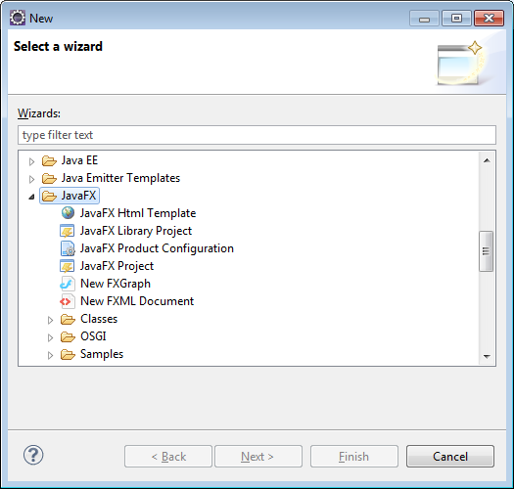
JavaFx (cont)
Tutorial: http://docs.oracle.com/javafx/scenebuilder/1/use_java_ides/sb-with-eclipse.htm

Slide 3
JavaFx (cont)
Or take a look at my Demo: JavaFXMainDemo
Note, if you have Scene Builder installed, you
Can view Teacher.fxml with “Open with Scene Builder”

Slide 4
Lots of bugs in my Application …
But that’s OK, because it’s a Demo
Your job is to do something similar with
your project. Start simple. Begin with just
One of your data models and create the table,
New, Save, Delete buttons
Re-use as much or little of my code as you want
Honestly, the BEST way to learn Java Fx is by
Digging into a project
http://download.oracle.com/otndocs/products/javafx/2/samples/Ensemble/index.html
If you don’t want to use Scene Builder, then don’t use it ;)
http://www.oracle.com/technetwork/java/javase/downloads/jdk7-downloads-1880260.html bottomlink

