Slide 1
Testing your REST Server with Apache Jmeter
By Henry Chan
Nov 14, 2014
hchan@apache.org
Source: https://github.com/hchan/jmeterDemo

Slide 2
What is Jmeter good for?
http://jmeter.apache.org/
What can I do with it?
Apache JMeter may be used to test performance both on static
and dynamic resources (Files, Web dynamic languages - PHP, Java,
ASP.NET, etc. -, Java Objects, Data Bases and Queries, FTP Servers
and more).
It can be used to simulate a heavy load on a server, group of servers,
network or object to test its strength or to analyze overall performance
under different load types. You can use it to make a graphical analysis
of performance or to test your server/script/object behavior under heavy concurrent load.

Slide 3
Why use Jmeter to test your REST Server?
Two parts to this question
a) Why Test your REST Server?
  To make sure it is up like a ping and check validity of response.
  Can be wrapped in a cronjob (with the 'headless') option (-n)
  Stress testing
b) Why Jmeter when there are so many other tools?
  Headless mode, can do reports
  Stress testing
  Open Source
  Other goodies besides REST (i.e. DBSampler, Java Sampler)
  Comes with a Drag and Drop GUI to help create TestCases
    And saves the final script as an XML (.jmx)

Slide 4
Example – Let's test the GitHub API
The following Demo will consume a few REST Services from GitHub
https://api.github.com
It will parse the JSON request (to get all the projects in GITHub projects with
the search string 'java' and iterate through each item) response to
'visit' the owner of that project's home_url

Slide 5
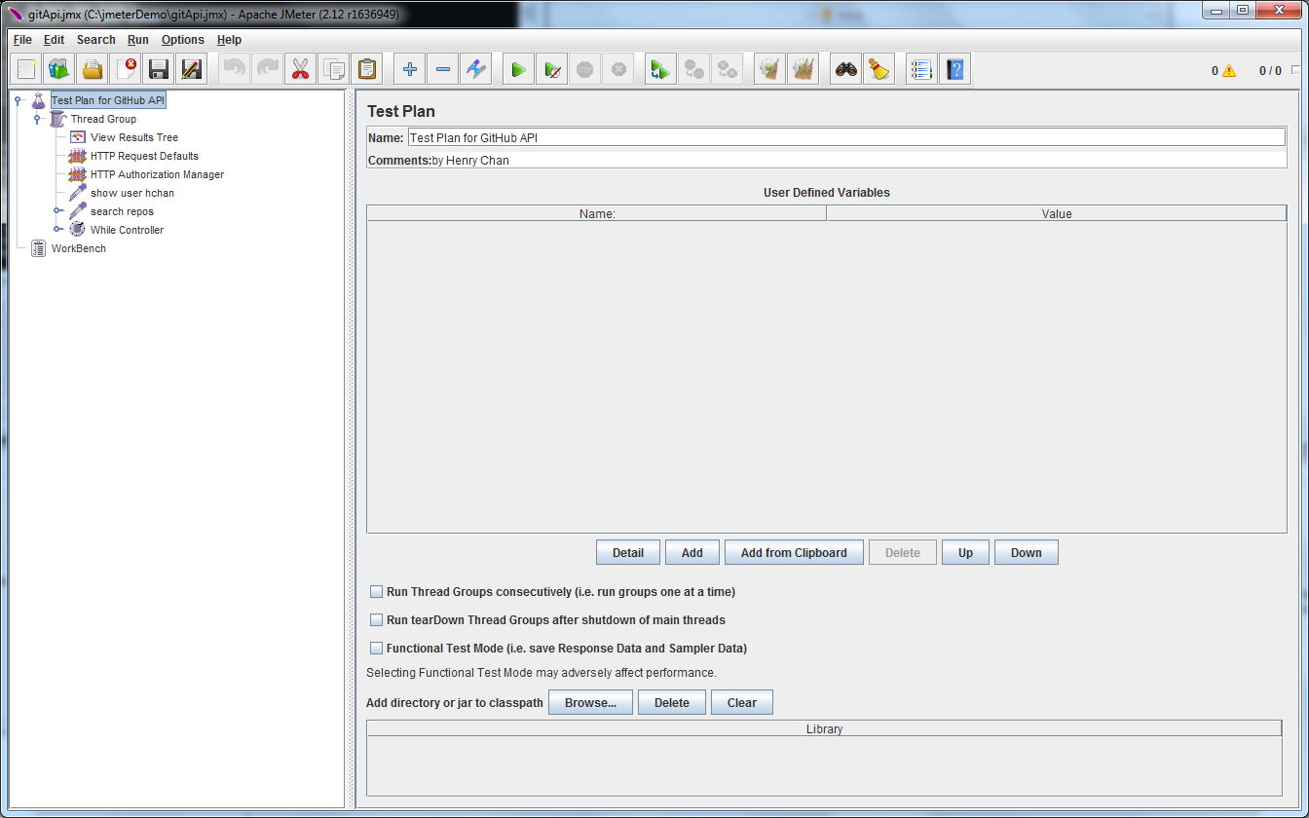

Jmeter comes with a GUI

Slide 6
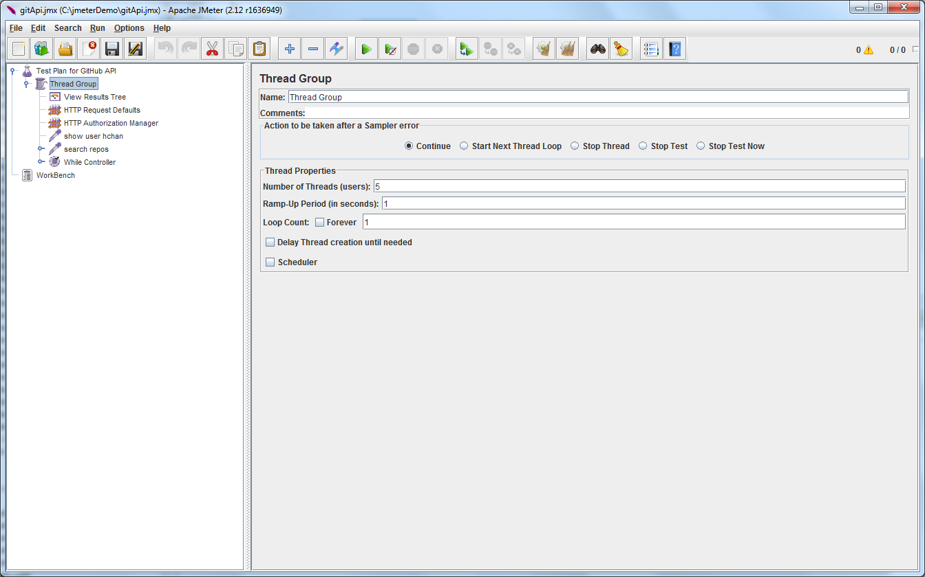
Can create Thread Groups for load testing

Slide 7
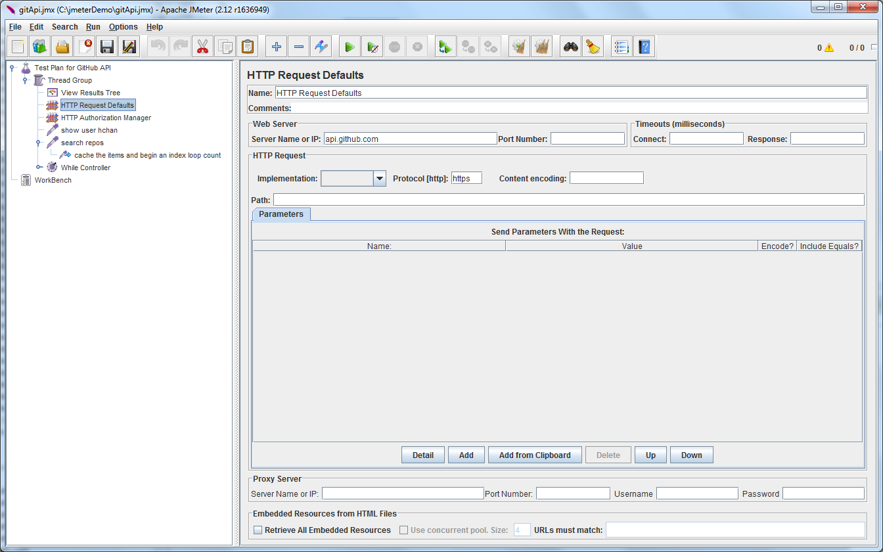
Define your HTTP Request Defaults

Slide 8
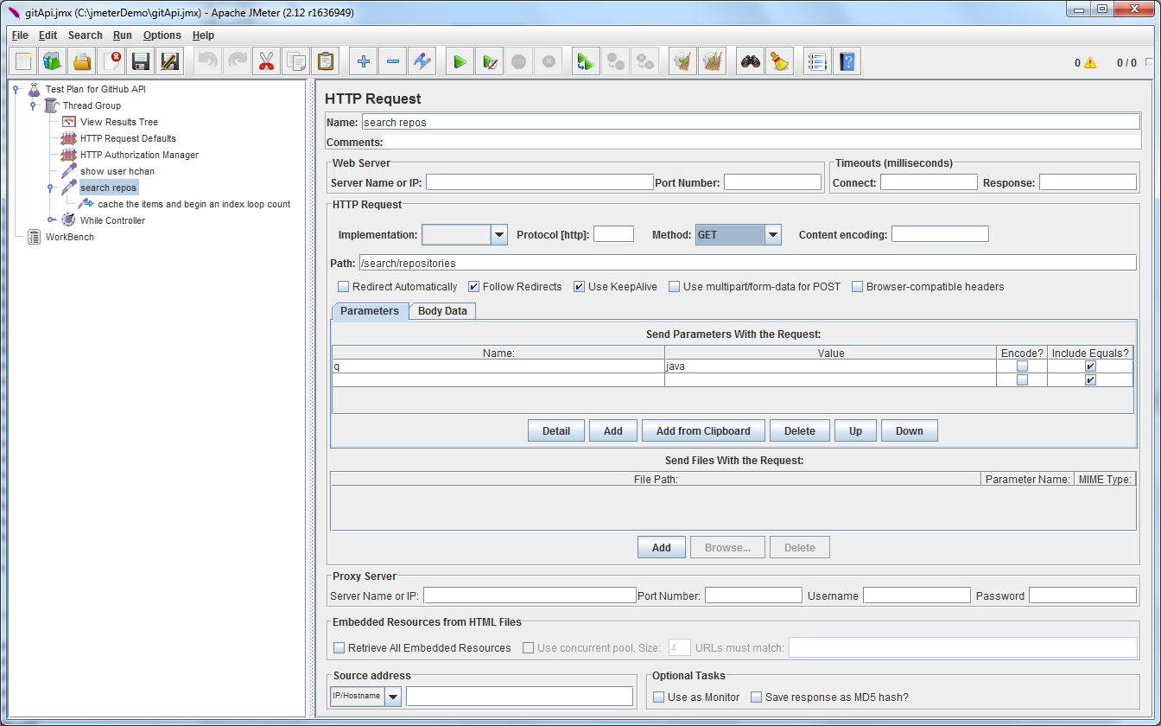
Create your Test Cases (GET, PUT, DELETE, POST)

Slide 9
Assertions and PostProcessors
* Assertion help verify that your server under test returns the expected results
* PostProcessor – similar to assertion, but isn't necessary used to verify the response message. Jmeter PostProcessors can be written in various languages, but with REST responses (JSON), I recommend Javascript

