Slide 1
Lecture #3
Pointers:
A Quick Review of Pointers
Dynamic Memory Allocation
Resource Management Part 1:
Copy Constructors
If you feel uncomfortable with pointers, then study and become an expert before our next class!
(Yeah right… like you’re gonna review on your own)

Slide 2
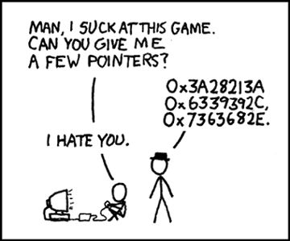
Pointers

Slide 3


Pointers… Why should you care?
Pointers are a critical feature of C and C++.
And you’ll struggle during the rest of CS32 if you don’t understand them super well.
And job interviewers love asking pointer questions.
So pay attention!

Slide 4
Every Variable Has An Address
00000000
00000001
Every time you define a variable in your program, the compiler finds an unused address in memory and reserves one or more bytes there to store it.
…
00001000
00001001
00001002
00001003
00001004
00001005
00001006
00001007
00001008
00001009
00001010
00001011
Important: The address of a variable is defined to be the lowest address in memory where the variable is stored.
So, what is age’s address in memory?
age
What about grade’s address?
41
int main()
{
int age = 41;
char grade = ‘B’;
...
}
grade
66
…
99999990
99999991
99999992

Slide 5
Getting the Address of a Variable
We can get the address of a variable using C++’s & operator.
00000000
00000001
…
If you place an & before a variable in a program statement, it means “give me the numerical address of the variable.”
00001000
00001001
00001002
00001003
00001004
00001005
00001006
00001007
00001008
00001009
00001010
00001011
Output:
age’s address: 1006
age
grade’s address: 1011
41
int main()
{
int age = 41;
char grade = ‘B’;
}
cout << “age’s address: “<< &age ;
cout << “grade’s address: “ << &grade ;
grade
66
…
99999990
99999991
99999992

Slide 6
Ok, So What’s a Pointer?
pointer variable
I’m a regular variable… and I hold a regular value!
A pointer is a special kind of variable that holds another variable’s address instead of a regular value.
...
00001000
00001002
00001004
00001006
00001008
00001010
00001012
00001014
...
Here’s how we define a pointer variable! The * means pointer.
Here’s how we define a regular variable!
idontknow
42
void foo()
{
}
Another way to say this is:
“p points to address 1000”
int idontknow; idontknow = 42;
“Variable p is a
p
pointer to
1000
an int variable.”
I’m a pointer variable… and all I can hold are the addresses of other variables!
For instance, right now I hold a value of 1000, the address of the “idontknow” variable.
int *p;
To understand the type of your pointer variable, simply read your declaration from right to left…
p = &idontknow;

Slide 7
What do I do with Pointers?
Question: So I have a pointer variable that points to another variable… now what?
Answer: You can use your pointer and the star operator to read/write the other variable.
I just changed idontknow’s value to 5…
...
00001000
00001002
00001004
00001006
00001008
00001010
00001012
00001014
...
void foo()
{
}
idontknow
42
42
“Get the address value stored in the p variable…
Then go to that address in memory…
and give me the value stored there.”
void foo()
{
}
int idontknow; idontknow = 42;
“Get the address value stored in the p variable…
Then go to that address in memory…
and store a value of 5 there.”
int idontknow; idontknow = 42;
p
1000
1000
…without ever referring to its variable name!
1000
int *p;
p = &idontknow;
int *p;
cout << *p;
cout << *p → cout << *1000 → cout << 42
1000;
p = &idontknow;
*p = 5 → *1000 = 5
1000
*p = 5;
5

Slide 8
Another Pointer Example
void set(int *px)
{
*px = 5;
}
int main()
{
int x = 1;
set(&x);
cout << x;
}
00000000
00000001
…
“Store a value of 5 at location .”
x
00009240
00009241
00009242
00009243
00009244
00009245
00009246
00009247
00009248
00009249
00009250
1
5
px
9240
9240
9240
// prints 5
Let’s use pointers to modify a variable inside of another function.
Cool – that works! We can use pointers to modify variables from other functions!

Slide 9
What if We Didn’t Use Pointers?
void set(int *px)
{
*px = 5;
}
int main()
{
int x = 1;
set(&x);
cout << x;
}
Now what would happen if we didn’t use pointers in our code?
00000000
00000001
…
x
00009240
00009241
00009242
00009243
00009244
00009245
00009246
00009247
00009248
00009249
00009250
1
1
// prints 1
px
5
Oh no! We tried to change the value of x in set but it only changed the local variable!
1
Had we used a pointer, it would have worked!

Slide 10
Pointers vs References
Since the set function accepts a reference…
Since val points to our original variable, x, this line actually changes x!
When you pass a variable by reference to a function, what really happens?
00000000
00000001
…
x
00009240
00009241
00009242
00009243
00009244
00009245
00009246
00009247
00009248
00009249
00009250
void set(int &val) // val is a ref
{
val = 5;
}
int main()
{
int x = 1;
set(x);
cout << x;
}
1
5
It looks like we’re just passing the value of x, but in fact…
This line is really passing the address of variable x to set…
val
9240
9240
In fact, a reference is just a simpler notation for passing by a pointer!
(Under the hood, C++ uses a pointer)

Slide 11
What Happens Here?
00000000
00000001
int main()
{
int *iptr;
…
iptr
00009240
00009241
00009242
00009243
00009244
00009245
00009246
00009247
00009248
00009249
00009250
int someVar; iptr = &someVar; // now iptr is valid!
*iptr = 123456; // #1 mistake!
}
123456
?????
// A-OK now!
What address does iptr hold?
Who knows??? Since the programmer didn’t initialize it, it points to some random spot in memory!
Moral: You must always set the value of a pointer variable before using the * operator on it!
CRASH!
Your "nature" pictures?
Operating system??

Slide 12
Class Challenge
Write a function called swap that accepts two pointers to integers and swaps the two values pointed to by the pointers.
Prize: 3 prize tickets (and maybe some candy)
int main()
{
int a=5, b=6;
swap(&a, &b);
cout << a; // prints 6;
cout << b; // prints 5
}
Hint: Make sure you never use a pointer unless you point it to a variable first!!!

Slide 13
Class Challenge Solution
Get the value stored at location 9240…
and put it in temp.
Get the value stored in temp and store it in location 9244…
And put it into location 9240.
Get the value stored at location 9244…
void swap (int *pa, int *pb)
{
int temp;
temp = *pa;
*pa = *pb;
*pb = temp;
}
int main()
{
int a=5, b=6;
swap(&a,&b);
cout << a;
cout << b;
}
00000000
00000001
…
a
00009240
00009242
00009244
00009246
00009248
00009250
00009252
00009254
00009256
00009258
00009260
5
5
b
6
6
9240, 9244
9240
9244
pa
9240
pb
9244
temp
-23

Slide 14
Wrong Challenge Solution #1
And put it in location 50000!
Get the value stored at location 9240…
Problem: In this solution, we use a pointer without first pointing it at a variable!
void swap (int *pa, int *pb)
{
int *temp;
*temp = *pa;
*pa = *pb;
*pb = *temp;
}
int main()
{
int a=5, b=6;
swap(&a,&b);
cout << a;
cout << b;
}
00000000
00000001
…
a
00009240
00009242
00009244
00009246
00009248
00009250
00009252
00009254
00009256
00009258
00009260
5
5
b
6
9240, 9244
9240
9244
pa
9240
CRASH!
pb
9244
temp
50000

Slide 15
Wrong Challenge Solution #2
void swap (int *pa, int *pb)
{
int *temp;
temp = pa;
pa = pb;
pb = temp;
}
int main()
{
int a=5, b=6;
swap(&a,&b);
cout << a;
cout << b;
}
Problem: In this solution, we swap the pointers but not the values they point to!
00000000
00000001
…
a
00009240
00009242
00009244
00009246
00009248
00009250
00009252
00009254
00009256
00009258
00009260
5
b
6
9240, 9244
9240
9244
// prints 5
pa
9240
// prints 6
9240
pb
9244
9244
temp
9240
50000

Slide 16
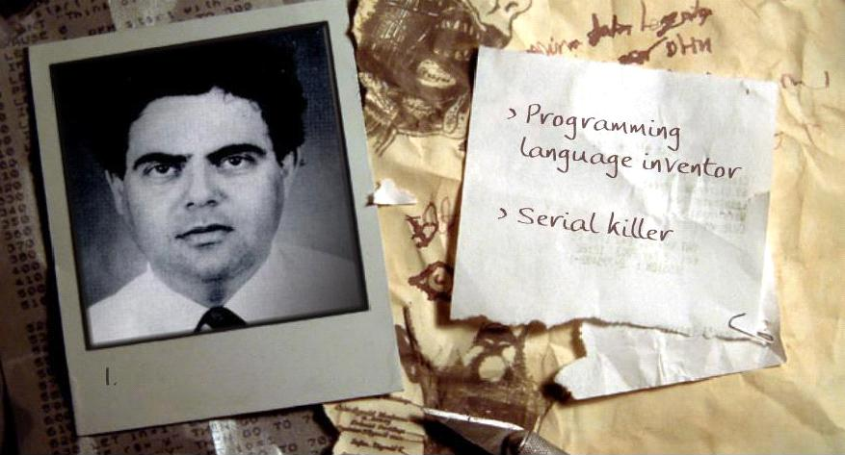
Let’s Play….
Programming Language Inventor
Or
Serial Killer
See if you can guess who uses a keyboard and who uses a chainsaw!
Notes:
Bertrand Meyer: invented eiffel programming language

Slide 17
Arrays, Addresses and Pointers
nums is just an array.
It holds three regular integer values.
But it doesn’t hold an address like a pointer variable, so it’s not a pointer!
And here’s how to make a pointer point to an array…
Just like any other variable, every array has an address in memory.
Question: So is “nums” an address or a pointer or what?
But… in C++ you don’t use the & operator to get an array’s address!
Answer: “nums” is just an array. But C++ lets you get its address without using the & so it looks like a pointer…
You simply write the array’s name (without brackets) and C++ will give you the array’s address!
…
00009240
00009242
00009244
00009246
00009248
00009250
00009252
00009254
00009256
00009258
00009260
ptr is a pointer variable.
Why? Because it’s a variable that holds an address value!
nums
9242
10
9242
int main()
{
int nums[3] = {10,20,30};
}
[0]
[1]
20
cout << nums;
// prints 9242
[2]
30
int *ptr = nums; // pointer to array
ptr

Slide 18
Arrays, Addresses and Pointers
NOTE: when we say “skip down j elements,” we don’t just mean “skip down j bytes!”
Instead we mean, skip over j of the actual elements/values in the array (e.g., skip over the values 10 and 20 to get to 30)
In C++, a pointer to an array can be used just as if it were an array itself!
In C++, the two syntaxes have identical behavior:
Or you can use the * operator with your pointer to access the array’s contents.
ptr[j] *(ptr + j)
They both mean: “Go to the address in ptr, then skip down j elements and get the value.”
They both mean: “Go to the address in ptr, then skip down j elements and get the value.”
They both mean: “Go to the address in ptr, then skip down j elements and get the value.”
This line says “print out the item that is two elements down from where ptr points.” (in this case, ptr points to the top of the array) It’s the same as printing out nums[2] or ptr[2].
Since ptr points to the top of the nums array, this prints out the value that is two integer elements from the top of the nums array.
…
Since ptr points to the top of the nums array, this prints out the value that is at address 9242 – i.e., the first element of the nums array.
00009240
00009242
00009244
00009246
00009248
00009250
00009252
00009254
00009256
00009258
00009260
nums
int main()
{
int nums[3] = {10,20,30};
}
[0]
10
[1]
20
int *ptr = nums; // pointer to array
[2]
30
cout << ptr[2];
// prints nums[2] or 30
cout << *ptr;
// prints nums[0] or 10
ptr
cout << *(ptr+2);
// prints nums[2] or 30
9242

Slide 19
Pointer Arithmetic and Arrays
The array parameter variable is actually a pointer!
You can use [ ] syntax if you like but it’s REALLY a pointer!
This line prints the element that is one item from the top.
Since array starts at 3000, and each item is an integer, our next integer is at 3004…
Did you know that when you pass an array to a function…
This line prints the element that is zero items
from the top of where ‘array’ points to.
array
int *array
You’re really just passing the address to the start of the array!
void printData(int array[ ])
{
cout << array[0] << “\n”;
cout << array[1] << “\n”;
}
Here we’re passing the address of the second element of the array.
Since nums[0] is at address 3000, nums[1] is 4 bytes down at 3004.
… not the array itself!
int main()
{
int nums[3] = {10,20,30};
printData(nums);
printData(&nums[1]);
printData(nums+1);
}
array
nums
3000
3000
3004
3008
[0]
10
20
30
10
3004
[1]
20
[2]

Slide 20
Pointer Arithmetic and Arrays
Our printData function thinks the array actually starts at location 3004!
It knows nothing about the earlier part of the array!
This prints the element that’s zero items from the top of where our array starts…
i.e., the item at location 3004!
Did you know that when you pass an array to a function…
When you use recursion on arrays, you’ll often use this notation…
and this prints the item that is one item down from the start of the array…
If the array starts at 3004, then the next integer is in slot 3008!
array
3004
This line is tricky!
First, what happens when you just write the name of an array all by itself?
Answer: C++ replaces the name with the start address of the array.
void printData(int array[ ])
{
cout << array[0] << “\n”;
cout << array[1] << “\n”;
}
You’re really just passing the address to the start of the array!
To process successively smaller suffixes of the array.
Then when we add 1, we tell C++ we want the address of the element that is one down from the top of the array.
… not the array itself!
int main()
{
int nums[3] = {10,20,30};
printData(nums);
printData(&nums[1]);
printData(nums+1);
}
nums
3000
3004
3008
3000
[0]
nums + 1 points here!
10
20
30
array
[0]
[1]
20
[1]
[2]
30
3004
+ one array element down
10
20

Slide 21
Pointers Work with Structures Too!
You can use pointers to access structs too! Use the * to get to the structure, and the dot to access its fields.
carey
00001000
00001001
00001002
00001003
00001004
00001005
00001006
00001007
00001008
00001009
00001010
00001011
00001012
00001013
00001014
00001015
00001016
00001017
.numZits
140
Or you can use C++’s -> operator to access fields!
struct Nerd
{
int numZits;
int hoursOfStarCraft;
};
int main()
{
Nerd carey;
Nerd *ptr;
ptr = &carey;
(*ptr).numZits = 140;
}
.hoursOfStarCraft
42
ptr
1000
ptr->hoursOfStarCraft = 42;

Slide 22
Classes and Pointers
foo
3000
3001
3002
3003
3004
3005
3006
3007
3008
3009
3010
…
m_x m_y m_rad
class Circ
{
public:
Circ(float x, float y, float rad)
{ m_x = x; m_y = y; m_rad = rad; }
float getArea()
{ return (3.14 * m_rad * m_rad); }
…
private:
m_x m_y m_rad
};
3 4 10
class Circ
{
public:
Circ(float x, float y, float rad)
{ m_x = x; m_y = y; m_rad = rad; }
float getArea()
{ return (3.14 * m_rad * m_rad); }
…
private:
float m_x, m_y, m_rad;
};
class Circ
{
public:
Circ(float x, float y, float rad)
{ m_x = x; m_y = y; m_rad = rad; }
float getArea()
{ return (3.14 * m_rad * m_rad); }
…
private:
};
3 4 10
10
10
C++: Since ptr points to 3000, I’ll call the getArea function associated with the foo variable at 3000!
You can also use this alternate syntax…
(It does the same thing)
void printInfo(Circ *ptr)
{
cout << “The area is: “;
cout << ptr->getArea();
}
int main()
{
Circ foo(3,4,10);
printInfo(&foo);
}
(*ptr).getArea();
You can use pointers with classes just like you do with structs.
ptr
3000
The area is:
314
3000

Slide 23
Classes and the “this” Pointer
Before C++, in the dark ages when Carey learned programming, we didn’t use classes!
Let’s see how we used to do things… with structs, pointers, and functions instead of classes!
And maybe this will help us understand how C++ classes actually work!

Slide 24
The Old Days…Before Classes
A Wallet structure keeps track of how many $1 and $5 the wallet holds…
The function can then use its pointer to get to the original variable.
w
num1s
0
4000
struct Wallet
{
int num1s, num5s;
};
void Init(Wallet *ptr)
{
ptr->num1s = 0;
ptr->num5s = 0;
}
void AddBill(Wallet *ptr, int amt)
{
if (amt == 1) ptr->num1s++; else if (amt == 5) ptr->num5s++;
}
The Init() function initializes the wallet... It’s like a constructor.
Before C++, we would use structs, pointers and regular functions to create class-like programs.
0
num5s
1
ptr
4000
ptr
4000
And the AddBill() function lets us add a bill to the wallet...
by updating the contents of the struct.
To let a function operate on a struct variable, we used to have to pass in the variable’s address...
amt 5
void main()
{
Wallet w;
Init(&w);
AddBill(&w , 5);
}
4000
4000
5
As it turns out, C++ classes work in an almost identical fashion!

Slide 25
The Wallet Class
class Wallet
{
public:
void Init();
void AddBill(int amt);
…
private:
int num1s, num5s;
};
void Wallet::Init()
{
num1s = num5s = 0;
}
void Wallet::AddBill(int amt)
{
if (amt == 1) num1s++;
else if (amt == 5)num5s++;
}
Here’s a class equivalent of our old-skool Wallet…
As you can see, we can initialize a new wallet…
And we can add either a $1 or $5 bill to our wallet.
Our wallet then keeps track of how many bills of each type it holds…
int main()
{
Wallet a;
a.Init();
a.AddBill(5);
}
And here’s how we might use our class…

Slide 26
Classes and the “this” Pointer
Here what your Init() method looks like…
But here’s what’s REALLY happening! ☺
Every time you call a member function of an object, e.g.:
And C++ does the same thing to your actual member functions!
a.addBill(5);
It adds a hidden first argument that’s a pointer to your original variable!
C++ invisibly rewrites your function call and passes in the variable’s address!
addBill(&a, 5);
void Wallet::Init()
{
num1s = num5s = 0;
}
void Wallet::AddBill(int amt)
{
if (amt == 1) num1s++;
else if (amt == 5)num5s++;
}
...
::
void Init(
{
num1s = num5s = 0;
}
void
{
if (amt == 1) num1s++;
else if (amt == 5) num5s++;
}
...
Wallet
Init(Wallet *this)
)
*this
this->
this->
Wallet
::
AddBill(
int amt)
*this,
this->
this->
So here we’re calling the Init() method of a…
But here’s what’s REALLY happening! ☺
int main()
{
Wallet a, b;
a.Init();
b.AddBill(5);
}
int main()
{
Wallet a, b;
Init(
AddBill(
}
a
.
);
&
b
5);
.
& ,
Notes:
Any time you call a member function for a class, C++ automatically and invisibly passes the address of the variable to the function.

Slide 27
Classes and the “this” Pointer
C++ converts all of your member functions automatically and invisibly by adding an extra pointer parameter called “this”:
Yes… the pointer is actually called “this”!
void Wallet::Init()
{
num1s = num5s = 0;
}
void Wallet::AddBill(int amt)
{
if (amt == 1) num1s++;
else if (amt == 5)num5s++;
}
...
void Init(Wallet *this)
{
this->num1s = this->num5s = 0;
}
void AddBill(Wallet *this, int amt)
{
if (amt == 1) this->num1s++;
else if (amt==5) this->num5s++;
}
...
int main()
{
Wallet a, b;
a.Init();
a.AddBill(5);
}
int main()
{
Wallet a, b;
Init(&a);
AddBill(&b,5);
}

Slide 28
Classes and the “this” Pointer
void Wallet::Init(Wallet *this)
{
this-> num1s = this-> num5s = 0;
}
void Wallet::AddBill(Wallet *this, int amt)
{
if (amt == 1) this-> num1s++;
else if (amt==5) this-> num5s++;
}
...
a
1000
num1s
0
1
num5s
0
this
1000
amt
5
int main()
{
Wallet a;
a.Init(&a);
a.AddBill(&a , 5);
}
1000
1000
5
This is how it actually works under the hood….
But C++ hides the “this pointer” from you to simplify things.

Slide 29
Classes and the “this” Pointer
You can explicitly use the “this” variable in your methods if you like! It works fine!
While C++ hides the “this pointer” from you, if you want, your class’s methods can explicitly use it.
void Wallet::Init()
{
num1s = num5s = 0;
}
void Wallet::AddBill(int amt)
{
if (amt == 1) num1s++;
else if (amt == 5) num5s++;
}
...
Your class’s methods can use the this variable to determine their address in memory!
this->num1s = this->num5s = 0;
cout << “I am at address: “ << this;
So now you know how C++ classes work under the hood!
a
1000
num1s
0
int main()
{
Wallet a;
a.Init();
}
num5s
0
I am at address: 1000
cout << “a is at address: “ << &a;
a is at address: 1000

Slide 30
Pointers… to Functions?!?
Just like every variable, every function has an address in memory too!
YES! Just as you can have pointers to variables, in C++ you can also have pointers to functions!
void squared(int a) { cout << a*a;}
3000
3050
3100
3150
3200
3250
3300
3350
3400
3450
3500
3550
3600
3650
3700
3750
3800
3850
3900
3950
100
void cubed(int a) { cout << a*a*a;}
8
Let’s gloss over the syntax for a second, and just see how it might work…
int main()
{
FuncPtr f;
f = &squared;
f(10);
}
f
3000
This line gets the address of our squared() function and puts it into f.
Now we can use the function pointer just like a regular function call!
First we define a function pointer.
It can hold the address of… a function!
10
3150
f = &cubed; f(2);
2

Slide 31
Pointers… to Functions?!?
YES! Just as you can have pointers to variables, in C++ you can also have pointers to functions!
3000
3050
3100
3150
3200
3250
3300
3350
3400
3450
3500
3550
3600
3650
3700
3750
3800
3850
3900
3950
void squared(int a) { cout << a*a;}
void cubed(int a) { cout << a*a*a;}
Let’s gloss over the syntax for a second, and just see how it might work…
And here’s the real syntax to declare a function pointer...
int main()
{
FuncPtr f;
f = &squared;
f(10);
}
void (*f)(int);
Oh, and you can leave out the & if you like.
It works the same way!
Don’t worry about the syntax right now…
f = &cubed; f(2);
Just remember the concept.

Slide 32
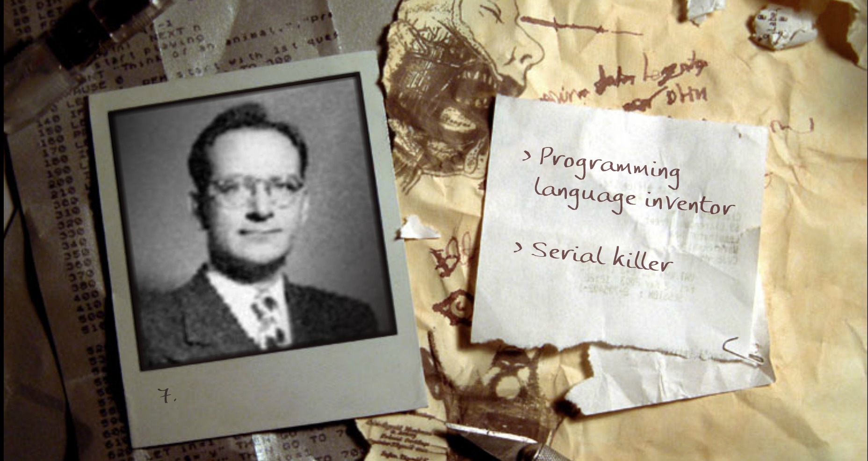
And now it’s time for your favorite game!
Notes:
John Mauchly – proposed shortcode, the first high-level programming language for an electronic computer, first run on a UNIVAC 1 Serial 1 in 1950

Slide 33
A New Type of Variable
Thus far, all variables we’ve defined have either been
local variables,
global variables
or class member variables.
Let’s learn about a new type of variable: a dynamic variable
void foo()
{
int a;
cin >> a;
}
int aGlobalVariable;
int main()
{
Circ a(3,4,10);
float c[10];
c[0] = a.getArea();
}
class Student
{
public:
string getZits()
{
int numZits = m_age * 5;
return(numZits);
}
private:
string m_name;
int m_age;
};

Slide 34
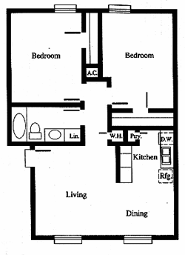


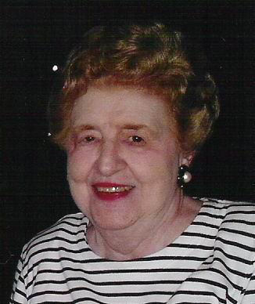

Dynamic Variables
You can think of traditional variables like rooms in your house.
Just like a room can hold a person, a variable holds a value.
?
But what if you run out of rooms because all of your aunts and uncles surprise you and come over.
?
In this case, you have to call a hotel, reserve some rooms, and place your relatives in the hotel rooms instead.

Slide 35
Dynamic Variables
In a similar fashion, sometimes you won’t know how many variables you’ll need until your program runs.
In this case, you can dynamically ask the operating system to reserve new memory for variables.
The operating system will allocate room for your variable in the computer’s free memory and then return the address of the new variable.
When you’re done with the variable, you can tell the operating system to free the space the variable occupies for someone else to use.

Slide 36
New and Delete (For Arrays)
For example, let’s say we want to define an array, but we won’t know how big to make it until our program actually runs …
int main()
{
int *arr;
int size;
cin >> size;
arr = new int[size];
arr[0] = 10;
arr[2] = 75;
delete [] arr;
}
The new command can be used to allocate an arbitrary amount of memory for an array.
Your pointer variable will then be assigned the address of the new array.
So it points to the new array!
#1
How do you use it?
1. First, define a new pointer variable.
Note: Don’t forget to include brackets
delete [ ] ptr;
if you’re deleting an array…
#2
2. Then determine the size of the array you need.
#3
3. Then use the new command to reserve the memory. Your pointer gets the address of the memory.
#4
4. Now use the pointer just like it’s an array!
#5
5. Free the memory when you’re done (check your relatives out of the hotel).

Slide 37
New and Delete (For Arrays)
int main()
{
int size, *arr;
cout << “how big? ”;
cin >> size;
arr = new int[size];
arr[0] = 10;
// etc
delete [] arr;
}
The new command requires two pieces of information:
1. What type of array you want to allocate.
2. How many slots you want in your array.
Make sure that the pointer’s type
is the same as the type of array you’re creating!

Slide 38
New and Delete (For Arrays)
int main()
{
int *arr;
int size;
cin >> size;
arr = new int[size];
arr[0] = 10;
// etc
delete [] arr;
}
…
arr
00001000
00001001
00001002
00001003
00001004
00001005
00001006
00001007
00001008
…
3
size
4
* 3
= 12 bytes
3
First, the new command determines how much memory it needs for the array.

Slide 39
New and Delete (For Arrays)
int main()
{
int *arr;
int size;
cin >> size;
arr = new int[size];
arr[0] = 10;
// etc
delete [] arr;
}
…
arr
00001000
00001001
00001002
00001003
00001004
00001005
00001006
00001007
00001008
…
Yo dawg – can you reserve 12 bytes of memory for me?
Ok, ok. Mr. Operating System… can you reserve 12 bytes of memory for me?
size
4
* 3
= 12 bytes
3
00030050
00030051
00030052
00030053
00030054
...
00030060
That’s better. Ok, I found 12 bytes of free memory at address 30050.
Yo Dawg? You will address me as Mr. Operating System or NO memory for you.
Next, the new command asks the operating system to reserve that many bytes of memory.
...

Slide 40
New and Delete (For Arrays)
int main()
{
int *arr;
int size;
cin >> size;
arr = new int[size];
arr[0] = 10;
// etc
delete [] arr;
}
…
arr
00001000
00001001
00001002
00001003
00001004
00001005
00001006
00001007
00001008
…
You can now treat your pointer just like an array!
(i.e. use [ ] to index it)
You can also use the * notation if you like (instead of brackets)
30050
size
4
* 3
= 12 bytes
3
*(arr+0) = 10; // arr[0] = 10;
*(arr+1) = 20; // arr[1] = 20;
00030050
00030051
00030052
00030053
00030054
...
00030060
10
Finally, your pointer variable gets the address of the newly reserved memory.
...

Slide 41
New and Delete (For Arrays)
… not the pointer variable itself! Our pointer variable still holds the address of the previously-reserved memory slots!
int main()
{
int *arr;
int size;
cin >> size;
arr = new int[size];
arr[0] = 10;
// etc
delete [] arr;
}
…
arr
00001000
00001001
00001002
00001003
00001004
00001005
00001006
00001007
00001008
…
30050
size
Operating System – I’m done with my 12 bytes of memory at location 30050.
3
Note: When you use the delete command, you free the pointed-to memory…
CRASH!
arr[0] = 50;
}
00030050
00030051
00030052
00030053
00030054
...
00030060
10
But they’re no longer reserved for this program! So don’t try to access them or bad things will happen!
Ok.. I’ll let someone else use that memory now…
When you’re done, you use the delete command to free the array.
Usage: delete [] ptrname;
...
Notes:
Note in this example that the pointer size is 4 bytes. This assumes that we are on a 32-bit system. With most systems today, you would see the pointer occupying 8 bytes of memory because systems today are 64-bit.
64 bits, with 8 bits per byte, means 8 bytes.
So because 64 bit systems can address 2^64 memory locations, we need pointers to occupy 8 bytes.

Slide 42
New and Delete (For Non-Arrays)
We can also use new and delete to dynamically create other types of variables as well!
int main()
{
}
For instance, we can allocate an integer variable like this…
Since we didn’t allocate an array up here!
Operating System – can you reserve 4 bytes of memory for me?
// define our pointer
int *ptr;
// allocate our dynamic variable
ptr = new int;
ptr
30050
00030050
00030051
00030052
00030053
00030054
...
00030060
// use our dynamic variable
*ptr = 42;
cout << *ptr << endl;
Notice that we don’t need the [] brackets when we delete here…
Operating System – I’m done with my 4 bytes of memory at location 30050.
42
Ok.. I’ll let someone else use that memory now…
Ok.. I found 4 bytes of free memory at address 30050.
// free our dynamic variable
delete ptr;
...

Slide 43
New and Delete (For Non-Arrays)
struct Point
{
int x;
int y;
};
We can also use new and delete to dynamically create other types of variables as well!
int main()
{
}
For instance, we can allocate an integer variable like this…
Operating System – can you reserve 8 bytes of memory for me?
// define our pointer
int *ptr;
// define our pointer
Point *ptr;
Or we can allocate a struct variable like this….
// allocate our dynamic variable
ptr = new int;
// allocate our dynamic variable
ptr = new Point;
// use our dynamic variable
*ptr = 42;
cout << *ptr << endl;
// use our dynamic variable
ptr->x = 10;
(*ptr).y = 20;
ptr
30050
Operating System – I’m done with my 8 bytes of memory at location 30050.
Ok.. I’ll let someone else use that memory now…
00030050
00030052
00030054
00030056
00030058
...
00030068
x
y
10
Ok.. I found 8 bytes of free memory at address 30050.
// free our dynamic variable
delete ptr;
20
// free our dynamic variable
delete ptr;
...

Slide 44
New and Delete (For Non-Arrays)
class Nerd
{
public:
Nerd(int IQ, int zits)
{
m_myIQ = IQ;
m_myZits = zits;
}
void saySomethingNerdy()
{
cout << “C++ rocks!”;
}
…
};
We can also use new and delete to dynamically create other types of variables as well!
int main()
{
}
For instance, we can allocate an integer variable like this…
// define our pointer
Point *ptr;
// define our pointer
Nerd *ptr;
Or we can allocate a struct variable like this….
// allocate our dynamic variable
ptr = new Point;
Then calls the Nerd constructor with these parameters to initialize it!
// allocate our dynamic variable
ptr = new Nerd(150, 1000);
// use our dynamic variable
ptr->x = 10;
(*ptr).y = 20;
Or we can even allocate a class instance like this….
// use our dynamic variable
ptr->saySomethingNerdy();
This allocates enough memory for a Nerd variable...
// free our dynamic variable
delete ptr;
// free our dynamic variable
delete ptr;

Slide 45
Using new and delete in a class
Step #2:
Update our constructor so the user can pass in the size of the nerd’s array.
Step #3:
Use the new command to allocate an array of the right size. Remember its size!
class PiNerd
{
public:
PiNerd() {
for (int j=0;j< 10 ;j++)
m_pi[j] = getPiDigit(j); }
void showOff()
{
for (int j=0;j< 10 ;j++)
cout << m_pi[j] << endl; }
private:
int m_pi[10];
};
Let’s assume we’re given a function that can give us any digit of π.
Step #4:
Update our loop so we compute the first n square numbers (instead of just the first 100)
So how we might use new/delete within a class?
PiNerd(int n) {
Well, here we have a class that represents people who like to memorize π – PiNerds!
Step #6:
Add a destructor that frees the dynamic array when we’re done!
m_pi = new int[n]; // alloc array
m_n = n; // store its size!
m_n
As you can see, right now Pi Nerds can only memorize up to the first 10 digits of π.
Cool! Now we can have PiNerds of varying nerdiness!
~PiNerd() {
delete [] m_pi; // free memory
}
Step #5:
Update our loop so we print out all N numbers.
Let’s update our class so they can memorize as many digits as they like!
Step #1:
Change our fixed array to a pointer variable and add a size variable.
int main()
{
PiNerd notSoNerdy(5);
PiNerd superNerdy(100);
notSoNerdy.showOff();
superNerdy.showOff();
}
m_n
int *m_pi, m_n;

Slide 46
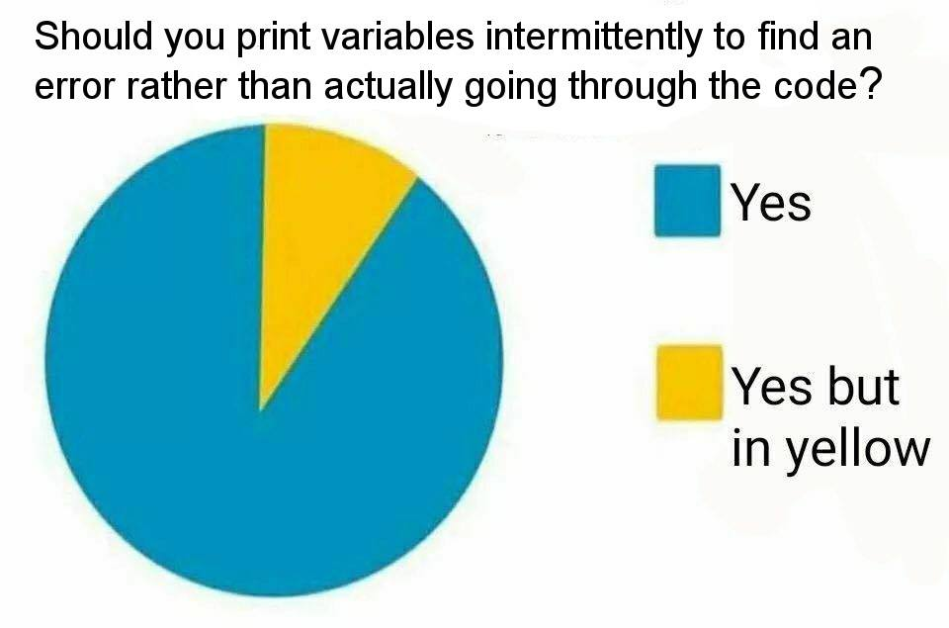
Copy Construction
* Note: This meme has nothing to do with copy construction.

Slide 47

Copy Construction… Why should you care?
Copy Construction is required in all nontrivial C++ programs.
If you fail to use it properly, it can result in nasty bugs and crashes.
So pay attention!

Slide 48
Copy Construction
class Circ
{
public:
float GetArea() const;
private:
float m_x, m_y, m_rad;
};
Last time we saw how to create a constructor function for a class…
Circ(float x, float y, float r)
{
m_x = x; m_y = y; m_rad = r;
}
Our simple constructor accepts three ints as arguments..
Question: Can constructors accept other types of variables as parameters?
Let’s see…

Slide 49
Copy Construction
class Circ
{
public:
float GetArea() const;
private:
float m_x, m_y, m_rad;
};
class Circ
{
public:
float GetArea() const;
private:
float m_x, m_y, m_rad;
};
For example, what if I have a Point class like this…
class Point // an x,y coordinate
{
public:
float m_x, m_y;
};
const means that our function can’t modify the pt variable.
The & means “pass by reference” which is more efficient.
Circ(float x, float y, float r)
{
m_x = x; m_y = y; m_rad = r;
}
If we like, we can define a Circ constructor that accepts a Point variable as an argument!
, float rad
Circ( )
{
}
const Point &pt
And of course, we still want our constructor to have a radius parameter…
m_x = pt.m_x;
m_y = pt.m_y;
m_rad = rad;
Finally, we can write our constructor’s body…
Allright, let’s see it in action…

Slide 50
Copy Construction
p
class Circ
{
public:
float GetArea() const;
private:
float m_x, m_y, m_rad;
};
class Circ
{
public:
float GetArea() const;
private:
float m_x, m_y, m_rad;
};
m_x
7
7
class Point // an x,y coordinate
{
public:
float m_x, m_y;
};
m_y
9
9
Circ(int x, int y, int r)
{
m_x = x; m_y = y; m_rad = r;
}
c
class Circ
{
...
Circ(const Point &pt,float rad)
{
m_x = pt.m_x;
m_y = pt.m_y;
m_rad = rad;
}
...
private:
m_x m_y m_rad
}
3
, float rad
int main()
{
Point p;
p.m_x = 7;
p.m_y = 9;
Circle c(p,3);
cout << c.getArea();
...
}
Circ( )
{
}
const Point &pt
m_x = pt.m_x;
m_y = pt.m_y;
m_rad = rad;
And now we have a fully constructed Circle!
3

Slide 51
Copy Construction
class Circ
{
public:
float GetArea() const;
private:
float m_x, m_y, m_rad;
};
That makes my head spin!
Circ(float x, float y, float r)
{
m_x = x; m_y = y; m_rad = r;
}
Ok, so we’ve seen a simple constructor…
This will allow us to initialize a new Circ variable (b) based on the value of an existing Circ variable (a).
, float rad
And a constructor that accepts another class’s variable…
Circ( )
{
}
const Point &pt
m_x = pt.m_x;
m_y = pt.m_y;
m_rad = rad;
What if we want to define a constructor for Circ that accepts another Circ variable??
Circ( )
{
}
Let’s see how to do it!
const Circ &old
m_x = old.m_x;
m_y = old.m_y;
m_rad = old.m_rad;
int main()
{
Circ a(1,2,3);
Circ b(a);
...
}

Slide 52
Copy Construction
But wait! Circ variable b is accessing the private variables/functions of Circ variable a – isn’t that violating C++ privacy rules?
class Circ
{
public:
float GetArea() const;
private:
float m_x, m_y, m_rad;
};
b
class Circ
{
...
Circ( const Circ &old )
{
m_x = old.m_x;
m_y = old.m_y;
m_rad = old.m_rad;
}
...
private:
m_x m_y m_rad
}
Circ(float x, float y, float r)
{
m_x = x; m_y = y; m_rad = r;
}
a
class Circ
{
...
Circ(float x, float y, float rad)
{
m_x = x;
m_y = y;
m_rad = rad;
}
...
private:
m_x m_y m_rad
}
Circ( )
{
}
const Point &pt
, float rad
Carey says:
That’s not a problem. Every Circ variable is allowed to “touch” every other Circ variable’s privates –
“private” protects one class from another, not one variable from another (of the same class)!
So every CSNerd object can touch every other CSNerd object’s privates.
But a CSNerd can’t touch an EENerd’s privates (for obvious reasons).
m_x = pt.m_x;
m_y = pt.m_y;
m_rad = rad;
This means:
“Initialize variable b based on the value of variable a.”
Circ( )
{
}
const Circ &old
3
1
2
3
1
2
m_x = old.m_x;
m_y = old.m_y;
m_rad = old.m_rad;
This kind of thing is actually pretty useful… It lets us create a new variable with the same value as an existing variable.
int main()
{
Circ a(1,2,3);
Circ b(a);
...
}
1
2
3

Slide 53
Copy Construction
class Circ
{
public:
float GetArea() const;
private:
float m_x, m_y, m_rad;
};
In C++ talk, this function is called a “copy constructor.”
Circ(float x, float y, float r)
{
m_x = x; m_y = y; m_rad = r;
}
A copy constructor is a
constructor function
that is used to
initialize a new variable from an existing variable
of the same type.
, float rad
Circ( )
{
}
const Point &pt
m_x = pt.m_x;
m_y = pt.m_y;
m_rad = rad;
Circ( )
{
}
const Circ &old
m_x = old.m_x;
m_y = old.m_y;
m_rad = old.m_rad;
int main()
{
Circ a(1,2,3);
Circ b(a);
...
}

Slide 54
Copy Construction
class Circ
{
public:
Circ(float x, float y, float r)
{
m_x = x; m_y = y; m_rad = r;
}
float GetArea()
{
return(3.14159*m_rad*m_rad);
}
private:
float m_x, m_y, m_rad;
};
int main()
{
Circ a(1,1,5);
Circ b(a);
cout << b.GetArea();
}
Circ(
const Circ & oldVar)
{
m_x = oldVar.m_x;
m_y = oldVar.m_y;
m_rad = oldVar.m_rad;
}
A Copy Constructor is just like a regular constructor.
However, it takes another instance of the same class as a parameter instead of regular values.

Slide 55
Copy Construction
This one’s a bit more difficult to explain right now.
For now, just make sure you use an & here!
This is a promise that you won’t modify the oldVar while constructing your new variable!
class Circ
{
public:
Circ(float x, float y, float r)
{
m_x = x; m_y = y; m_rad = r;
}
float GetArea()
{
return(3.14159*m_rad*m_rad);
}
private:
float m_x, m_y, m_rad;
};
The parameter to your copy constructor should be const!
The parameter to your copy constructor must be a reference!
Circ(
const Circ & oldVar)
{
m_x = oldVar.m_x;
m_y = oldVar.m_y;
m_rad = oldVar.m_rad;
}
oldVar.m_x = 10; // error ‘cause of const
The type of your parameter must be the same type as the class itself!

Slide 56
Copy Construction
Oh, C++ also allows you to use a simpler syntax…
Instead of writing:
Circ b(a);
which is ugly…
You can write:
Circ b = a;
It does exactly the same thing! It defines a new variable b and then calls the copy constructor!
class Circ
{
public:
Circ(float x, float y, float r)
{
m_x = x; m_y = y; m_rad = r;
}
float GetArea()
{
return(3.14159*m_rad*m_rad);
}
private:
float m_x, m_y, m_rad;
};
Circ(
const Circ & oldVar)
{
m_x = oldVar.m_x;
m_y = oldVar.m_y;
m_rad = oldVar.m_rad;
}
int main()
{
Circ a(1,2,3);
Circ b(a);
}
Circ b = a; // same!

Slide 57
Copy Construction
class Circ
{
public:
Circ(float x, float y, float r)
{
m_x = x; m_y = y; m_rad = r;
}
float GetArea()
{
return(3.14159*m_rad*m_rad);
}
private:
float m_x, m_y, m_rad;
};
The copy constructor is not just used when you initialize a new variable from an existing one:
Circ b(a);
Circ(
const Circ & oldVar)
{
m_x = oldVar.m_x;
m_y = oldVar.m_y;
m_rad = oldVar.m_rad;
}
It’s used any time you make a new copy of an existing class variable.
Can anyone think of other times when a copy constructor would be used?

Slide 58
Copy Construction
temp
class Circ
{
...
Circ(const Circ &old)
{
m_x = old.m_x;
m_y = old.m_y;
m_rad = old.m_rad;
}
...
private:
m_x m_y m_rad
}
class Circ
{
public:
Circ(float x, float y, float r)
{
m_x = x; m_y = y; m_rad = r;
}
float GetArea()
{
return(3.14159*m_rad*m_rad);
}
private:
float m_x, m_y, m_rad;
};
void foo(Circ temp)
{
cout << “Area is: “
<< temp.GetArea();
}
int main()
{
Circ a(1,2,10);
foo(a);
}
Wait a second!
We’re creating a new variable called temp and copying the value of a into it! Hmmm!!!
Circ(
const Circ & oldVar)
{
m_x = oldVar.m_x;
m_y = oldVar.m_y;
m_rad = oldVar.m_rad;
}
a
class Circ
{
...
Circ(float x, float y, float rad)
{
m_x = x;
m_y = y;
m_rad = rad;
}
...
private:
m_x m_y m_rad
}
Here’s a simple program that passes a circle to a function… Any guesses if/when the copy constructor is called?
Now that our temp variable has been copy-constructed, it can be used normally by our foo function!
2
2
10
1
10
1

Slide 59
Copy Construction
But then why would I ever need to define my own copy constructor?
b
m_x
class Circ
{
public:
Circ(float x, float y, float r)
{
m_x = x; m_y = y; m_rad = r;
}
float GetArea()
{
return(3.14159*m_rad*m_rad);
}
private:
float m_x, m_y, m_rad;
};
m_y
If you don’t define your own copy constructor…
m_rad
a
m_x
1
1
2
3
C++ will provide a default one for you…
It just copies all of the member variables from the old instance to the new instance…
m_y
2
m_rad
3
Circ(const Circ & oldVar)
{
m_x = oldVar.m_x;
m_y = oldVar.m_y;
m_rad = oldVar.m_rad;
}
This is called a “shallow copy.”
Carey says:
“Patience, grasshopper! I’ll show you in a minute!”
int main()
{
Circ a(1,2,3);
Circ b(a);
}

Slide 60

Copy Construction
Ok – so why would we ever need to write our own Copy Constructor function?
After all, C++ shallow copies all of the member variables for us automatically if we don’t write our own!
Well, we’ll see very soon.
But first, let’s go back to our PiNerd class…

Slide 61
The PiNerd Class
When constructed, it uses new to dynamically allocate an array to hold the first N digits of π.
class PiNerd
{
public:
PiNerd(int n) {
m_n = n;
m_pi = new int[n];
for (int j=0;j<n;j++)
m_pi[j] = getPiDigit(j); }
~PiNerd(){delete []m_pi;}
void showOff()
{
for (int j=0;j<m_n;j++)
cout << m_pi[j] << endl; }
private:
int *m_pi, m_n;
};
As you recall, every PiNerd memorizes the first N digits of π.
Also recall that PiNerd uses new and delete to dynamically allocate memory for its array of N digits.
Let’s see what happens when we use this class in a simple program.
And when it is destructed, it uses delete [] to release this array.

Slide 62
Copy Construction
Operating system, can you reserve 12 bytes of memory for me?
class PiNerd
{
public:
PiNerd(int n) {
m_n = n;
m_pi = new int[n];
for (int j=0;j<n;j++)
m_pi[j] = getPiDigit(j); }
~PiNerd(){delete []m_pi;}
void showOff()
{
for (int j=0;j<m_n;j++)
cout << m_pi[j] << endl; }
private:
int *m_pi, m_n;
};
int main()
{
PiNerd ann(3);
if (...)
{
PiNerd ben = ann;
...
}
ann.showOff();
}
3
ann
3
00000800
00000804
00000808
m_n
3
1
Sure, I’ll reserve 12 bytes for you at address 800.
m_pi
800
4

Slide 63
Copy Construction
Now, watch what happens when we create our new ben variable and shallow copy ann’s member variables into it…
class PiNerd
{
public:
PiNerd(int n) {
m_n = n;
m_pi = new int[n];
for (int j=0;j<n;j++)
m_pi[j] = getPiDigit(j); }
~PiNerd(){delete []m_pi;}
void showOff()
{
for (int j=0;j<m_n;j++)
cout << m_pi[j] << endl; }
private:
int *m_pi, m_n;
};
int main()
{
PiNerd ann(3);
if (...)
{
PiNerd ben = ann;
...
}
ann.showOff();
}
Point to ann’s original copy of the array!
Both ann’s m_pi pointer…
ann
3
00000800
00000804
00000808
m_n
3
1
m_pi
800
4
And ben’s m_pi pointer…
ben
m_n
3
m_pi
800

Slide 64
Copy Construction
But that’s a problem!
Because when ben is destructed…
class PiNerd
{
public:
PiNerd(int n) {
m_n = n;
m_pi = new int[n];
for (int j=0;j<n;j++)
m_pi[j] = getPiDigit(j); }
~PiNerd(){delete []m_pi;}
void showOff()
{
for (int j=0;j<m_n;j++)
cout << m_pi[j] << endl; }
private:
int *m_pi, m_n;
};
int main()
{
PiNerd ann(3);
if (...)
{
PiNerd ben = ann;
...
}
ann.showOff();
}
Operating system, I’m done with the memory at address 800.
It ends up deleting the array that’s really owned by variable ann!
// ben's d’tor called
ann
3
00000800
00000804
00000808
m_n
3
1
m_pi
800
4
ben
m_n
3
m_pi
800

Slide 65
Copy Construction
class PiNerd
{
public:
PiNerd(int n) {
m_n = n;
m_pi = new int[n];
for (int j=0;j<n;j++)
m_pi[j] = getPiDigit(j); }
~PiNerd(){delete []m_pi;}
void showOff()
{
for (int j=0;j<m_n;j++)
cout << m_pi[j] << endl; }
private:
int *m_pi, m_n;
};
int main()
{
PiNerd ann(3);
if (...)
{
PiNerd ben = ann;
...
}
ann.showOff();
}
Because now, when we try to access ann’s array, we get garbage!!!
// ben's d’tor called
ann
?
?
?
m_n
3
m_pi
800
That’s a big problem!

Slide 66
Copy Construction
So what’s the moral of the story?
And you make a shallow copy of a class instance…
class PiNerd
{
public:
PiNerd(int n) {
m_n = n;
m_pi = new int[n];
for (int j=0;j<n;j++)
m_pi[j] = getPiDigit(j); }
~PiNerd(){delete []m_pi;}
void showOff()
{
for (int j=0;j<m_n;j++)
cout << m_pi[j] << endl; }
private:
int *m_pi, m_n;
};
int main()
{
PiNerd ann(3);
if (...)
{
PiNerd ben = ann;
...
}
ann.showOff();
}
BAD THINGS will happen when you destruct either copy...
// ben's d’tor called
Any time your class holds pointer member variables*…
* or file objects (e.g., ifstream), network sockets, etc.

Slide 67
Copy Construction
So how do we fix this?
The old variable requires three slots of memory!
For such classes, you must define your own copy constructor!
Here’s how it works for
PiNerd ben = ann;
Determine how much memory is allocated by the old variable.
Allocate the same amount of memory in the new variable.
Copy the contents of the old variable to the new variable.
3
00000800
00000804
00000808
ann
m_n
3
1
m_pi
800
4
ben
m_n
3
00000700
00000704
00000708
3
1
m_pi
700
4

Slide 68
The Copy Constructor
This means: “The new instance must have the same number of array slots as the old instance.”
class PiNerd
{
public:
PiNerd(int n) { … }
~PiNerd(){ delete[]m_pi; }
// copy constructor
void showOff() { ... }
private:
int *m_pi, m_n;
};
int main()
{
PiNerd ann(3);
if (...)
{
PiNerd ben = ann;
...
}
ann.showOff();
}
PiNerd(const PiNerd &src)
{
}
First our copy constructor must determine how much memory is required by the new instance.
m_n = src.m_n;
Let’s see how to define our copy constructor!

Slide 69
The Copy Constructor
This ensures that the new instance has its own array and doesn’t share the old instance’s array!
class PiNerd
{
public:
PiNerd(int n) { … }
~PiNerd(){ delete[]m_pi; }
// copy constructor
void showOff() { ... }
private:
int *m_pi, m_n;
};
int main()
{
PiNerd ann(3);
if (...)
{
PiNerd ben = ann;
...
}
ann.showOff();
}
PiNerd(const PiNerd &src)
{
}
m_n = src.m_n;
m_pi = new int[m_n];
Next, our copy constructor must allocate its own copy of any dynamic memory!
Let’s see how to define our copy constructor!

Slide 70
The Copy Constructor
class PiNerd
{
public:
PiNerd(int n) { … }
~PiNerd(){ delete[]m_pi; }
// copy constructor
void showOff() { ... }
private:
int *m_pi, m_n;
};
int main()
{
PiNerd ann(3);
if (...)
{
PiNerd ben = ann;
...
}
ann.showOff();
}
This ensures that the new instance has its own copy of all of the array data!
PiNerd(const PiNerd &src)
{
}
m_n = src.m_n;
m_pi = new int[m_n];
for (int j=0;j<m_n;j++)
m_pi[j] = src.m_pi[j];
Finally, we have to manually copy over the contents of the original array to our new array.
Let’s see how to define our copy constructor!

Slide 71
The Copy Constructor
class PiNerd
{
public:
PiNerd(int n) { … }
~PiNerd(){ delete[]m_pi; }
// copy constructor
PiNerd(const PiNerd &src)
{
m_n = src.m_n;
m_pi = new int[m_n];
for (int j=0;j<m_n;j++)
m_pi[j] = src.m_pi[j];
}
void showOff() { ... }
private:
int *m_pi, m_n;
};
int main()
{
PiNerd ann(3);
if (...)
{
PiNerd ben = ann;
...
}
ann.showOff();
}
Operating system, the original variable needed 12 bytes of memory, so can you reserve 12 bytes for me too?
Now I’ll copy the values from the old array into my new array.
Sure, I’ll reserve 12 bytes for you at address 900.
src
3
00000800
00000804
00000808
ann
m_n
3
1
m_pi
800
4
ben
m_n
3
00000900
00000904
00000908
3
Let’s watch our correct copy constructor work!
1
m_pi
900
4

Slide 72
The Copy Constructor
Operating System, can you free the memory at address 900 for me?
class PiNerd
{
public:
PiNerd(int n) { … }
~PiNerd(){ delete[]m_pi; }
// copy constructor
PiNerd(const PiNerd &src)
{
m_n = src.m_n;
m_pi = new int[m_n];
for (int j=0;j<m_n;j++)
m_pi[j] = src.m_pi[j];
}
void showOff() { ... }
private:
int *m_pi, m_n;
};
int main()
{
PiNerd ann(3);
if (...)
{
PiNerd ben = ann;
...
}
ann.showOff();
}
3
1
4
// ben's d’tor called
ann
3
00000800
00000804
00000808
m_n
3
No sweat, homie. Consider it freed.
1
m_pi
800
4
ben
m_n
3
00000900
00000904
00000908
3
We’re A-OK, since ann still has its own array!
1
m_pi
900
4

