Slide 1

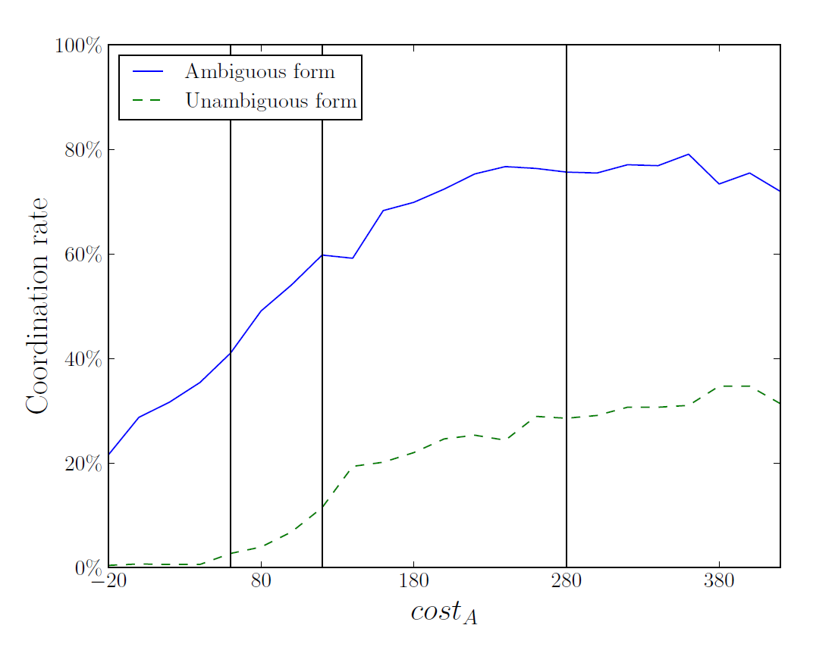
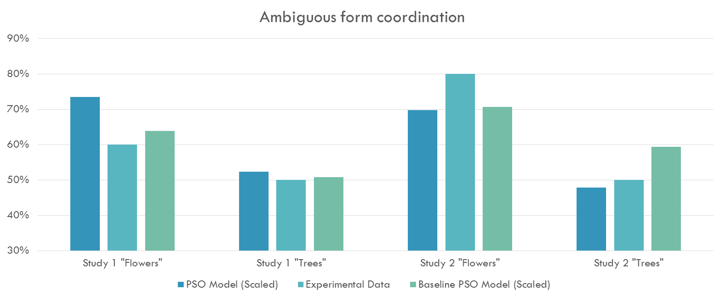
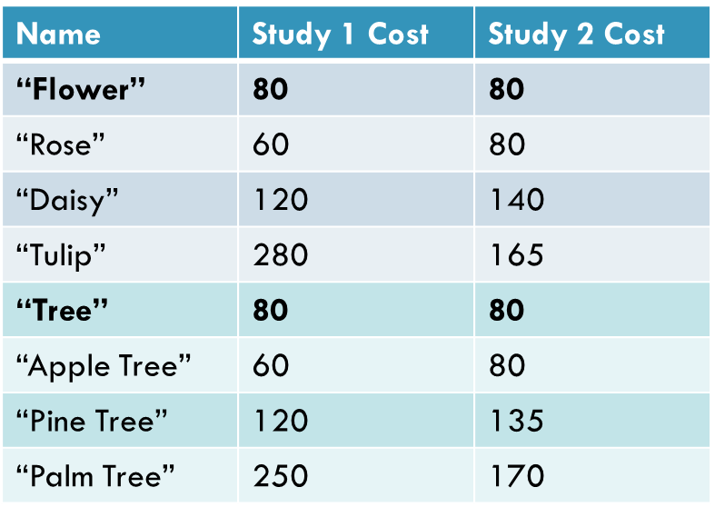
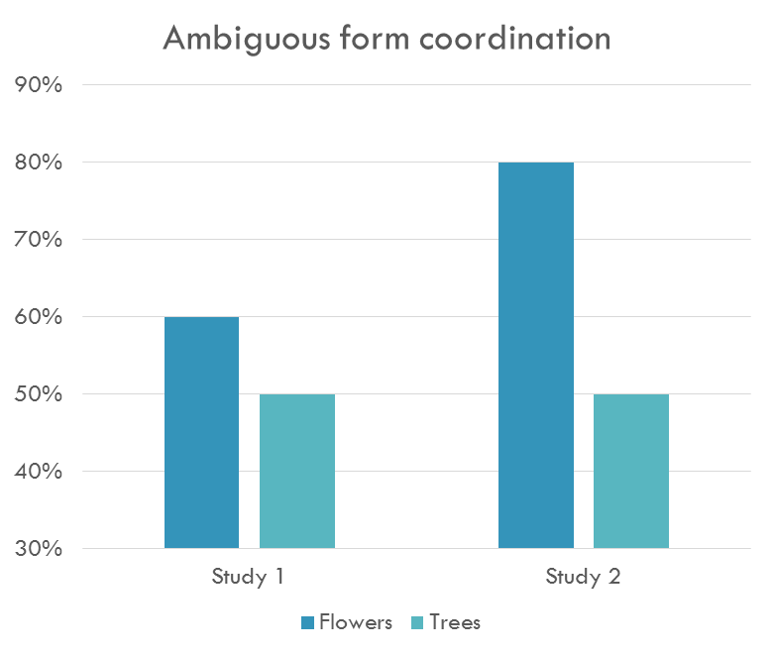
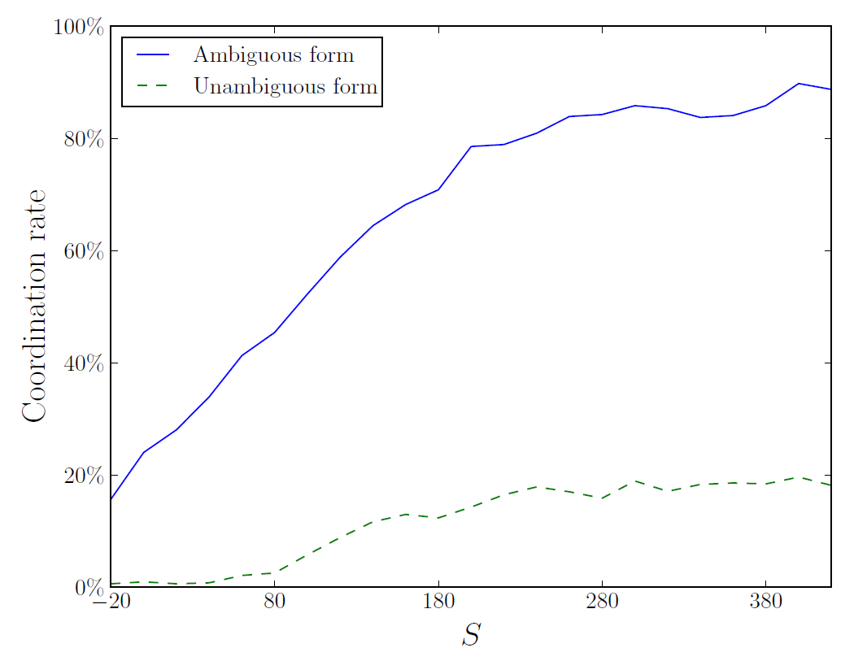
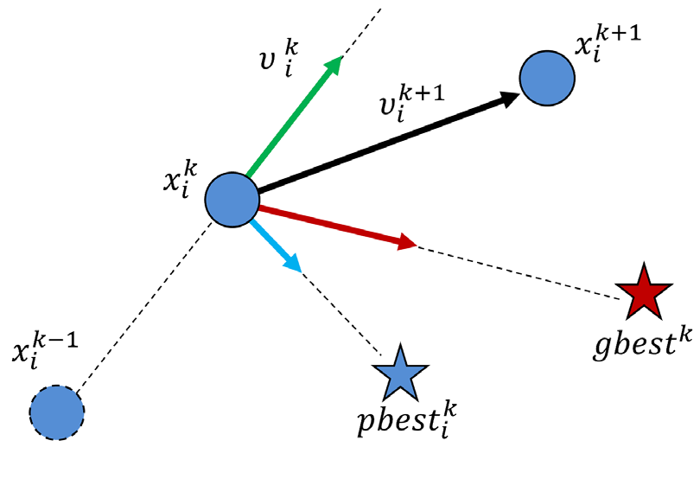
Proceedings of the 19th Workshop on the Semantics and Pragmatics of Dialogue, 24-26th August 2015, University of Gothenburg
Modeling Referential Coordination as a Particle Swarm Optimization Task
H. Chase Stevens & Hannah Rohde
Abstract
4. Applying PSO to Rohde et al. 2012
8. Results – predictions varying ambiguous form cost
The question of how referential choice and interpretation are influenced by production cost remains unresolved in the literature. Recent research (Rohde et al., 2012; Degen & Franke, 2012; Frank & Goodman, 2012) investigates the conditions under which speakers coordinate the use of ambiguous expressions.
We take a novel approach to modeling referential coordination by simulating the results of one such study on referring expression costs (Rohde et al., 2012). The simulation uses a general-purpose optimization method, particle swarm optimization, to capture the previously reported referential choices and to extrapolate to new communicative conditions.
Our results replicate observed overinformativity behaviors (Brennan & Clark, 1996) and demonstrate that dyadic referential coordination can be framed as a constrained optimization problem in which agents may need only to maintain a simplified representation of the common ground and of each other.
Agents’ strategies modeled as sets of probabilities
Each dimension of search space represents preference of an agent to use ambiguous referring expression instead of given unambiguous referring expression
Pairs of interlocutors modelled as 2-particle swarms
Fitness of a referential strategy is evaluated with regards to costs and rewards defined by language game, in conjunction with likelihood of successful communication dictated by partner’s referential strategy
Full-stop prompt: IC verbs yield more Explanation continuations than Non-IC
1. Goal
6. Results – replicating previous findings
Study 1 “Flower” context with ambiguous form cost varied; lines indicate costs for unambiguous forms. We suggest the positive trend here reflects higher ambiguous form cost more readily indicating which unambiguous forms it should supplant and ergo facilitating dyadic coordination.
To understand the influence of production cost on referential coordination, specifically, coordination in a setting allowing the use of both high-cost unambiguous forms and low-cost ambiguous forms.
Our PSO-based model, parameterized using optimized values, is able to successfully capture the relative effects of varying form costs on referential coordination rate observed by Rohde et al.
2. Previous work on referential coordination
9. Conclusions
Rohde et al. (2012) present an iterated referential coordination language game in which players attempt to indicate an object to their partner via one of several possible referring expressions, spending points to communicate but gaining points when communication is successful.
Our PSO-based model captures and extrapolates beyond experimentally observed behavior, enabling exploration of the influence of form costs on referential coordination and production
Our use of PSO suggests that referential coordination can be explained in terms of a generalized optimization process – a finding in keeping with more egocentric models of communication (Horton & Keysar, 1996)
Our model suggests a lower bound for how complex agents must be in order to respond to variations in form costs in a similar manner to humans
p(Explanation | IC ) > p(Explanation | Non-IC)
Additionally, agents in our model capture the overinformativity behavior noted in Brennan and Clark, in which human participants continued the use of forms on which they had been entrained, even when a change in the discourse context permitted the use of less costly forms.
10. References
Brennan, S. E., & Clark, H. H. (1996). Conceptual pacts and lexical choice in conversation. Journal of Experimental Psychology: Learning, Memory, and Cognition, 22 (6), 1482.
Degen, J., & Franke, M. (2012). Optimal reasoning about referential expressions. Proceedings of SemDIAL.
Frank, M. C., & Goodman, N. D. (2012). Predicting pragmatic reasoning in language games. Science, 336 (6084), 998-998.
Horton, W. S., & Keysar, B. (1996). When do speakers take into account common ground? Cognition, 59 (1), 91-117.
Kennedy, J., & Eberhart, R. (1995). Particle swarm optimization. In IEEE international conference on neural networks, 1995. Proceedings. (Vol. 4, p. 1942-1948). doi: 10.1109/ICNN.1995.488968
Rohde, H., et al. (2012). Communicating with cost-based implicature: A game-theoretic approach to ambiguity. In The 16th workshop on the semantics and pragmatics of dialogue. Paris.
3. Particle Swarm Optimization
7. Results – predictions varying reward
PSO represents potential solutions for maximizing an objective function as particle positions existing within a multidimensional space. Over a number of iterations, increasingly suitable solutions are found as particles explore this space, their paths influenced by the thus far best-found solutions (Kennedy & Eberhart, 1995).
In keeping with findings from Rohde et al., our PSO model predicts higher rates of coordination when agents are more greatly rewarded for successful communication, which is speculated to promote exploration of the space.
Noto et al. (2013). Agent-based Social Simulation Model for Analyzing Human Behaviours using Particle Swarm Optimization.
Contact: chase@chasestevens.com

