Slide 1
Multi-Hypothesis
A clear explanation

Slide 2
Multi-Hypothesis representation
local hypotheses(hypotheses trees) representation
global weights
hypotheses look-up table
local hypotheses forest
global hypotheses representation
global weights
global hypotheses

Slide 3



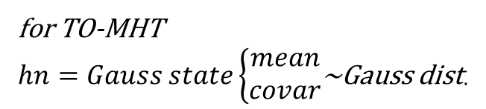


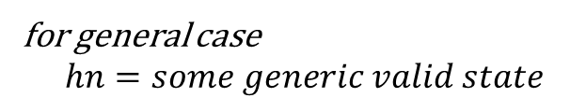

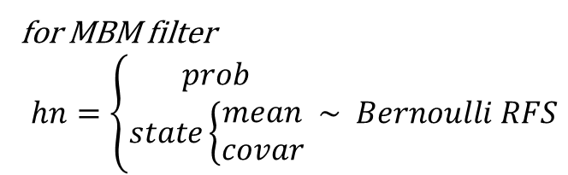


$$global weights$$
$$lookup table$$
$$hypotheses forest$$
w1
w2
w3
w4
w5
w6
1 | 1 | 1 | 1
1 | 0 | 0 | 1
1 | 3 | 2 | 1
2 | 1 | 4 | 3
1 | 2 | 1 | 1
2 | 0 | 1 | 1
h1 | h1 | h1 | h1
h2 | h2 | h2 | h2
 | h3 | h3 | h3
 |  | h4
for MBM filter
$$hn=\left\{\begin{aligned}prob \\ state\left\{\begin{aligned}mean \\ covar\end{aligned}\right.\end{aligned} \sim Bernoulli RFS\right.$$
$$\#mixture components$$
for TO-MHT
$hn=Gauss state\left\{\begin{aligned}mean \\ covar\end{aligned}\right.$~Gauss dist.
for general case
$$hn=some generic valid state$$
$$\#hypotheses trees$$
$$\#hypotheses trees$$
h1 h1 h1 h1
$$multi Bernoulli$$
w1
h1 h1 h1 h1
$$weighted multi Bernoulli$$

Slide 4

$$global weights$$
$$lookup table$$
$$hypotheses forest$$
w1
w2
w3
w4
w5
w6
1 | 1 | 1 | 1
1 | 0 | 0 | 1
1 | 3 | 2 | 1
2 | 1 | 4 | 3
1 | 2 | 1 | 1
2 | 0 | 1 | 1
h1 | h1 | h1 | h1
h2 | h2 | h2 | h2
 | h3 | h3 | h3
 |  | h4
$$hn=\left\{\begin{aligned}prob \\ state\left\{\begin{aligned}mean \\ covar\end{aligned}\right.\end{aligned} \sim Bernoulli RFS\right.$$
$$\#mixture components$$
$$\#hypotheses trees$$
$$\#hypotheses trees$$
h1 h2 h1 h1
$$multi Bernoulli$$
w1
h1 h1 h1 h1
w2
h1 h2 h1 h1
$$weighted multi Bernoulli$$

Slide 5

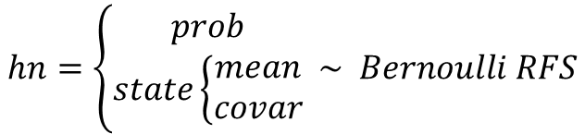
$$global weights$$
$$lookup table$$
$$hypotheses forest$$
w1
w2
w3
w4
w5
w6
1 | 1 | 1 | 1
1 | 0 | 0 | 1
1 | 3 | 2 | 1
2 | 1 | 4 | 3
1 | 2 | 1 | 1
2 | 0 | 1 | 1
h1 | h1 | h1 | h1
h2 | h2 | h2 | h2
 | h3 | h3 | h3
 |  | h4
$$hn=\left\{\begin{aligned}prob \\ state\left\{\begin{aligned}mean \\ covar\end{aligned}\right.\end{aligned} \sim Bernoulli RFS\right.$$
$$\#mixture components$$
$$\#hypotheses trees$$
$$\#hypotheses trees$$
h1 h3 h2 h1
$$multi Bernoulli$$
w1
h1 h1 h1 h1
w2
h1 h2 h1 h1
w3
h1 h3 h2 h1
$$weighted multi Bernoulli$$

Slide 6

$$global weights$$
$$lookup table$$
$$hypotheses forest$$
w1
w2
w3
w4
w5
w6
1 | 1 | 1 | 1
1 | 0 | 0 | 1
1 | 3 | 2 | 1
2 | 1 | 4 | 3
1 | 2 | 1 | 1
2 | 0 | 1 | 1
h1 | h1 | h1 | h1
h2 | h2 | h2 | h2
 | h3 | h3 | h3
 |  | h4
$$hn=\left\{\begin{aligned}prob \\ state\left\{\begin{aligned}mean \\ covar\end{aligned}\right.\end{aligned} \sim Bernoulli RFS\right.$$
$$\#mixture components$$
$$\#hypotheses trees$$
$$\#hypotheses trees$$
h2 h1 h4 h3
$$multi Bernoulli$$
w1
h1 h1 h1 h1
w2
h1 h2 h1 h1
w3
h1 h3 h2 h1
w4
h2 h1 h4 h3
$$weighted multi Bernoulli$$

Slide 7

$$global weights$$
$$lookup table$$
$$hypotheses forest$$
w1
w2
w3
w4
w5
w6
1 | 1 | 1 | 1
1 | 0 | 0 | 1
1 | 3 | 2 | 1
2 | 1 | 4 | 3
1 | 2 | 1 | 1
2 | 0 | 1 | 1
h1 | h1 | h1 | h1
h2 | h2 | h2 | h2
 | h3 | h3 | h3
 |  | h4
$$hn=\left\{\begin{aligned}prob \\ state\left\{\begin{aligned}mean \\ covar\end{aligned}\right.\end{aligned} \sim Bernoulli RFS\right.$$
$$\#mixture components$$
$$\#hypotheses trees$$
$$\#hypotheses trees$$
h1 h2 h1 h1
$$multi Bernoulli$$
w1
h1 h1 h1 h1
w2
h1 h2 h1 h1
w3
h1 h3 h2 h1
w4
h2 h1 h4 h3
w5
h1 h2 h1 h1
$$weighted multi Bernoulli$$

Slide 8

$$global weights$$
$$lookup table$$
$$hypotheses forest$$
w1
w2
w3
w4
w5
w6
1 | 1 | 1 | 1
1 | 0 | 0 | 1
1 | 3 | 2 | 1
2 | 1 | 4 | 3
1 | 2 | 1 | 1
2 | 0 | 1 | 1
h1 | h1 | h1 | h1
h2 | h2 | h2 | h2
 | h3 | h3 | h3
 |  | h4
$$hn=\left\{\begin{aligned}prob \\ state\left\{\begin{aligned}mean \\ covar\end{aligned}\right.\end{aligned} \sim Bernoulli RFS\right.$$
$$\#mixture components$$
$$\#hypotheses trees$$
$$\#hypotheses trees$$
h2 h2 h1 h1
$$multi Bernoulli$$
w1
h1 h1 h1 h1
w2
h1 h2 h1 h1
w3
h1 h3 h2 h1
$$multi Bernoulli mixture(MBM)$$
w4
h2 h1 h4 h3
w5
h1 h2 h1 h1
w6
h2 h2 h1 h1

Slide 9

$$global weights$$
$$lookup table$$
$$hypotheses forest$$
w1
w2
w3
w4
w5
w6
1 | 1 | 1 | 1
1 | 0 | 0 | 1
1 | 3 | 2 | 1
2 | 1 | 4 | 3
1 | 2 | 1 | 1
2 | 0 | 1 | 1
h1 | h1 | h1 | h1
h2 | h2 | h2 | h2
 | h3 | h3 | h3
 |  | h4
$$hn=\left\{\begin{aligned}prob \\ state\left\{\begin{aligned}mean \\ covar\end{aligned}\right.\end{aligned} \sim Bernoulli RFS\right.$$
$$\#mixture components$$
$$delete unused leaves$$
$$\#hypotheses trees$$
$$\#hypotheses trees$$
h2 h2 h1 h1
$$multi Bernoulli$$
w1
h1 h1 h1 h1
w2
h1 h2 h1 h1
w3
h1 h3 h2 h1
$$multi Bernoulli mixture(MBM)$$
w4
h2 h1 h4 h3
w5
h1 h2 h1 h1
w6
h2 h2 h1 h1

Slide 10
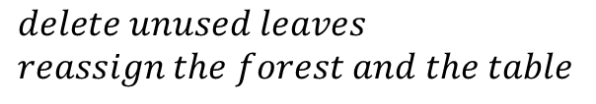
$$global weights$$
$$lookup table$$
$$hypotheses forest$$
w1
w2
w3
w4
w5
w6
1 | 1 | 1 | 1
1 | 0 | 0 | 1
1 | 3 | 2 | 1
2 | 1 | 3 | 2
1 | 2 | 1 | 1
2 | 0 | 1 | 1
h1 | h1 | h1 | h1
h2 | h2 | h2 | h2
 | h3 | h3
$$hn=\left\{\begin{aligned}prob \\ state\left\{\begin{aligned}mean \\ covar\end{aligned}\right.\end{aligned} \sim Bernoulli RFS\right.$$
$$\#mixture components$$
$$delete unused leaves$$
$$reassign the forest and the table$$
$$\#hypotheses trees$$
$$\#hypotheses trees$$
h2 h2 h1 h1
$$multi Bernoulli$$
w1
h1 h1 h1 h1
w2
h1 h2 h1 h1
w3
h1 h3 h2 h1
$$multi Bernoulli mixture(MBM)$$
w4
h2 h1 h3 h2
w5
h1 h2 h1 h1
w6
h2 h2 h1 h1

Slide 11

$$global weights$$
$$lookup table$$
$$hypotheses forest$$
w1
w2
w3
w4
w5
w6
1 | 1 | 1 | 1
1 | 0 | 0 | 1
1 | 3 | 2 | 1
2 | 1 | 3 | 2
1 | 2 | 1 | 1
2 | 0 | 1 | 1
h1 | h1 | h1 | h1
h2 | h2 | h2 | h2
 | h3 | h3
$$hn=\left\{\begin{aligned}prob \\ state\left\{\begin{aligned}mean \\ covar\end{aligned}\right.\end{aligned} \sim Bernoulli RFS\right.$$
$$\#mixture components$$
$$delete unused leaves$$
$$reassign the forest and the table$$
MBM has three parts in hypotheses
trees representation:
global weights
lookup table
hypotheses forest
$$\#hypotheses trees$$
$$\#hypotheses trees$$
h2 h2 h1 h1
$$multi Bernoulli$$
w1
h1 h1 h1 h1
w2
h1 h2 h1 h1
w3
h1 h3 h2 h1
$$MBM$$
w4
h2 h1 h3 h2
w5
h1 h2 h1 h1
w6
h2 h2 h1 h1

Slide 12
$$global weights$$
$$lookup table$$
$$hypotheses forest$$
w1
w2
w3
w4
w5
w6
1 | 1 | 1 | 1
1 | 0 | 0 | 1
1 | 3 | 2 | 1
2 | 1 | 3 | 2
1 | 2 | 1 | 1
2 | 0 | 1 | 1
h1 | h1 | h1 | h1
h2 | h2 | h2 | h2
 | h3 | h3
$$hn=\left\{\begin{aligned}prob \\ state\left\{\begin{aligned}mean \\ covar\end{aligned}\right.\end{aligned} \sim Bernoulli RFS\right.$$
$$\#mixture components$$
$$delete unused leaves$$
$$reassign the forest and the table$$
MBM has three parts in hypotheses
trees representation:
global weights
lookup table
hypotheses forest
$$\#hypotheses trees$$
$$\#hypotheses trees$$
h2 h2 h1 h1
$$multi Bernoulli$$
w1
h1 h1 h1 h1
MBM has two parts in global hypotheses
representation:
global weights
global hypotheses
w2
h1 h2 h1 h1
w3
h1 h3 h2 h1
$$MBM$$
w4
h2 h1 h3 h2
w5
h1 h2 h1 h1
w6
h2 h2 h1 h1

Slide 13
$$global weights$$
$$lookup table$$
$$hypotheses forest$$
w1
w2
w3
w4
w5
w6
1 | 1 | 1 | 1
1 | 0 | 0 | 1
1 | 3 | 2 | 1
2 | 1 | 3 | 2
1 | 2 | 1 | 1
2 | 0 | 1 | 1
h1 | h1 | h1 | h1
h2 | h2 | h2 | h2
 | h3 | h3
$$hn=\left\{\begin{aligned}prob \\ state\left\{\begin{aligned}mean \\ covar\end{aligned}\right.\end{aligned} \sim Bernoulli RFS\right.$$
$$\#mixture components$$
$$delete unused leaves$$
$$reassign the forest and the table$$
MBM has three parts in hypotheses
trees representation:
global weights
lookup table
hypotheses forest
$$\#hypotheses trees$$
$$\#hypotheses trees$$
h2 h2 h1 h1
$$multi Bernoulli$$
w1
h1 h1 h1 h1
MBM has two parts in global hypotheses
representation:
global weights
global hypotheses
w2
h1 h2 h1 h1
w3
h1 h3 h2 h1
$$MBM$$
w4
h2 h1 h3 h2
As you can see, the global hypotheses
representation has many duplicated
local states. So we prefer the hypotheses
trees representation.
w5
h1 h2 h1 h1
w6
h2 h2 h1 h1

Slide 14
Multi-Hypothesis predict(local hypo. repr.)
local hypotheses(forest) predict
for each local hypo. in each hypo. tree
predict local hypo.
global weights / look-up table don’t change.

Slide 15









$$global weights$$
$$hypotheses forest$$
$$timestamp=k$$
w1
w2
w3
w4
w5
w6
1 | 1 | 1 | 1
1 | 0 | 0 | 1
1 | 3 | 2 | 1
2 | 1 | 3 | 2
1 | 2 | 1 | 1
2 | 0 | 1 | 1
h1 | h1 | h1 | h1
h2 | h2 | h2 | h2
 | h3 | h3
$$hn=generic state$$
$$\#mixture components$$
$$multi hypotheses$$
$$global weights$$
$$hypotheses forest prediction$$
$$timestamp=k+1$$
w1
w2
w3
w4
w5
w6
1 | 1 | 1 | 1
1 | 0 | 0 | 1
1 | 3 | 2 | 1
2 | 1 | 3 | 2
1 | 2 | 1 | 1
2 | 0 | 1 | 1
h1 | h1 | h1 | h1
h2 | h2 | h2 | h2
 | h3 | h3
$$hn=generic state$$
$$\#mixture components$$
$$multi hypotheses prediction$$

Slide 16
Multi-Hypothesis update(local hypo. repr.)
local hypotheses(forest) update
for each local hypo. in each hypo. tree
gating(ellipsoidal gating in Gaussian state)
update hypo. and associated measurement log-likelihood with missed detection and associated measurements in gate
resulted in [#meas in gate + 1(missed hypo)] updated hypos and measurement log-likelihoods correspondingly
global weights / look-up table / hypo. forest update
for each predicted global hypothesis
create cost matrix for data association(DA)(use the associated measurement log-likelihoods calculated before)
Murty DA
update global weights / look-up table / hypo. forest

Slide 17



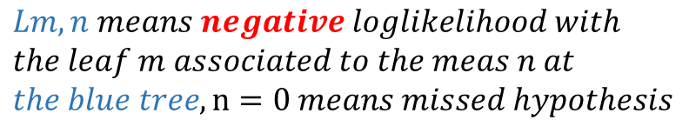
$$global weights$$
$$lookup table$$
$$hypotheses forest$$
$$timestamp=k$$
w1
w2
w3
w4
w5
w6
1 | 1 | 1 | 1
1 | 0 | 0 | 1
1 | 3 | 2 | 1
2 | 1 | 3 | 2
1 | 2 | 1 | 1
2 | 0 | 1 | 1
h1 | h1 | h1 | h1
h2 | h2 | h2 | h2
 | h3 | h3
$$hn=generic state$$
$$\#mixture components$$
$$multi hypotheses$$
$$timestamp=k+1$$
$$new measurements: z1,z2$$
$$hypotheses forest$$
$$leaves update$$
$$association negative log likelihoods$$
h1 | h1 | h1 | h1
h2 | h2 | h2 | h2
 | h3 | h3
h1,0 | h1,0 | h1,0 | h1,0
h1+z1 | h1+z1 | h1+z1 | h1+z1
h1+z2 | h1+z2 | h1+z2 | h1+z2
h2,0 | h2,0 | h2,0 | h2,0
h2+z1 | h2+z1 | h2+z1 | h2+z1
h2+z2 | h2+z2 | h2+z2 | h2+z2
 | h3,0 | h3,0
 | h3+z1 | h3+z1
 | h3+z2 | h3+z2
L1,0 | L1,1 | L1,2
L2,0 | L2,1 | L2.2
L1,0 | L1,1 | L1,2
L2,0 | L2,1 | L2.2
L3,0 | L3,1 | L3.2
L1,0 | L1,1 | L1,2
L2,0 | L2,1 | L2.2
L3,0 | L3,1 | L3.2
L1,0 | L1,1 | L1,2
L2,0 | L2,1 | L2.2
$$Lm,n means negative loglikelihood with$$
$$the leaf m associated to the meas n at$$
$$the blue tree, n=0 means missed hypothesis$$

Slide 18









$$timestamp=k+1$$
$$new measurements: z1,z2$$
$$hypotheses forest$$
$$leaves update$$
$$association log likelihood$$
h1 | h1 | h1 | h1
h2 | h2 | h2 | h2
 | h3 | h3
h1 | h1 | h1 | h1
h2 | h2 | h2 | h2
h3 | h3 | h3 | h3
h4 | h4 | h4 | h4
h5 | h5 | h5 | h5
h6 | h6 | h6 | h6
 | h7 | h7
 | h8 | h8
 | h9 | h9
L1,0 | L1,1 | L1,2
L2,0 | L2,1 | L2.2
L1,0 | L1,1 | L1,2
L2,0 | L2,1 | L2.2
L3,0 | L3,1 | L3.2
L1,0 | L1,1 | L1,2
L2,0 | L2,1 | L2.2
L3,0 | L3,1 | L3.2
L1,0 | L1,1 | L1,2
L2,0 | L2,1 | L2.2
$$global weights$$
$$lookup table$$
$$cost matrix:size\left[\#trees, \#trees+\#meas\right]=[4, 4+2]$$
w1
w2
w3
w4
w5
w6
1 | 1 | 1 | 1
1 | 0 | 0 | 1
1 | 3 | 2 | 1
2 | 1 | 3 | 2
1 | 2 | 1 | 1
2 | 0 | 1 | 1
L1,1 | L1,2 | L1,0 | Inf | Inf | Inf
L1,1 | L1.2 | Inf | L1,0 | Inf | Inf
L1,1 | L1.2 | Inf | Inf | L1,0 | Inf
L1,1 | L1.2 | Inf | Inf | Inf | L1,0
1 | 2
4 | 1
2 | 5
6 | 6
Murty DA
$$DA matrix$$
NOTE: ele. in DA matrix > #trees
means missed DA
$$obj. DA mat.$$
$$missed DA mat.$$

Slide 19
$$timestamp=k+1$$
$$new measurements: z1,z2$$
$$hypotheses forest$$
$$leaves update$$
$$association log likelihood$$
h1 | h1 | h1 | h1
h2 | h2 | h2 | h2
 | h3 | h3
h1 | h1 | h1 | h1
h2 | h2 | h2 | h2
h3 | h3 | h3 | h3
h4 | h4 | h4 | h4
h5 | h5 | h5 | h5
h6 | h6 | h6 | h6
 | h7 | h7
 | h8 | h8
 | h9 | h9
L1,0 | L1,1 | L1,2
L2,0 | L2,1 | L2.2
L1,0 | L1,1 | L1,2
L2,0 | L2,1 | L2.2
L3,0 | L3,1 | L3.2
L1,0 | L1,1 | L1,2
L2,0 | L2,1 | L2.2
L3,0 | L3,1 | L3.2
L1,0 | L1,1 | L1,2
L2,0 | L2,1 | L2.2
$$global weights$$
$$lookup table$$
$$cost matrix:size\left[\#trees, \#trees+\#meas\right]=[4, 4+2]$$
w1
w2
w3
w4
w5
w6
1 | 1 | 1 | 1
1 | 0 | 0 | 1
1 | 3 | 2 | 1
2 | 1 | 3 | 2
1 | 2 | 1 | 1
2 | 0 | 1 | 1
L2,1 | L2,2 | L2,0 | Inf | Inf | Inf
L1,1 | L1.2 | Inf | L1,0 | Inf | Inf
L3,1 | L3.2 | Inf | Inf | L3,0 | Inf
L2,1 | L2.2 | Inf | Inf | Inf | L2,0
1 | 2
4 | 1
2 | 5
6 | 6
Murty DA
$$DA matrix$$
NOTE: ele. in DA matrix > #meas
means missed DA
$$obj. DA mat.$$
$$missed DA mat.$$

Slide 20
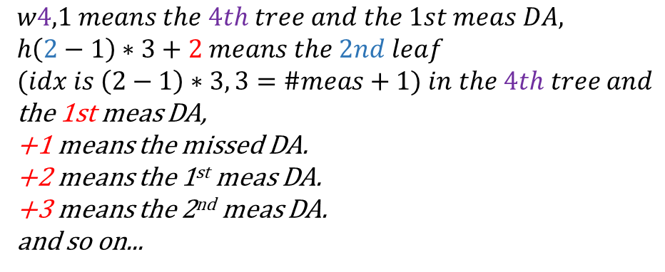




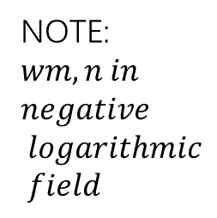

$$global weights$$
$$lookup table$$
$$cost matrix:size\left[\#trees, \#trees+\#meas\right]=[4, 4+2]$$
w1
w2
w3
w4
w5
w6
1 | 1 | 1 | 1
1 | 0 | 0 | 1
1 | 3 | 2 | 1
2 | 1 | 3 | 2
1 | 2 | 1 | 1
2 | 0 | 1 | 1
L2,1 | L2,2 | L2,0 | Inf | Inf | Inf
L1,1 | L1.2 | Inf | L1,0 | Inf | Inf
L3,1 | L3.2 | Inf | Inf | L3,0 | Inf
L2,1 | L2.2 | Inf | Inf | Inf | L2,0
1 | 2
4 | 1
2 | 5
6 | 6
Murty DA
$$cost1=L2,1+L1,0+L3,2+L2,0$$
NOTE: $Lm,n in negative logarithmic field$
$$w4,1=w4−cost1$$
w4,1 | h(2-1)*3+2 | h(1-1)*3+1 | h(3-1)*3+3 | h(2-1)*3+1
$$leaves update$$
NOTE: $wm,n in$
$$negative$$
$$logarithmic$$
$$field$$
h1 | h1 | h1 | h1
h2 | h2 | h2 | h2
h3 | h3 | h3 | h3
h4 | h4 | h4 | h4
h5 | h5 | h5 | h5
h6 | h6 | h6 | h6
 | h7 | h7
 | h8 | h8
 | h9 | h9
$$w4,1 means the 4th tree and the 1st meas DA,$$
$$h\left(2−1\right)∗3+2 means the 2nd leaf$$
$$(idx is \left(2−1\right)∗3, 3=\#meas+1) in the 4th tree and$$
the 1st meas DA,
+1 means the missed DA.
+2 means the 1st meas DA.
+3 means the 2nd meas DA.
and so on...

Slide 21


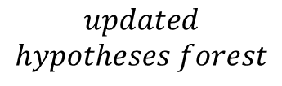
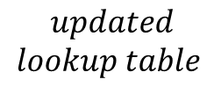
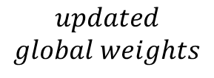

$$global weights$$
$$lookup table$$
$$cost matrix:size\left[\#trees, \#trees+\#meas\right]=[4, 4+2]$$
w1
w2
w3
w4
w5
w6
1 | 1 | 1 | 1
1 | 0 | 0 | 1
1 | 3 | 2 | 1
2 | 1 | 3 | 2
1 | 2 | 1 | 1
2 | 0 | 1 | 1
L2,1 | L2,2 | L2,0 | Inf | Inf | Inf
L1,1 | L1.2 | Inf | L1,0 | Inf | Inf
L3,1 | L3.2 | Inf | Inf | L3,0 | Inf
L2,1 | L2.2 | Inf | Inf | Inf | L2,0
1 | 2
4 | 1
2 | 5
6 | 6
Murty DA
$$cost2=L2,2+L1,1+L3,5+L2,6$$
NOTE: $Lm,n in negative logarithmic field$
$$w4,1=w4−cost1$$
w4,1 | h(2-1)*3+2 | h(1-1)*3+1 | h(3-1)*3+3 | h(2-1)*3+1
w4,2 | h(2-1)*3+3 | h(1-1)*3+3 | h(3-1)*3+1 | h(2-1)*3+1
$$w4,2=w4−cost2$$
$$leaves update$$
NOTE: $wm,n in$
$$negative$$
$$logarithmic$$
$$field$$
h1 | h1 | h1 | h1
h2 | h2 | h2 | h2
h3 | h3 | h3 | h3
h4 | h4 | h4 | h4
h5 | h5 | h5 | h5
h6 | h6 | h6 | h6
 | h7 | h7
 | h8 | h8
 | h9 | h9
w4,1 | h5 | h1 | h9 | h4
w4,2 | h6 | h3 | h7 | h4
$$timestamp=k+1$$
$$updated$$
$$hypotheses forest$$
$$and so on…$$
$$updated$$
$$global weights$$
$$updated$$
$$lookup table$$

