Slide 1
Implementing IPASIR-UP Interface on MiniSat
Chenqi Hao
2025/02/05

Slide 2
Incremental SAT Solving
SAT solvers alone work great
sometimes a solution needs to be refined: incrementally adding more constraints while keeping solving state
used within Satisfiability modulo Theories (SMT) or Satisfiability modulo Symmetries (SMS) solvers

Slide 3
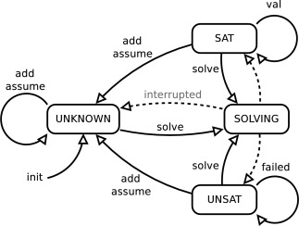
IPASIR Interface
(reversed acronym for "Re-entrant Incremental Satisfiability Application Program Interface", proposed for SAT Race 2015)
solver is called multiple times, solving state(variable scores, learned clauses, etc) is kept
user can add more clauses or make assumptions before each solver call

Slide 4
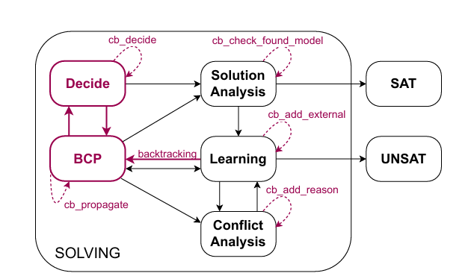
IPASIR-UP Interface
(Fazekas et al. IPASIR-UP: User Propagators for CDCL, was only implemented in CaDiCaL)
more control by user over solver:
solver: propagating and inprocessing
user(ExternalPropagator): deciding, propagating, adding new clauses, etc
This work: implementing the interface in MiniSat (Project) and a fuzzer (Lab) to ensure correctness.

Slide 5
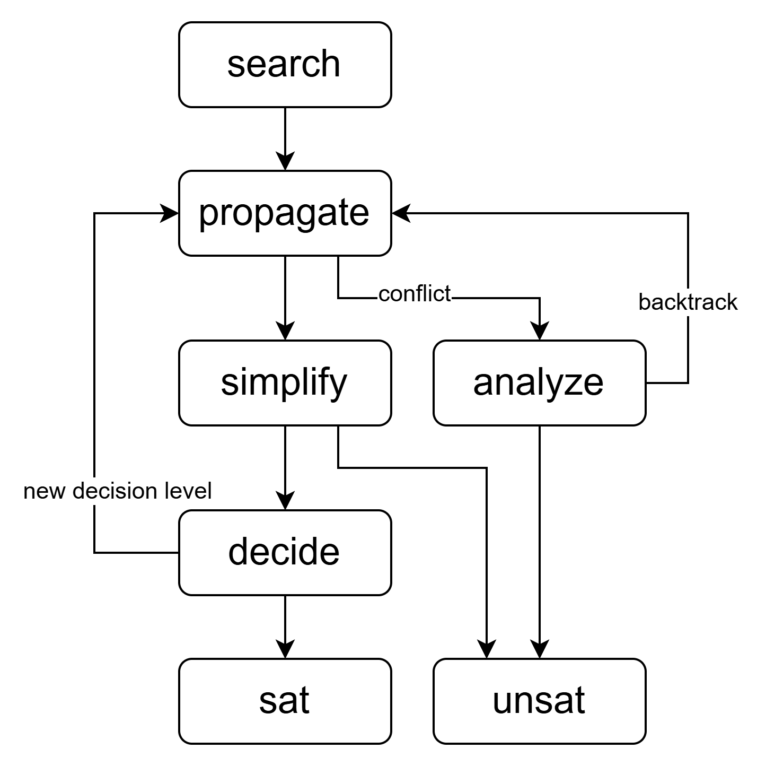
MiniSat
"minimalistic, open-source SAT solver"
"Easy to modify"
"Highly efficient"
"Designed for integration"
old and no longer maintained
lack of pre/inprocessing
a CDCL Solver (Conflict-Driven Clause Learning) using 2-watching scheme
supports incremental solving (like IPASIR)

Slide 6
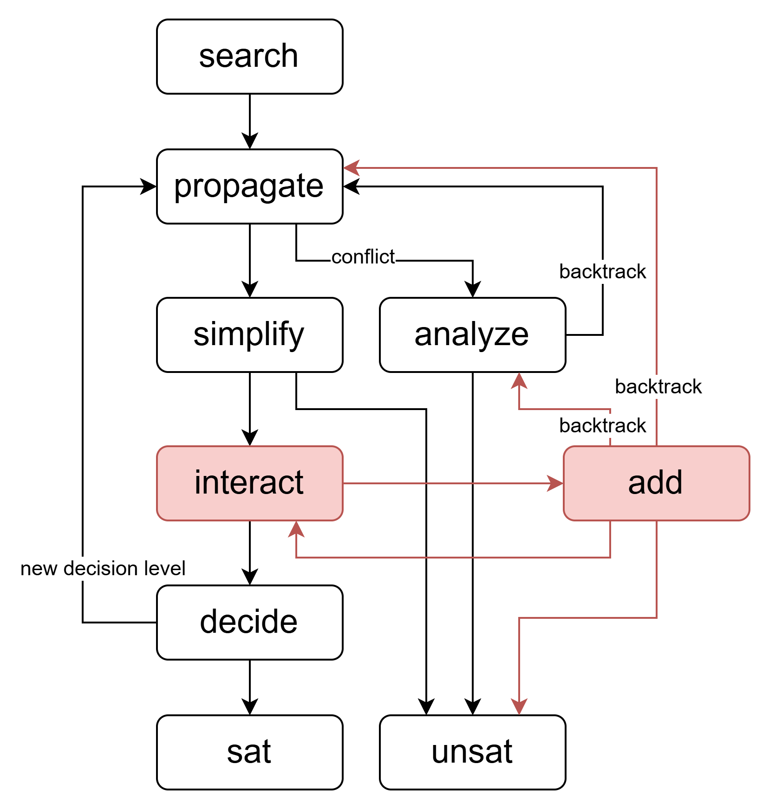
Adding Clause during Solving
interact with user propagator for new clauses in the CDCL loop
the new clauses could lead to propagation, conflict analysis or unsat

Slide 7
Adding Clause during Solving
clause that is tautology or root-satisfied is ignored
root-falsified literals are removed
cases:
empty clause leads to unsat
unit clause leads to propagation in root level
clause left with at least two literals can lead to propagation or conflict analysis

Slide 8
Adding Clause during Solving (Unit)
backtrack to level 0
propagate
if (ps.size() == 1) {
cancelUntil(0);
uncheckedEnqueue(ps[0]);
propagate = true;
return false;
}

Slide 9
Adding Clause during Solving (length ≥ 2)
2-watching scheme:
each clause is watched by two non-falsified literals
if one watching literal is falsified during propagation, another must be found, or it leads to propagation or conflict analysis
watching for a clause added during solving:
sort literals by assignment(true/false/unassigned) and decision level
watch the first two literals after sorting

Slide 10
Invariant of 2-Watching Scheme Across Decision Levels
in decision level l > 0:
a propagating clause is watched by the propagated literal(true) and another literal(false), both assigned on level l
a conflict clause is watched by two literals(both false) on level l
after backtracking to level k < l:
the propagating clause or conflict clause at level l is still watched by the same two literals, now both unassigned

Slide 11
Sorting the Literals
literals are sorted in the following order:
true(low - high) - unassigned - false(high - low)
int Solver::calculate_lit_sort_index(Lit lit) {
return value(lit) == l_Undef ? 0 : value(lit) == l_False ? (INT_MAX - level(lit))
: (INT_MIN + level(lit));
}
void Solver::sort_clause_solving(vec<Lit>& ps) {
sort(ps, [this](Lit a, Lit b) {
int la = calculate_lit_sort_index(a), lb = calculate_lit_sort_index(b);
return la == lb ? a < b : la < lb;
});
}

Slide 12
2 Watching Literals
watch the first two literals, whose assignments can be:
false, false
unassigned, false
unassigned, unassigned
true, false
true, unassigned
true, true
(respectively of level a, b if assigned)

Slide 13
Case false, false
false, false:
a = b: (conflict clause)
backtrack to level a = b
do conflict analysis
a > b:
backtrack to level b
propagate
Lit a = ps[0], b = ps[1];
if (value(a) == l_False) {
assert(value(b) == l_False);
if (level(a) == level(b)) {
cancelUntil(level(a));
conflict = cr;
return false;
} else {
assert(level(a) > level(b));
cancelUntil(level(b));
uncheckedEnqueue(a, cr);
propagate = true;
return false;
}
} else if (value(a) == l_Undef) {

Slide 14
Other Cases
} else if (value(a) == l_Undef) {
if (value(b) == l_False) {
cancelUntil(level(b));
uncheckedEnqueue(a, cr);
propagate = true;
return false;
} else {
assert(value(b) == l_Undef);
}
} else {
assert(value(a) == l_True);
if (value(b) == l_False) {
if (level(a) > level(b)) {
cancelUntil(level(b));
uncheckedEnqueue(a, cr);
propagate = true;
return false;
}
} else if (value(b) == l_Undef) {
} else {
assert(value(b) == l_True);
assert(level(a) <= level(b));
}
}
unassigned, false:
backtrack to level b
propagate
unassigned, unassigned: (skip)
true, false:
a > b:
backtrack to level b
propagate
a ≤ b: (skip)
true, unassigned (skip)
true, true (skip)

Slide 15
External Propagation with Lazy Explanation
most propagations are useless and the reason clauses can be expensive to calculate
lazy explanation:
get a propagated literal from user propagator without the reason clause
request the reason clause only when the literal needs to be explained during conflict analysis

Slide 16
Adding Clause Lazily during Conflict Analysis
similar to adding clause during solving
the first two literals are respectively true, false after sorting
(under current implementation, it can't be a root level unit)
if (ps.size() == 1) {
assert(false); // can't do it yet
}
Lit a = ps[0], b = ps[1];
assert(value(a) == l_True);
assert(value(b) == l_False);
assert(level(a) >= level(b));
// here level(a) > level(b) is possible, which violates the invariant, but still works in actual testing
remark: CaDiCaL supports out-of-order propagation

Slide 17
Fuzzing
the fuzzer, to test the implementation and ensure the correctness:
implement the ExternalPropagator interface
simulate the interaction between MiniSat and ExternalPropagator
check model
(~300 lines of code)
fuzzing procedure:
generate random CNF as input (with cnfuzz)
split clauses for solver and ExternalPropagator, and run solver
print proof in DRUP format (not IDRUP, for simplicity)
check proof (with DRUP checker)

Slide 18
Fuzzing Result
an assertion error in the cases of watching literals found and fixed
a bug with the sorting predicate found and fixed early
a bug found related with the timing of attaching ExternalPropagator to the solver
a bug found related with lazy propagations when the reason clause of a propagated literal is marked with a placeholder

Slide 19
Summary
implemented IPASIR-UP interface on MiniSat, which is the first implementation on another SAT solver other than CaDiCaL
implemented an independent and relatively tiny fuzzer for IPASIR-UP
future work:
support out-of-order assignments
integrate and test with cvc5
improve the performance
support input with ICNF and proof output in IDRUP format for fuzzing

Slide 20
Questions

Slide 21
Thank you!

