Slide 1
Visualising Sorting Algorithms
By Henry Cheung 27th Sep 2024

Slide 2
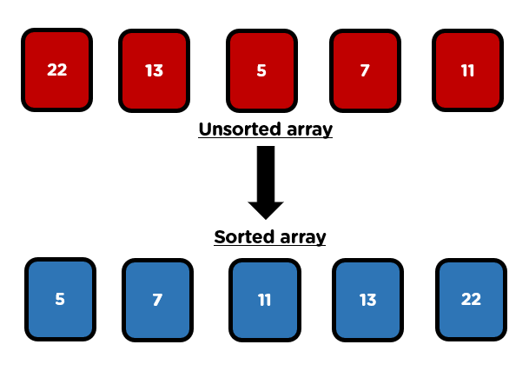
What is Sorting?
Ordering of information in ascending or descending order according to the relation between the data
Sorting is crucial in CS as organised data can improve search efficiency
Fundamental problems work on sorting integers and letters
The set of methods that are used to perform sorting is called Sorting Algorithms
Source: Simplilearn

Slide 3
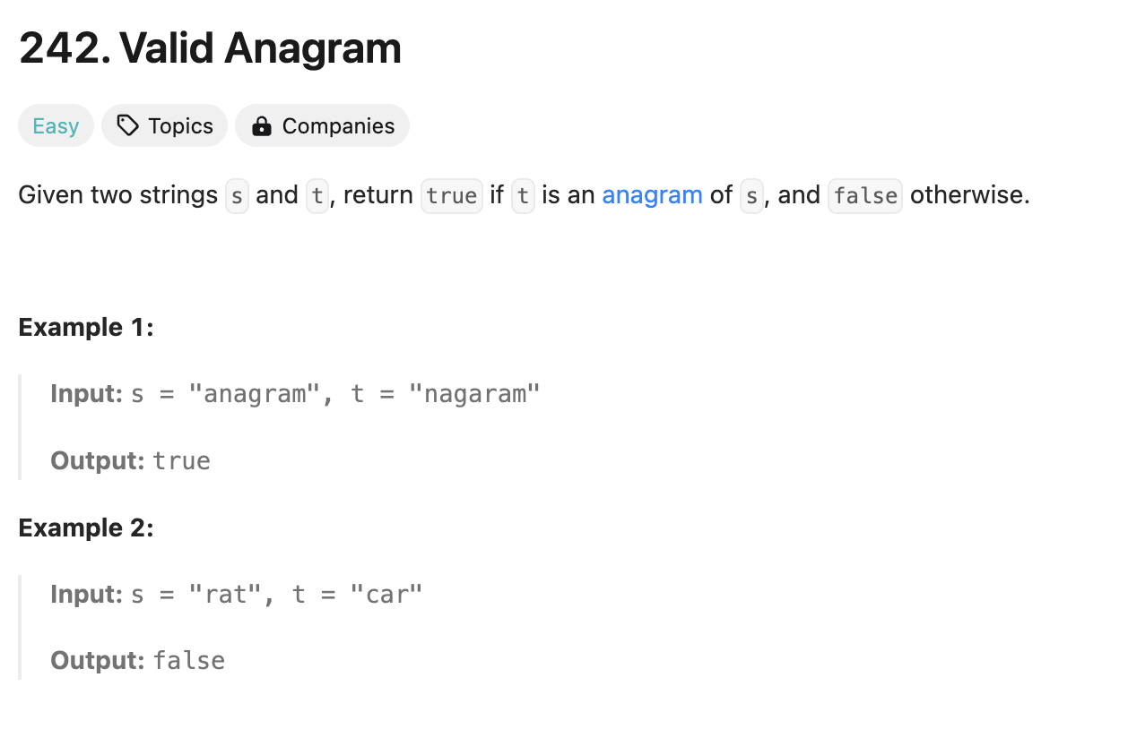
Example of a Sorting Problem (Grouping Data)
Source: Leetcode

Slide 4
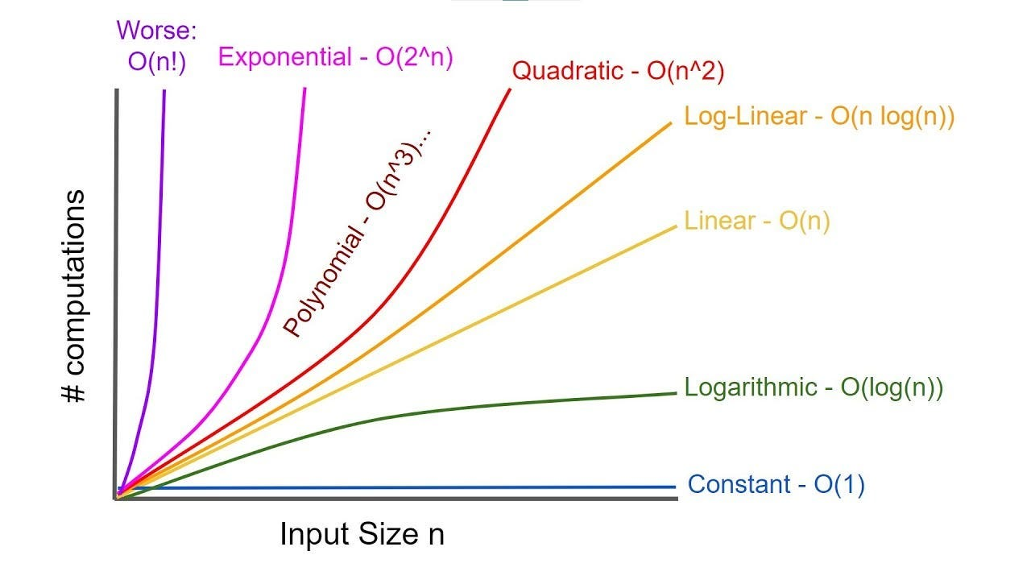
Sorting Algorithm
Scientists developed various methods to sort data. They use time complexity to measure the efficiency of an algorithm.
Source: Sumeet Panchal, Medium

Slide 5
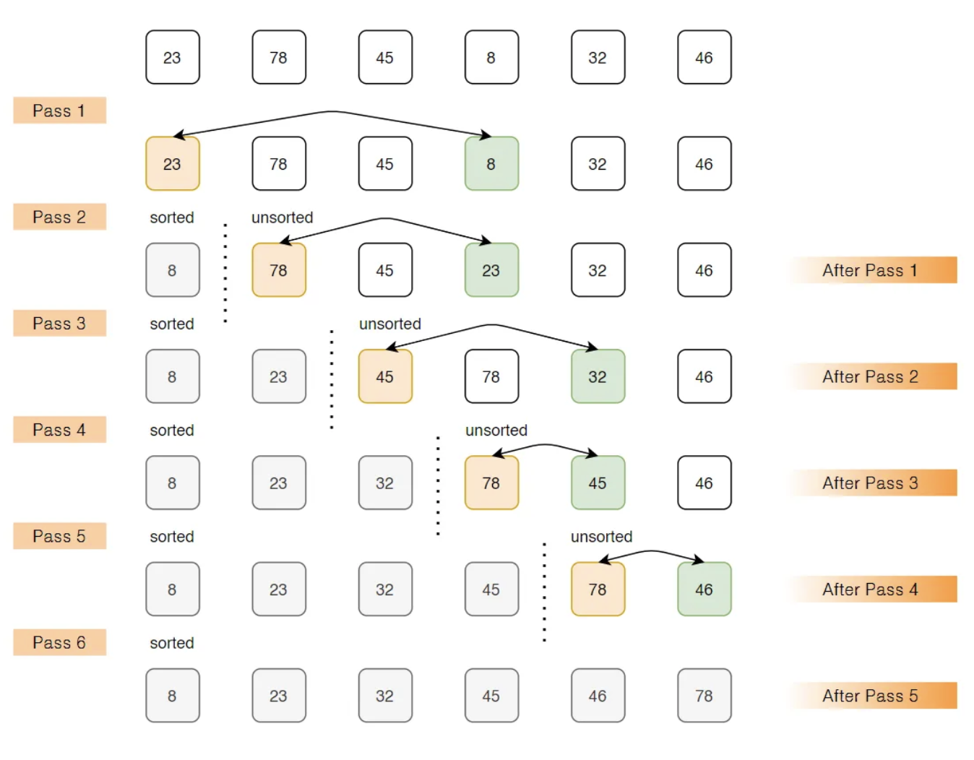
Learn how a Sorting Algorithm works (Diagram)
Source: Adwiteeya Reynad, Medium

Slide 6
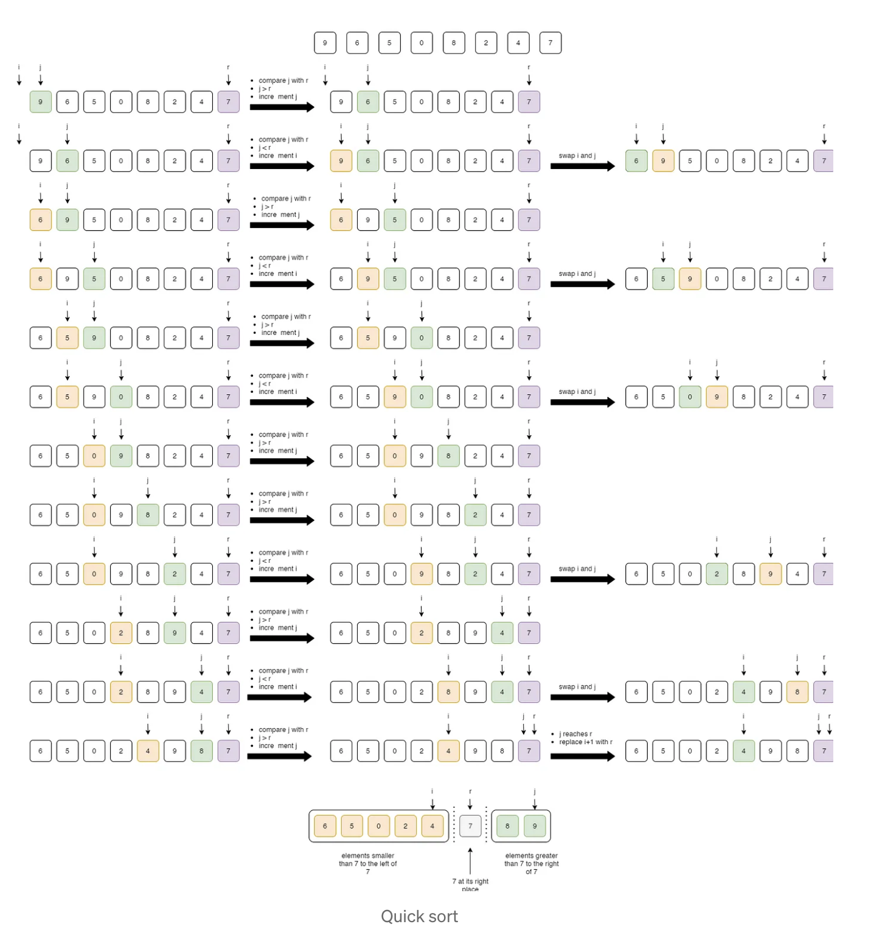
Learn how a Sorting Algorithm works (Diagram)
Sometimes it could be difficult to visualise the steps in our brain in the learning process
Source: Adwiteeya Reynad, Medium

Slide 7
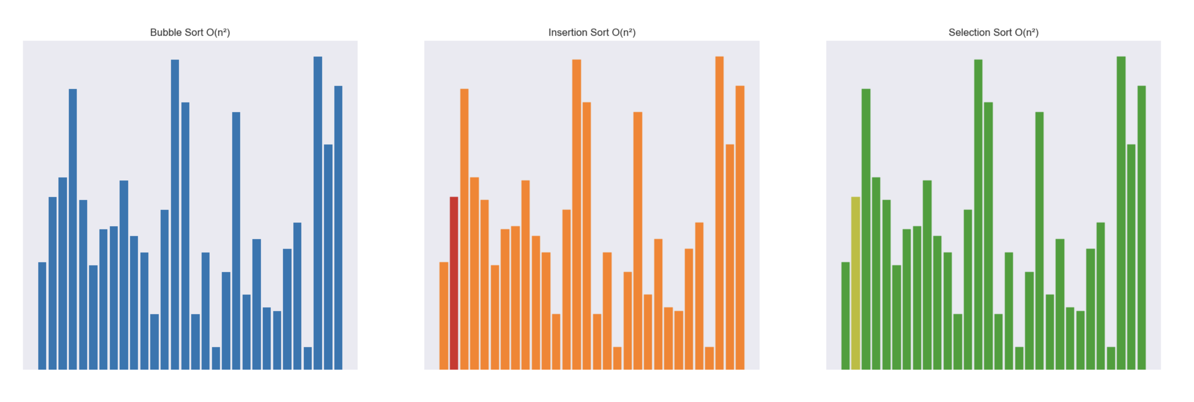
Sorting Algorithm Visualiser
Build a visualiser that animates sorting processes of different algorithms
Use bars with different colours in a graph to identify the search process

Slide 8
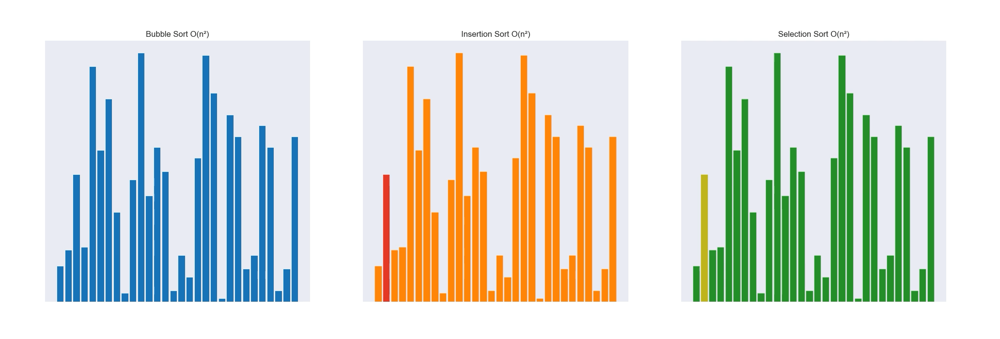
Sorting Algorithm Visualiser

Slide 9
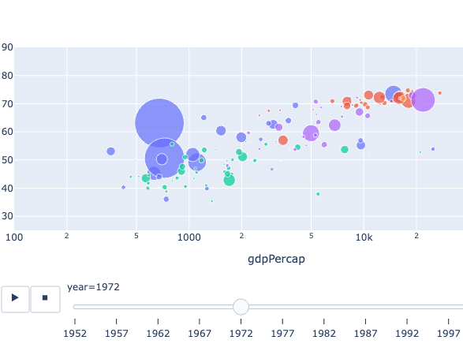
Reflection (Visual)
Matplotlib is a low-level library for creating graphs. There are more high-level Python libraries with more appealing front-end, such as Plotly.
Sounds can be added to the animation to make it more fun to watch!

Slide 10
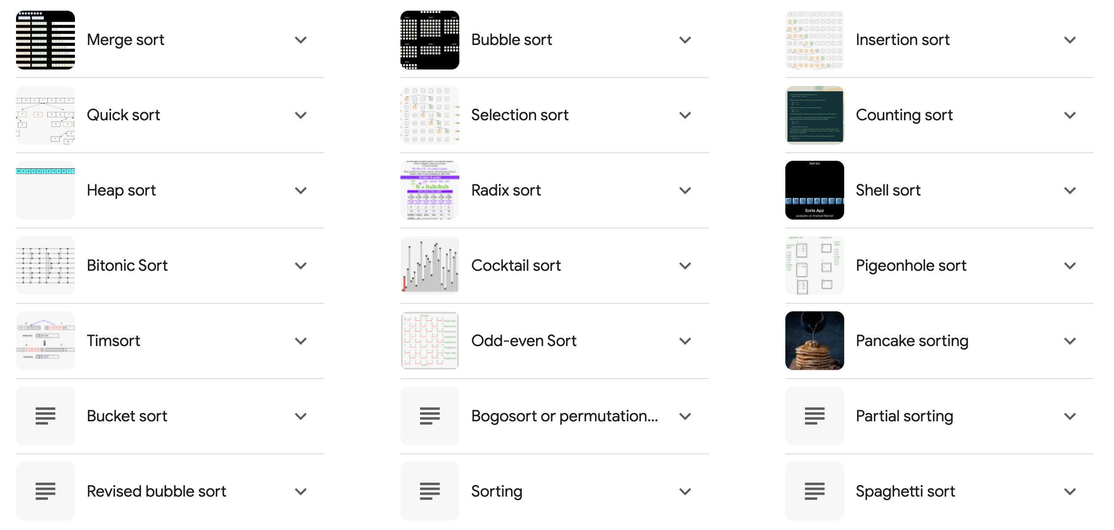
Reflection (Knowledge)
More sorting algorithms can be included for comparison.

Slide 11

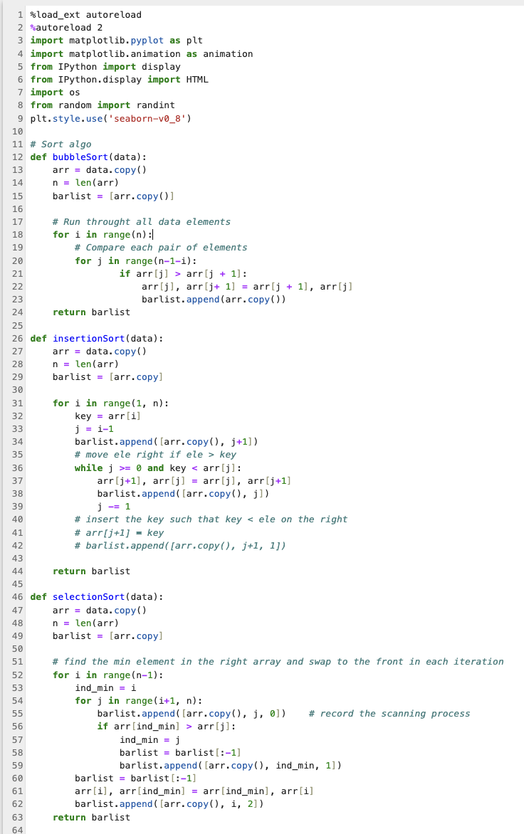
Code

Slide 12
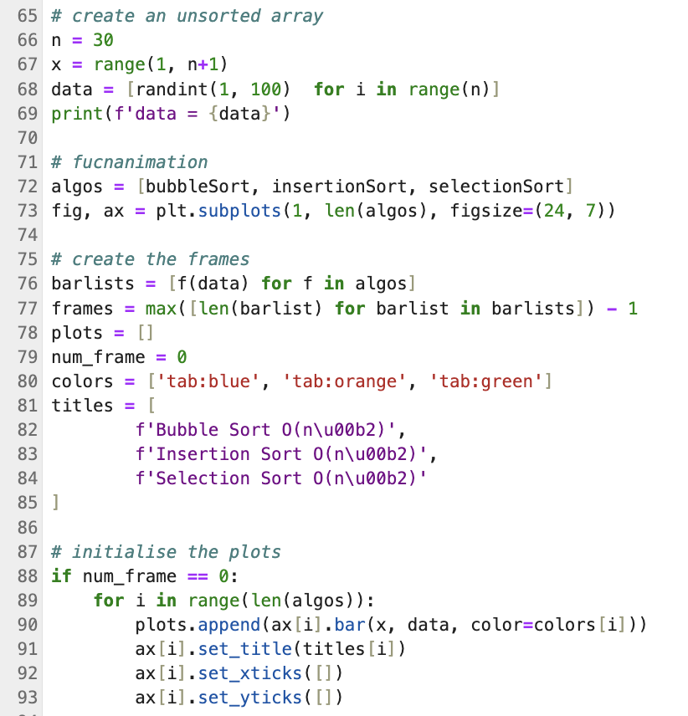
Code

Slide 13
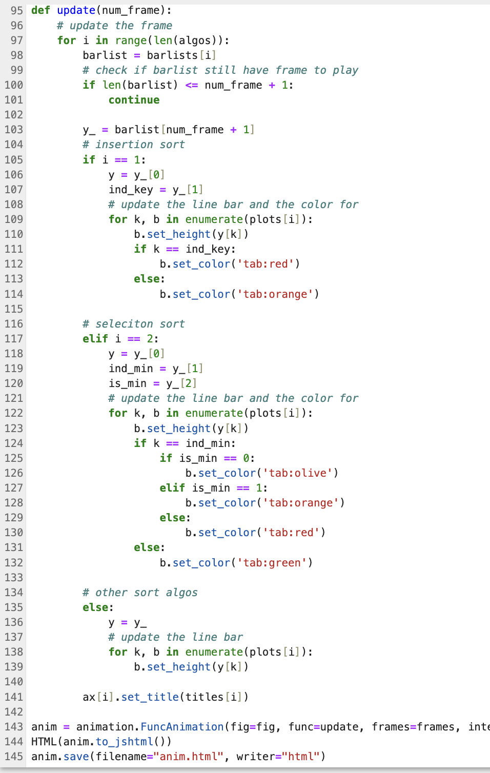
Code

Slide 14
Tools
Software
Jupyter Notebook
Python (Matplotlib)

Slide 15
Reference
Sorting Algorithms Every Programmer Should Know
Sorting Algorithms
Matplotlib API Reference

Slide 16
Thank you!

