Slide 2
Using WReSTT – Instructor and Student View
Gursimran Singh Walia
North Dakota State University
gursimran.walia@ndsu.edu
Raymond Chang-Lau
Florida International University
rchan001@fiu.edu

Slide 3
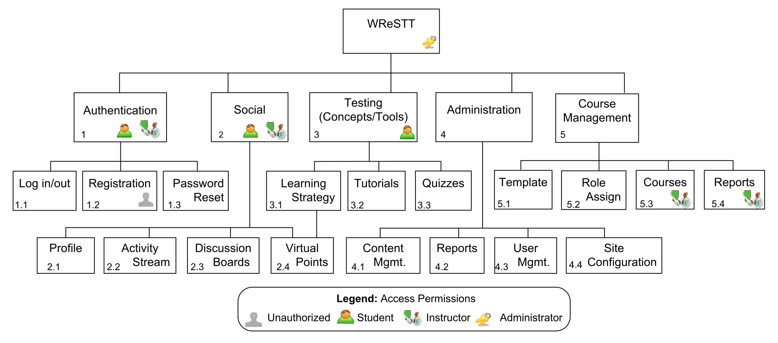

Agenda – Block Diagram [Clarke et al.]
Testing tools and Concepts
Allows users to access social n/w’ing features
Update content, and generate reports

Slide 4
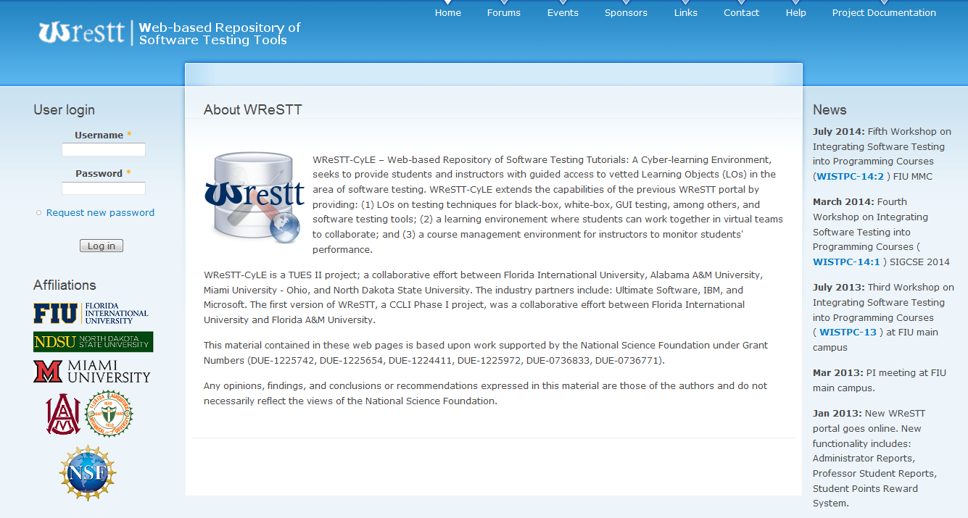
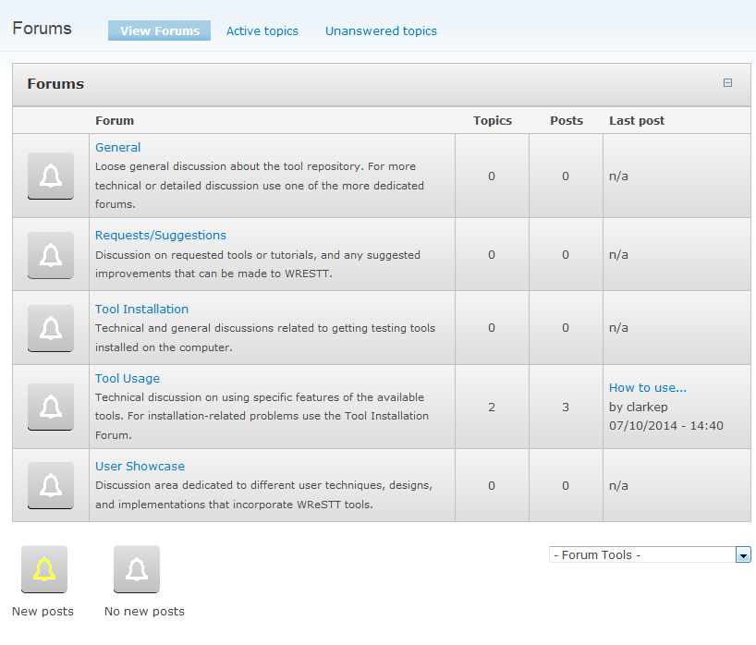
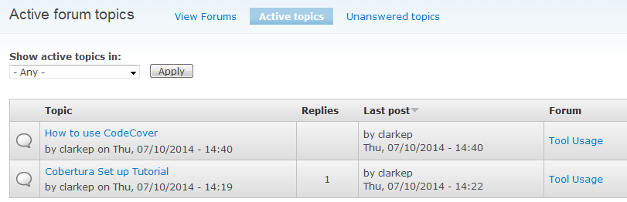
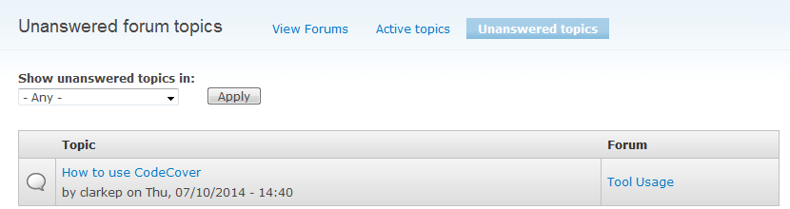
Homepage
Demo Site: wrestt.cis.fiu.edu/d7demo

Slide 5
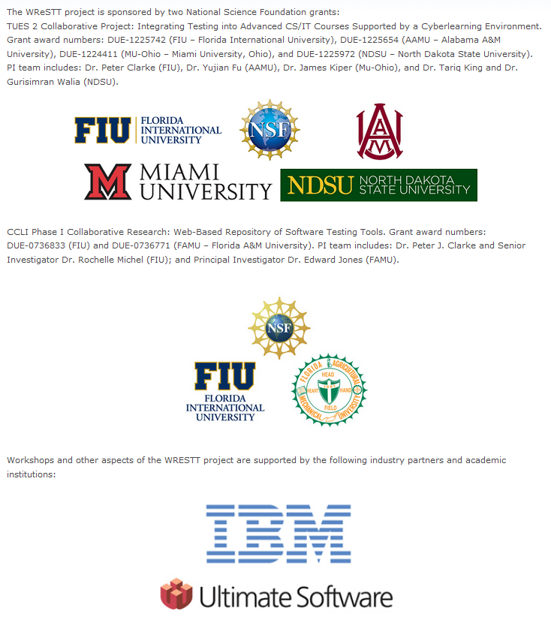
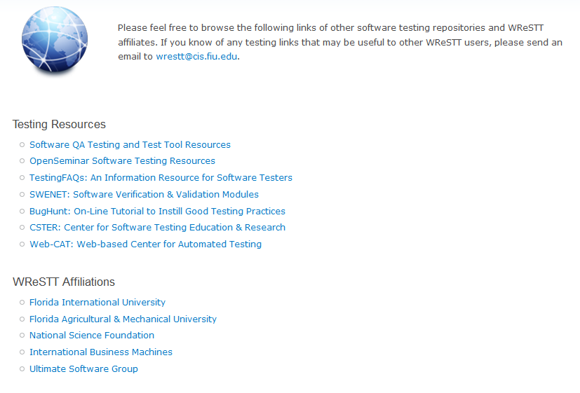
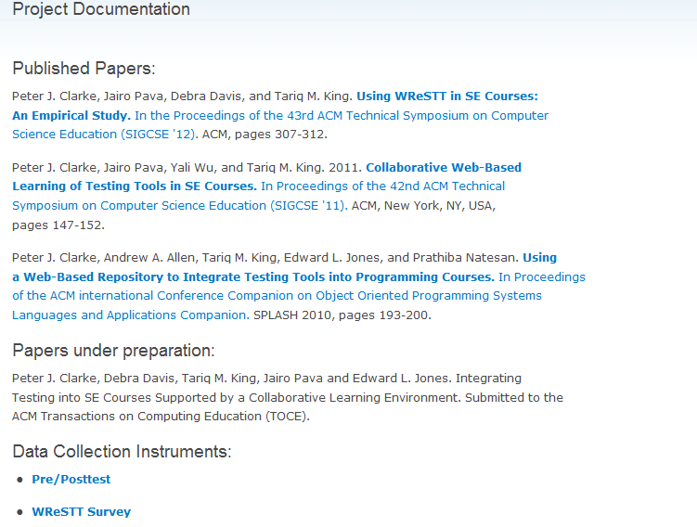
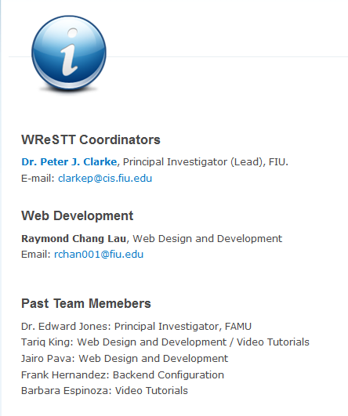
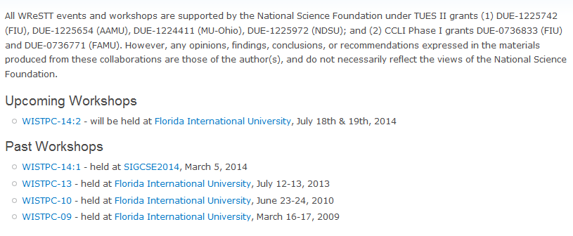
Homepage
Demo Site: wrestt.cis.fiu.edu/d7demo

Slide 6
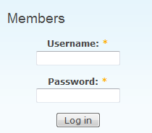
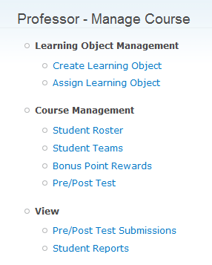
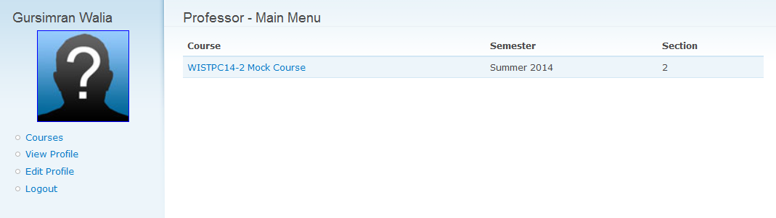
Logging on
ID - p_your-email-address-here
password - pass12345

Slide 7
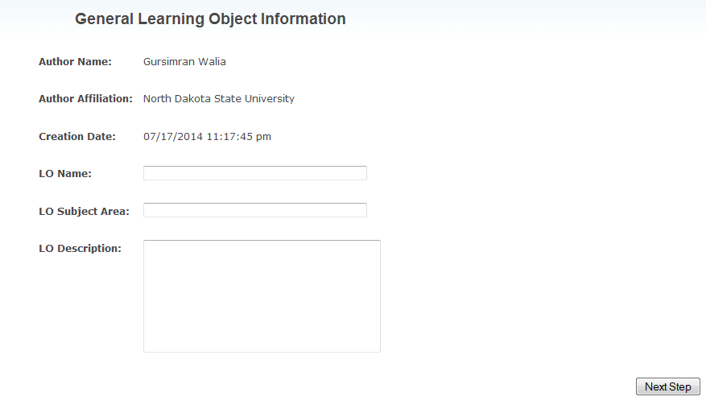
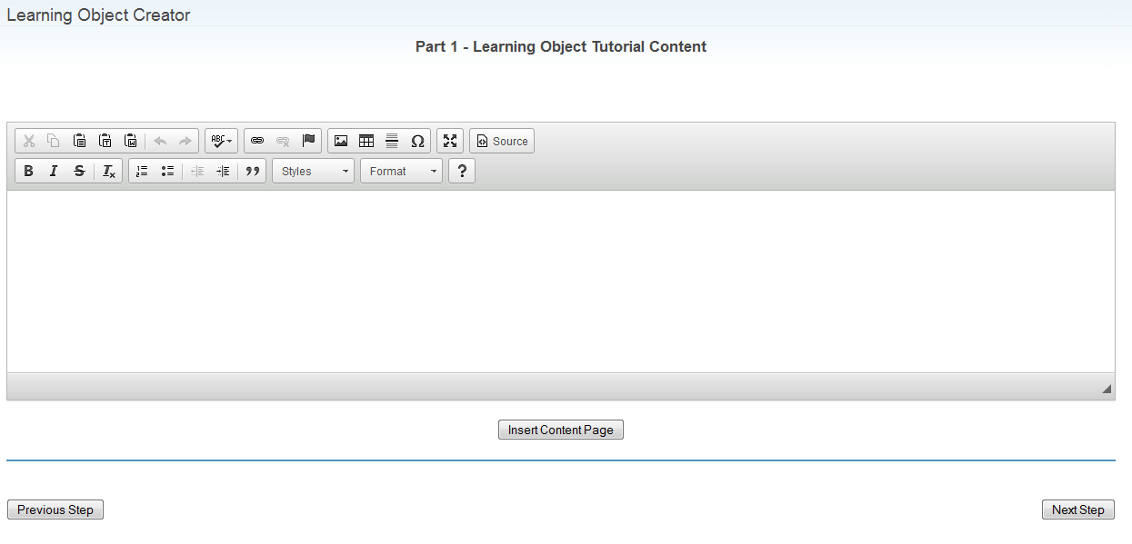
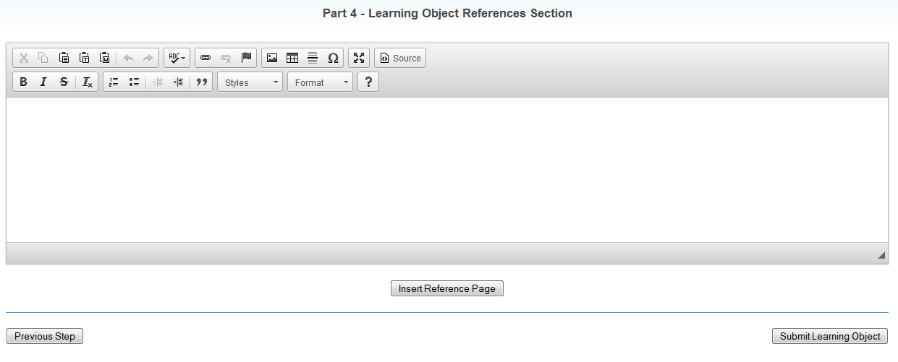
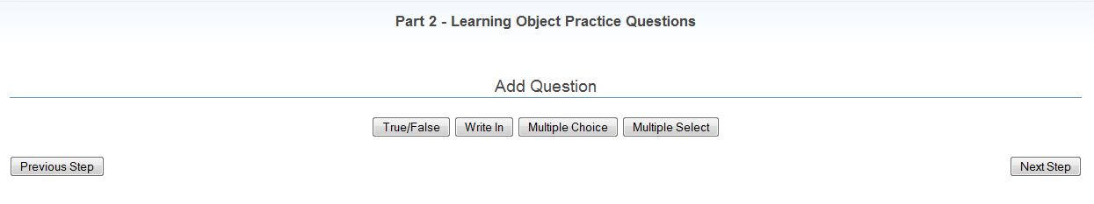
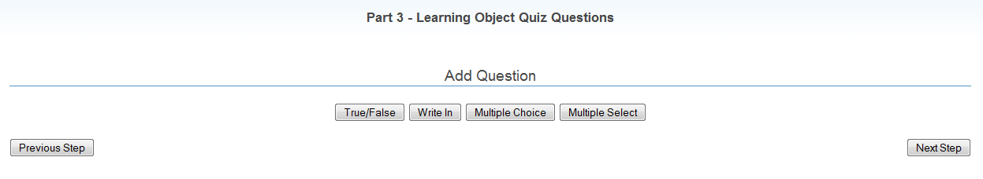

Slide 8
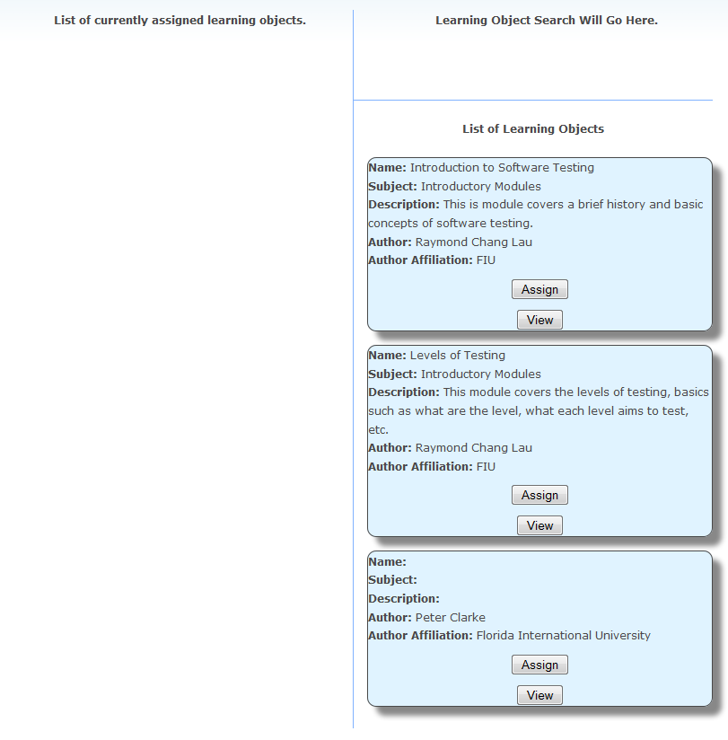
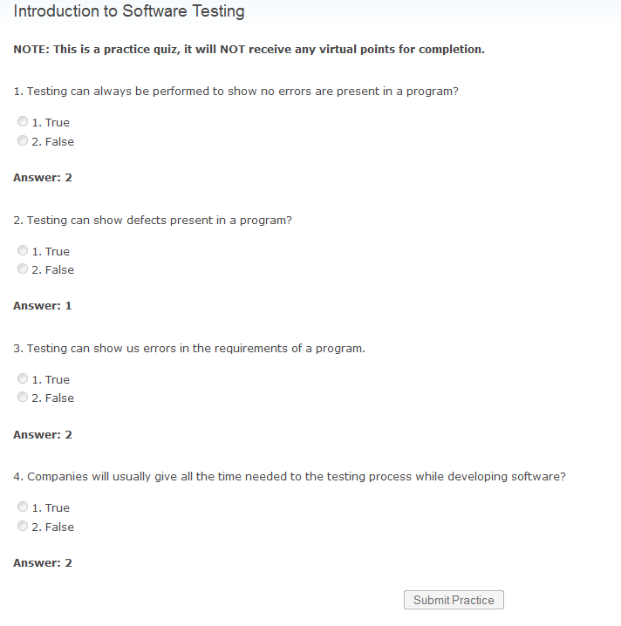

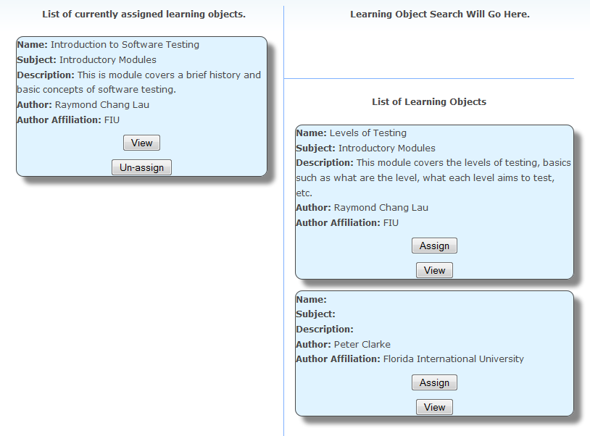
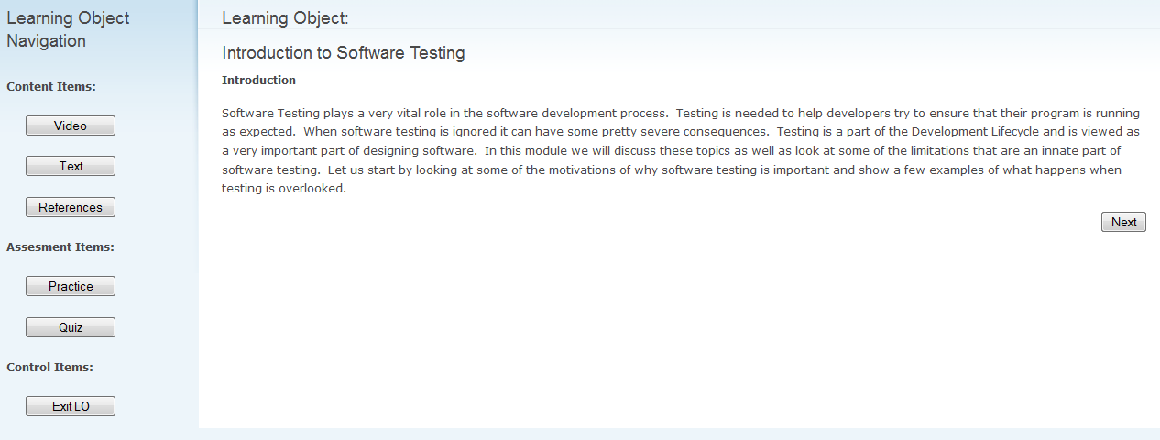

Slide 9
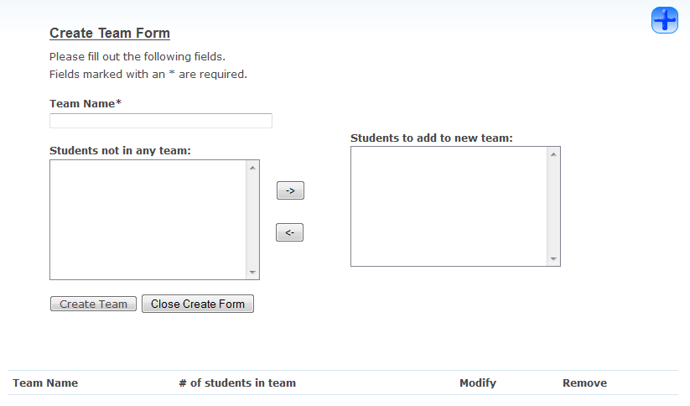
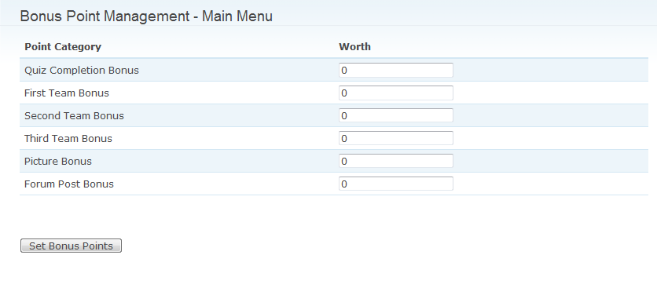
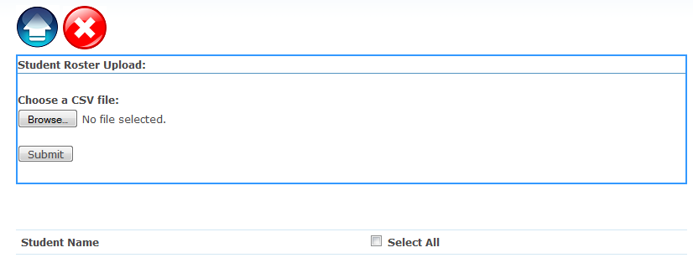
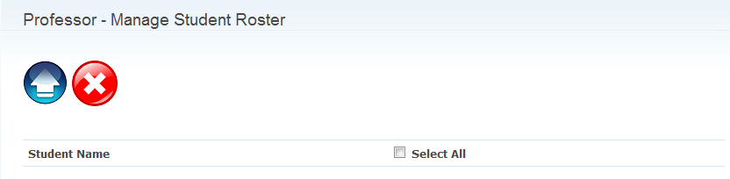
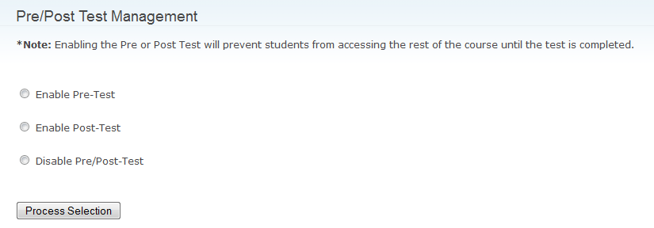
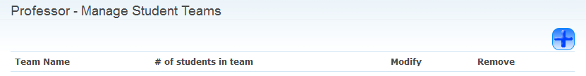

Slide 10
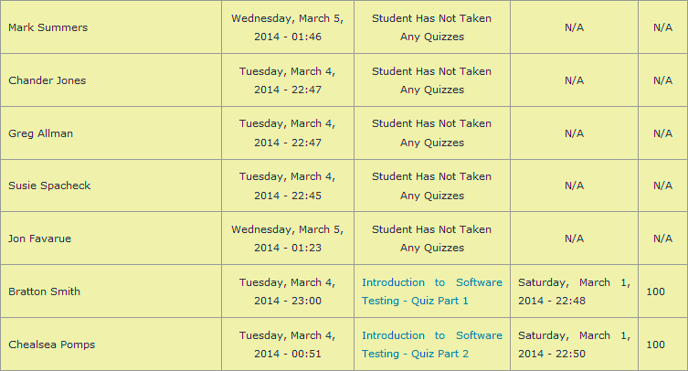
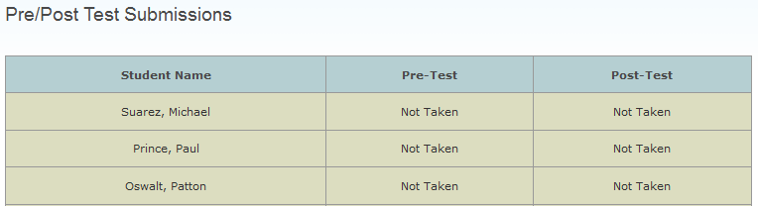

Slide 11
Practice Time – Instructor View
Agenda
Upload Student Class roll
Create teams
Reward Points
Pre/Post test enable and disable
Download student class roll`

Slide 12
Student View
User name: s_your-email-address-here
Password - pass12345

Slide 13
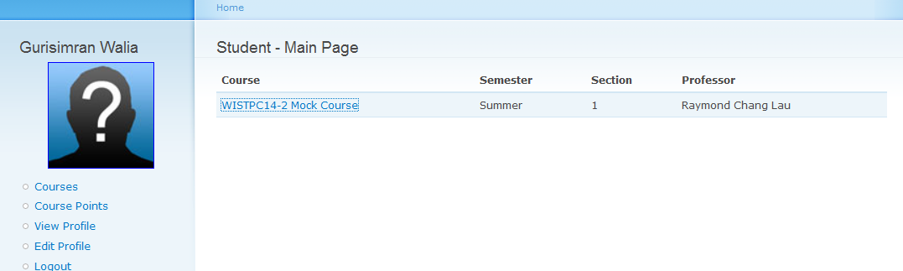
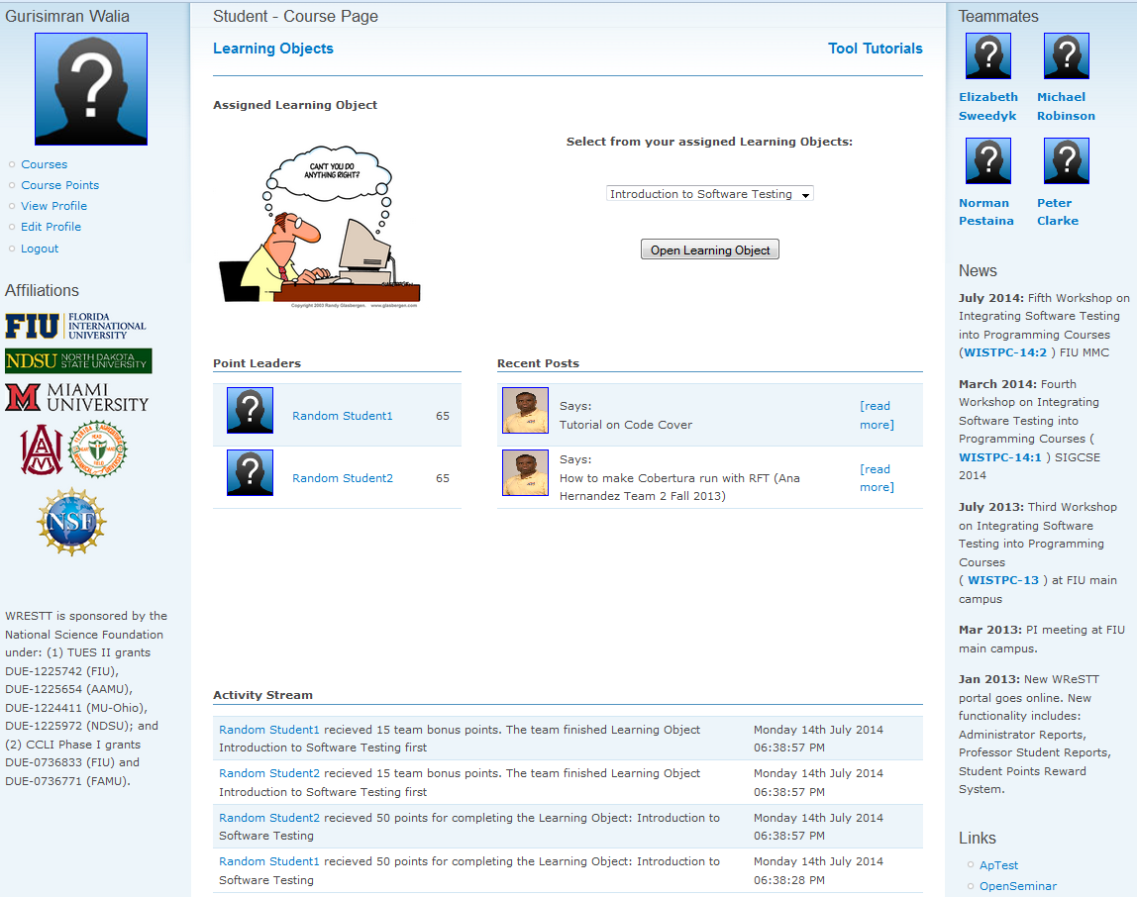
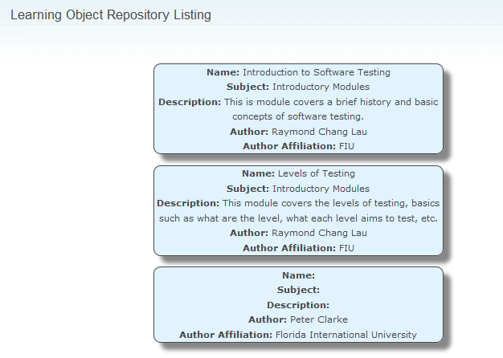

Slide 14
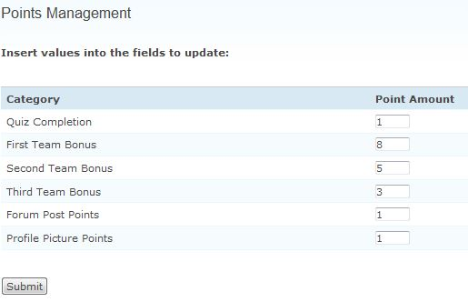

Using WReSTT in the Classroom
Week 0:
Virtual points allocation scheme
Week 1-2:
Intorduce WReSTT to the Students
Student Assignments: The instructor may require students to submit a report with each assignment containing the testing techniques used, test cases, test coverage achieved using different criteria and an explanation of any criteria for which the speciﬁed coverage is not achieved.
Monitor Teams: monitor the postings to the forums and provides feedback to the virtual teams and the class, with respect to their participation on completing the tutorials and quizzes
Week 2-20:
Assignments and Monitor Teams

