Slide 1
Enhancing the Web-Based Repository of Software Testing Tools
WISTPC ’10
Florida International University, Miami FL
Tariq M. King
June 24, 2010

Slide 2
Outline
Overview of WReSTT
Initial Version
Development
Content and Features
Planned Improvements
New Prototype
Demo/Discussion

Slide 3
Overview
NSF CCLI Phase I Project
Florida International University (PI-Clarke)
Florida A&M University (PI-Jones)
Goal:
Provide students and instructors with guided access to a set of vetted software testing tools and program analyzers that will support the development of high quality software during their academic training
Targets CS1–CS3, but also benefits SE courses

Slide 4
Overview (cont’d)
Major Benefits
Availability of a vetted selection of software testing tools (in a single location) that can be used for pedagogical purposes
Easy access to tutorials on software testing, and tutorials on testing tools
Provision of a moderated forum where students and instructors can share feedback on the useful-ness of the tools and tutorials in the repository

Slide 5
Initial Version
Architecture
Developed by Tariq M. King and Frank Hernandez, using the Drupal Content Management System [1]
Notes:
WReSTT is designed to allow access to four user roles: developers, moderators, instructors,
and students. Users of each category have access to different subsets of facilities in WReSTT:
developers are provided administrative access to the systems; moderators respond to queries
from users and moderate the forums that users can access; and instructors monitor the usage
of WReSTT by the students in their classes (e.g., access scores obtained by students on a
particular tutorial); and students have access to all the learning materials. Currently, there are
over 520 users from 16 different academic institutions registered in WReSTT. WReSTT is
currently accessible from MERLOT. Access to WReSTT from NDSL [NDSL (2009)] and
Connexions [Connexions (2009)] is currently pending. WReSTT was denied a request to host it
on OpenDOAR [SHERPA(2009)] due to the fact that WReSTT requires registration to access
some of the material.

Slide 6
Initial Version (cont’d)
CONTENT
Contains learning materials and tutorials for:
Automated Testing (Regression)
Rational Functional Tester
JUnit, CppUnit
SWAT
Code Coverage
Cobertura, EclEMMA
Metrics
JDepend

Slide 7
Initial Version (cont’d)
Features
Tool and Tutorial Browsing
By Category – popular classifications such as code coverage, metrics, plugins, test execution, and web
By Language – programming language used to implement the system under test, e.g., C++, Java
By Test Level – stage of the development process, e.g., unit, integration, and system testing
Advanced – allows users to filter testing tools using tags from the previous browsing methods
Tool Rating, Forum, and User Statistics (Limited)

Slide 8
Planned Improvements
Includes enriching the content of WReSTT, and enhancing the set of currently available features
Enriching the content will involve populating the repository with additional instructional materials
More tutorials, example syllabi, and sample labs
Feature wise we will be incorporating of a social networking component for students and instructors
Incorporating suggestions to improve end-user experience, e.g., YouTube as a download mirror
Notes:
We plan to enhance WReSTT in the coming months to include additional instructional materials
(e.g., multimedia tool tutorials, syllabi, and labs). Feature enhancements to WReSTT will
include incorporating a social networking component for students and instructors, and adding
new features for instructors.
The student social networking component will support social learning [Lave & Wenger(1998)] by
providing students with the opportunity to learn and think in groups. Students will be able to set
up virtual groups and work on tutorials together, pose questions to each other in the group, and
seek advice from instructors as a group. Similarly, the instructor social networking component
will also allow instructors to create virtual groups, but for the purpose of exchanging ideas and
experiences on how to use the resources in WReSTT to effectively support software testing
instruction. Both student and instructor members of WReSTT, who are also members of the
social networking utilities Facebook [Facebook(2010)] and Twitter [Twitter(2010)], will have the
option of linking these social networking accounts to newly created WReSTT user groups and
news feeds. The aforementioned groups and feeds will be available and accessible through the
WReSTT portal and will also serve as a basis for expanding the user base of WReSTT through
links back to the WReSTT website.
Additional instructor features will provide the ability to upload class rolls using a CSV file, and
allow queries to the repository based on attributes related to class rolls. An example of one
application of such features is to allow students to work through a tutorial, and then provide the
instructor with access to feedback on each student’s performance. Such an application can be
extremely beneficial when learning to use new testing tools. Finally, to enhance the overall
student user experience, statistics on the most frequently accessed tutorials will be tracked
using the existing monitoring features of WReSTT, and the content uploaded to the popular
video sharing website YouTube [YouTube(2010)]. Mirroring this content to YouTube should
facilitate faster download times for the multimedia tutorials that are most demanded by students.
The YouTube versions of the video tutorials will be directly accessible and viewable through
links embedded in the WReSTT portal.

Slide 9
Social Networking
STUDENTS
Objective is to create a competitive social online environment where students will be more disposed to participate on WReSTT and learn about testing
Realized by tailoring existing drupal modules, or if necessary developing new modules
Newly installed and developed modules include:
Virtual Teams (Quizzes)
Activity Stream
Points Leaderboard
User Profiles
Notes:
These modules extend the original WReSTT by adding the ability to place students into virtual teams. Virtual teams are to read the WReSTT testing tutorials together. At the end of every tutorial, the students are given the option to take a quiz to reinforce the material learned. A quiz is divided into as many parts as there are virtual team members. Students have one opportunity to complete one of the quiz parts. Individual team members receive WReSTT points for passing their part of the quiz. The entire virtual team is awarded additional WReSTT points if everyone on the team passes their individual quiz. WReSTT points translate to extra credit points at the discretion of the professor. As students complete quizzes on WReSTT, their accomplishments are published on the WReSTT points leader board and activity stream (akin to Facebook).

Slide 10
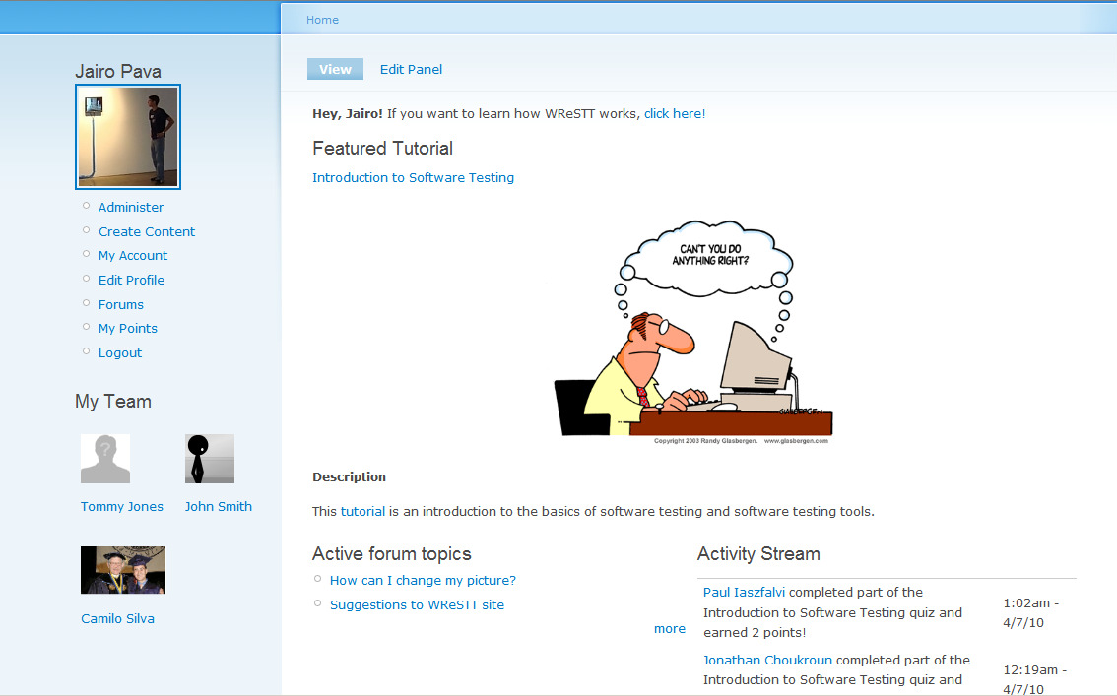
Teams & Activity Streams

Slide 11
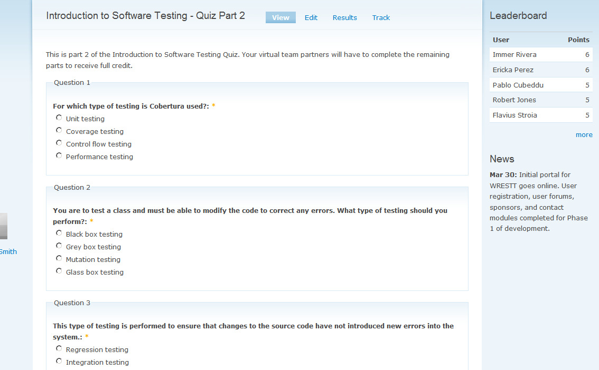
Quizzes & Leaderboards

Slide 12
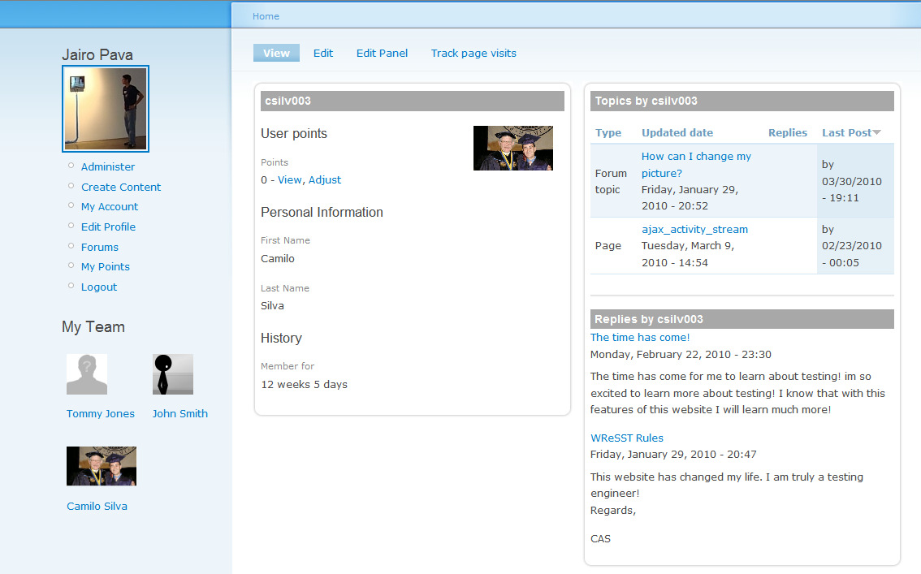
User Profiles

Slide 13
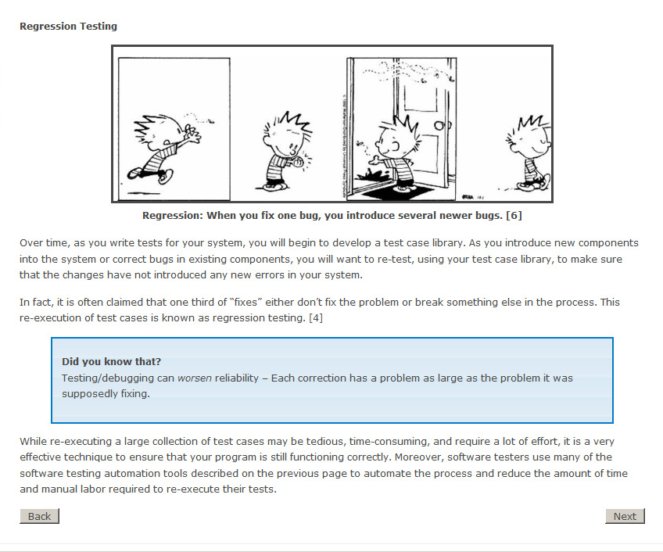
General Software Testing Tutorial

Slide 14
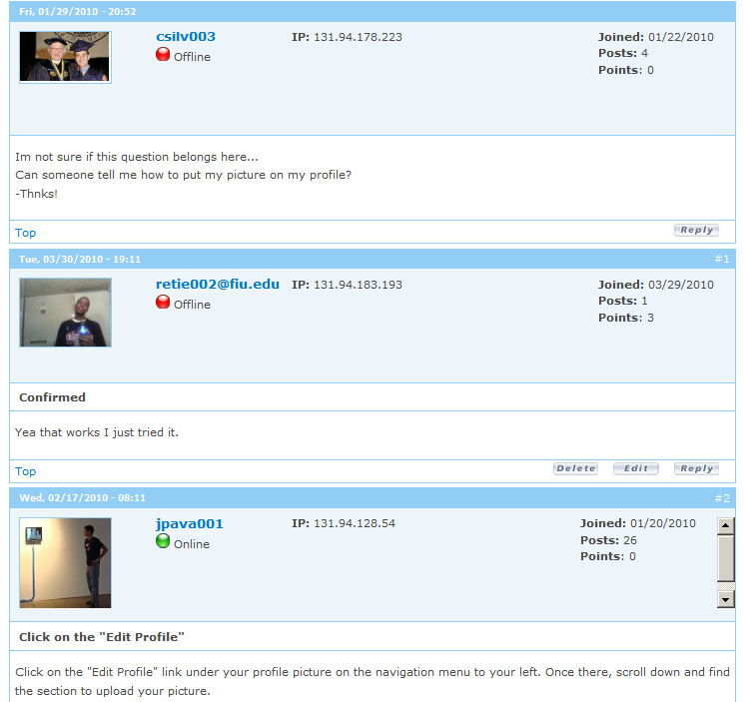
Updated Discussion Board

Slide 15
More Social Networking
Instructor social networking features:
Virtual Groups – to exchange ideas and experiences on how the resources in WReSTT can be used to effectively support CS instruction
Others?
Both students and instructors who are members of Twitter and Facebook will be able to link their WReSTT accounts to these popular sites
User groups and news feed broadcasts to via these sites can attract new users to WReSTT

Slide 16
Acknowledgements
Jairo Pava, FIU Honors College
Peter J. Clarke, FIU
Edward Jones, FAMU
WISTPC ‘09 participants
Fall 2009 and Spring 2010 class members of the Software Testing & Debugging course at NDSU

Slide 17
References
Drupal Content Management System, http://drupal.org/
Jairo Pava and Peter J. Clarke. FIU Honors College Thesis on WReSTT, FIU April 2010.

Slide 18
Demo/Discussion
Questions? ¿Preguntas? 問題 Sawwal вопросы 質問 domande ερωτήσεις

