Slide 1
Using Learning Objects in WReSTT
WISTPC 2014:2
Peter J. Clarke
03/05/2014

Slide 2
Outline of Presentation
Introduction to Learning Objects (LOs)
LO Examples
LOs and WReSTT

Slide 3
Intro to LOs
An LO is a “collection of content items, practice items, and assessment items that are combined based on a single learning objective”.
Smaller chunks: Compared to traditional learning, LOs are much smaller units of learning, typically 2 minutes to 15 minutes.
Are self-contained: LOs can be taken independently
Can be aggregated: LOs can be grouped into larger collections

Slide 4
Intro to LOs cont
Are reusable: LOs may be used in multiple contexts
Tagged with metadata: All LOs have descriptive information allowing it to be found by a search
http://en.wikipedia.org/wiki/Learning_object
http://www4.uwm.edu/cie/learning_objects.cfm?gid=56
http://www.merlot.org/merlot/viewMaterial.htm?id=80093
http://www.merlot.org/merlot/viewMaterial.htm?id=77772

Slide 5
LOs and WReSTT
We reviewed two IEEE compliant formats of Los:
IMS Learning Object Discovery & Exchange (LODE) specification; and
SCORM (Sharable Content Object Reference Model) specifications
Decided to go with SCORM
Implemented an interface in WReSTT that will allow instructors to create LOs.

Slide 6
LOs and WReSTT cont
Creating LOs in WReSTT
General Learning Object Information
Content Page – can create content in this page
Practice Page – create practice questions based on the content, may use four different formats
Quiz Page – create questions to be graded by the system
Links/References Page – insert links to other tutorials.
Finally you can submit the LO for review.

Slide 7
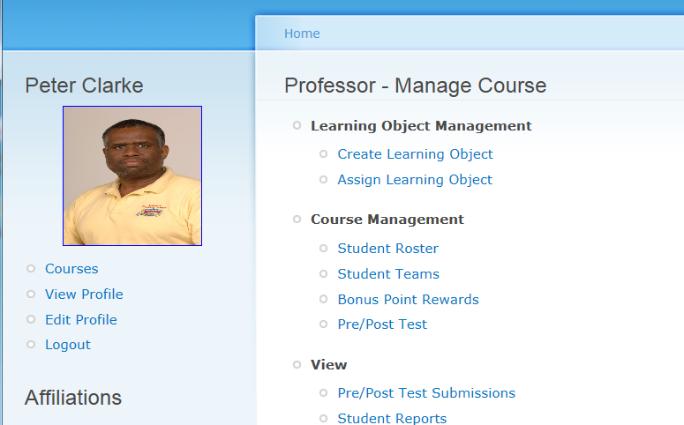
LOs and WReSTT cont
Log in using your user id and password

Slide 8
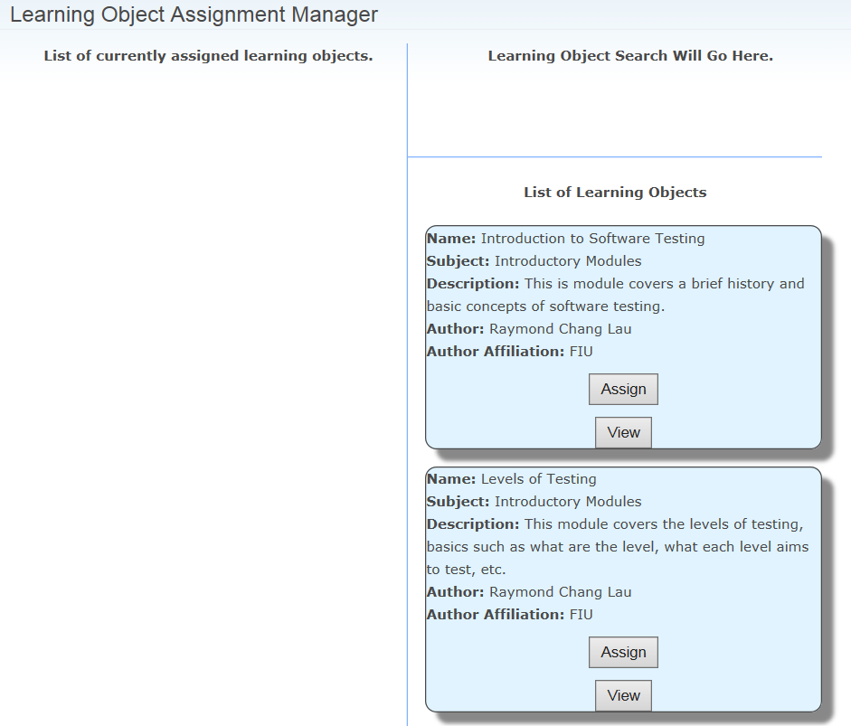
LOs and WReSTT cont

Slide 9
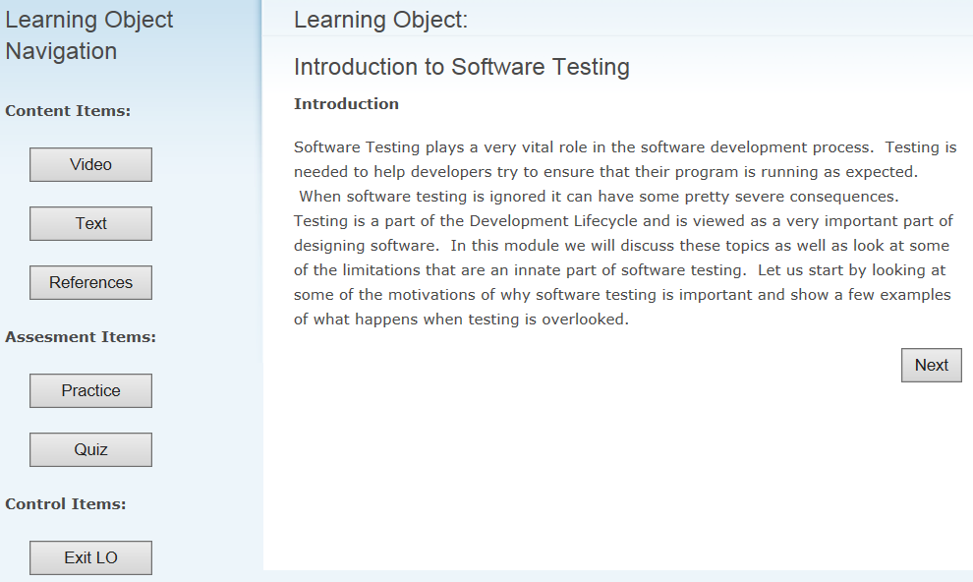
LOs and WReSTT cont
Press “Exit LO when you are finish viewing

Slide 10
LOs and WReSTT cont

Slide 11
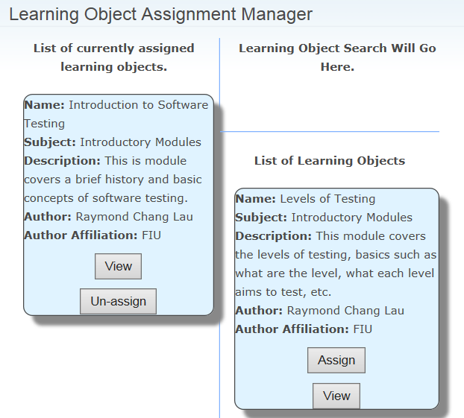
LOs and WReSTT cont
Course → Click on Course

Slide 12
LOs and WReSTT cont
Log in using your user id and password

Slide 13
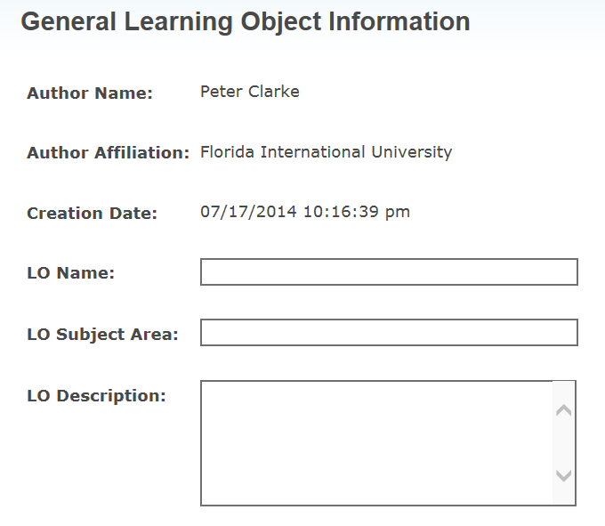
LOs and WReSTT cont
Enter some data of your choice. Press “Next Step”

Slide 14
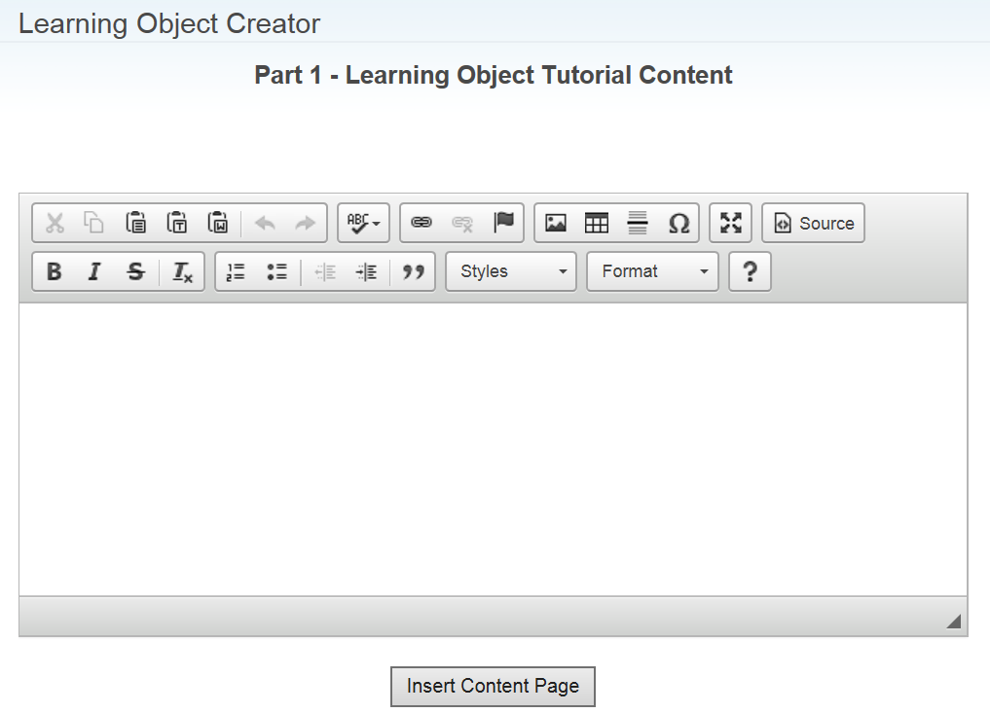
LOs and WReSTT cont

Slide 15
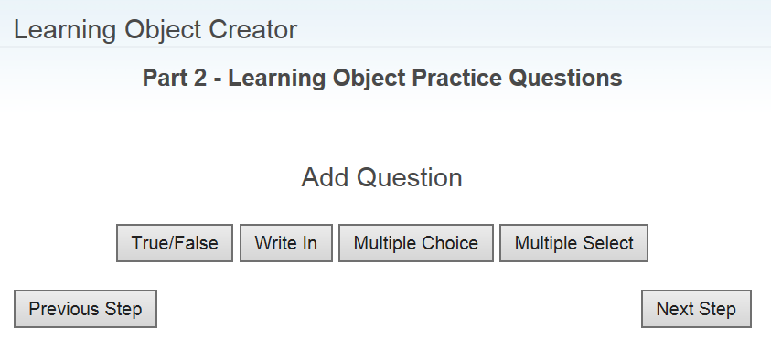
LOs and WReSTT cont
Practice adding questions

Slide 16
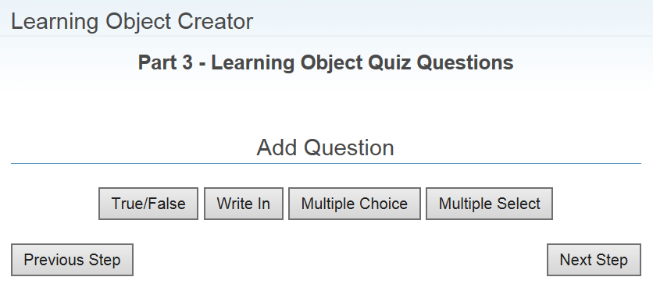
LOs and WReSTT cont

Slide 17
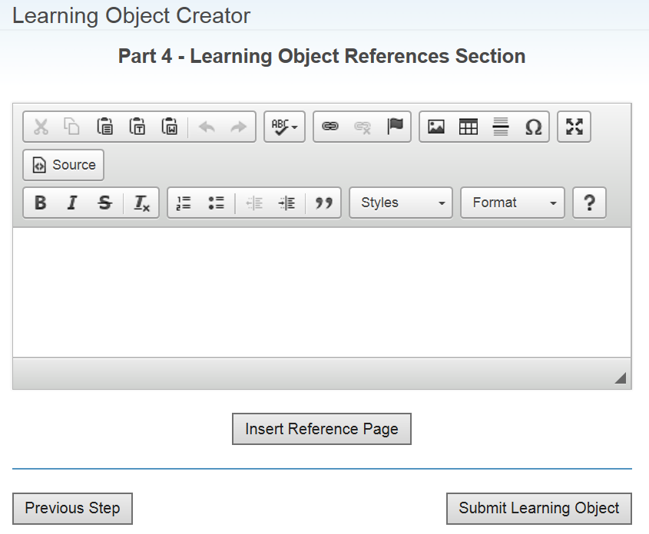
LOs and WReSTT cont

Slide 18
Summary
Introduced Learning Objects (LOs)
Showed examples of LOs
Described how LOs may be used in WReSTT

