Slide 1

Testing Tools:
Test Automation and supporting tools
Jariro Pava, Robert Vanderwall
WISTPC-14
WISTPC-14

Slide 2
Agenda
Introduction to Automated Testing
Session 1: Functional Testing
  Web UI Testing with Selenium
Session 2: Unit Testing
  TDD
  NUnit and NSubstitute for C#

Slide 3
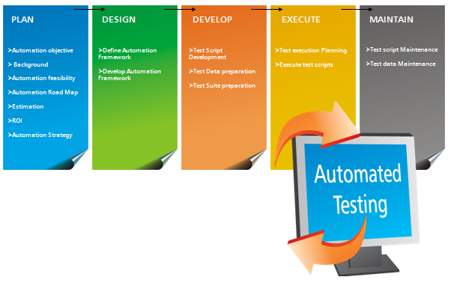
What is automated testing?
Writing code to test code
Notes:
Since it’s code, it needs the same level of professionalism and discipline that any other code
Should it get tested? Maybe so! Google often has 1 level of recursion on testing.
What kind of tools do we have to support this?

Slide 4

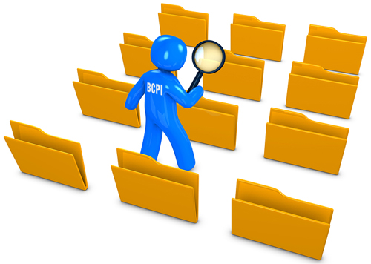
Categories of testing tools - 1
Test Creation
Test Execution Engine
Test Repository
Test Management System
Notes:
Test creation tools help automate this step: pict, rulegen,
Test repository tools: TFS, SPIRA,
Execution engines: Nunit, Junit, selenium

Slide 5


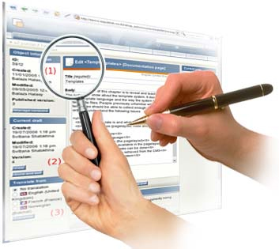

Categories of testing tools - 2
Notes:
Functional – black box & clear box :SoapUI
Performance, scalability, reliability : Loadrunner LoadUI
Security : fuzzers
Inspection and coverage tools: NCover

Slide 6
Tool Sources
TOOL Audience
    Managers
    Developers
    Testers
In house
Open source
Purchase
TOOL DIVERSITY
    One Person Shop
      One tool set
    Enterprise with N engineers
      N tool sets

Slide 7
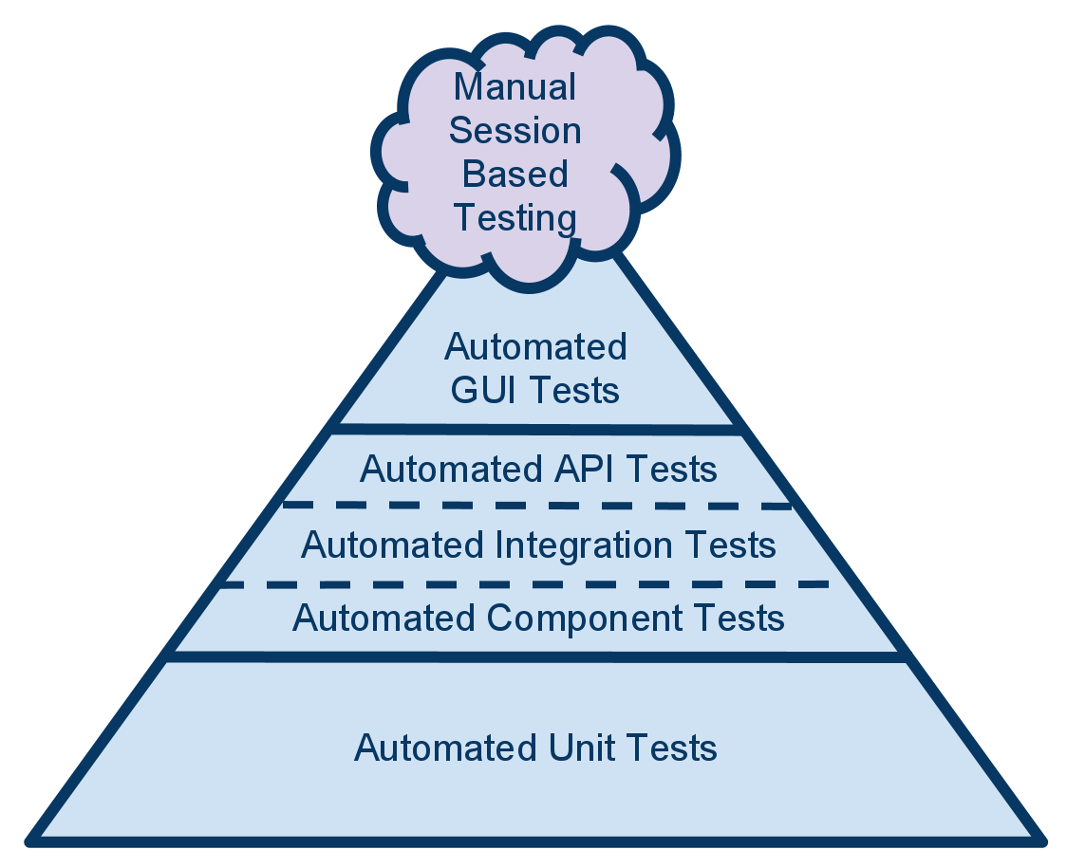
Test pyramid
Notes:
What’s the purpose of dividing up tests in this way?
It is desirable to have many fast tests and few slow tests.

Slide 8
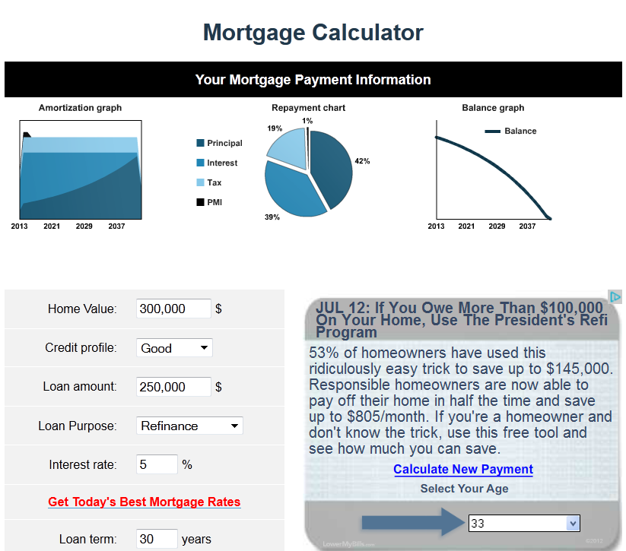
Manual Testing Session: Bug Bash
Test this website: http://www.mortgagecalculator.org
Notes:
Lets use the techniques that Jim talked about yesterday to ‘bug bash’ this web site.
Home value 0

Slide 9
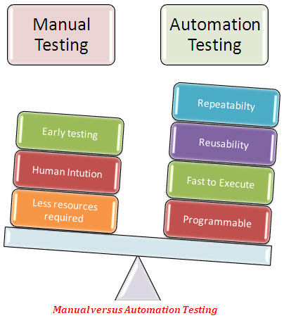
Manual Versus Automated Testing

Slide 10
Agenda
Introduction to Automated Testing
Session 1: Functional Testing
  Web UI Testing with Selenium
Session 2: Unit Testing
  TDD
  NUnit and NSubstitute for C#

Slide 11
Selenium Demo

Slide 12
Agenda
Introduction to Automated Testing
Session 1: Functional Testing
  Web UI Testing with Selenium
Session 2: Unit Testing
  TDD
  NUnit and NSubstitute for C#

Slide 13
Unit Testing
Testing of the smallest unit of behavior
  Function
  Method
  Class
Usually very fast
  Mock out external resources (DB, network, etc.)
  Sometimes mock internal code

Slide 14
TDD
Test Driven Development
  Write the test
  Write the code
  Refactor the code
Some terms
  Red - a failing test
  Green – a passing test

Slide 15
TDD in C
Really? Isn’t TDD a new approach and isn’t C an old language?
Yes, Yes, Yes.
Notes:
TDD is usually seen in the context of java, C#, python, or some ‘modern’ language but nothing in TDD prevents its use in C.

Slide 16
TDD
Write a test
  The test should fail since we haven’t written the code yet.
Write the code
  Write only enough code to get green.
Refactor
  Modify the code to be clean, efficient, stylized, etc.

Slide 17
Write a test
Make sure you see red first.
You know the test is actually testing something
  And not just tautologically passing.
You’ve defined in unambiguous terms what you expect the code to do.

Slide 18
Write the code
Right only as much code as you need in order to get the test to pass
Writing any more would produce untested code.

Slide 19
Refactor
This is really a critical step since the code probably is ugly.
You have sufficient test automation in place to assure that refactoring does not break existing functionality.

Slide 20
TDD Demo

Slide 21
TDD Advantages
The resulting code is testable
The code has a significant part of the unit test suite already constructed
We are in a good position to optimize the code and know if we will break it
The tests provide clear examples of how to use the code
Notes:
You could argue that the last 3 advantages can be realized with any automated unit testing approach. TDD simply encourages it.

Slide 22
TDD Limits
I’ve had a lot of success with TDD, but it doesn’t ‘work’ for every programming effort.
It works really well when you have clear and relatively straight-forward requirements
I’ve not had much luck when the code is very complex. I found it difficult to incrementally build the code, I found it easier to ‘just build it’
Notes:
See Ron Jefferies and the “sudoku debacle’ http://ravimohan.blogspot.com/2007/04/learning-from-sudoku-solvers.html
Also see http://beust.com/weblog/2014/05/11/the-pitfalls-of-test-driven-development/

Slide 23
TDD in the classroom
Fairly common practice in industry, so familiarity is valuable
Helps student get the assignment correct by breaking it down
Helps in the grading process because it’s easier to see the evolution of the code.

Slide 24

Nunit Demo

