Slide 1



Introduction to WRESTT
(WISTPC 2014:2) July 18th, 2014 @ FIU Main Campus
A Cyber Enabled Learning Environment of Software Testing Education
Supported by NSF / TUES Type II

Slide 3

History of WReSTT
First funded by NSF/CCLI in 2009
Collaborative project: FIU & FAMU, lead by Peter Clarke
Long term Goal: creating a web-based repository for vetted software artifacts to support pedagogy.
Project goal: creating web-based repository of testing tools to support pedagogy.

Slide 4
Findings of WReSTT
Results: need to extend the learning materials in WReSTT, provide a more attractive web interface and additional incentives for students and instructors to use WReSTT

Slide 5

Demand for Cyber Enabled Learning Environment
“cyberlearning has the potential to transform education throughout a lifetime, enabling customized interaction with diverse learning materials on any topic” – NSF report 09
Rapid development of information technology & population of Internet
Shifting from Instructor based, passive learning to student centered, interactive learning
Technology driven – characters of current groups of learners (emails, cell phones, instant messengers, … ) – new era of communication
Unbeatable advantages: free distance, space, time limitations

Slide 6
Demand for Cyber Enabled Learning Environment (Cont’d)
Disadvantages: Laboratories
Categories: synchronous and asynchronous
Current status in STEM and CS education
Introductory courses, numerous platforms, full fledged,
Senior and capstone courses

Slide 7
WRESTT – Web based Repository Of Testing Tool w/ Cyber enabled LE (ver 2)
Main goal: to create new learning materials and develop faculty expertise to significantly increase the number of undergraduate students that are exposed to testing methodologies and use of testing tools in undergraduate courses with a programming component. Specifically,
Create new software testing learning objects and transform WReSTT into a cyberlearning environment (WReSTT-CyLE – Web-based Repository of Software Testing Tutorials: A Cyberlearning Environment).
Conduct bi-annual workshops to develop faculty expertise in software testing and in using the new features in WReSTT-CyLE to support pedagogy.
Foster students’ acquisition of software testing concepts and skills in upper-level undergraduate courses with a programming component.
Promote the new features and learning objects in WReSTT-CyLE and disseminate the research findings and success stories from the project to the academic community.

Slide 8

WReSTT/CyLE
Context: Software engineering, software testing, and programming (CS1-CS3)
Pedagogy: Web based repository + social networks => Cyber enabled LE
Audience: students, learners, instructors, educators, and researchers
Technology: SCORM standardized Los
Outcomes:
Increased number of testing learning objects and cyberlearning features in WReSTT-CyLE when compared to WReSTT.
Pre/post test improvement of instructor knowledge of software testing, positive survey responses on using WReSTT-CyLE, and increased number of instructors using WReSTT-CyLE.
Pre/post test, grades, and survey responses reflecting an improvement of students’ knowledge and skills in software testing in upper-level undergraduate courses with a programming component.
Increase the number of (1) users accessing WReSTT-CyLE by at least 20% each year, and (2) citations to WReSTT-CyLE and to the project’s published research findings by at least 20% each year.

Slide 9
Overview (1)
Professor view
Manage class
Student enrollment
Team creation
Point rewards set up
Pre/post Test
View
Pre/post test submission
Student report

Slide 10

Overview (2)
Student view
Create student account
Learning objects overview
Profile
Forum and posts

Slide 11
Others
Leadership – Dr. Clarke and FIU group
Strong evaluation team
Student support and experience exposed to both educational research and technology
Dissemination and community communication
Previous workshops: http://wrestt.cis.fiu.edu/wistpc-14-2

Slide 12
References & Documentations
Peter J. Clarke, Jairo Pava, Debra Davis, and Tariq M. King. Using WReSTT in SE Courses: An Empirical Study. In the Proceedings of the 43rd ACM Technical Symposium on Computer Science Education (SIGCSE '12). ACM, pages 307-312.
Peter J. Clarke, Jairo Pava, Yali Wu, and Tariq M. King. 2011. Collaborative Web-Based Learning of Testing Tools in SE Courses. In Proceedings of the 42nd ACM Technical Symposium on Computer Science Education (SIGCSE '11). ACM, New York, NY, USA, pages 147-152.
Peter J. Clarke, Andrew A. Allen, Tariq M. King, Edward L. Jones, and Prathiba Natesan. Using a Web-Based Repository to Integrate Testing Tools into Programming Courses. In Proceedings of the ACM international Conference Companion on Object Oriented Programming Systems Languages and Applications Companion. SPLASH 2010, pages 193-200.

Slide 13
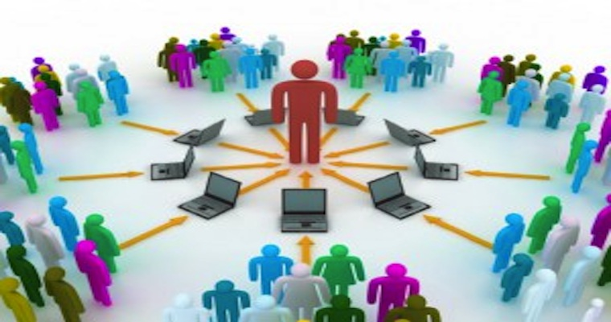
Thank You!

