Slide 1
Studies and Success Stories
Peter J. Clarke
6/13/2015

Slide 2
Outline
WReSTT Studies and Success Stories
FIU
MU
NDSU
Questions, Comments Suggestions

Slide 3
FIU Study 1
The objectives of the studies are to investigate the improvements in students’: (a) conceptual understanding of software testing, and (b) practical program testing skills, when using the learning materials in WReSTT.
Control group for S/w Eng I (SP11 + SP12) - undergraduate Software Engineering class in Spring 2011 and Spring 2012.
Treatment group (group using WReSTT) for the S/w Eng I (SU11 + SU12) – Summer 2011 and Summer 2012 classes

Slide 4
FIU Study 1 Results
Class | Size | Overall Testing Knowledge | Use of Testing Techniques | Tool Usage | Perceived Tool Proficiency
S/w Eng I (SP11 + SP12) | 35 | -12% (12.8 to 11.3) | -20% (4.8 to 3.8) | 12.1% (0.7 to 0.7) | 3.7% (2.8 to 2.8)
S/w Eng I (SU11 + SU12) | 37 | 98% (11.0 to 21.7) | 23.2% (5.2 to 6.4) | 640% (0.4 to 2.8) | 654% (0.6 to 4.3)

Slide 5
FIU Study 2
Objectives:
Use of code coverage tools increases student’s propensity to improve the quality of their black-box test suites.
Students find WReSTT a useful learning resource for testing techniques and tools.
Students find that WReSTT supports collaborative learning.

Slide 6
FIU Study 2 Results
Class | Size | # of Project Teams | # of Coverage Tools used | Increase # of Unit Test Cases | % Increase in Statement Coverage
S/w Testing I (Fa12) | 35 | 6 | 2 | 28% (25 to 32) | 76% (54 to 90)
S/w Testing I (Fa13) | 30 | 6 | 3 | 38% ( 32 to 44) | 58% (56 to 89)
Results in Table are for unit testing only

Slide 7
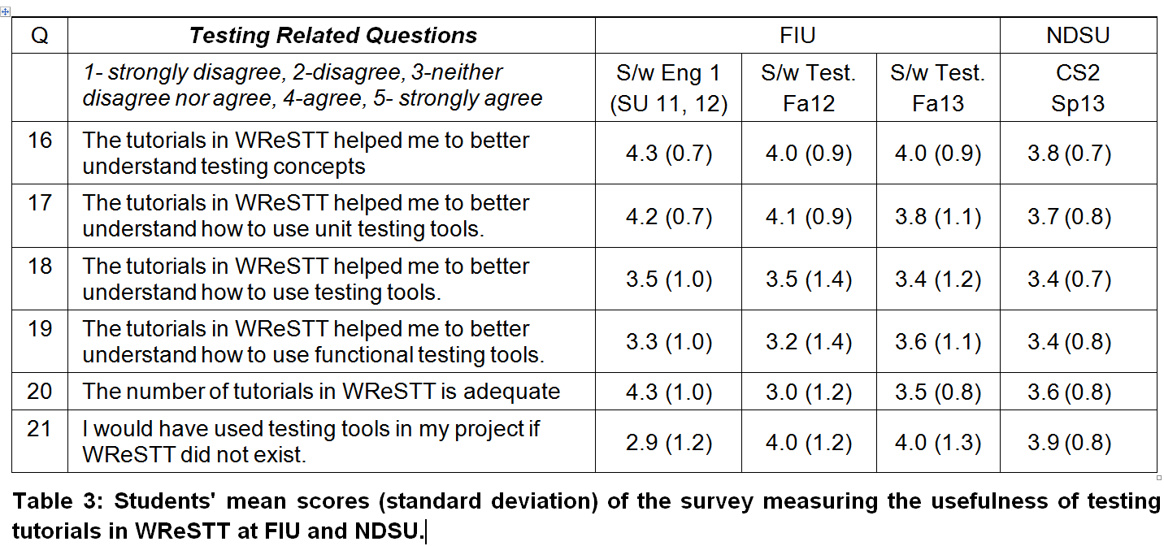
WReSTT Results
1- strongly disagree, 2-disagree, 3-neither disagree nor agree, 4-agree, 5- strongly agree.

Slide 8
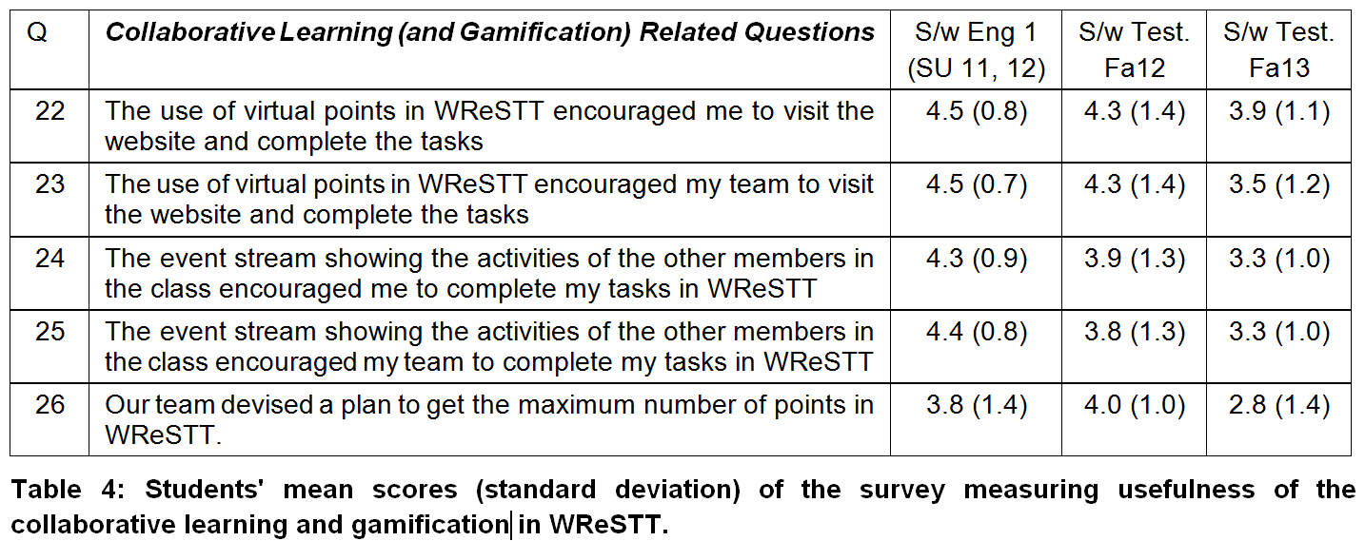
WReSTT Results cont
1- strongly disagree, 2-disagree, 3-neither disagree nor agree, 4-agree, 5- strongly agree.

Slide 9
Data of Class Study at AAMU
The WRESTT tool was introduced to four (4) courses at AAMU – CS 206 (Java), CS 328 (OO Design), CS 403 (Senior Design), and CS 561 (Software Eng.)
Pre/Post tests were enabled
Three initial LOs were used in all four classes
Around March 30 – to April 22nd, Spring 2015
Students grade and report were available in WRESTT tool

Slide 10
Data of Class Study at AAMU cont
Interviewed by Dr. Steven Condly April 24
Short Summary:
Three LOs are very useful for class CS 206, many students had very positive response to the content.
WRESTT tool is more appropriate for students in programming classes to help them to understand software testing in the conceptual level.
For CS 561 students need more high level knowledge other than initial introduction.
For other two, half-half.

Slide 11
Project Status: Miami University
Update to introduction to testing tutorials.
Additional tutorials about:
Black box testing
Structural testing
Modeling software for testing

Slide 12
Project Status cont
Features of new or revised tutorials:
Shorter tutorials
More quiz questions
More examples

Slide 13
Classroom Experiment
In a sophomore-junior level course
A course about networking
Programming was an important component
Testing was not a specific course objective

Slide 14
Studies at North Dakota State University
WReSTT was introduced in
CS I (160),
CS II (161),
Software Testing and Debugging (316 and 716)
2013 –
21 students in CS II used WReSTT to complete programming assignments (Unit and Coverage).
Pre/Post test showed a significant increase in testing knowledge

Slide 15
Major Results
WReSTT was able to improve the students understanding of general testing concepts and their ability to apply a particular technique to test the code
Testing tool Usage :
significantly higher during the posttest when compared to their pretest score (an average of 3.2) at p<0.01 level
students during the posttest were able to identify a significantly larger number of tools for each category (i.e., Unit testing, Functional testing, Code Coverage) when compared to their responses during the pretest
the results from a One-sample Wilcoxon Signed-Rank test showed that the average ratings of the “benefit of using tools to support testing of programming assignments” after using the WReSTT (at posttest) was significantly greater than 3 (i.e., midpoint of the scale) at p<0.05

Slide 16
Studies – Cont’d
2014
WReSTT with collaborative learning, virtual teams and virtual points and Learning Object on Introduction to Software Testing
Students enrolled in CS I, S/W Testing and Debugging
Results: Students found WReSTT to be beneficial but felt “more LO’s should be added”

Slide 17
Studies – Cont’d
2015
WReSTT with revised LO’s
121 students enrolled in 3 sections of CS I used WReSTT with collaborative learning
Preliminary results based on Steve’s visit on April 22
Students found WReSTT’s collaborative aspects useful but felt it should be a part of course
LO’s can be improved with more videos and examples

Slide 18
Questions? Comments! Suggestions …

