Slide 1
Introduction to WReSTT
Peter J. Clarke
6/12/2015

Slide 2
Outline
History of WReSTT
What is WReSTT today?
Current versions of WReSTT
Future of WReSTT

Slide 3
History of Project
WReSTT – Web-Based Repository of Software Testing Tools (version 1) NSF CCLI Phase 1 Project (2008)
Provided students and instructors with an online repository of tutorials on software testing tools.
WReSTT (version 2) NSF TUES 2 Project (2012)
Added collaborative learning and social networking features (based on student’s suggestion in 2011)
Introduced tutorials on software testing concepts

Slide 4
What is WReSTT today?
WReSTT – Web-Based Repository of Software Testing Tutorials, is a cyberlearning environment that helps to improve students’ conceptual and practical understanding of software testing concepts and skills.
WReSTT uses a combination of learning and engagement strategies (LESs) to get students more involved in the learning process.
LESs include collaborative learning, gamification, and social interaction
Learning content organized as “Learning Objects”

Slide 5
What is WReSTT today? cont
Collaborative learning [Smith et al. 1992, Wiki]
Involvement – interacting more with other students and teachers (forums)
Cooperation and teamwork – students engaging in common tasks (virtual teams)
Civic responsibility - each individual depends on and is accountable to each other (bonus points)
Gamification [Malone 1980]
Uses game design elements and game mechanics to increase user experience and engagement with a system, which can be applied to an educational context (virtual points, leader board)

Slide 6
What is WReSTT today? cont
Social Interaction [Wiki]
Online learning community – uses positive reinforcement, presents new information in motivating ways, and encourages group collaboration (LOs, forums and activity streams)
Cyberlearning
The use of networked computing and communications technologies to support learning
Issues
standards used to create learning materials (LO – SCORM),
support for content delivery using different multimedia formats

Slide 7
Current Versions of WReSTT
Three versions of WReSTT
Live (used by classes)
devel (site used for development and testing)
demo (demonstration site used during workshops)
http://demo.wrestt.cis.fiu.edu/

Slide 8
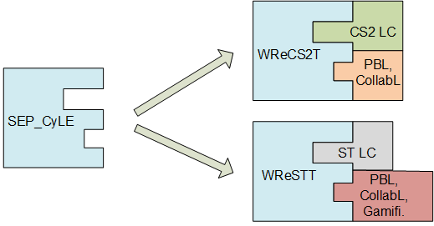
Future of WReSTT
SEP-CyLE – Software Engineering and Programming
CyberLearning Environment
Configurable LESs
collaborative learning (CollabL)
problem-based learning (PBL)
gamification (Gamifi)
social interaction (SI)
Learning Content (LC)
Software Testing (ST)
Software Engineering (SE)
Computer Programming 2 (CS2)
Instantiation of the SEP-CyLE into platforms for CS2 and software engineering (SE).

Slide 9
Summary
Provided a historical perspective on WReSTT
Described WReSTT in its current form
Peeked into the future of WReSTT
Commercialization$$$$

