Slide 1
Using Learning Objects (LOs) in WRESTT

Slide 2
Outline
Background of LOs
Steps of Creating LOs in WRESTT tool (interactive)

Slide 3
Intro to LOs
An LO is a “collection of content items, practice items, and assessment items that are combined based on a single learning objective”.
Smaller chunks: Compared to traditional learning, LOs are much smaller units of learning, typically 2 minutes to 15 minutes.
Are self-contained: LOs can be taken independently
Can be aggregated: LOs can be grouped into larger collections
Acknowledgement: Dr. Peter Clarke ☺

Slide 4
LOs and WReSTT
Decided to go with SCORM (Sharable Content Object Reference Model) specifications
Developed by FIU team has implemented Learning Objects (LOs) in the current WReSTT, which allows instructors to create LOs.

Slide 5
Start Now
http://demo.wrestt.cis.fiu.edu
Log on as instructor

Slide 6
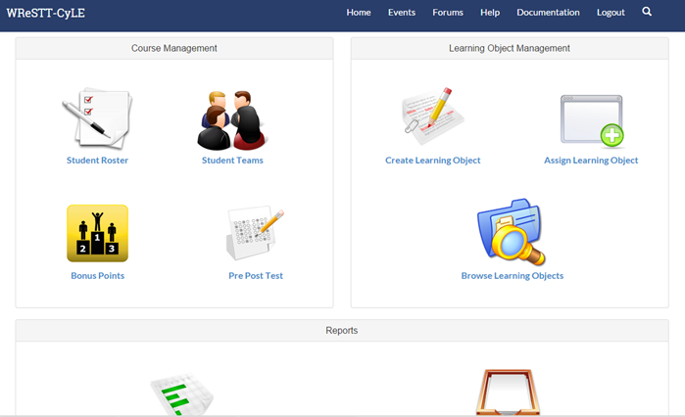
Current Interface

Slide 7
Learning Object Management
Create Learning Object (√)
Assign Learning Object
Browse Learning Objects

Slide 8
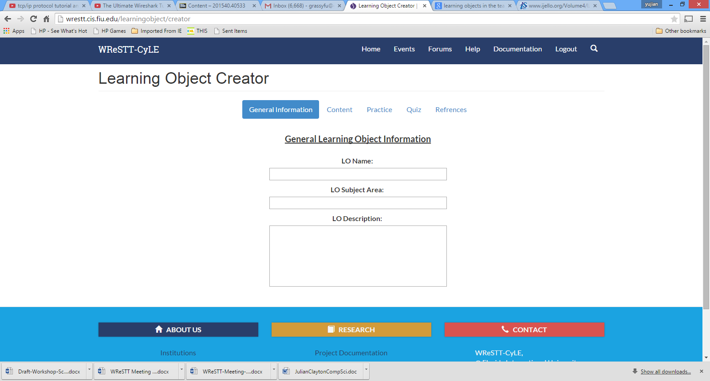
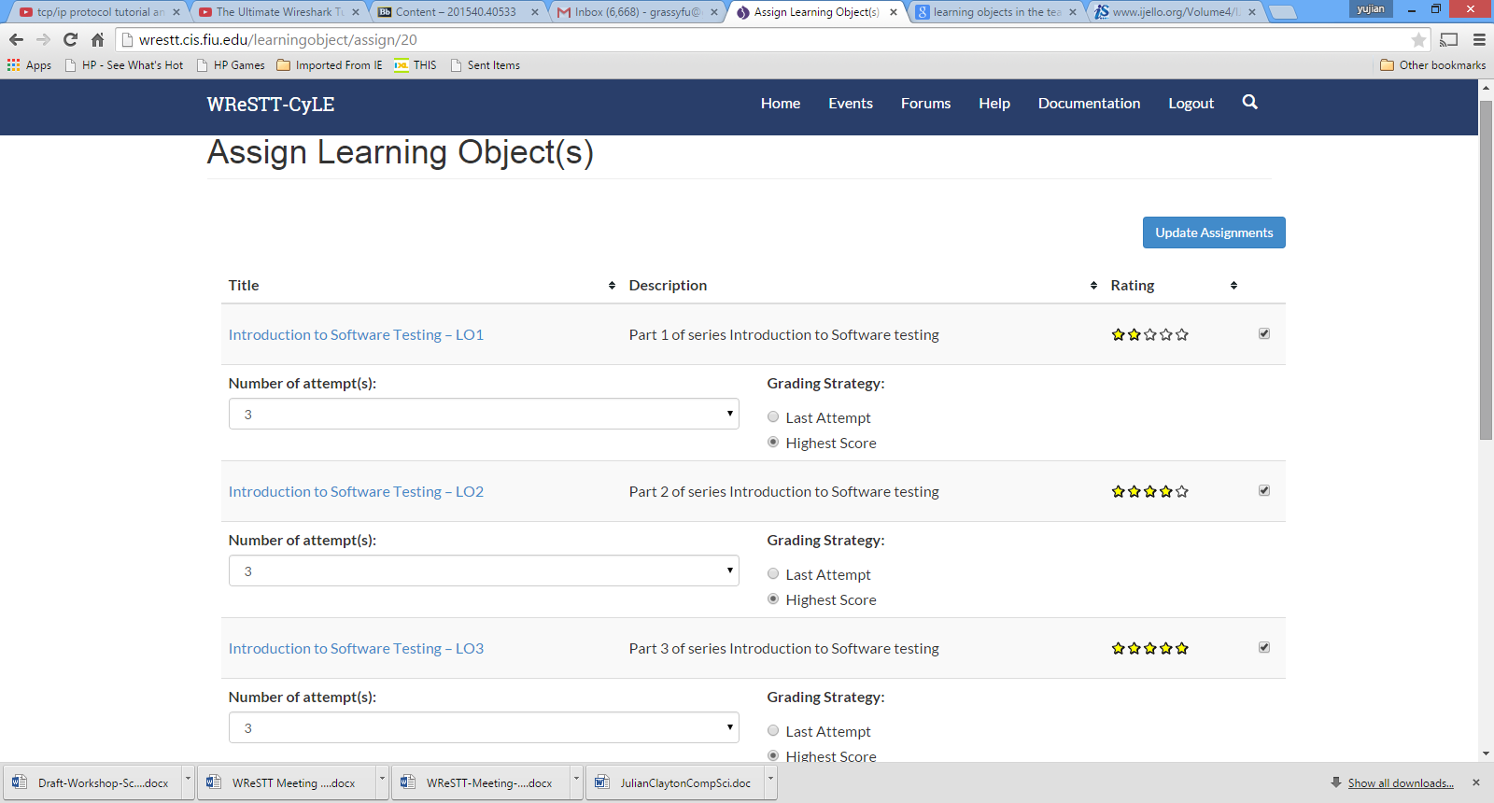
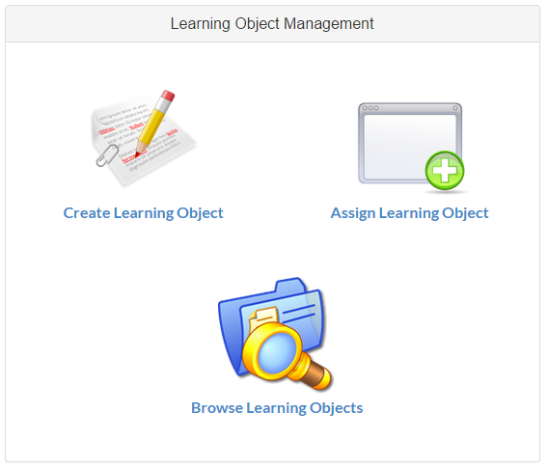
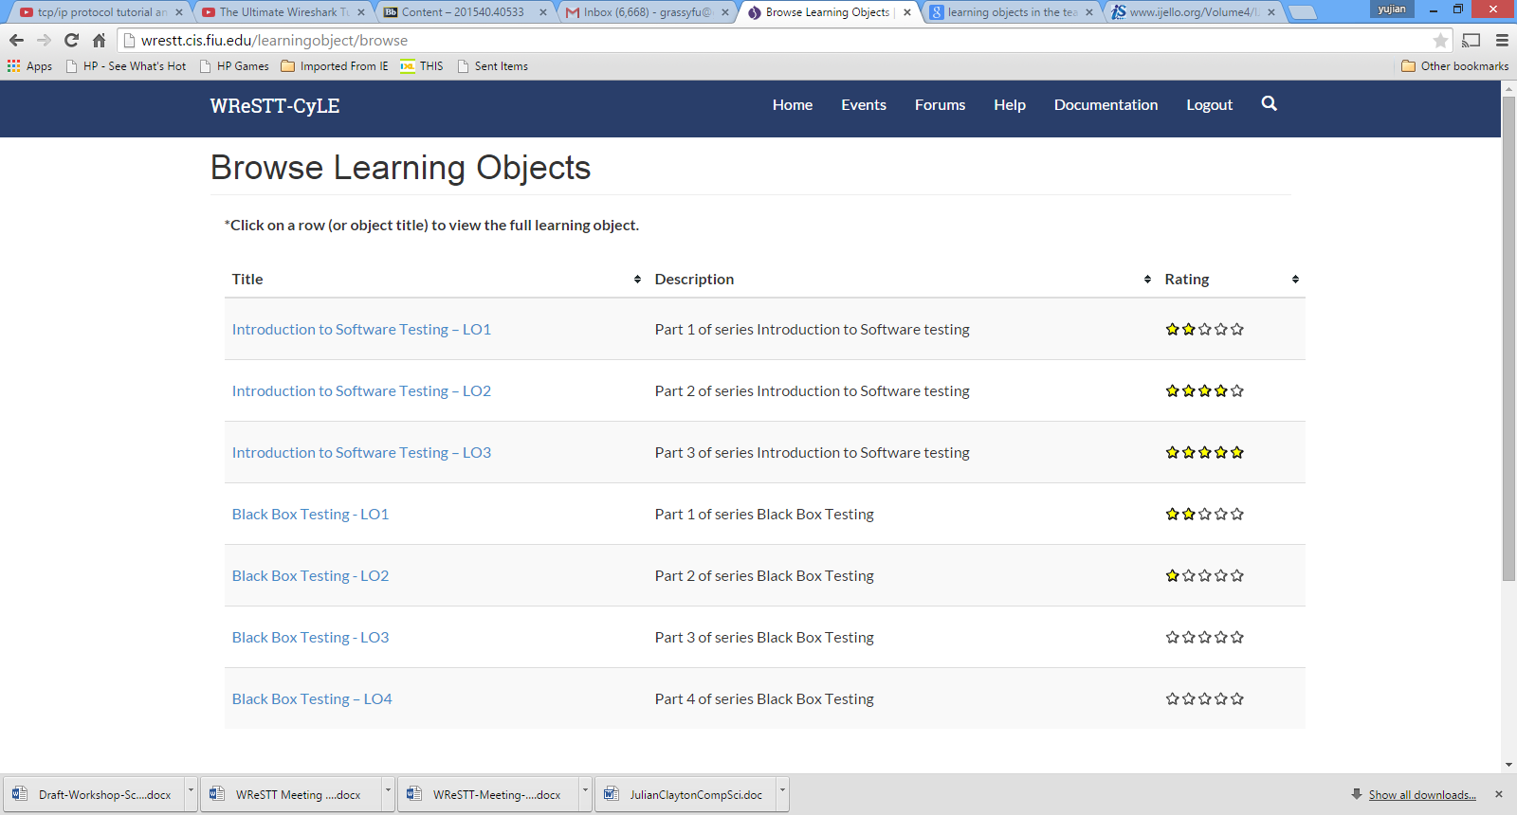

Slide 9
Steps of Creating Learning Object
General Learning Object Info (Name, Subject Area, and Description)
Content: the place you input content
Practice
Quiz
References

Slide 10
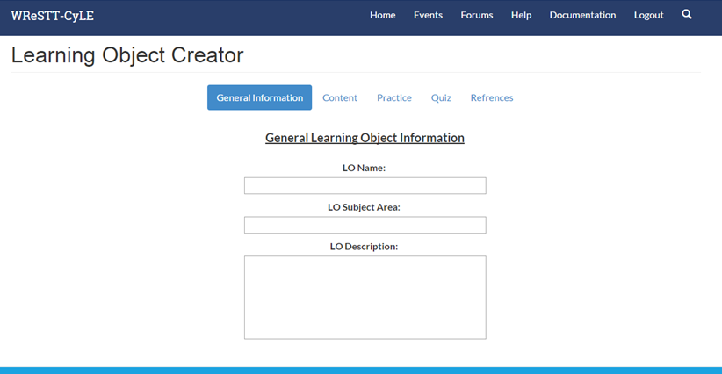
CLO – General Info

Slide 11
Category
Introduction to Software Testing
Unit testing
Blackbox testing
Equivalence partitioning
Boundary value analysis
State transition table decision table
Whitebox testing
Static testing
Dynamic testing

Slide 12
Category (cont’d)
Installation testing
Usability testing
Compatability testing
Beta testing
Regression testing
Acceptance
Non-functional testing

Slide 13
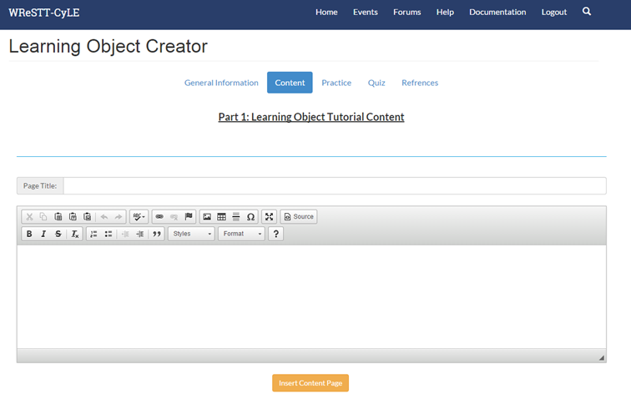
Content – Add Content Page

Slide 14
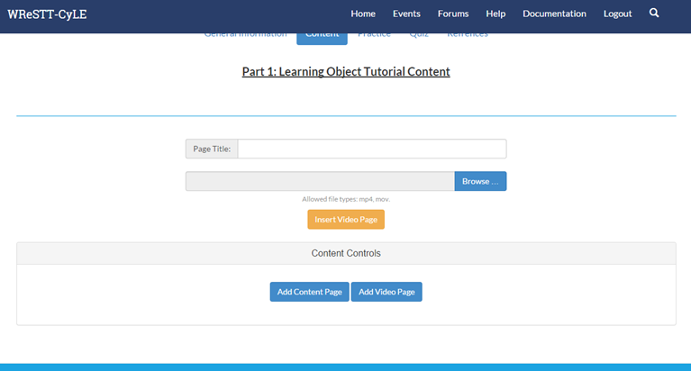
Content – Add Video Page

Slide 15
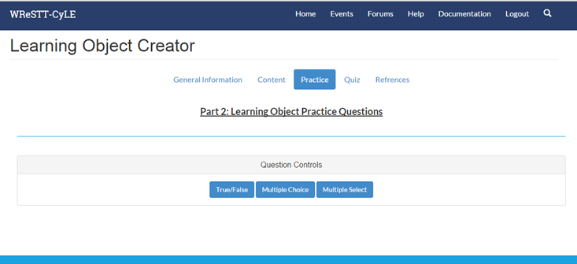
Practice Question

Slide 16
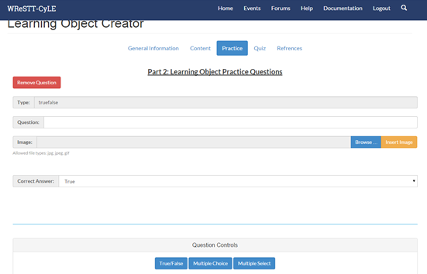
Practice Questions (interface)

Slide 17
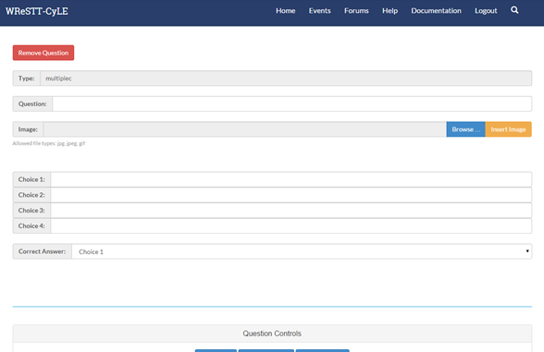
Practice Questions (adding choices)

Slide 18
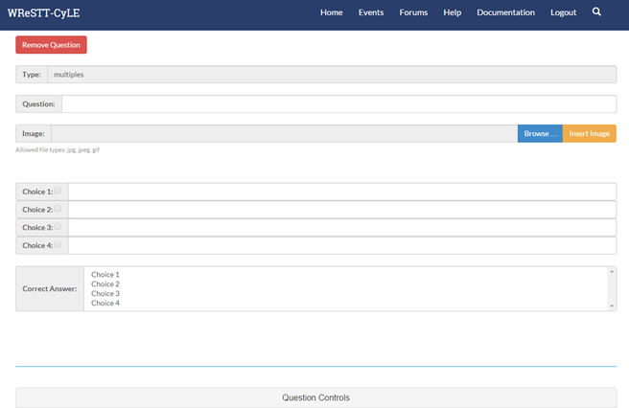
Practice Questions (type and correct answer)

Slide 19
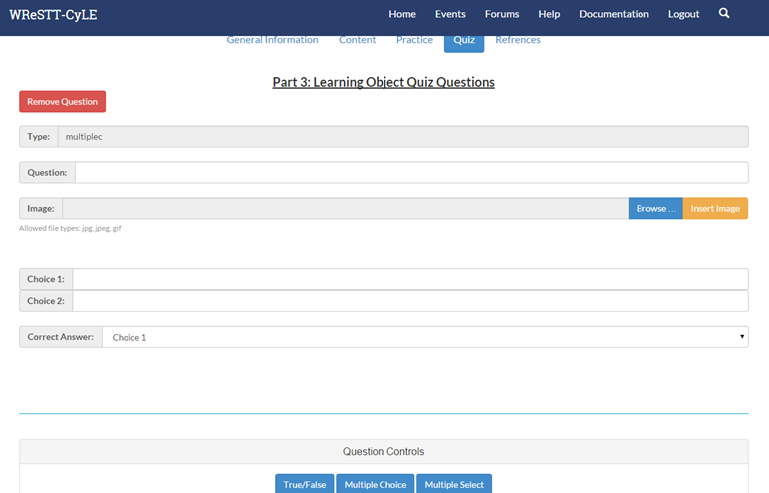
Quiz

Slide 20
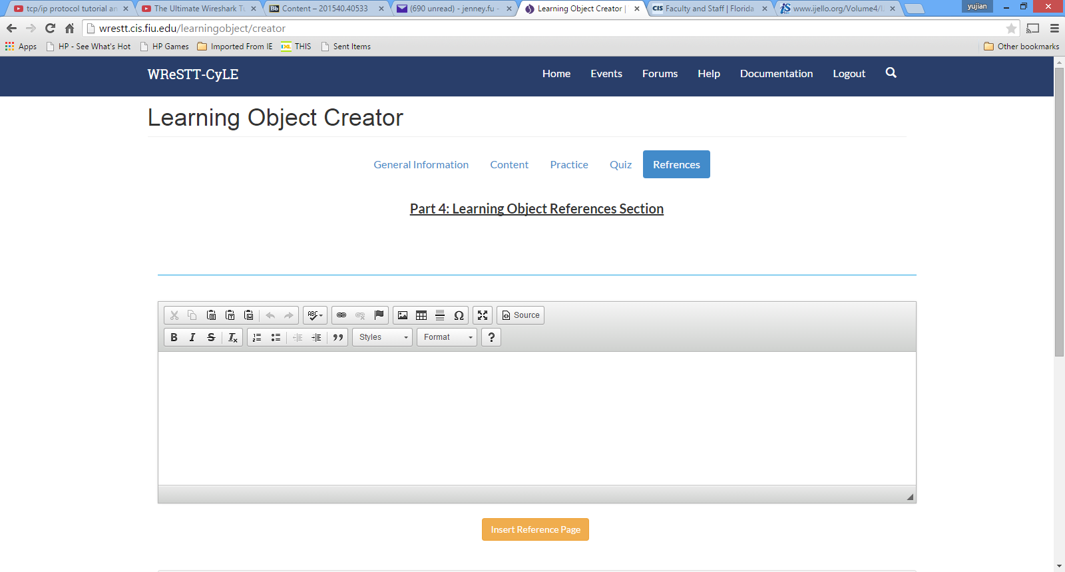
Add Reference click add reference page

Slide 21
Class Study at AAMU
CS 206, 328, 403, 561
CS 582
CS 401

