Slide 1

Testing Tools:
Test Automation and supporting tools
Dionny Santiago, Robert Vanderwall
WISTPC-15
WISTPC-15

Slide 2
Agenda
Introduction to Automated Testing
Session 1: Functional Testing
  Web UI Testing with Selenium
Session 2: Unit Testing
  TDD
  NUnit and NSubstitute for C#

Slide 3
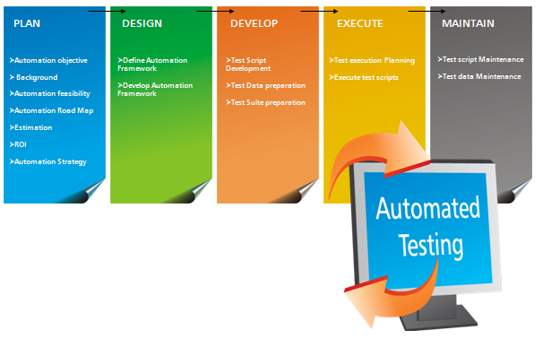
What is automated testing?
Writing code to test code
Notes:
Since it’s code, it needs the same level of professionalism and discipline that any other code
Should it get tested? Maybe so! Google often has 1 level of recursion on testing.
What kind of tools do we have to support this?

Slide 4
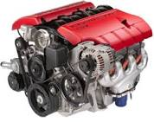

Categories of testing tools - 1
Test Creation
Test Execution Engine
Test Repository
Test Management System
Notes:
Test creation tools help automate this step: pict, rulegen,
Test repository tools: TFS, SPIRA,
Execution engines: Nunit, Junit, selenium

Slide 5




Categories of testing tools - 2
Notes:
Functional – black box & clear box :SoapUI
Performance, scalability, reliability : Loadrunner LoadUI
Security : fuzzers
Inspection and coverage tools: NCover

Slide 6
Tool Sources
TOOL Audience
    Managers
    Developers
    Testers
In house
Open source
Purchase
TOOL DIVERSITY
    One Person Shop
      One tool set
    Enterprise with N engineers
      N tool sets

Slide 7
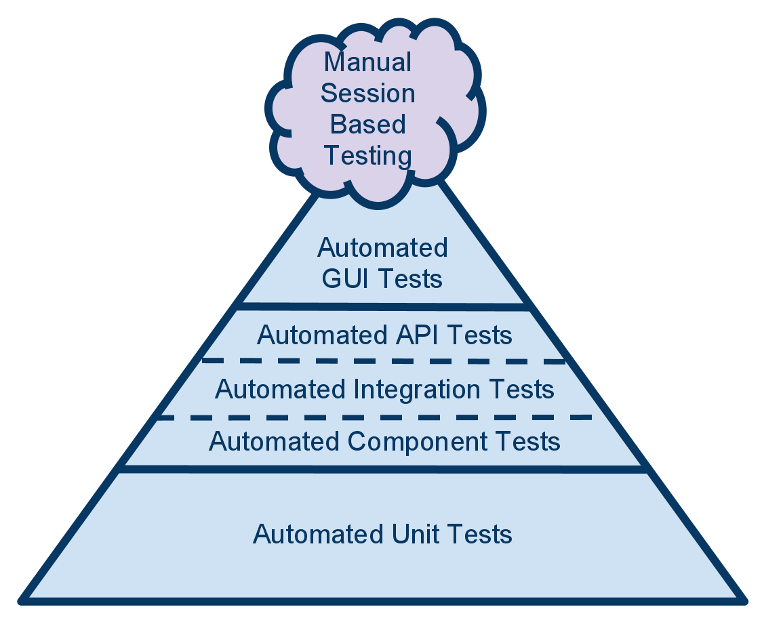
Test pyramid
Notes:
What’s the purpose of dividing up tests in this way?
It is desirable to have many fast tests and few slow tests.

Slide 8
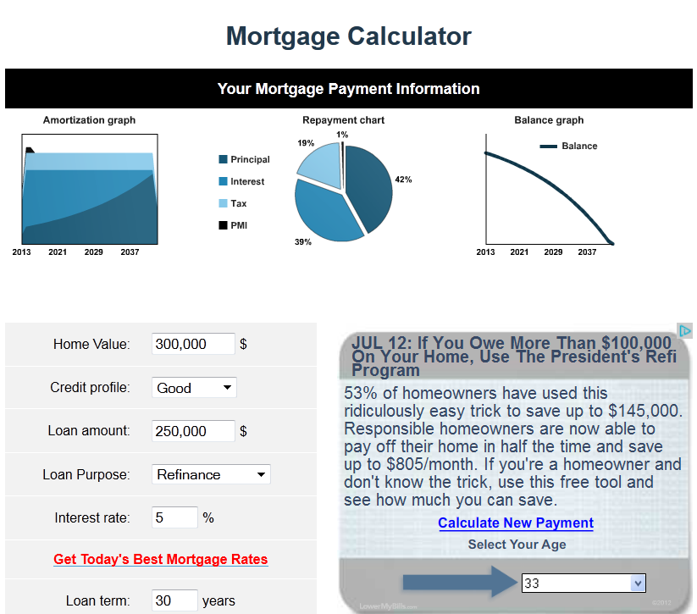
Manual Testing Session: Bug Bash
Test this website: http://www.mortgagecalculator.org
Notes:
Lets use the techniques that Jim talked about yesterday to ‘bug bash’ this web site.
Home value 0

Slide 9
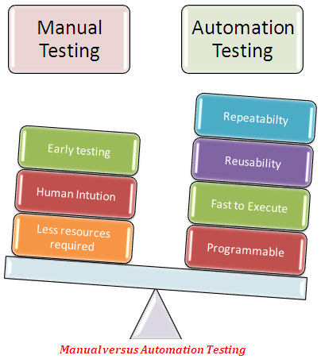
Manual Versus Automated Testing

Slide 10
Agenda
Introduction to Automated Testing
Session 1: Functional Testing
  Web UI Testing with Selenium
Session 2: Unit Testing
  TDD
  NUnit and NSubstitute for C#

Slide 11
Selenium Demo

