Slide 1
Using WReSTT – Instructor View
Gursimran Singh Walia, Associate Professor
North Dakota State University [FARGO, ND]
www.gursimransinghwalia.com

Slide 2
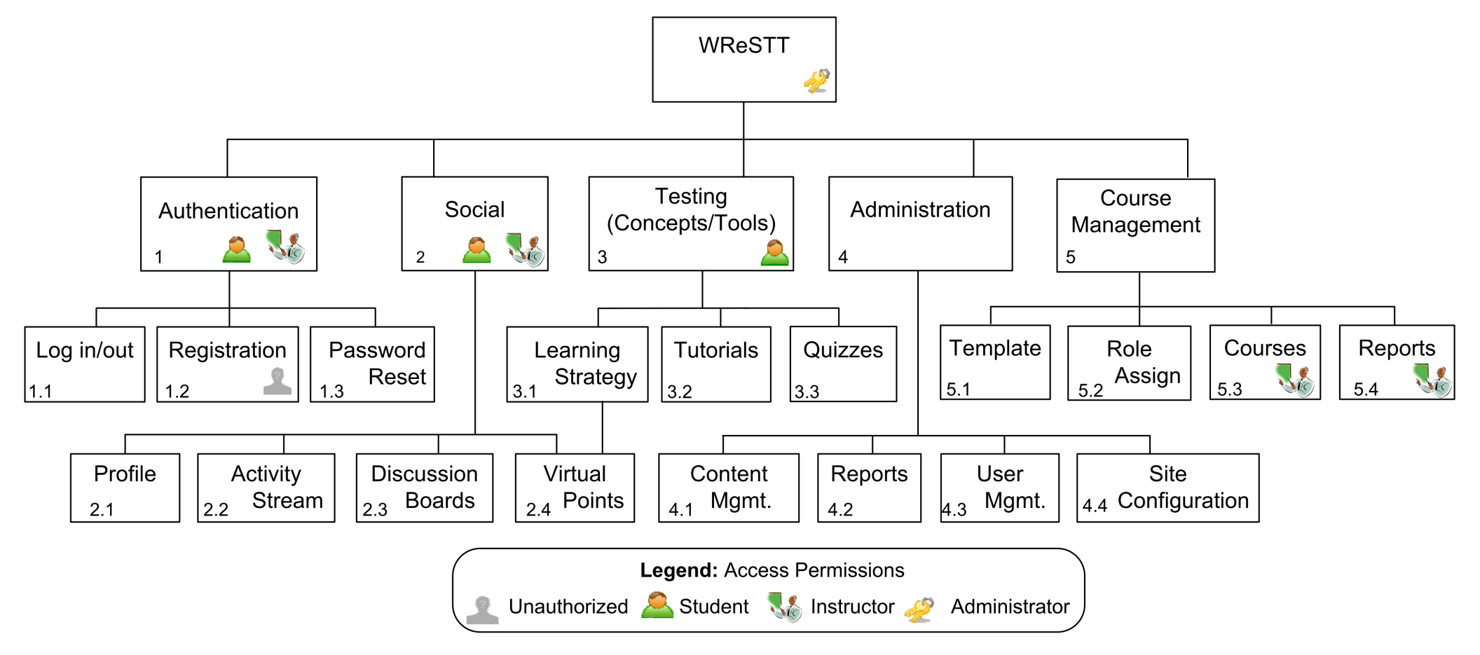

Agenda – Block Diagram [Clarke et al.]
Testing tools and Concepts
Allows users to access social n/w’ing features
Update content, and generate reports

Slide 3
Homepage
Demo Site: http://demo.wrestt.cis.fiu.edu/

Slide 4
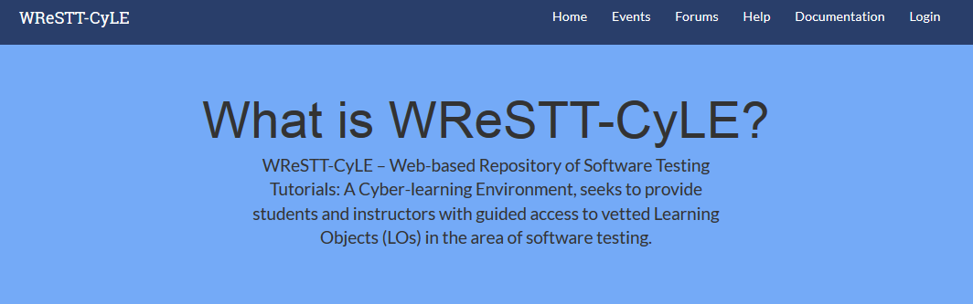




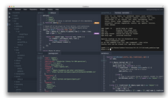


http://demo.wrestt.cis.fiu.edu/

Slide 5
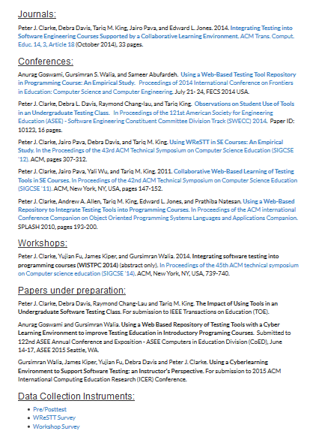


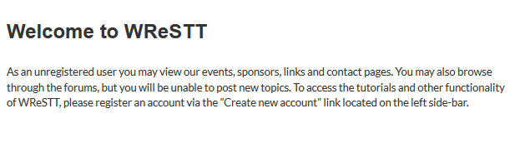
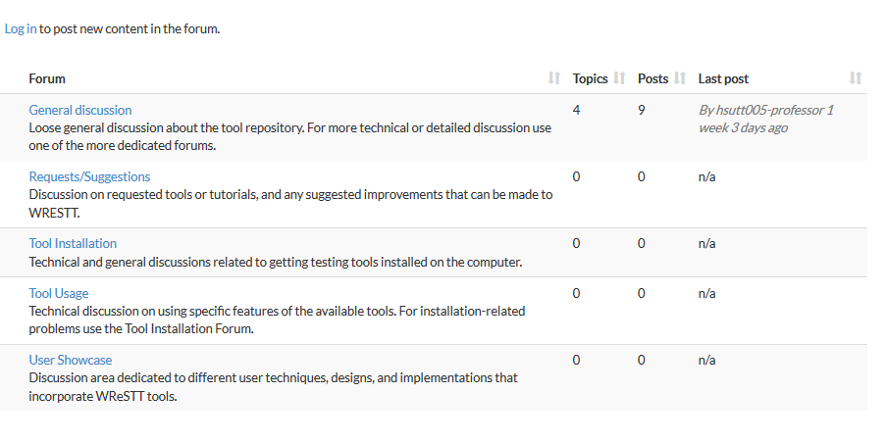
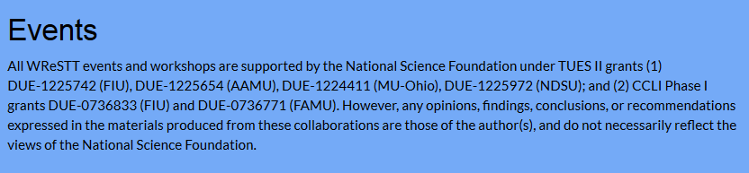
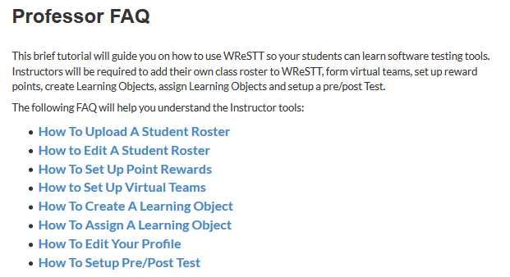
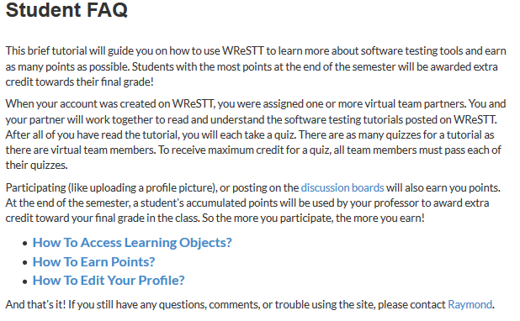
Home Page

Slide 6

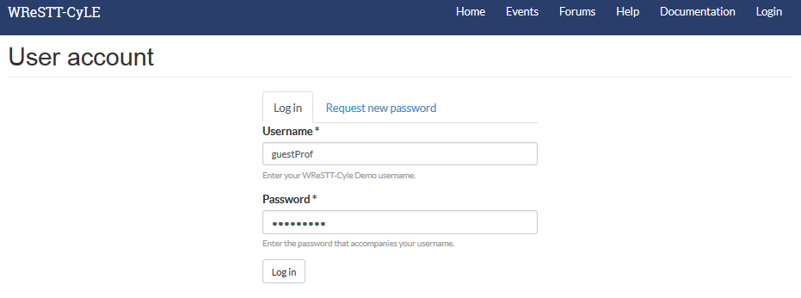
Logging in as Guest Instrcutor

Slide 7
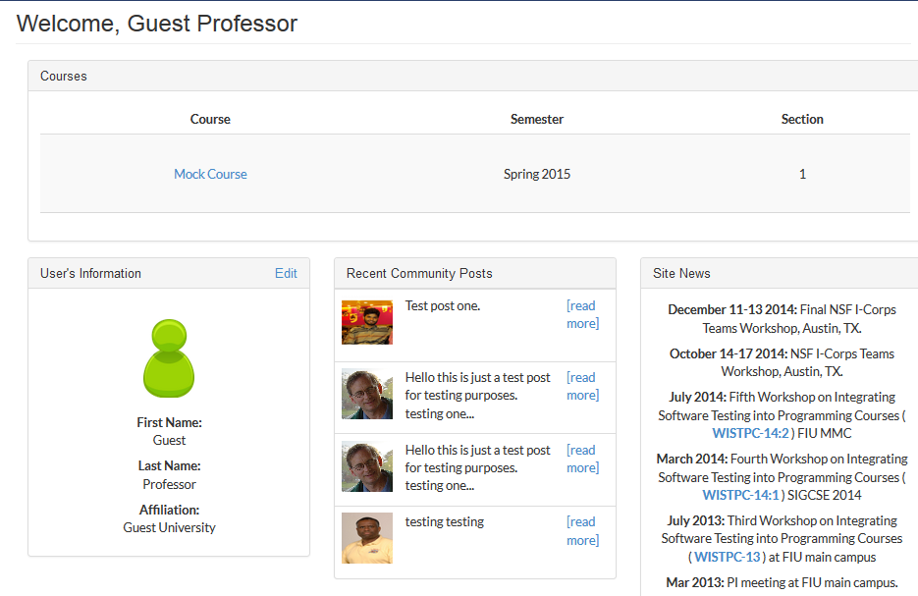
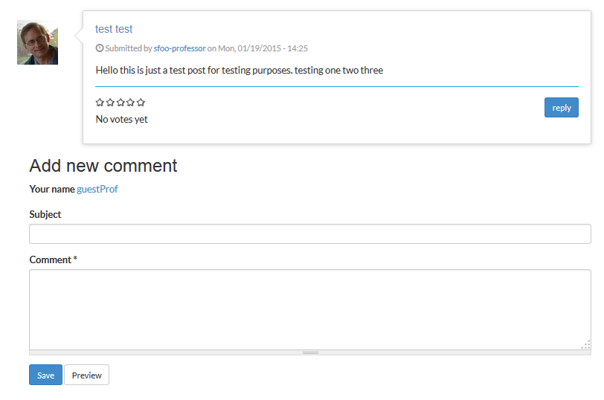
Instructor – Welcome View

Slide 8
Instructor – Welcome View

Slide 9
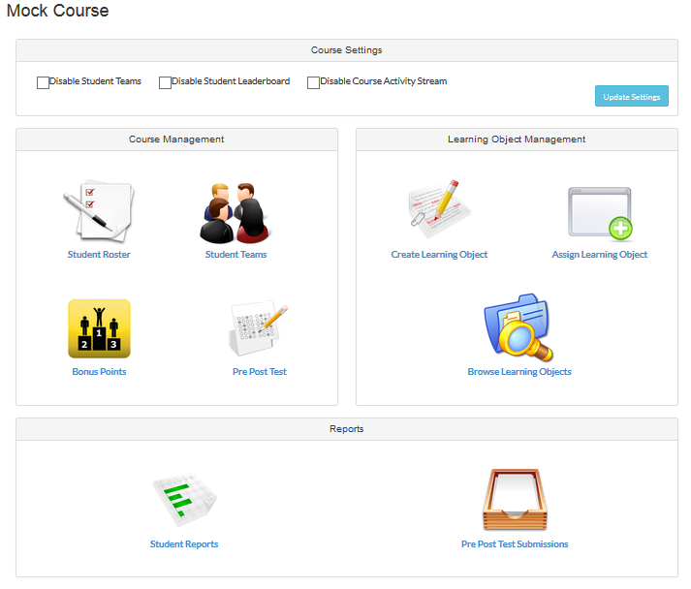
Mock Course

Slide 10
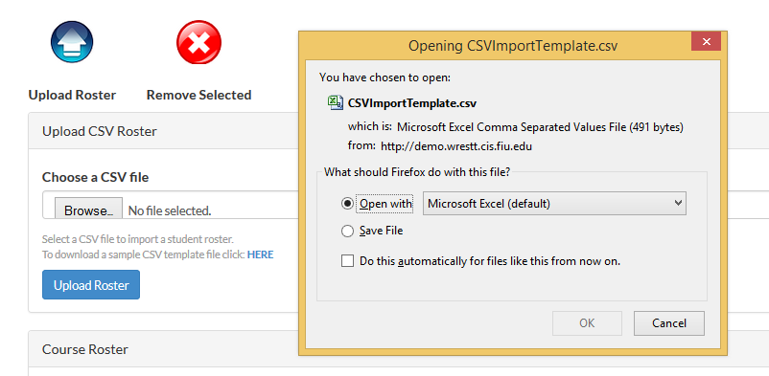
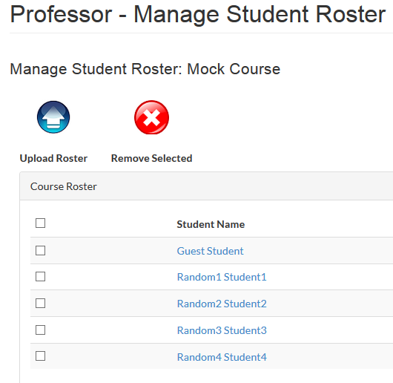
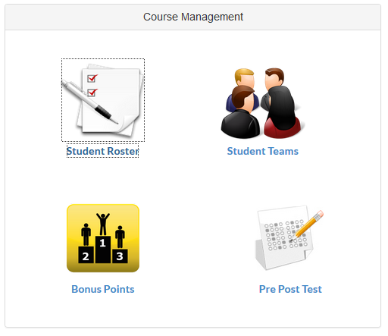
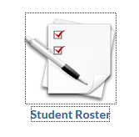
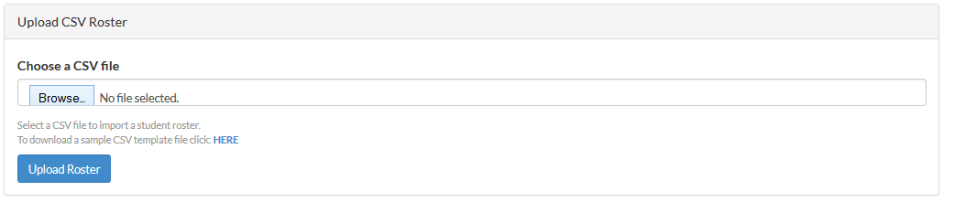
Course Management

Slide 11
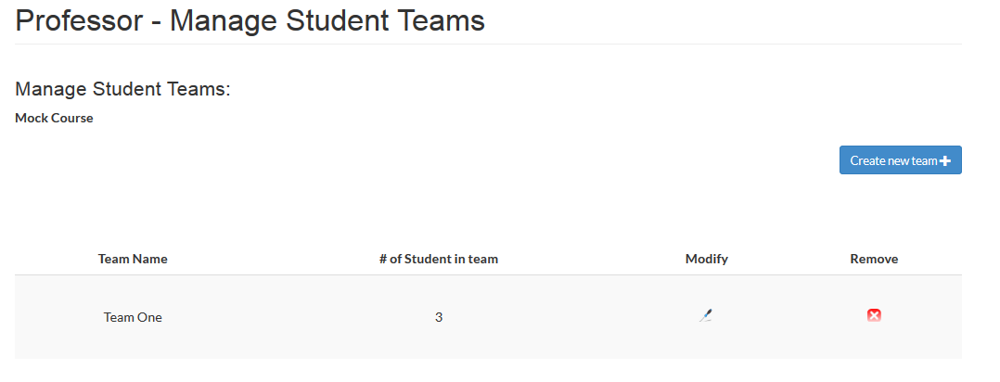
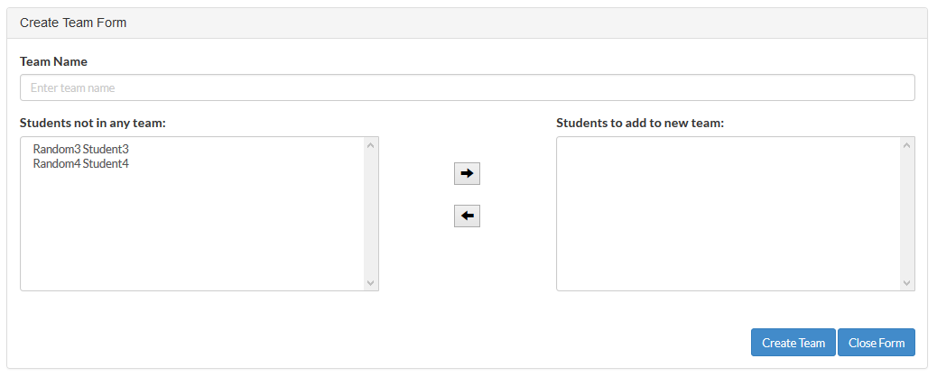
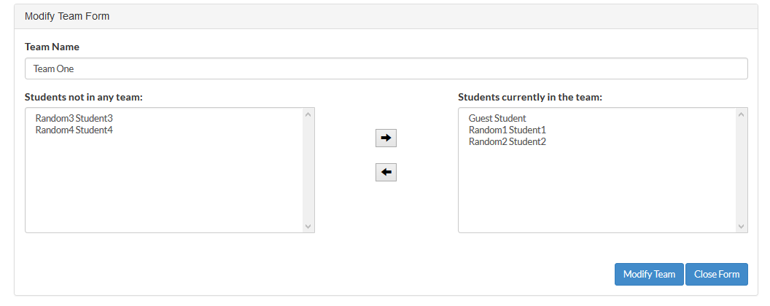
Course Management: Manage Student Teams

Slide 12
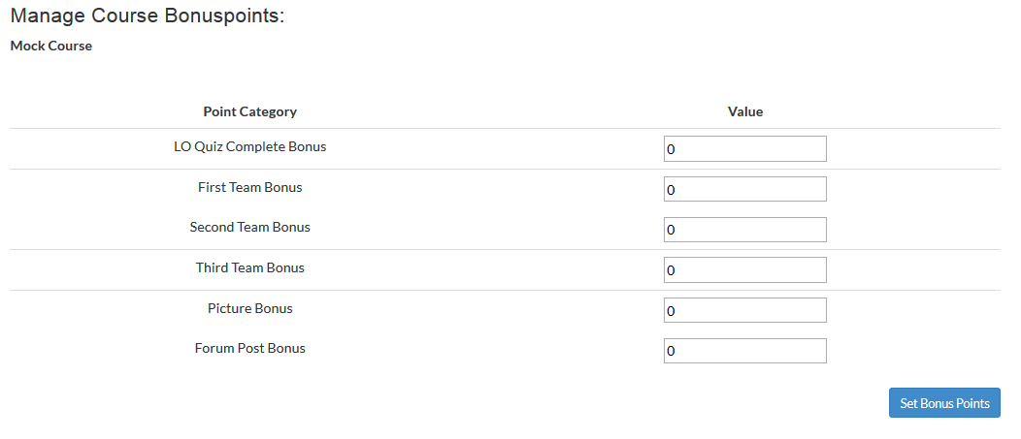
Course Management: Manage Bonus Points

Slide 13
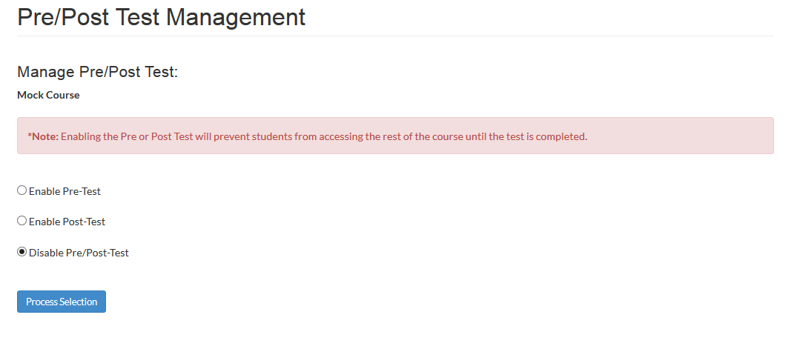
Course Management: Pre and Post Test

Slide 14
Mock Course

Slide 15
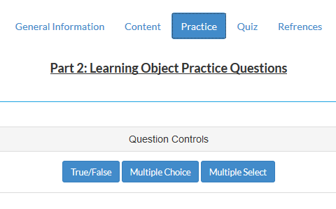
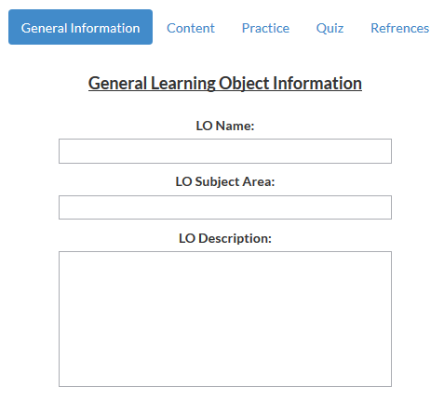
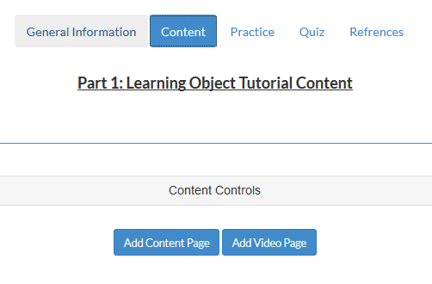
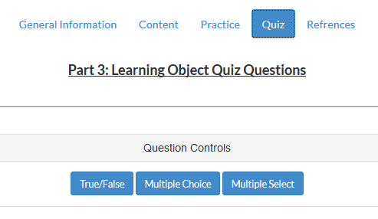
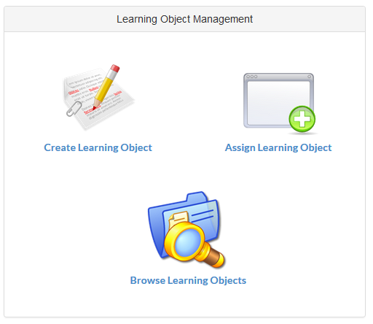
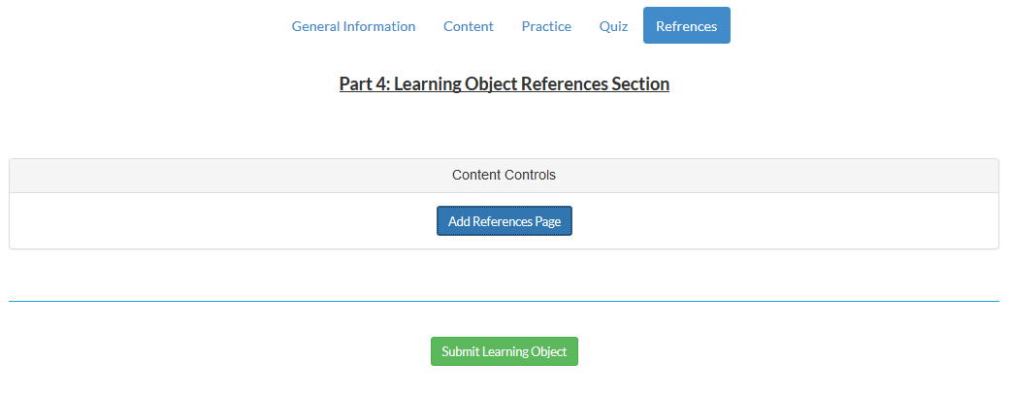
Learning Object Management

Slide 16
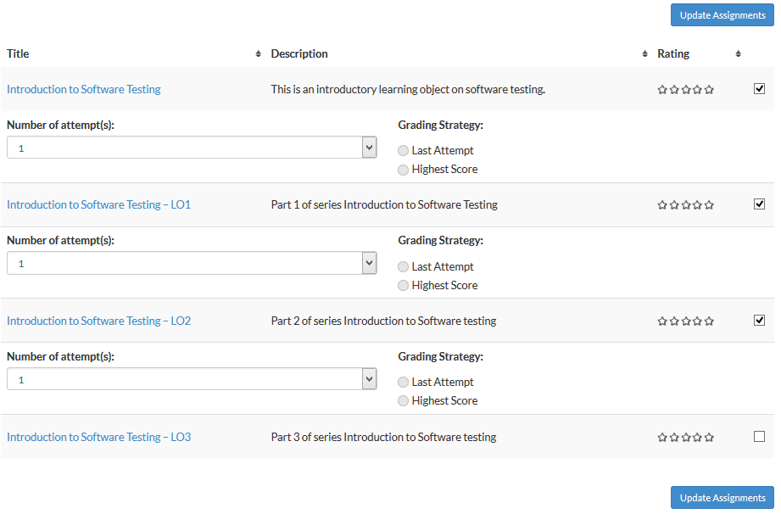
Assigning Learning Objects

Slide 17
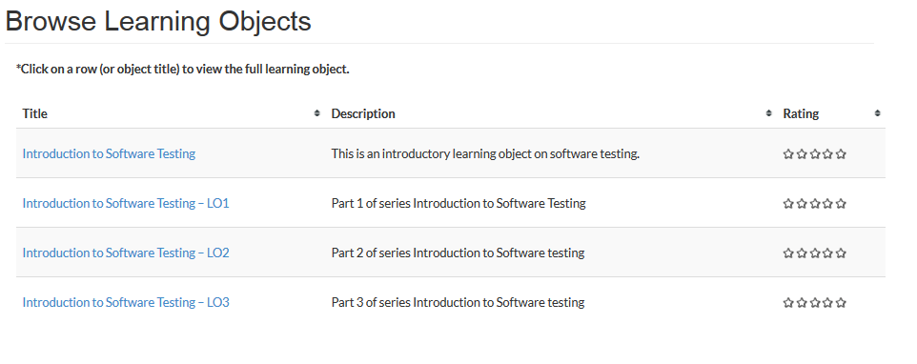
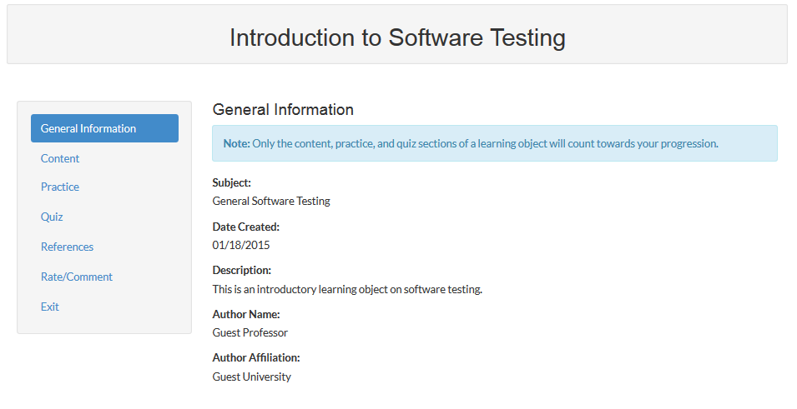
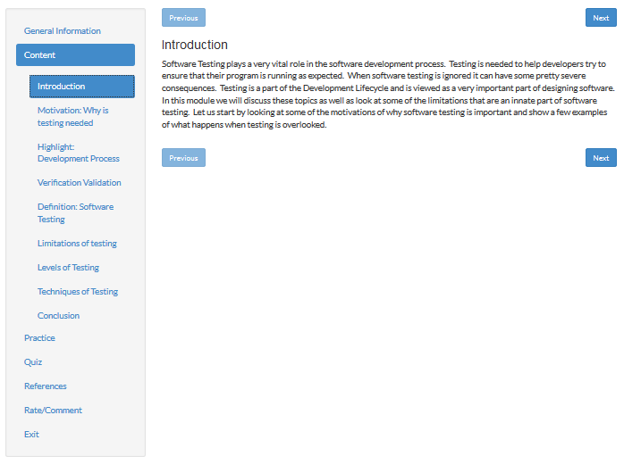
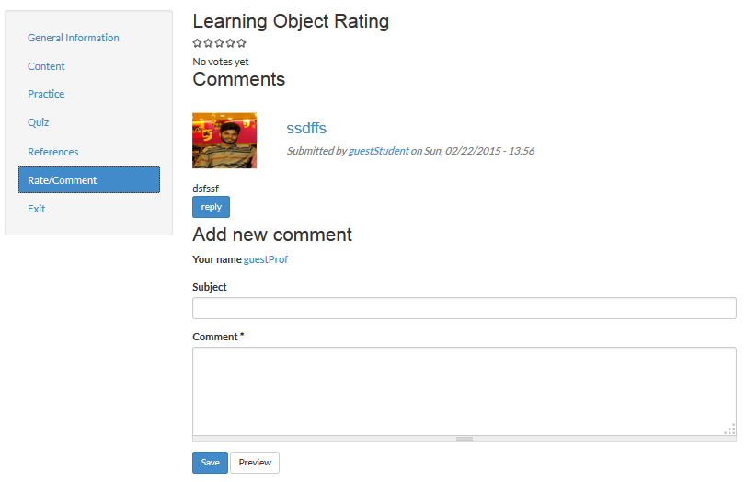
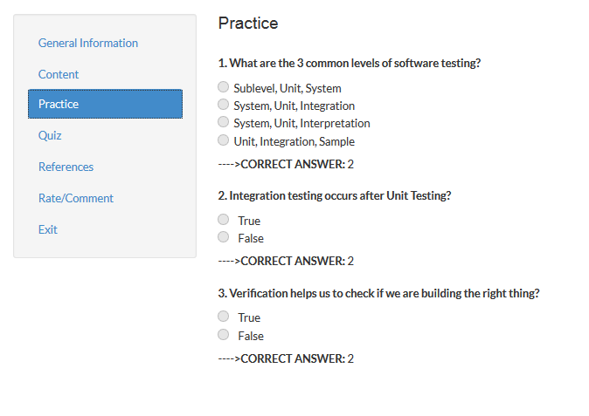
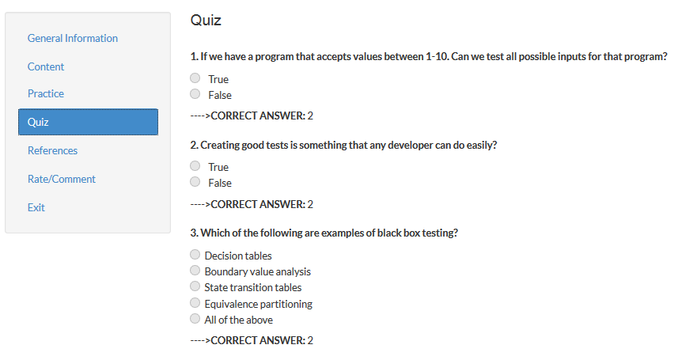
Assigning Learning Objects

Slide 18
Mock Course

Slide 19
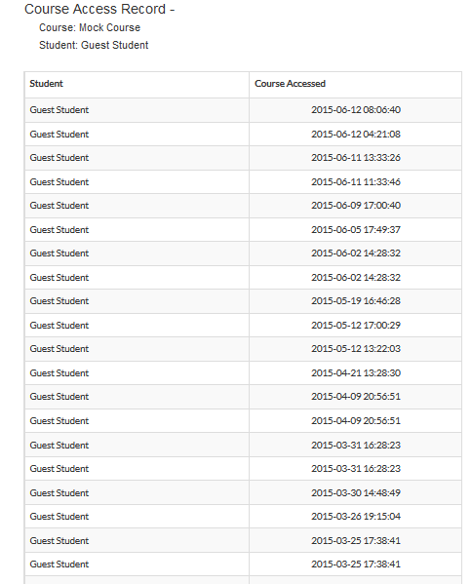
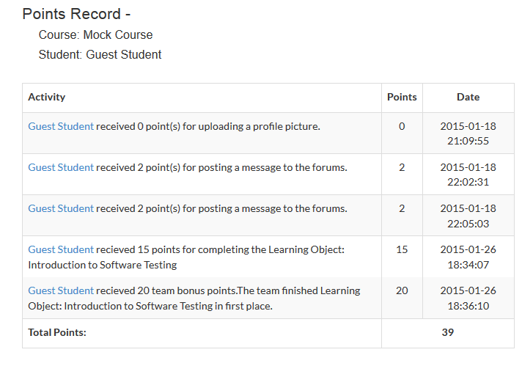
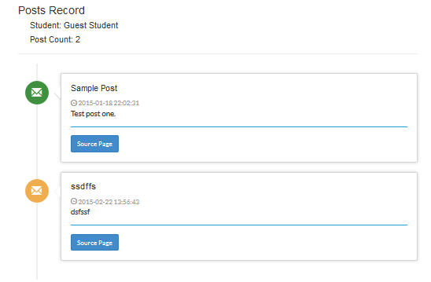
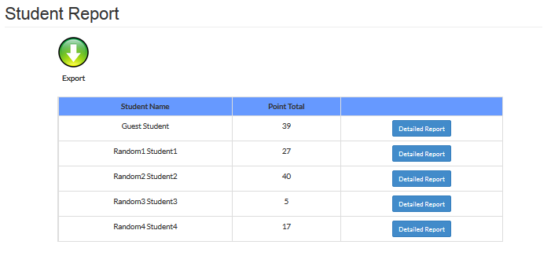
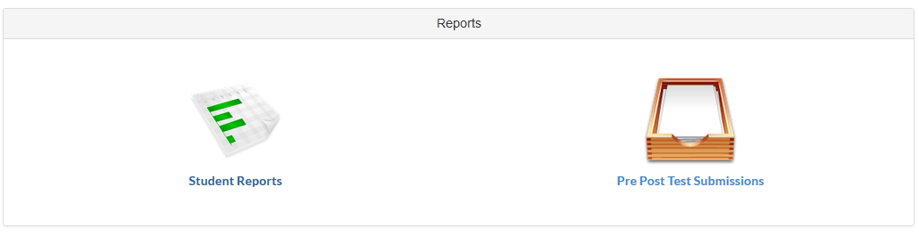
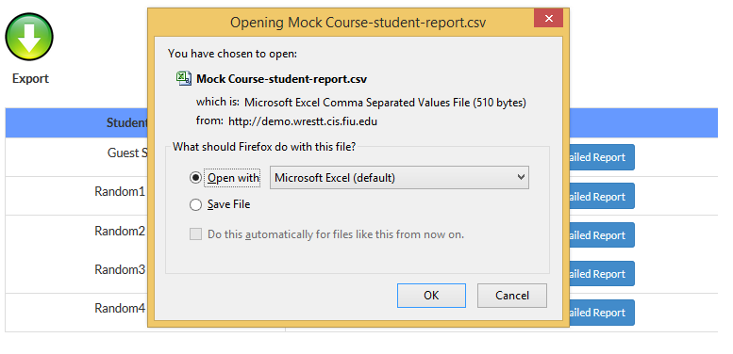
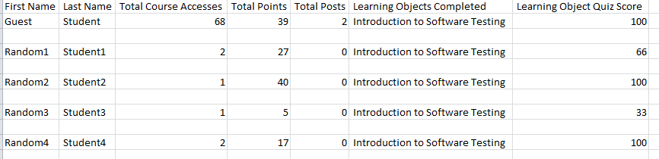
Reports

Slide 20
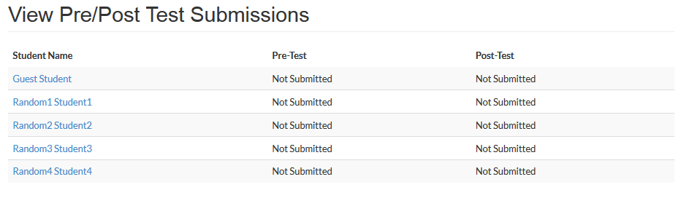
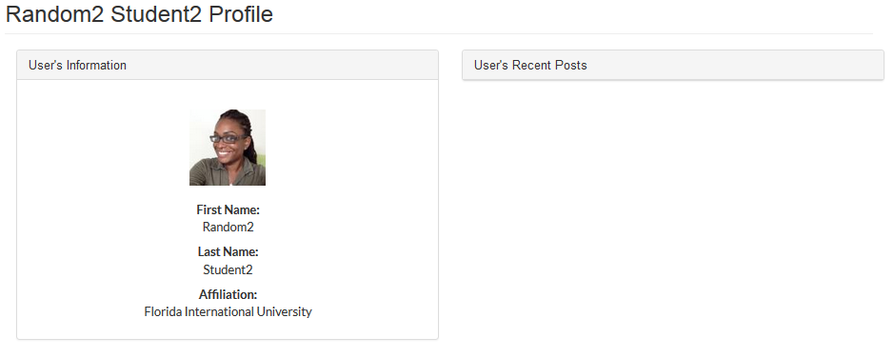
Reports

Slide 21
Mock Course

Slide 22
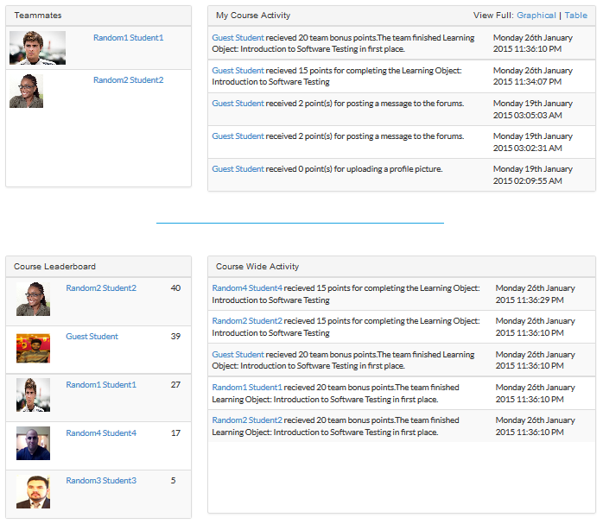

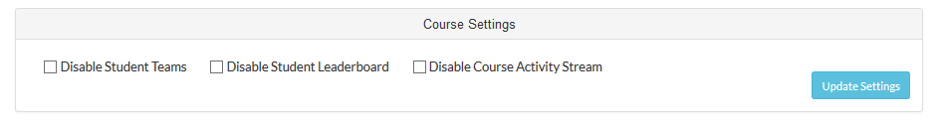


Course Settings

Slide 23
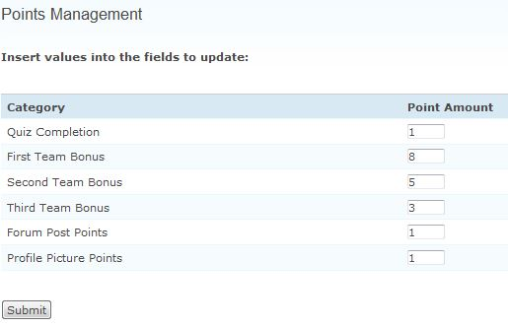

Using WReSTT in the Classroom
Week 0:
Virtual points allocation scheme
Week 1-2:
Intorduce WReSTT to the Students
Student Assignments: The instructor may require students to submit a report with each assignment containing the testing techniques used, test cases, test coverage achieved using different criteria and an explanation of any criteria for which the speciﬁed coverage is not achieved.
Monitor Teams: monitor the postings to the forums and provides feedback to the virtual teams and the class, with respect to their participation on completing the tutorials and quizzes
Week 2-20:
Assignments and Monitor Teams

Slide 24
Using WReSTT – Instructor View
Gursimran Singh Walia, Associate Professor
North Dakota State University [FARGO, ND]
www.gursimransinghwalia.com

