Slide 1
IBM Rational’s Solutions to Ensure Quality
Susann Ulrich – sulrich@us.ibm.com

Slide 2
Agenda
Overview of Rational Testing Solutions
Rational Functional Tester Hands on Lab
Wrap- up
  Other Resources
  Questions

Slide 3
IBM Rational Quality Tools by Lifecycle Phase
Rational Requisite Pro
Rational Purify Plus
Rational AppScan
Rational Software Analyzer
Rational Quality Manager
Rational Functional Tester
Rational AppScan
Rational Performance Tester
Requirements
Design
Code
Test
Design
Develop
Test
Notes:
Finally, we can take a quick glance at where these technologies are used during the SDLC. Keep in mind that some of these steps such as Code, Build and Test will often happen in parallel as part of an iterative Agile process..

Slide 4




Black Box vs. White Box Testing
Any deployed application
Easier to use in the testing stage
  Where code is often unavailable
AppScan Tester Edition
Rational Functional Tester
Rational Performance Tester
Rational Tool
BB
AppScan Developer Edition
Purify Plus
Software Analyzer
Application code
Can be used earlier during development
  As soon as the application compiles
WB
Bank.war
Notes:
The different approaches also mean the two analysis techniques require different prerequisites for them to run.
Black-Box Scanning requires a running application, while White-Box requires compiling code.
During development, there is often a gap between a compiling application and a working application. In such cases, Static Analysis can be performed earlier, allowing the finding and remediating of issues before the application even runs. That said, validating that a white-box issue isn’t a false positive without a running application is sometimes hard.
After development, there is usually very limited access to source code. Quality Assurance and Staging-phase testing do not usually deal with source code, and would therefore usually favor Black-Box testing.

Slide 5
Rational AppScan
What it does:
  Automated Web application scanning and testing for all common Web application vulnerabilities, including WASC threat classification - such as SQL-Injection, Cross-Site Scripting, and Buffer Overflow - and intelligent fix recommendations to ease remediation
DeveloperWorks
  http://www.ibm.com/developerworks/rational/products/appscan/
Demonstration
  http://www.demos.ibm.com/on_demand/Demo/IBM_Demo_Rational_AppScan-Jun08.html?S=index&S_TACT=105AGX15&S_CMP=LP
Courseware (on courseware repository in AI)
  Web Application Security Testing

Slide 6
Purify Plus
What is it
  IBM Rational PurifyPlus is a collection of three tools: IBM Rational PureCoverage®, IBM Rational Quantify®, and IBM Rational Purify®.
    PureCoverage is for code coverage analysis: it measures how much of the product code was exercised in a test suite, and how much remains to be tested.
    Quantify is for performance analysis: it helps find performance bottlenecks in applications.
    Purify is for memory analysis: it is useful in finding memory leaks and incorrect use of memory in the application, which may be resulting in crashes.
Overview
  http://www.ibm.com/developerworks/rational/library/07/0306_chitale/?S_TACT=105AGX15&S_CMP=LP
DeveloperWorks
  http://www.ibm.com/developerworks/rational/products/purifyplus/
Notes:
PurifyPlus for Microsoft® Windows® can be used with C++, Java™, or managed code. It is also available integrated within the Microsoft® Visual Studio® .NET IDE (integrated development environment).
PurifyPlus for Linux® and UNIX® is available for C/C++ and Java applications built on Red Hat, SUSE, Solaris™, HP-UX, and AIX platforms. This article, however, will look at automation and analysis on the Windows platform only.

Slide 7
Code Review – Rational Software Analyzer(RSAR)
What it does:
  Code review -This type of tool is typically one that performs automated code parsing, where each source file is loaded and passed through a parser that looks for particular code patterns that violate a set of established rules. In some languages, such as C++, many of these rules are built into the compiler or available in external programs, such as Lint. In other languages, such as Java, the compiler does little in the way of automated code review. Code review is a good tool to enforce coding standards, find basic performance problems, and find possible API abuse. Code review can also include deeper forms of analysis, such as data flow, control flow, type state, and so forth. Some of these are discussed in other articles in this series.
  Code dependency - Rather than examining the format of individual source files, code dependency tools examine the relationships between source files (typically, classes) to create a map of the overall architecture of a program. Dependency tools are commonly used to discover known design patterns (good) or common anti-patterns (bad) in code.
  Code complexity - Complexity tools analyze the program code and compare it to established software metrics to determine whether it is unnecessarily complex. If a particular piece of code exceeds a given threshold, it can be flagged as a candidate for refactoring to help improve maintainability.
  TrendingTrend analysis does not use code artifacts directly. Rather, it is the study of improvements or degradations in code quality, based on other forms of analysis (essentially, it analyzes the results of analysis). Results generated by these tools typically appeal to managers, executives, and customers rather than developers, because they make a statement about the direction of quality improvements, thereby answering the question: "Is the code getting better or worse?"

Slide 8
Code Review – Rational Software Analyzer(RSAR)
DeveloperWorks
  http://www.ibm.com/developerworks/rational/products/rsar/
Demonstrations
  http://www.ibm.com/developerworks/views/rational/libraryview.jsp?sort_by=Date&type_by=Demos&search_by=Rational+Software+Analyzer
Recommended white papers
  Static Analysis IBM Software Analyzer Part 1 Getting Started
    http://www.ibm.com/developerworks/rational/library/08/0429_gutz1/index.html
  Static Analysis IBM Software Analyzer : Part 2 Creating Rules and Filters to extend Java Code Review
    http://www.ibm.com/developerworks/rational/library/08/0429_gutz2/index.html
  Static Analysis IBM Software Analyzer : Part 3 – Enhancing Rules for Java code Review
    http://www.ibm.com/developerworks/rational/library/08/0429_gutz3/index.html
Courses
  RD195

Slide 9
Rational Functional Tester
What is does:
  Provides testers with automated testing capabilities for functional testing, regression testing, GUI testing and data-driven testing.
DeveloperWorks
  http://www.ibm.com/developerworks/rational/products/functionaltester/
Tutorial
  http://www.ibm.com/developerworks/edu/i-dw-r-functionaltest-i.html?S_TACT=105AGX15&S_CMP=LP
Demo
  http://www.demos.ibm.com/view/rationalfunctionaltester/?S_CMP=rnav
Courseware (on courseware repository in AI)
  TST279

Slide 10
RFT Hands on Lab

Slide 11
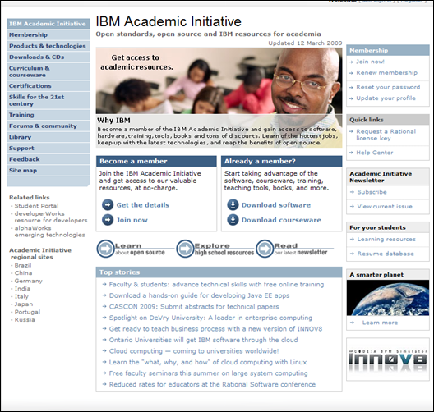
What’s Available
University Academic Initiative
  http://www-304.ibm.com/jct01005c/university/scholars/academicinitiative
Free software
Free courseware

