Slide 1
OOP-Python

Slide 2

Index
Python Basics
• Classes and Objects
• Defining a class
• Creating an object
• Constructors in python
• Deleting Attributes and Objects

Slide 3
Classes and Objects
Class:
· Python is an object oriented programming language. Unlike procedure oriented programming, where the main emphasis is on functions, object oriented programming stress on objects.
· A class is a code template for creating objects. Objects have member variables and have behaviour associated with them. In python a class is created by the keyword class.
· An object is created using the constructor of the class. This object will then be called the instance of the class.
· The first string is called docstring and has a brief description about the class.
Examples:
class Classname:
'''This is a docstring. I have created a new class'''
pass
· Classes Name should start with a Uppercase letter.

Slide 4
Classes and Objects
Defining a class:
· The first string is called docstring and has a brief description about the class.
· Class is defined using the keyword class.
Examples:
class Classname:
'''This is a docstring. I have created a new class'''
pass
· Classes Name should start with a Uppercase letter.
· A class creates a new local namespace where all its attributes are defined. Attributes may be data or functions.
· There are also special attributes in it that begins with double underscores (__). For example, __doc__ gives us the docstring of that class.
· When we define a class, a new class object is created with the same name. This class object allows us to access the different attributes as well as to instantiate new objects of that class.

Slide 5
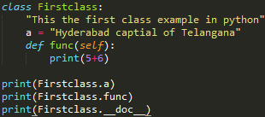

Classes and Objects
Example:

Slide 6
Classes and Objects
Creating an Object:
· Class object is used to access different attributes.
· It is also used to create new object instances of that class. Creating an object is same as functions.
Example:
Initial = Firstclass()
· This will create a new instance object Initial.
· Attributes may be data or method. Method of an object are corresponding functions of that class.
· Here Firstclass.func is function object whereas Initial.func will be a method object.

Slide 7
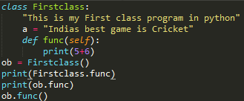

Classes and Objects
Example:
· Here self parameter in function definition inside the class but, we called the method simply as ob.func() without any arguments it still worked.
· This is because, whenever an object calls its method, the object itself is passed as the first argument. So, ob.func() translates into Firstclass.func(ob).

Slide 8
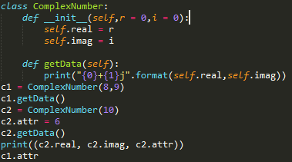
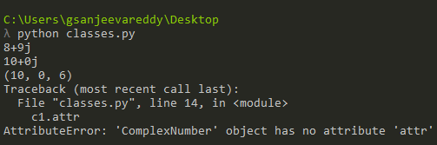
Classes and Objects
Constructors in python:
· Class functions that begins with double underscore (__) are called special functions as they have special meaning.
· __init__() gets called whenever a new object of that class is instantiated.
· This is called constructors in Object Oriented Programming.
· Here, we define a new class to represent complex numbers. It has two functions, __init__() to initialize the variables and getData() to display the number properly.
· We created a new attribute attr for object c2 and we read it as well. But this did not create that attribute for object c1 so it shows the AttributeError.

Slide 9
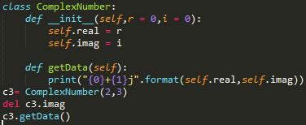
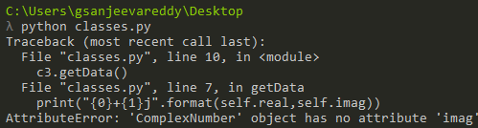
Classes and Objects
Deleting attributes and objects:
· We can delete an attribute of object by using del statement.
· We can even delete object using del statement.
Example:
· Here with del we deleted imag value from c3 when we try to getdata it show the error as it is not existed.
·Same way we can delete object by using del objectname.
» del c1
. This will delete c1 and no data will be retrived.

Slide 10
Assignment
Write a Python class to reverse a string word by word. Input string : 'hello .py' Expected Output : '.py hello'.
Write a Python class to implement pow(x, n).
Write a Python class to remove duplicates from a list.
Write a Python class to check a list is empty or not.
Write a Python class to print a specified list after removing the 0th, 4th and 5th elements.
Sample List : [‘A', ‘B', ‘C', ‘D', ‘E', ‘F']
Expected Output : [‘B', ‘C', ‘D]

