Slide 1
Python – Basics

Slide 2

Index
Python Basics
Exception Handling
• Exception
• Exception Handling
• Except clause
• Try & finally clause
• User Defined Exceptions

Slide 3
Exception Handling
Exception
An exception is an event, which occurs during the execution of a program that disrupts the normal flow of the program's instructions.
In general, when a Python script encounters a situation that it cannot cope with, it raises an exception.
An exception is a Python object that represents an error.
When a Python script raises an exception, it must either handle the exception immediately otherwise it terminates and quits.

Slide 4
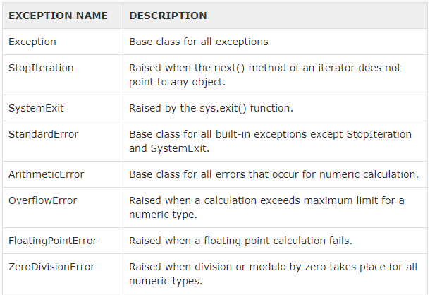
Exception Handling
List of Standard Exceptions:

Slide 5
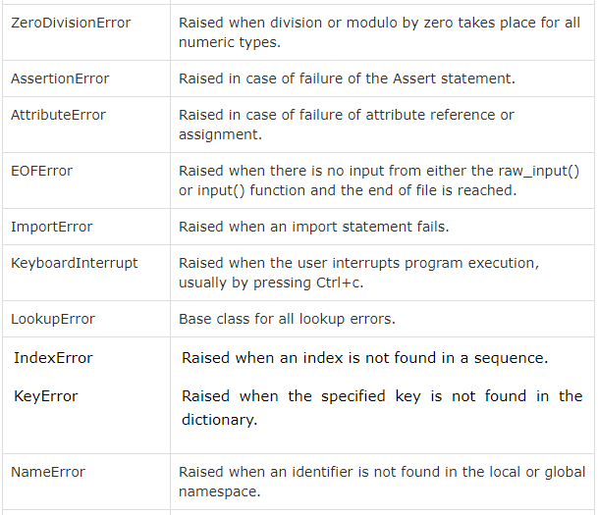
Exception Handling

Slide 6
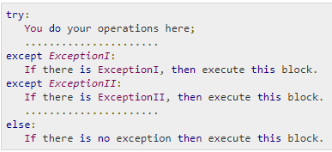
Exception Handling
Handling an exception:
If you have some suspicious code that may raise an exception, you can defend your program by placing the suspicious code in a try: block.
After the try: block, include an except: statement, followed by a block of code which handles the problem as elegantly as possible.
Syntax:

Slide 7
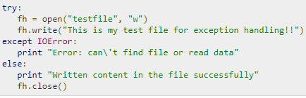
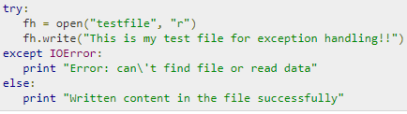
Exception Handling
Here are few important points about the above-mentioned syntax:
A single try statement can have multiple except statements. This is useful when the try block contains statements that may throw different types of exceptions.
You can also provide a generic except clause, which handles any exception.
After the except clause(s), you can include an else-clause. The code in the else-block executes if the code in the try: block does not raise an exception.
The else-block is a good place for code that does not need the try: block's protection.
Examples:

Slide 8
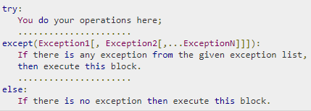
Exception Handling
The except Clause with Multiple Exceptions:
You can also use the same except statement to handle multiple exceptions

Slide 9
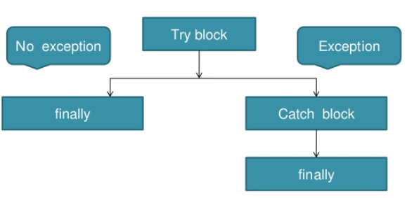

Exception Handling
try-finally Clause:
You can use a finally: block along with a try: block. The finally block is a place to put any code that must execute, whether the try-block raised an exception or not.

Slide 10


Exception Handling
User-Defined Exceptions:
Python also allows you to create your own exceptions by deriving classes from the standard built-in exceptions.
Here is an example related to RuntimeError. Here, a class is created that is subclassed from RuntimeError. This is useful when you need to display more specific information when an exception is caught.
In the try block, the user-defined exception is raised and caught in the except block. The variable e is used to create an instance of the class Networkerror.
So once you defined above class, you can raise the exception

