Slide 1
Python – Basics

Slide 2

Index
Python Basics
• Modules
• Keywords and Identifiers
• Importing Module
• Reloading a module
• dir() built-in function

Slide 3
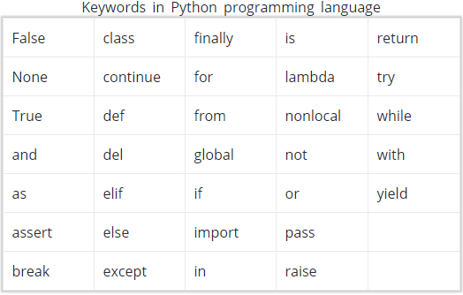
Modules
Keywords :
Keywords are the reserved words in Python.
We cannot use a keyword as variable name, function name or any other identifier. They are used to define the syntax and structure of the Python language.
Keywords are case sensitive. There are 33 keywords.
All the keywords except True, False and None are in lowercase

Slide 4
Modules
Identifiers:
» Identifier is the name given to entities like class, functions, variables etc. in Python. It helps differentiating one entity from another.
Rules for writing identifiers:
» Identifiers can be a combination of letters in lowercase (a to z) or uppercase (A to Z) or digits (0 to 9) or an underscore (_).
» An identifier cannot start with a digit.
» Keywords cannot be used as identifiers.
» We cannot use special symbols like !, @, #, $, % etc. in our identifier.
» Identifier can be of any length.
» Multiple words can be separated using an underscore, date_of_birth.

Slide 5
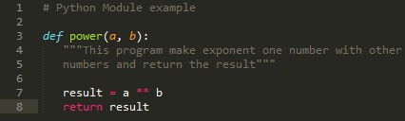
Modules
Module:
» Modules refer to a file containing Python statements and definitions.
» A file containing Python code, for e.g.: basic.py, is called a module and its module name would be basic.
» Modules are used to break down large programs into small manageable and organized files and provide reusability of code.
» we have defined a function power() inside a module named power. The function takes in two numbers and returns power of one number with other.

Slide 6
Modules
Import Module:
» We can import the definitions inside a module to another module or the interactive interpreter in Python.
» We use the import keyword for importing a module.
import basic
» This does not enter the names of the functions defined in basic directly in the current symbol table. It only enters the module name basic there.
» To access function dot(.) should be used.
basic.power(1,2)
» Python has large no.of standard modules.
» Standard modules can be imported the same way as we import our user-defined modules.
» There are different ways to import a module.

Slide 7



Modules
Import statement:
» We can import a module using import statement and access the definitions inside it using the dot operator(.).
» Here we get the pi value using math.pi as we import math.
Import with renaming:
» We can import a module by renaming.
» Here we renamed math to m and get pi using m.pi

Slide 8


Modules
from...import statement:
» We can import specific names form a module without importing the module as a whole.
» Here we imported only attribute pi from the module.
» Here we don’t want to use dot(.) operator.
Import all names:
» We can import all names form a module using *.
» imported all definitions from math module.
» Using * is not a good practice this can lead to duplicate definitions for an identifier.

Slide 9
Modules
Module search path:
» While importing a module, Python looks at several places. Interpreter first looks for a built-in module then into a list of directories defined in sys.path.
1.The current directory.
2.PYTHONPATH (an environment variable with a list of directory).
3.The installation-dependent default directory.
Reloading a module:
» The Python interpreter imports a module only once during a session. This makes things more efficient.
» When we execute 2 time it is not going to run as it import once during a session.
» To overcome this we use reload() inside imp module.

Slide 10
Modules
import imp
imp.reload(modules)
Dir() built-in function:
» We can use the dir() function to find out names that are defined inside a module.
» It will return a list of name that present in the module where (__) names indicates default python attributes that are associated with the module.
» All the names defined in our current namespace can be found out using the dir() function without any arguments.
» The __name__ attribute contains the name of the module

