Slide 1
Python – Basics

Slide 2

Index
Python Basics
• Modules and Packages
• Math Module
• Random Module
• Packages

Slide 3


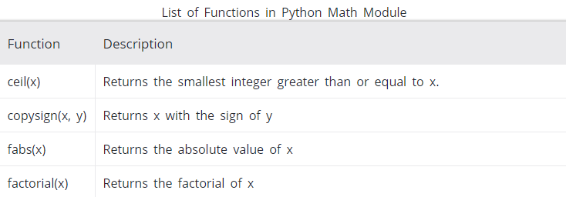
Modules
Math Module:
The math module is a standard module in Python.
We can import mathematical functions using import math.
For Complex data types we cant use math we have to use cmath
some built-in functions in math module

Slide 4


Modules
Random Module:
» Python offers random module that can generate random numbers.
» These are pseudo-random number as the sequence of number generated depends on the seed.
» If the seeding value is same, the sequence will be the same.
» This generator is completely deterministic, it must not be used for encryption purpose.

Slide 5
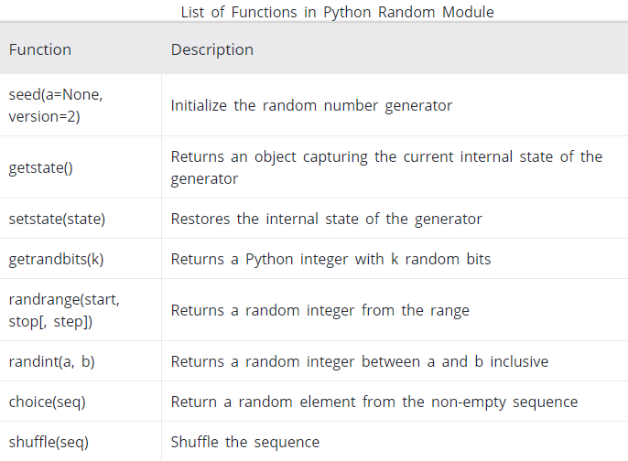
Modules
Built-in Random functions:

Slide 6
Packages
Package:
» A package is a hierarchical file directory structure that defines a single Python application environment that consists of modules and sub packages and sub-sub packages, and so on.
» A directory can contain sub-directories and files, a Python package can have sub-packages and modules.
» A directory must contain a file named __init__.py in order for Python to consider it as a package.
» We can keep __init__.py file as empty but generally used to write the initialization code
Example:
» While developing a game , the packages and modules structure will look as show in figure.

Slide 7
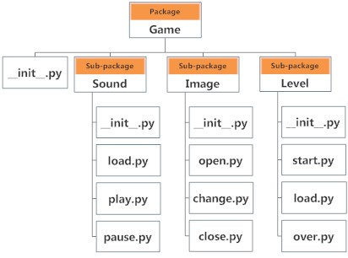
Modules
» We can import modules from packages using the dot (.) operator
» To import the start module in the example.
import Game.Level.start
» Now if this module contains a function named difficulty().
Game.Level.start.select_difficulty(2)

Slide 8
Modules
» If this construct seems lengthy, we can import the module without the package prefix
from Game.Level import start
» Now we can call function using
start.select_difficulty(2)
» Another way of importing just the required function form a module within a package.
from Game.Level.start import select_difficulty
select_difficulty(2)
» While importing packages, Python looks in the list of directories defined in sys.path.

Slide 9
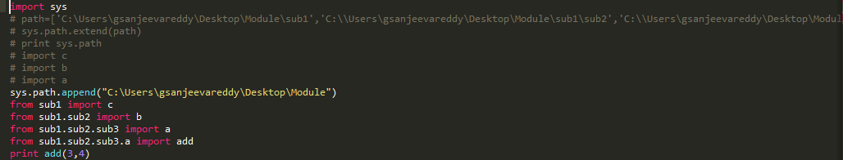


Modules
Example:
Main.py: a.py: b.py:
c.py: output:
» Here main.py is at some location and remaining are at some location.
» In main.py we specified directory path and then we import different py files and executed them in main.py file.
» In every subdirectory we should have __init__.py for making it as a package.

