Slide 1
OOPs in Python
Shah Ayub Quadri
aquadri@digital-lync.com

Slide 2

Index
OOPs in Python
• Attributes
• Introduction
• Accessing Attributes
• Built in Functions in Attributes

Slide 3

Attributes
Introduction:
· Class attributes are attributes which are owned by the class itself.
· Attributes will be shared by all the instances of the class. So, they have the same value for every instance.
· Class Attribute are placed outside of all methods in class . Usually, placed immediately after class header.
Example:
· This the basic example of class attribute where ‘a’ is attribute with some data in class A and these class will be assigned to an object ‘x’.

Slide 4
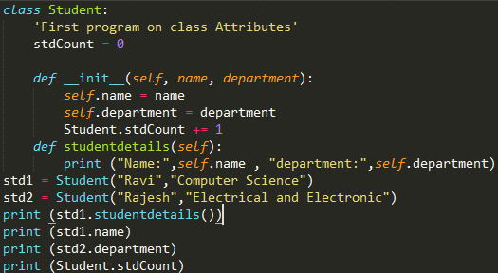

Attributes
Accessing Attributes:
· After declaring the attribute in class we can use dot operator(.) with the object to access the attribute.
· Class variable is accessed using class names.
Example:

Slide 5
Attributes
· In the example we accessed the attributes of class Student using the dot operator.
· After creating the “std1” object we accessed attribute in it by using std1.name , std1.department.
· We can access class variable by using classname.variablename (Student.stdCount)
which helps in count the number of students.

Slide 6
Attributes
Functions for class attributes:
· setattr(obj,name,value): This function help to set an attribute. If it does not exist it will create a attribute with the name specified.
· getattr(obj,name[,default]): This function is used to access a attribute in the object.
· hasattr(obj,name): This function check whether the attribute with the specified name exist in object or not.
· delattr(obj,name): This function will delete the attribute from the object.
· These are some of the function in class attributes.

Slide 7
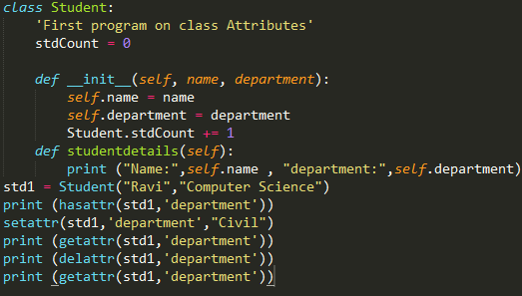
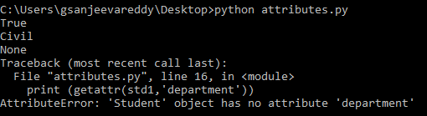
Attributes
Example:
· Here it display error at second getattr because already ‘department’ attribute has been deleted.

Slide 8
Attributes
Built-in functions in Class Attributes:
· Python has some built in function that are used to get information about the attributes.
· In this the attribute name is prefixed and suffixed using underscore.
· __dict__: It will display a dictionary containing all attributes along with its values of the class.
. __doc__: It will print the documentation of the class if exist and None if not defined.
· __name__: It will give the name of the class.
· __module__: It will return the module name in which it is defined otherwise it will return “__main__”.
· __bases__: This is used in inheritance when we use parent and child class. It will check where the class is base class are a child of another class and return the base class name.

Slide 9
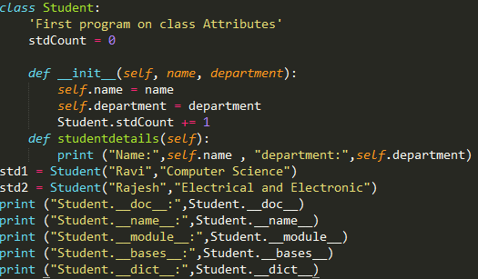
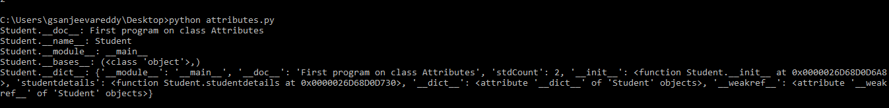
Attributes
Example:

