Slide 1
OOP-Python
Shah Ayub Quadri
aquadri@digital-lync.com

Slide 2

Index
Python Basics
• Inheritance
• Defining inheritance
• Multiple & Multilevel inheritance
• Accessing parent class in subclass
• Issubclass

Slide 3
Inheritance
Inheritance:
· Inheritance is a powerful feature in object oriented programming.
· It refers to defining a new class with little or no modification to an existing class. The new class is called derived class and the one from which it inherits is called the base class.
Syntax:
class Baseclass:
Body of base class
class Derivedclass(Baseclass):
Body of derived class
· Here derived class inherits property from base class and re-usability of code.

Slide 4
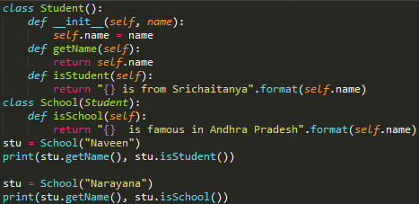

Inheritance
Example:
· Here we created a object stu with which we perform action in the class.

Slide 5
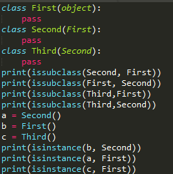
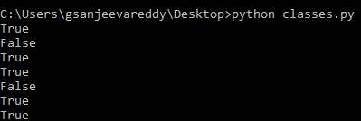
Inheritance
Issubclass():
· Python provide a function issubclass() that directly used to check whether a class is subclass of other.
Example:
· First is not the subclass of Third but it is subclass of Second and Second is subclass of Third.
· It will give output in boolean format as(True/False).

Slide 6
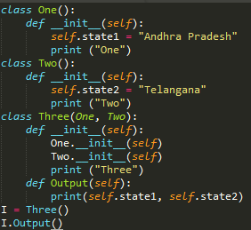

Inheritance
Multiple Inheritance:
· The process of inheriting all features of base classes to the derived classes is called multiple inheritance.
Syntax:
class One:
pass
class Two:
pass
class Three(One,Two):
pass
Example:

Slide 7
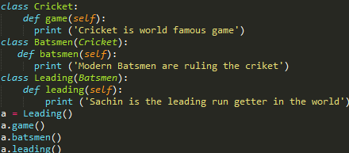

Inheritance
Multilevel Inheritance:
· Inheriting property from the child class is called multilevel inheritance.
· In this method property of both parent and child class is inherited to other child class.
Syntax:
class Parent:
pass
class Child1(Parent):
pass
class Child2(Child1):
pass
Example:
· In example Leading class inherit the property of both Batsmen and Cricket class features.

Slide 8
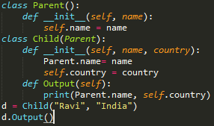

Inheritance
Access parent class in subclass:
· Two different methods of accessing parent class in a subclass are:
» Parent class name
» Super()
Parent classname:
· In this method we used the parent class name to access the value in parent class.
· We can use self.name in print statement instead of Parent.name, both perform same action.

Slide 9
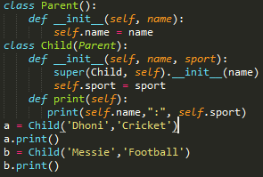

Inheritance
Super():
· The second method for accessing parent class is super().
Example:

