Slide 1
OOP’s in Python

Slide 2

Index
Oop’s in Python
• Operator Overloading
• Constructors and Expressions:
• Common Operator Overloading Methods
• Indexing and Slicing
• Iterable Objects
• Attribute Access

Slide 3
Python operators work for built-in classes. But same operator behaves differently with different types. For example, the + operator will, perform arithmetic addition on two numbers, merge two lists and concatenate two strings.
This feature in Python, that allows same operator to have different meaning according to the context is called operator overloading.

Slide 4
Operator Overloading
Really “operator overloading” simply means intercepting built-in operations in a class’s methods—Python automatically invokes your methods when instances of the class appear in built-in operations, and your method’s return value becomes the result of the corresponding operation.
Here’s a review of the key ideas behind overloading:
Operator overloading lets classes intercept normal Python operations.
• Classes can overload all Python expression operators.
• Classes can also overload built-in operations such as printing, function calls, attribute access, etc.
• Overloading makes class instances act more like built-in types.
• Overloading is implemented by providing specially named methods in a class.

Slide 5
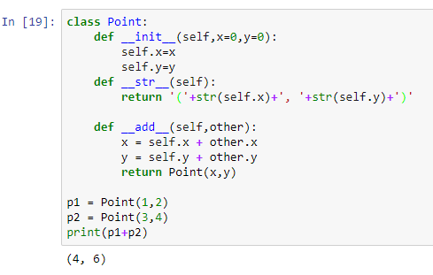
Operator Overloading
Addition overriding example __add__: Here, we override + to return the sum of two co-ordinate points (a,b) and (c,d)

Slide 6
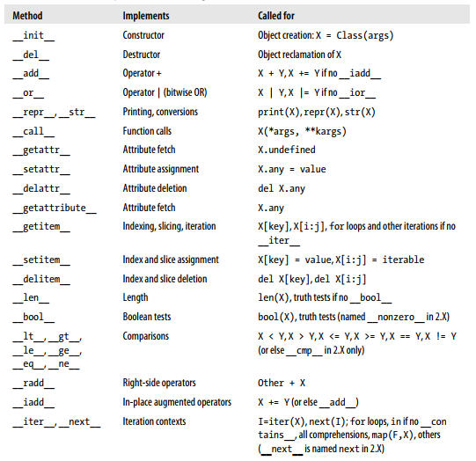
Operator Overloading
Common Operator Overloading Methods :

Slide 7
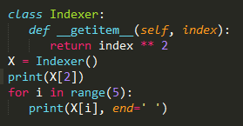

Operator Overloading
Indexing and Slicing: __getitem__ and __setitem__ :
If defined in a class (or inherited by it), the __getitem__ method is called automatically for instance-indexing operations.
When an instance X appears in an indexing expression like X[i], Python calls the __getitem__ method inherited by the instance, passing X to the first argument and the index in brackets to the second argument.

Slide 8
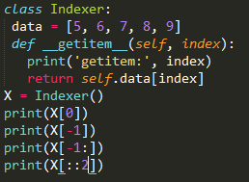
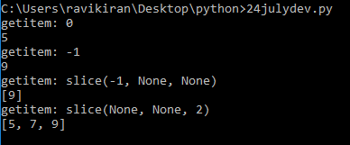
Operator Overloading
In addition to indexing, __getitem__ is also called for slice expressions— always in 3.X, and conditionally in 2.X if you don’t provide more specific slicing methods.
This matters in classes with a __getitem__ method—in 3.X, the method will be called both for basic indexing (with an index) and for slicing (with a slice object).
Intercepting Slices:

Slide 9
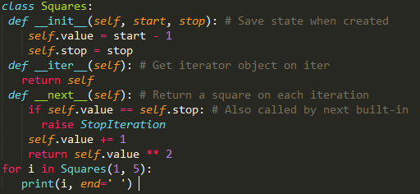

Operator Overloading
Iterable Objects: __iter__ and __next__:
Today, all iteration contexts in Python will try the __iter__ method first, before trying __getitem__.
Technically, iteration contexts work by passing an iterable object to the iter built-in function to invoke an __iter__ method, which is expected to return an iterator object.
If it’s provided, Python then repeatedly calls this iterator object’s __next__ method to produce items until a StopIteration exception is raised.
A next built-in function is info available as a convenience for manual iterations—next(I) is the same as I.__next__().

Slide 10
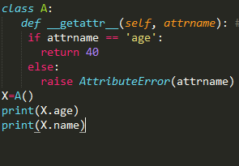
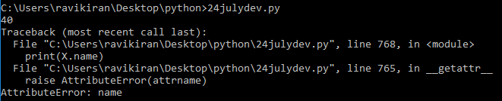
Operator Overloading
Attribute Access: __getattr__ and __setattr__:
__getattr__:
The __getattr__ method intercepts attribute references. It’s called with the attribute name as a string.

Slide 11
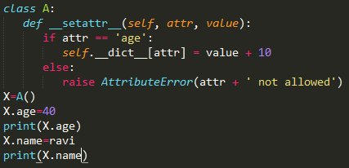
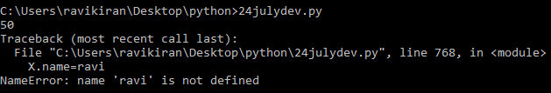
Operator Overloading
__setattr__:
String Representation: __repr__ and __str__:
If defined, __repr__ (or its close relative, __str__) is called automatically when class instances are printed or converted to strings. These methods allow you to define a better display format for your objects than the default instance display. Here, __repr__ uses basic string formatting to convert the managed self.data object to a more humanfriendly string for display.

Slide 12
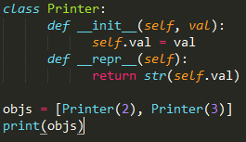

Operator Overloading
• __str__ is tried first for the print operation and the str built-in function (the internal equivalent of which print runs). It generally should return a user-friendly display.
• __repr__ is used in all other contexts: for interactive echoes, the repr function, and nested appearances, as well as by print and str if no __str__ is present. It should generally return an as-code string that could be used to re-create the object, or a detailed display for developers.

Slide 13
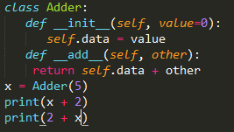
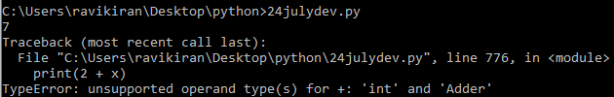
Operator Overloading
__radd__ and __iadd__:
Right-Side Addition:
For instance, the __add__ methods coded so far technically do not support the use of instance objects on the right side of the + operator

Slide 14
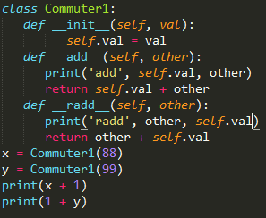

Operator Overloading
Python calls __radd__ only when the object on the right side of the + is your class instance.

Slide 15
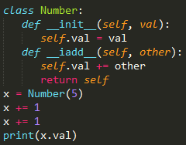

Operator Overloading
In-Place Addition:
To also implement += in-place augmented addition, code either an __iadd__ or an __add__.

