Slide 1
OOP-Python
Shah Ayub Quadri
aquadri@digital-lync.com

Slide 2

Index
Python oop
• Methods
• Defining Methods
• Creating Class Methods
• Creating Instance Methods

Slide 3
Methods
Methods:
Methods are simply another kind of function that reside in classes.
You create and work with methods in Python in precisely the same way that you do functions, except that methods are always associated with a class.
You can create two kinds of methods: those associated with the class itself and those associated with an instance of a class.
It’s important to differentiate between the two.

Slide 4

Methods
CREATING CLASS METHODS:
A class method is one that you execute directly from the class without creating an instance of the class.
Sometimes you need to create methods that execute from the class, such as the functions you used with the str class in order to modify strings.
The example class contains a single defined attribute, One().
This method doesn’t accept any arguments and doesn’t return any values.
It simply prints a message as output. However, the method works just fine for demonstration purposes.

Slide 5
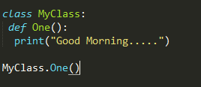

Methods
The example outputs the expected string.
Notice that you didn’t need to create an instance of the class the method is available immediately for use.

Slide 6
Methods
CREATING INSTANCE METHODS:
An instance method is one that is part of the individual instances.
You use instance methods to manipulate the data that the class manages.
As a consequence, you can’t use instance methods until you instantiate an object from the class.
All instance methods accept a single argument as a minimum, self.
The self argument points at the particular instance that the application is using to manipulate data.
Without the self argument, the method wouldn’t know which instance data to use. However, self isn’t considered an accessible argument — the value for self is supplied by Python, and you can’t change it as part of calling the method.

Slide 7
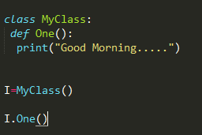
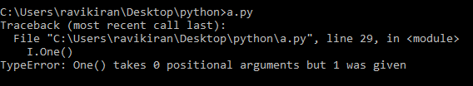
Methods
The example class contains a single defined attribute, One().
This method doesn’t accept any arguments and doesn’t return any values.
It simply prints a message as output. However, the method works just fine for demonstration purposes.

Slide 8
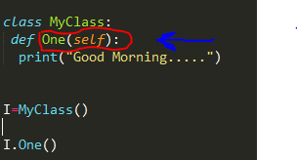

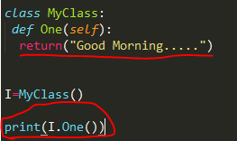

Methods
Solution:
Using return:

Slide 9
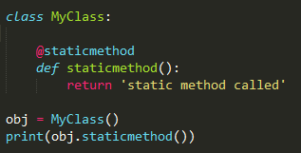

Methods
Static Methods :
The method was marked with a @staticmethod decorator to flag it as a static method.
This type of method takes neither a self nor a cls parameter.
Therefore a static method can neither modify object state nor class state. Static methods are restricted in what data they can access – and they’re primarily a way to namespace your methods.

Slide 10
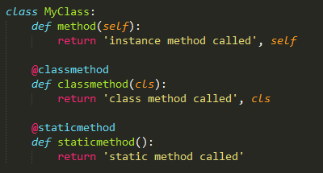
Methods
class that contains simple examples for all three method :
For Python 2 users: The @staticmethod and @classmethod decorators are available as of Python 2.4.

Slide 11



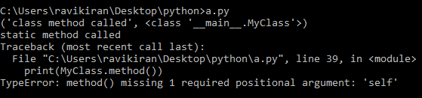
we call an instance method Class method & static method:
Another way to call an instance method Class method & static method:

