Slide 1
Python – Basics

Slide 2

Index
Python Basics
•Sets
• Introduction
• Accessing Sets
• Operations
• Methods

Slide 3
Sets
A set is an unordered collection of items where every element is unique.
A set is created by placing all the items inside curly braces {}, separated by comma or by using the built-in function set().
Empty curly braces {} will make an empty dictionary in Python. To make a set without any elements we use the set() function without any argument.
Examples of sets :
items = {10,20,30,40,50}
names = {"arrow", "spear", "arrow", "arrow", "rock"}
student = {"arrow", 99, "arrow", 50, "rock"}
program =set(“pythonprogramming”)
colors = {"arrow", 99, "arrow", 50, "rock"}
print (len(colors)) ## 5
print (program) ## {'r', 'h', 'a', 'i', 'p', 'g', 'o', 't', 'n', 'm', 'y'}

Slide 4
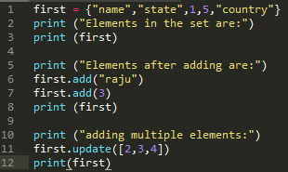
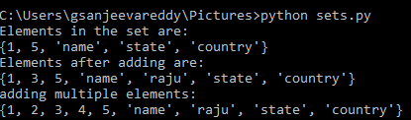
Sets
Updating Sets:
We can add single element using the add() method and multiple elements using the update() method. The update() method can take tuples, lists, strings or other sets as its argument.
For example:

Slide 5
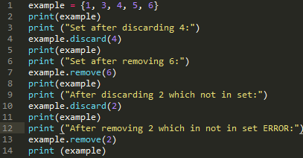
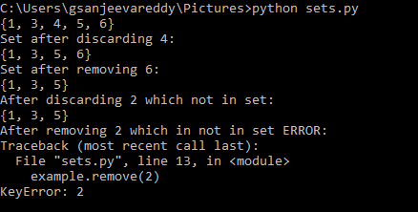
Sets
Delete Set Elements:
A particular item can be removed from set using methods, discard() and remove().
The only difference between the two is that, while using discard() if the item does not exist in the set, it remains unchanged. But remove() will raise an error in such condition.
For example :

Slide 6
Sets
Basic Set Operations:
Python Expression | Results | Description
len({1,2,'arrow','hyderabad',7} | 5 | Length
{1,2,”arrow”} | {"spear","rock"} | {1,2,”arrow”,”spear”,”rock”} | Union
{1,2,”arrow”}&{2,”arrow”,"rock”} | {2,”arrow”} | Intersection
{1, 2, 3, 4, 5} - {4, 5, 6, 7, 8} | {1,2,3} | Difference
{1, 2, 3, 4, 5} ^ {4, 5, 6, 7, 8} | {1,2,3,6,7,8} | Symmetric difference

Slide 7
Sets
Set Methods:
Here are some other common set methods.
set.remove(element) : remove an specified element.
set.add(elem) :add one (or) multiple elements to the set by using list,tuple.
set.clear() : It completely clear elements in set and display empty set.
set.difference(set1) : remove elements that are common in set with set1 and display set elements.
seta.isdisjoint(setb) : check both set has same elements (or) not and give boolean values.
a.issubset(b) : check a is subset of b or not and give boolean values.
set.pop(): Remove and return an arbitary set element. Raise KeyError if the set is empty

Slide 8
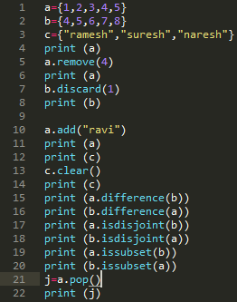
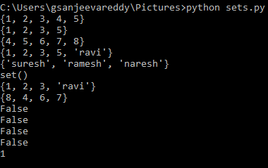
Sets
Sets Methods:
EXAMPLES:

Slide 9
Assignment - 5
Write a Python program to create a set.
Write a Python program to create an intersection of sets.
Write a Python program to create a union of sets.
Write a Python program to create set difference.
Write a Python program to create a symmetric

