Slide 1
Python – Basics

Slide 2

Index
Python Basics
Tuple
• Introduction
• Accessing Tuples
• Operations
• Working & Tuple Comprehension
• Functions and Methods

Slide 3
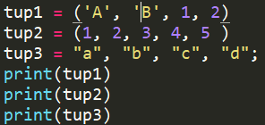

Tuple
A tuple is a sequence of immutable Python objects. Tuples are sequences, just like lists.
The differences between tuples and lists are, the tuples cannot be changed unlike lists and tuples use parentheses, whereas lists use square brackets.
Examples of Tuple :

Slide 4
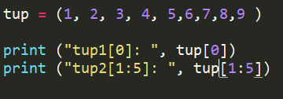

Accessing Values in Tuples:
To access values in tuple, use the square brackets for slicing along with the index or indices to obtain value available at that index.
For example:

Slide 5
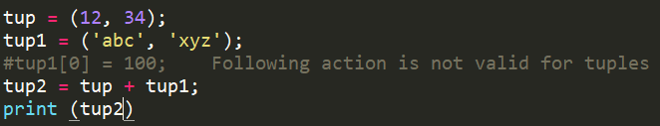

Tuple
Updating Tuple:
Tuples are immutable which means you cannot update or change the values of tuple elements. You are able to take portions of existing tuples to create new tuples as the following example demonstrate
For example:

Slide 6
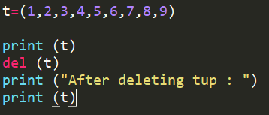
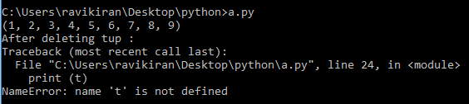
Tuple
Delete Tuple Elements :
Removing individual tuple elements is not possible. There is, of course, nothing wrong with putting together another tuple with the undesired elements discarded.
To explicitly remove an entire tuple, just use the del statement.
For example:

Slide 7
Tuple
Basic Tuples Operations :
Python Expression | Results | Description
len((1, 2, 3)) | 3 | Length
(1, 2, 3) + (4, 5, 6) | (1, 2, 3, 4, 5, 6) | Concatenation
('Hi!',) * 4 | ('Hi!', 'Hi!', 'Hi!', 'Hi!') | Repetition
3 in (1, 2, 3) | True | Membership
for x in (1, 2, 3): print x, | 1 2 3 | Iteration

Slide 8
Tuple
Built-in Tuple Functions:
.
cmp(tuple1, tuple2): The method cmp() compares elements of two tuple.
len(tuple): The method len() returns the number of elements in the tuple.
Max (tuple) : The method max() returns the elements from the tuple with maximum value.
min(tuple) : The method min() returns the elements from the tuple with minimum value.

Slide 9
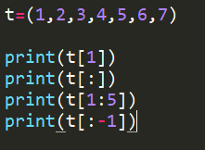
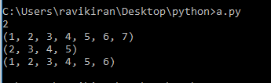
Tuple
tuple Slices:
Slices work on tuples just as with strings, and can also be used to change sub-parts of the tuple.

Slide 10
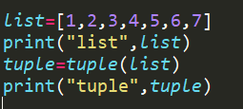

Tuple
Convert a list to a tuple:
The method tuple() converts a list of items into tuples

Slide 11
Assignment - 7
Write a Python program to create a tuple.
Write a Python program to create a tuple with different data types..
Write a Python program to convert a list to a tuple.
Write a Python program to slice a tuple.
Write a Python program to replace last value of tuples in a list. Sample list: [(10, 20, 40), (40, 50, 60), (70, 80, 90)] Expected Output: [(10, 20, 100), (40, 50, 100), (70, 80, 100)]

