Slide 1
An Out-of-core Implementation of Block Cholesky Decomposition on A Multi-GPU System
Lin Cheng, Hyunsu Cho, Peter Yoon, Jiajia Zhao
Trinity College, Hartford, CT
Notes:
Good afternoon, we are from Trinity College. I’m Jiajia. I’m Philip. We are presenting an out-of-core implementation of block cholesky decomposition on a multi-GPU system.

Slide 2
Outline
Block Cholesky decomposition
Multi-GPU system
Out-of-core implementation
Inter-device communication
Extension to disk I/O
Performance
Notes:
Here is an outline of our presentation. First we’ll briefly introduce the Block Cholesky Decomposition algorithm. Then we’ll discuss characteristics of a multi-GPU system. After that, we’ll talk about our out-of-core implementation, where GPU memory serves as a cache for main memory. Efficient inter-device communication is critical for an out-of-core implementation. Later, we discuss our main contribution: we’ve integrated disk I/O to the block Cholesky routine. Lastly, we discuss performance.

Slide 3

Block Cholesky decomposition
Widely used matrix factorization
Dense linear algebra routine
Diagonally dominant, numerically stable
Block version
Cache-aware block size
$$A=G^{T}G$$
A
G
Notes:
Block Cholesky decomposition is a widely used matrix factorization. Suppose A is symmetric positive definite. Then A can be decomposed to the product of triangular matrix G and its transpose. This factorization is numerically stable and produces a diagonally dominant solution. We chose to implement a block version of the algorithm so as to promote cache-aware computing with carefully chosen block size.

Slide 4
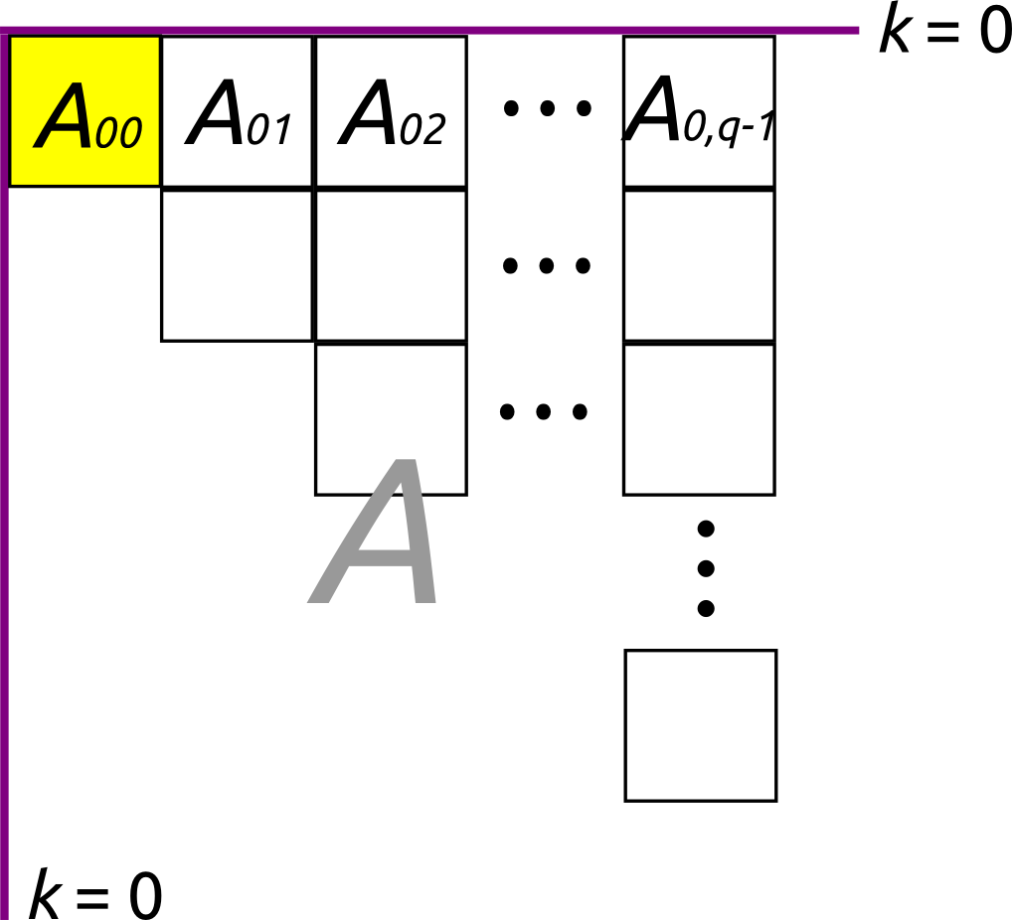
Procedure: Phase I
Notes:
We will briefly walk through the algorithm. In Phase I, we divide A into smaller submatrices and get rid of all submatrices on the lower half of the grid [point]. The upper left submatrix is processed first.

Slide 5
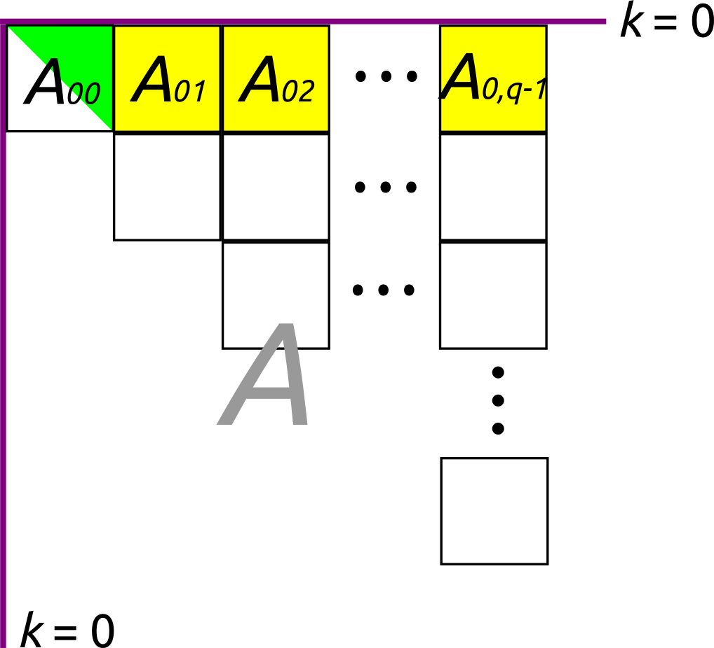
Procedure: Phase II
Notes:
After we reduce the upper left into the triangular form [point], we modify the band right next to it. That’s Phase II.

Slide 6
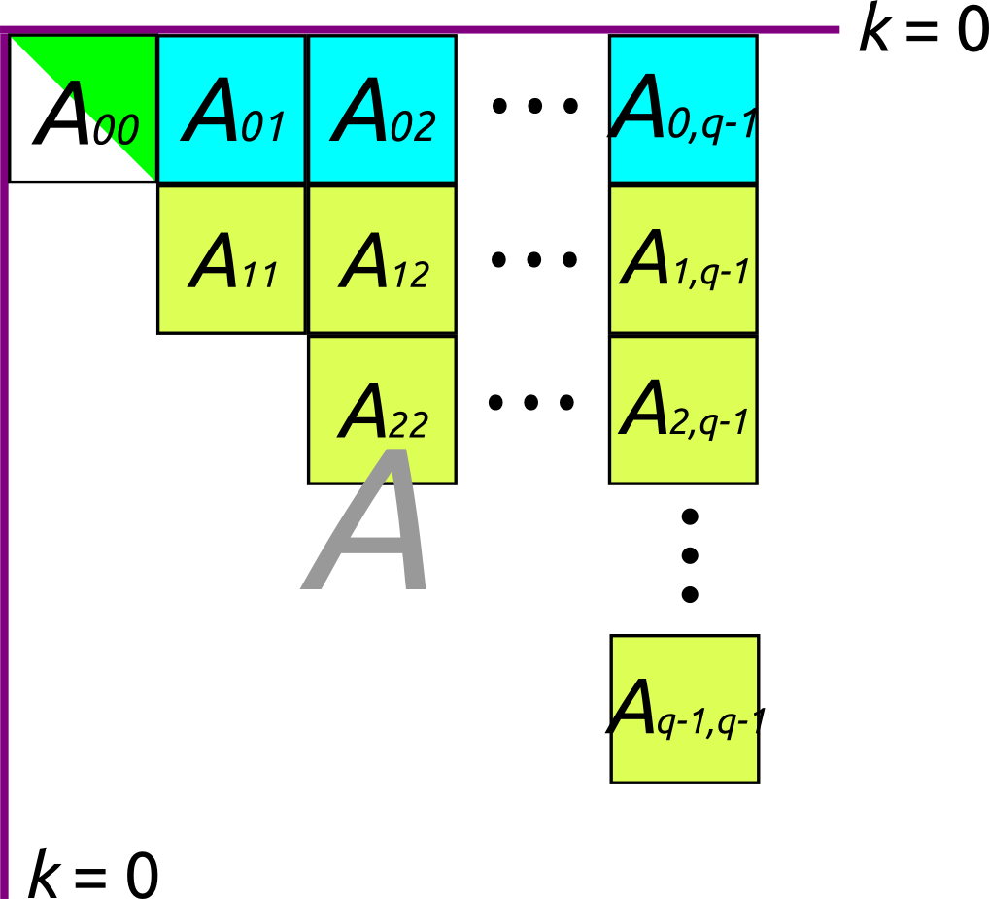
Procedure: Phase III
Notes:
Finally, in Phase III, we modify the rest of the matrix based on the content on the top.

Slide 7
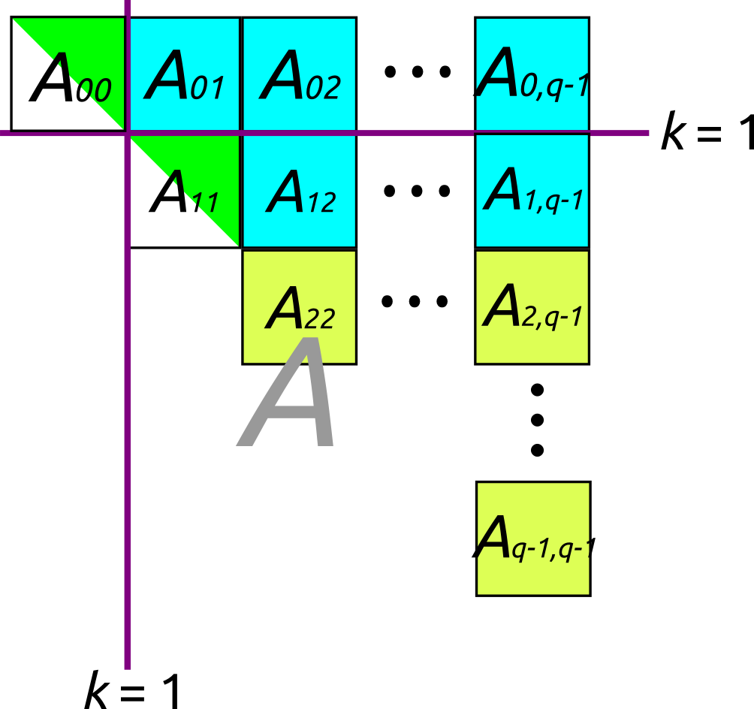
Procedure: Repeat
Notes:
And repeat the process multiple times until these diagonal submatrices [gesture] are all reduced in the triangular form.

Slide 8
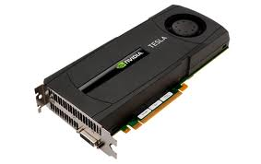
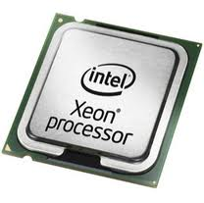
General Purpose GPU (GPGPU)
Cost-efficient parallel platform
Many-core approach
Device
Host
Notes:
To implement block Cholesky decomposition, we will be using GPUs. Today’s GPUs are equipped with tens of thousands of processing cores, so it offers a cost-efficient parallel platform. In GPGPU, we refer CPU as the host and GPUs as devices.

Slide 9
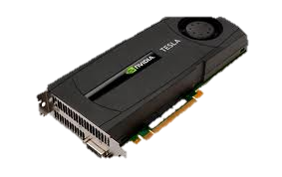
Multi-GPU system
GPU devices maintain separate memory & kernel invocations
Coordination becomes a significant issue
Memory transfer between devices is costly
Load-balancing is necessary to achieve high performance
Notes:
Here are some characteristics of a Multi-GPU system. GPU devices maintain their separate memory, and CPU invokes functions to run on GPU known as kernels. Thus co-ordination becomes a significant issue. Also, we have data dependency because the problem is not embarrassingly parallel. So memory transfer between devices is inevitable, but it’s expensive. We’ll discuss how to minimize such cost. Lastly, it’s necessary to balance load among multiple devices in order to achieve high performance.

Slide 10
Out-of-core implementation
GPU memory as cache for main CPU memory
Roughly 1/N of matrix were loaded to each device
Balanced load
Minimal communication w/ the host
Write back to main memory only finished parts
Submatrix size
small enough to load several of them at once
large enough to reduce latency
Notes:
Even with multiple GPUs, you never have enough memory. Therefore, the simplest solution to store only part of the matrix in the GPU memory. In other words, GPU memory serves as a cache for main memory. Such technique is called out-of-core. We allocate parts of the matrix to each GPU in a way that balances the load and minimizes communication with the host. In particular, the devices should write back to the main memory only the finished parts. Notice that we have to choose just the right submatrix size. It has to be small enough so that each device can load at least several of them. It has to large enough so that we don’t have too much latency.

Slide 11
Notes:
Here is a brief scheme of how we allocate data to GPU devices. Because our matrix is symmetric, we only have to store half of the whole matrix. In our block version of Cholesky, submatrices form rows as shown in the picture. We group every eight rows and assign 2 out of the 8 to each GPU. As you can see, device 0 takes row 0 and 7, and device 1 takes row 1 and 6 and so on. This way, the load is roughly balanced among all the devices. Notice that each submatrix row stays in exactly one device throughout its lifetime – it can be flushed into the host memory only when it requires no more modification.

Slide 12
Inter-device communication
Happens whenever we transition from one phase to another
Data transfer can be costly
Possible solutions
Peer-to-peer: 2x fast
Overlapping of computation and data transfer
Synchronization is critical.
CPU threads control GPU devices.
Between Phases II and III.
Notes:
Now we have devices having only parts of the matrix. So they have to talk to one another when we go from one phase to next. Data transfer between two devices can be costly. There are two solutions to this. First, we can use peer-to-peer copy, where data is copied bypassing the host. The throughput can be as twice as the traditional method. Second, we can overlap data transfer with computation. Both features are supported by latest Nvidia cards.
When two devices communicate, synchronization is critical. In our implementation, CPU threads control GPU devices, so the only thing we need to do is to synchronize those CPU threads.

Slide 13
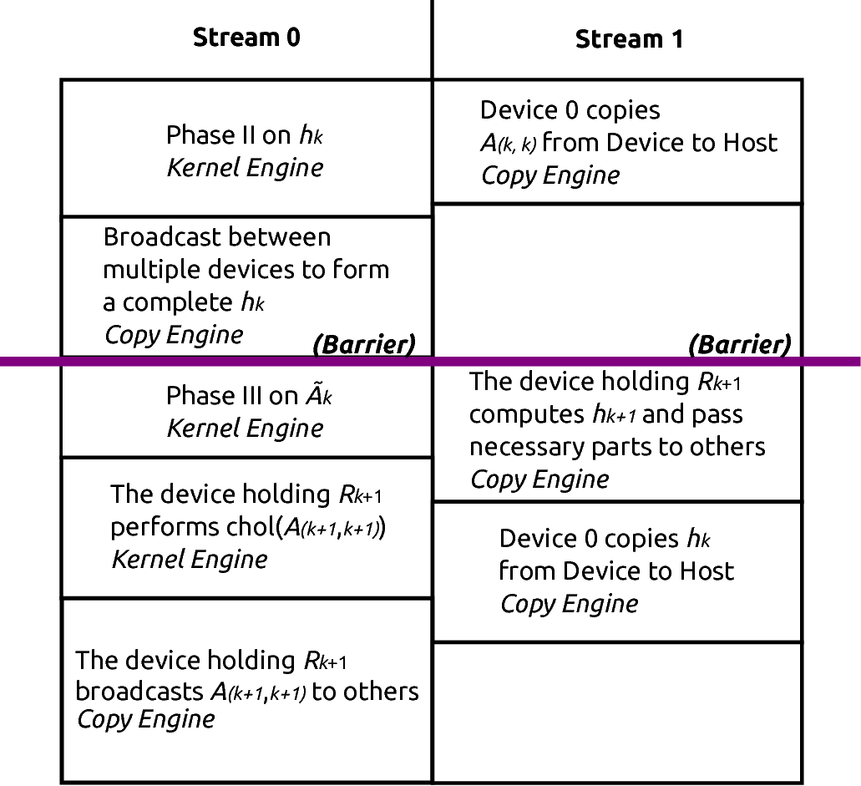
Do Phase II
Flush Phase I to Host
Communication to prepare for Phase III
Do Phase III
Communication to prepare for Phase II
Do Phase I
Flush Phase II to Host
Communication to prepare for Phase II
Notes:
Here’s a diagram showing how computation and data transfer are overlapped. We see that flushing happens at the same time as some computation. That’s good because sending data to the host is costly. Also, we have a global barrier between Phase II and Phase III. All devices are talking to one another, and they need to finish what they’ve been doing before they can exchange information.

Slide 14
Extension to disk I/O
For larger matrices, use main memory as cache for disks
Prefetching, delayed write: exploit locality
Notes:
Even main memory is never enough. So for larger matrices, we use main memory as a cache for hard disk. We exploit locality so that we don’t write to the disk as often. A block of neighboring submatrices are pre-fetched, and they are flushed back after we’re done modifying all of them.

Slide 15
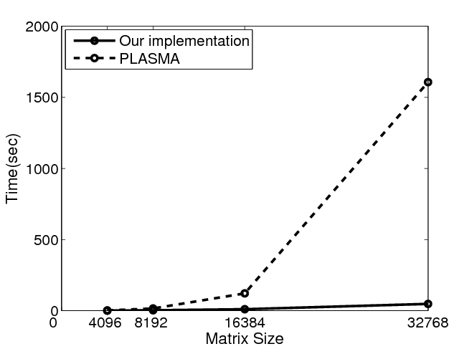
Performance
CPU: dual 2.4 GHz Intel® Xeon® quad-core
Main memory: 16GB
GPU: four Tesla C2050 graphics cards with 3GB memory
CUDA 4.2 Runtime
33x compared to PLASMA, a numerical linear algebra library for multicore CPU
Scalable to larger systems
65,000 x 65,000 matrix amounts to 32GB
Notes:
Here are exact specification of the machine we used. We used dual Intel Xeon quad-core CPU, 16 GB of main memory and four Tesla graphics card with 3GB memory each. For the largest case we tried, our implementation runs 33 times faster than PLASMA, which is a numerical linear algebra library for multicore CPU. The main strength of our implementation is that it can handle large matrices that don’t fit in the main memory. We have tried, for example, 65,000 by 65,000, which came about 32 GB. And the result was accurate.

Slide 16
Conclusion
Our implementation is scalable to very large systems.
We streamlined operation across three memory layers.
We were able to apply it to image segmentation.
Notes:
In conclusion, our implementation turns out to be scalable to very large systems. Input can be as large as it can be, as long as it fits in a hard disk. We have streamlined operation across three distinct memory layers. Those are GPU memory, main memory, and virtual memory on the disk. Finally, we were able to apply our program to image segmentation.

