Slide 1
GPU Accelerated Vessel Segmentation Using Laplacian Eigenmaps
Lin Cheng, Hyunsu Cho and Peter A. Yoon
Trinity College

Slide 2
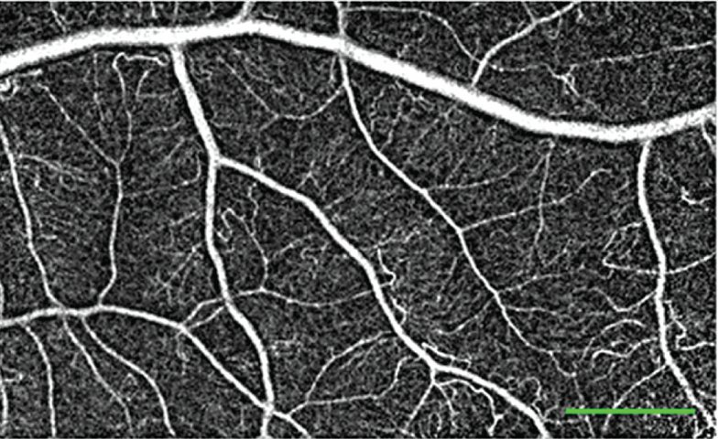
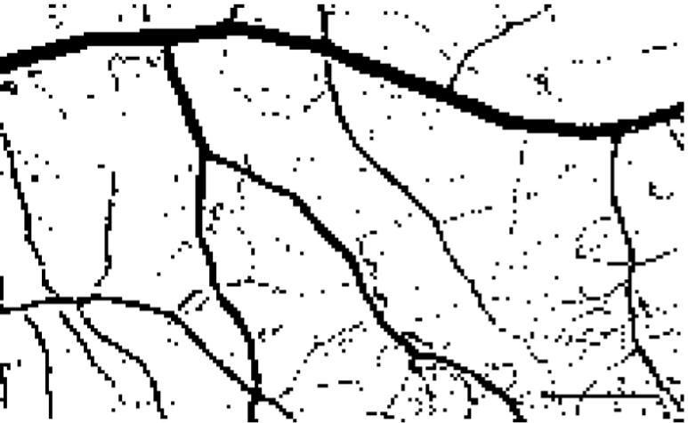
Problem
Image segmentation
Partition pictures of vessels into segments

Slide 3
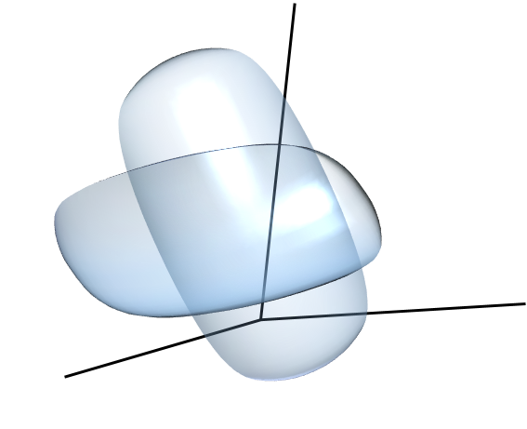
Laplacian eigenmap [1]
Local info embedded in high dimensional space
Project local info onto low-dimensional plane
Optimize the projection to preserve essential characteristics
Cluster the projected data points into segments
[1] Tziakos, Laskaris, and Fotopoulos

Slide 4
Segmentation process
Build graph of local info
Apply Laplace operator
Solve optimization problem

Slide 5
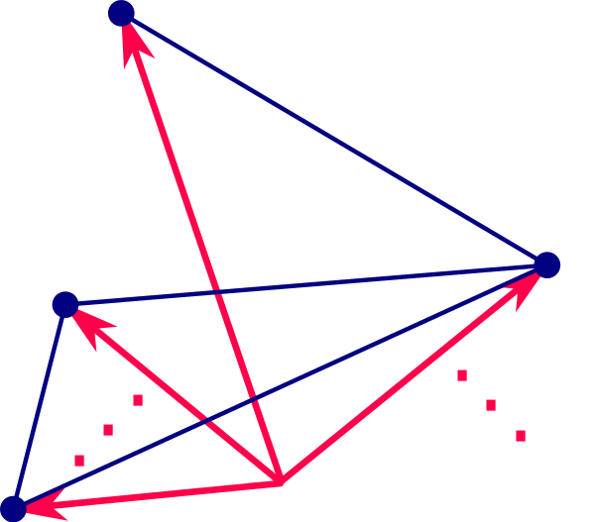
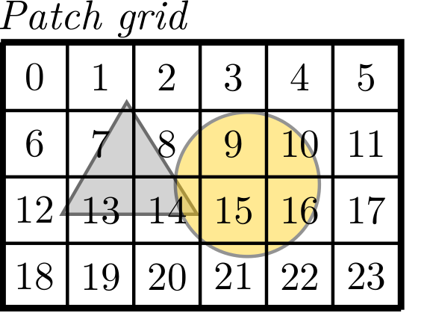
Build graph of local info
Store the resulting graph in a weight matrix
Edges reflect variations among different regions (global variation)

Slide 6

Apply Laplace operator
Form Laplacian matrix L = I – D^{1/2}WD^{1/2} encoding the Laplace operator.
The operator formulates an optimization problem: Projections of well-connected nodes should also be tightly clustered.

Slide 7
Solve optimization problem
Solutions to eigenvalue problem Ly = λy are optimal solutions
If solutions are good, we can detect clusters

Slide 8

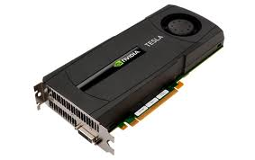
Characteristics of GPUs
Massively parallel – lots of small cores (workers)
Good for high-throughput, compute-bound tasks
Separate memory space from main memory

Slide 9
Strategy: Reduce memory footprint
On-GPU memory is limited
Reduce memory usage and we can pack in more work into GPU

Slide 10
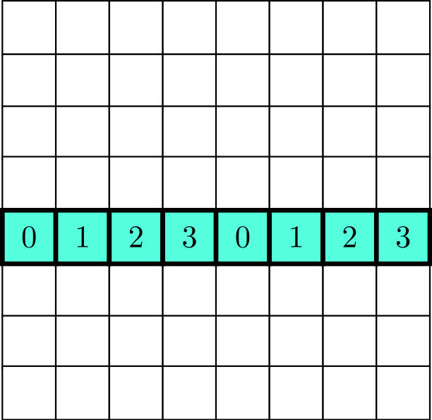
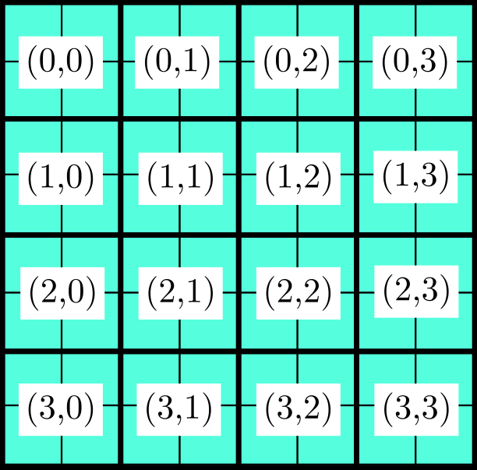
Strategy: Reduce memory footprint
Weight matrix generation:
Do not store intermediate results
More entries can be calculated in parallel; 10x faster

Slide 11
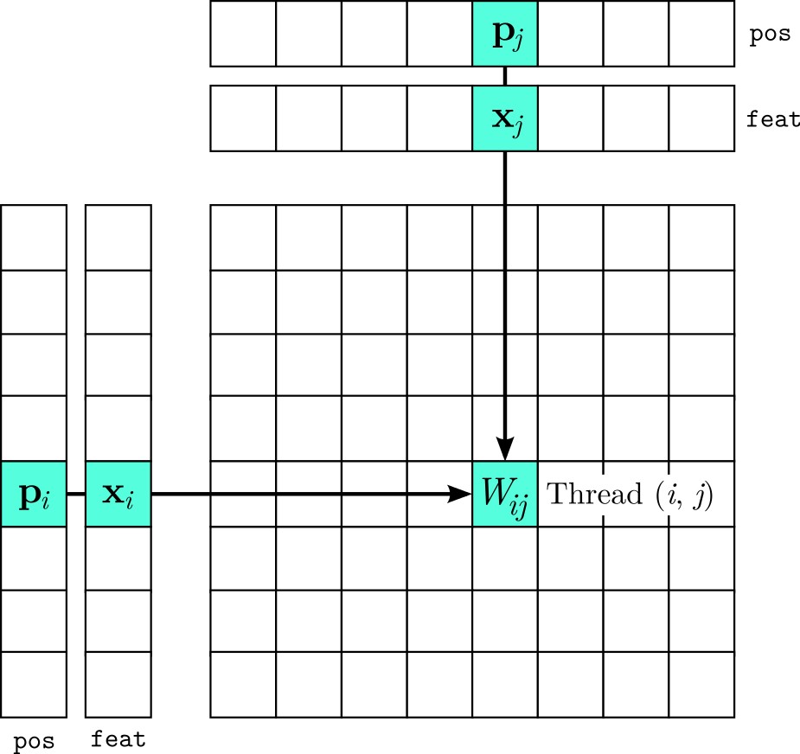
Worker allocation

Slide 12
Strategy: use Lanczos method
We need only a few smallest eigenvalues of L
Lanczos method iteratively solve for the eigenvalues needed
Takes 1/28 time of conventional method

Slide 13
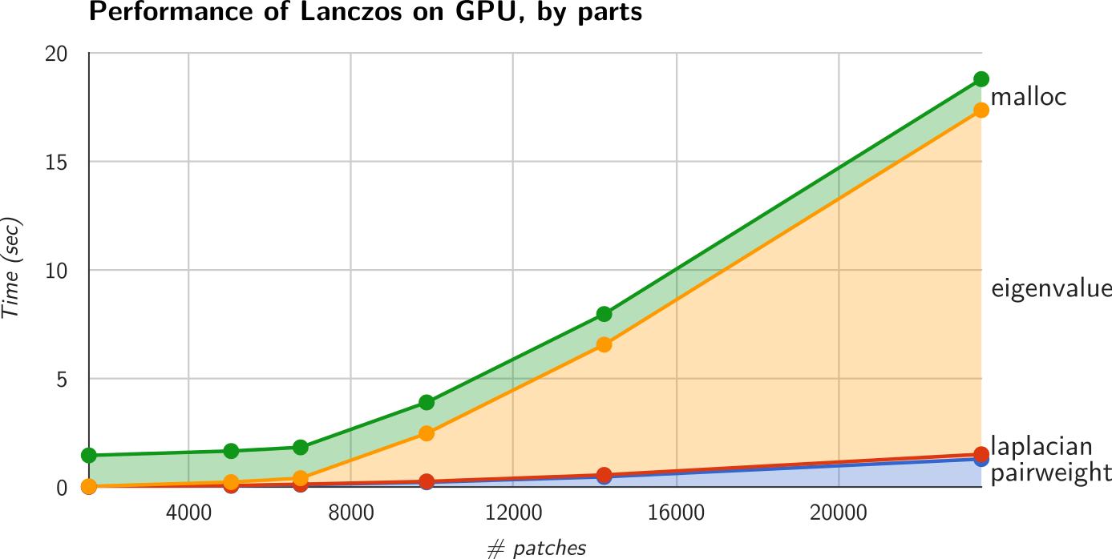
Performance

Slide 14
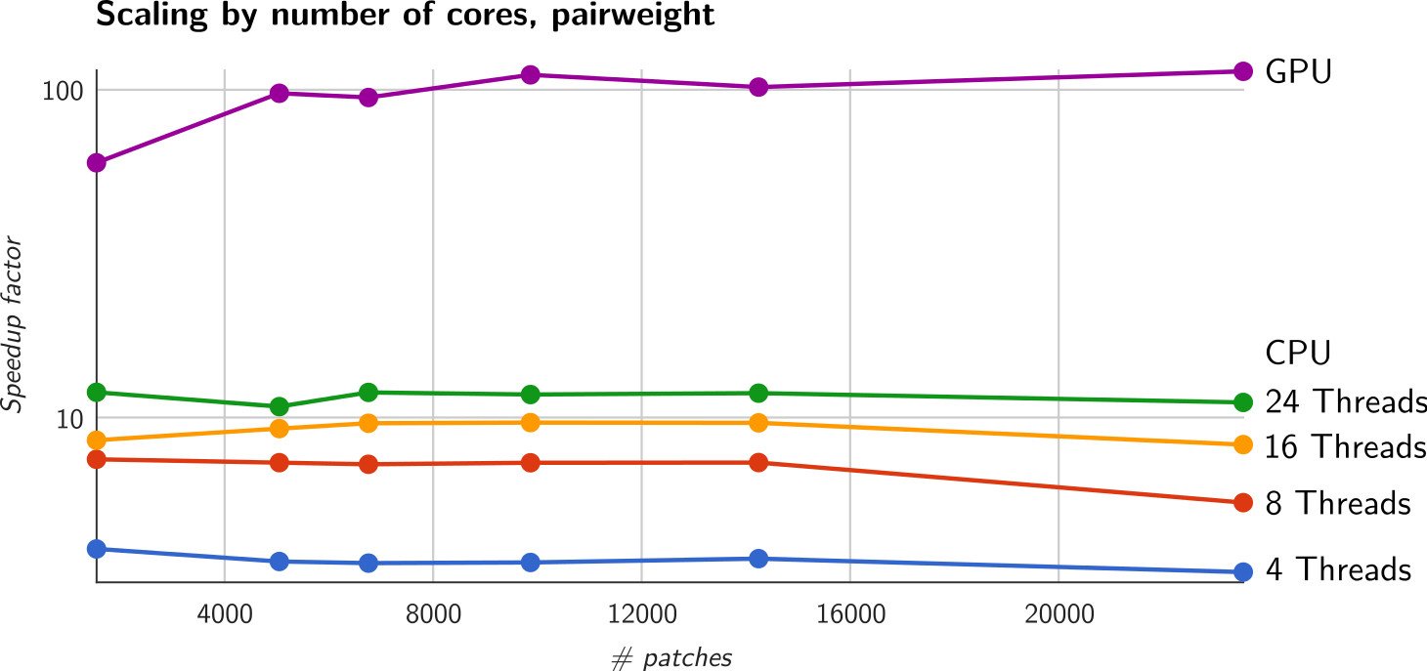
Performance: vs. multicore CPUs
CPU: two Intel® Xeon® E5-2620
GPU: one Nvidia Tesla® K20c

Slide 15
Acknowledgement
Trinity College, Student Research Program
Nvidia Corporation, CUDA Teaching Center Program

