Slide 1
An Accelerated Procedure for Hypergraph Coarsening on the GPU
Lin Cheng, Hyunsu Cho, and Peter Yoon
Trinity College
Hartford, CT, USA

Slide 2
Outline
Hypergraph coarsening
Implementation challenges
Runtime task planning
Results

Slide 3
Hypergraph
Nodes
Hyperedges (nets)
Subsets of nodes
e₁
e₂
v₂
v₁
v₃
e₃
v₄
v₅
v₆

Slide 4
Hypergraph
Hypergraph partitioning
Minimize edge cut
Balance constraint
NP-complete
e₁
e₂
v₂
v₁
v₃
e₃
v₄
v₅
v₆

Slide 5

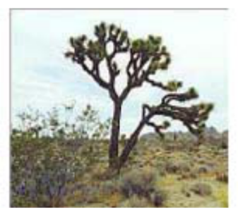

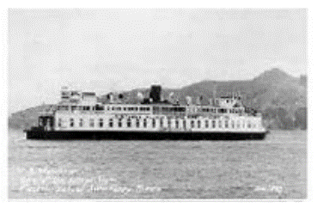

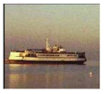
Image classification
Similar images should go to same category
Need to compare images to one another

Slide 6
Hypergraph construction
Compare multiple pictures at a time

Slide 7
Hypergraph coarsening
Heuristic: reduce # nodes by fusing
e₁
e₂
v₂
v₁
v₃
6 nodes
e₃
v₄
v₅
v₆

Slide 8
Hypergraph coarsening
Heuristic: reduce # nodes by fusing
e₁
e₂
v₂
v₃
v₁
3 nodes
v₄
e₃
v₅
v₆

Slide 9
Mondriaan algorithm
Given a node, find most “similar” neighbor
Similarity = # hyperedges containing both
v₂
Affinity = 2
v₃

Slide 10
Mondriaan algorithm
Given a node, find most “similar” neighbor
Similarity = # hyperedges containing both
← Nodes
Binary
sparse
matrix
Edges →
Member? (T/F)

Slide 11
Mondriaan algorithm
Given a node, find most “similar” neighbor
Similarity = # hyperedges containing both
1. Find edges containing v₃

Slide 12
Mondriaan algorithm
Given a node, find most “similar” neighbor
Similarity = # hyperedges containing both
1. Find edges containing v₃
2. Collect nonzeros

Slide 13
Mondriaan algorithm
Given a node, find most “similar” neighbor
Similarity = # hyperedges containing both
2
3. Inspect column index of each nonzero

Slide 14
Mondriaan algorithm
Given a node, find most “similar” neighbor
Similarity = # hyperedges containing both
2
2
1
2
1
Similarity scores
3. Inspect column index of each nonzero

Slide 15
Mondriaan algorithm
Parallel algorithm: Inspect edges in parallel
2
2
1
2
1
Thread 0
Thread 1
Thread 2

Slide 16
GPU as parallel accelerator
NVIDIA GPUs : organized in warps
32 threads share one instruction counter
LOAD A[*] INTO X
X
(register)
A[*]
(memory)

Slide 17
Warp divergence
Thread 0-9: LOAD A[0-9] INTO X
0
1
2
3
4
5
6
7
8
9
X
A[*]

Slide 18
Warp divergence
Thread 0-4: LOAD A[0-4] INTO X
Thread 5-9: NONE
0
1
2
3
4
5
6
7
8
9
X
A[*]

Slide 19
Warp divergence
Thread 0-4: LOAD A[0-4] INTO X
Thread 5-9: NONE
0
1
2
3
4
5
6
7
8
9
X
A[*]
stalled

Slide 20
Warp divergence
Serializes execution
Caused by load imbalance
Sparse/irregular data

Slide 21
Mondriaan algorithm
A naïve strategy results in load imbalance
Nonzero entry = workload
2
2
1
2
1
6
Thread 0
3
Thread 1
Thread 2
2

Slide 22
SHFL to the rescue
Compiler primitive
Shuffles content of adjacent registers
x=shfl_down(x,2)

Slide 23
SHFL to the rescue
Compiler primitive
Shuffles content of adjacent registers
Single machine instruction
Warp-synchronous; no sync. needed after
x=shfl_down(x,2)

Slide 24
Runtime planning with SHFL
6
Thread 0
3
Thread 1
2
Thread 2

Slide 25
Runtime planning with SHFL
Prefix sum
6
0
Thread 0
3
6
Thread 1
2
Thread 2
9
11

Slide 26
Runtime planning with SHFL
Prefix sum
6
0
Thread 0
3
6
Thread 1
2
Thread 2
9
11
ceil(11 / 3) = 4

Slide 27
Runtime planning with SHFL
Range
6
0 – 3
Thread 0
3
4 – 7
Thread 1
2
Thread 2
8 – 10
11
ceil(11 / 3) = 4

Slide 28
Runtime planning with SHFL
Range
0 – 3
Thread 0
Equal # of
nonzeros
4 – 7
Thread 1
Thread 2
8 – 10

Slide 29
Runtime planning with SHFL
2
2
Range
1
2
1
0 – 3
Thread 0
4 – 7
Thread 1
Thread 2
8 – 10

Slide 30
Results
NVIDIA Tesla K20c (5GB mem)
Intel Xeon E5-2620
Reference sequential implementation of Mondriaan

Slide 31
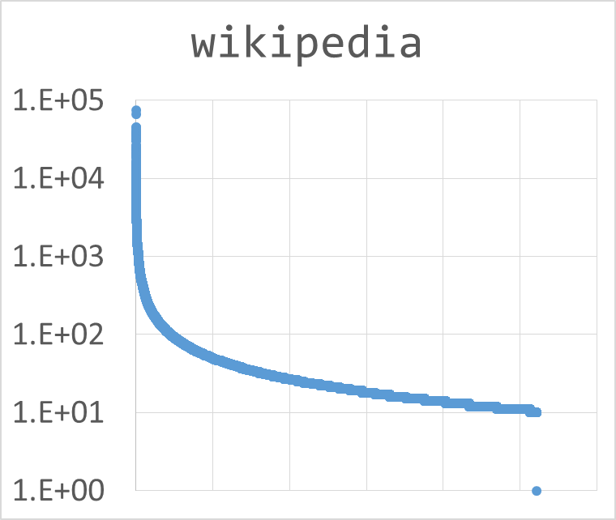
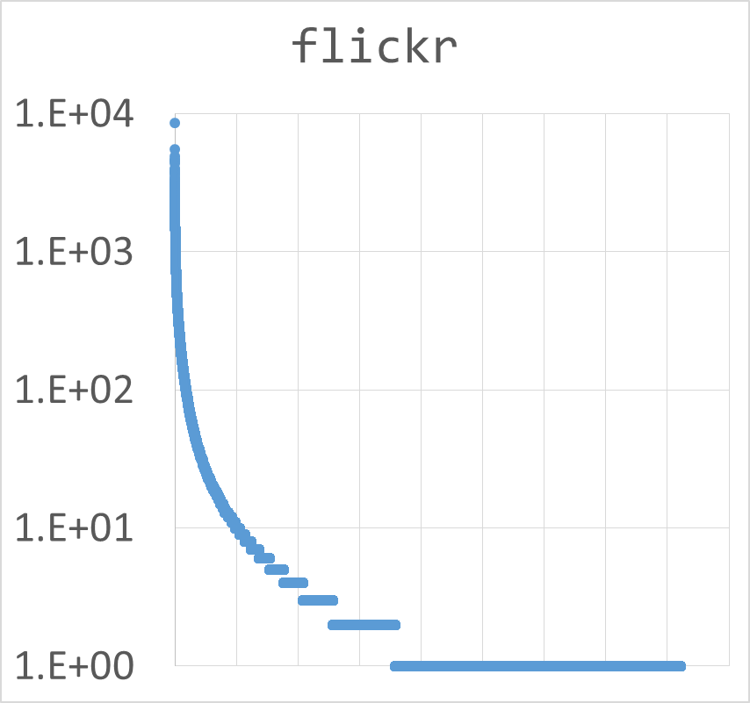
Results: long-tailed distribution
wikipedia
flickr
1.E+05
1.E+04
GPU: 50 s
Seq. : 811 s
16 x speed-up
GPU: 59 s
Seq. : 877 s
15 x speed-up
Y-axis: # of nonzeros in columns, descending, log-scale

Slide 32
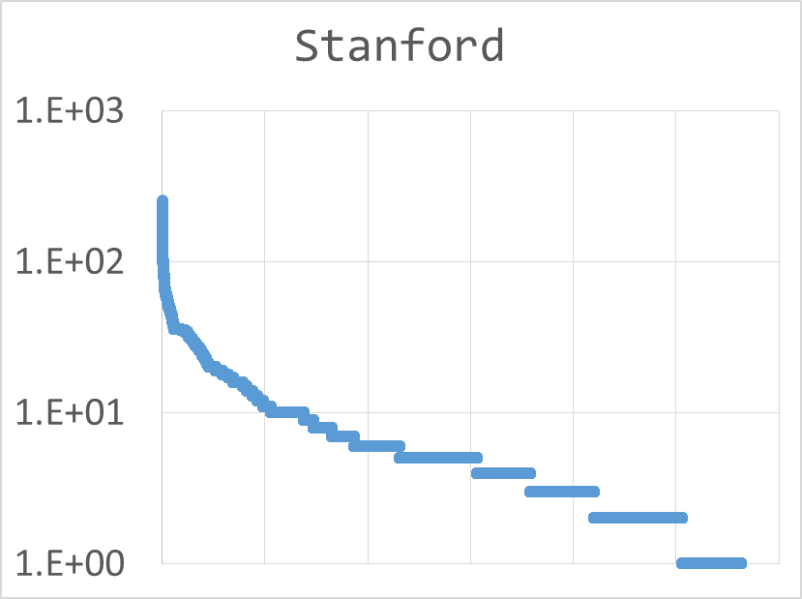
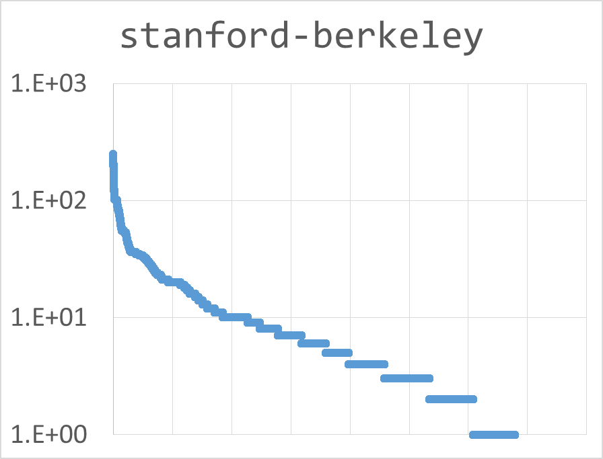
Results: non-long-tailed distribution
stanford
stanford-berkeley
1.E+03
1.E+03
GPU: 146 s
Seq. : 65 s
0.45 x
GPU: 626 s
Seq. : 41 s
0.07 x
Y-axis: # of nonzeros in columns, descending, log-scale

Slide 33
Analysis of results
Good speedup for data with long-tailed distribution of nonzeros

Slide 34
Analysis of results
Good speedup for data with long-tailed distribution of nonzeros
Synthetic data
First 1,000 columns : 100,000 nonzeros each
Next 699,000 columns : all zero
Speedup: 123 x

Slide 35
Analysis of results
Most nodes sparsely connected ( << 32 edges)
Now: one warp, one instance of Mondriaan
2
2
1
2
1
Thread 0
Thread 1
Thread 2
What if this column has < 32 nonzeros?

Slide 36
Work in progress
Pool multiple instances of Mondriaan into warp
2
2
1
2
1
1
2
1
2
1
Thread 0
Thread 1
Thread 2

Slide 37
Conclusion
Implemented hypergraph algorithm handling arbitrary connectivity patterns
Explored SHFL for task planning
Future work: more flexible allocation strategy

Slide 38
Acknowledgment
Trinity College: Student Research Program
NVIDIA: CUDA Teaching Center

