Slide 1
CARLA Sensing Group Literature Review
Eric Choi, Sree Nair, Linbo Tang

Slide 2
End-to-End Object Detection with Transformers
(ECCV 2020)
Eric Choi

Slide 3
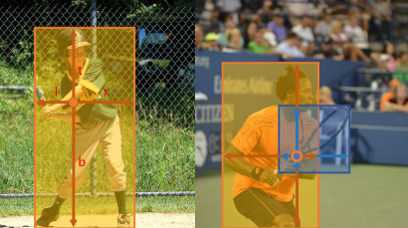
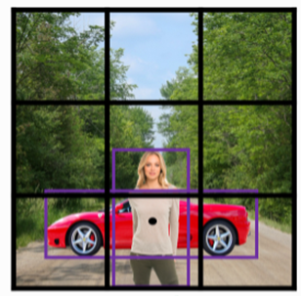
Background
[pre-defined anchor object detection]
Classical detectors were accompanied by hand-designed components that encode prior knowledge, such as anchor, window centers, etc.

Slide 4
Background
[pre-defined anchor object detection]
Increased generalization error
Hard to detect ground-truth different in size from the anchor box

Slide 5
Background
[pre-defined anchor object detection]
Highly dependent on post-processing

Slide 6
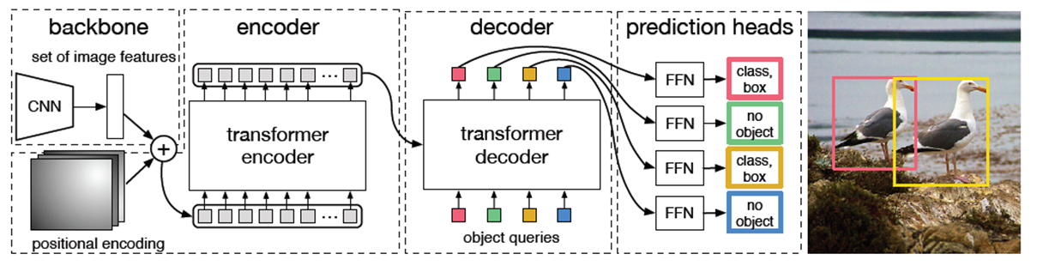
DEtection TRansformer (DETR)
[Architecture of DETR]
First case for Transformer to be used for object detection
Removed hand-crafted process using direct prediction

Slide 7
DEtection TRansformer (DETR)
[Architecture of DETR: Backbone]
Feature extraction
Positional encodings storing the localization information of the data

Slide 8
DEtection TRansformer (DETR)
[Architecture of DETR: Transformer]
The encoder learns to distinguish objects from background
The decoder uses non-autoregressive approach

Slide 9
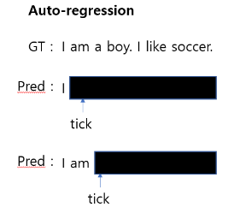
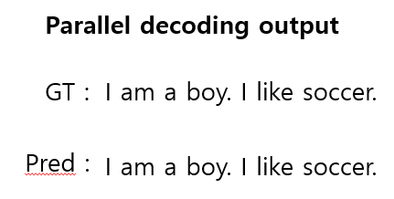
DEtection TRansformer (DETR)
[auto-regressive]
[non-autoregressive]
Sequential decoding output
Computational cost ↑
Accuracy ↑
Parallel decoding output
Computational cost ↓
Accuracy ↓

Slide 10
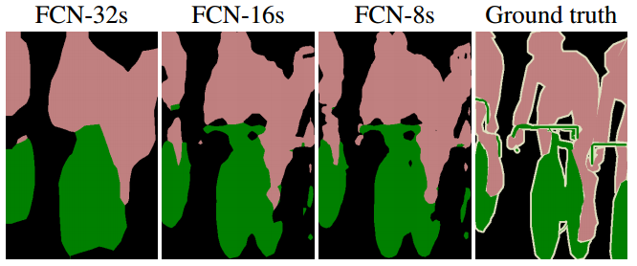
DEtection TRansformer (DETR)
[auto-regressive]
[non-autoregressive]
Sequential decoding output
Computational cost ↑
Accuracy ↑
Parallel decoding output
Computational cost ↓
Accuracy ↓

Slide 11
DEtection TRansformer (DETR)
[Architecture of DETR: Direct Set Prediction]
Apply bipartite matching to the output of the FFNs
Bipartite matching sets background to “no object”; they will be removed from the output

Slide 12
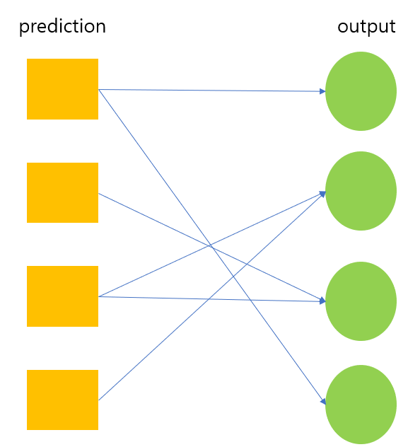
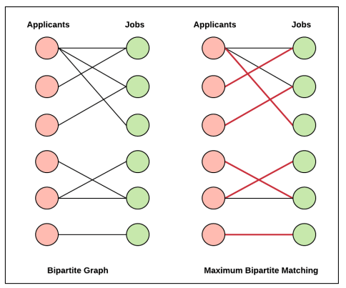
DEtection TRansformer (DETR)
[DETR: Bipartite matching]
Prediction is the DETR output, and output is Ground-Truth
No connection inside each group

Slide 13
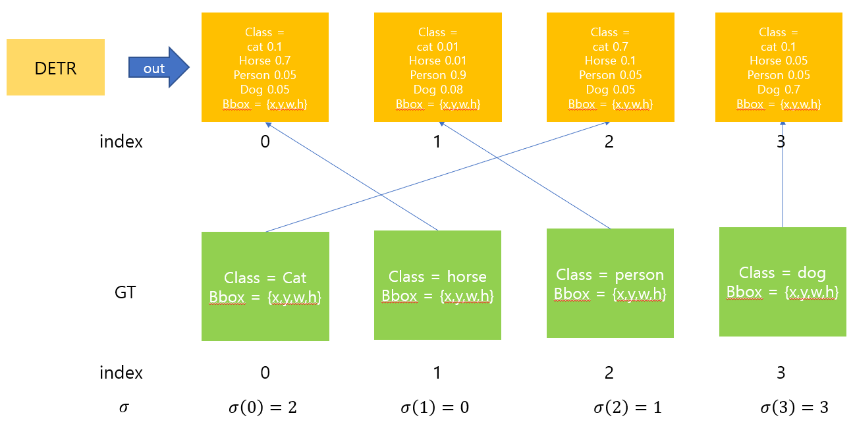
DEtection TRansformer (DETR)
[DETR: Bipartite matching]
DETR output: class and bbox
We want to calculate the loss by connecting the predicted to the GT

Slide 14
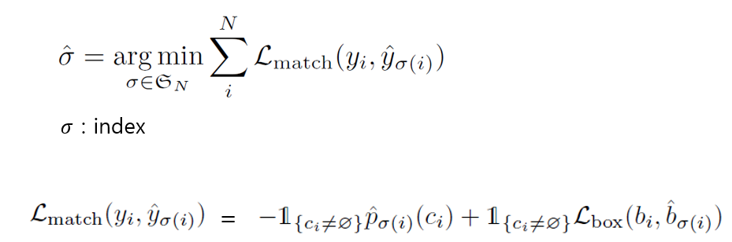
DEtection TRansformer (DETR)
[DETR: Bipartite matching]
Left: probability that the predicted is same as GT class
Right: loss between the predicted bbox and GT bbox

Slide 15
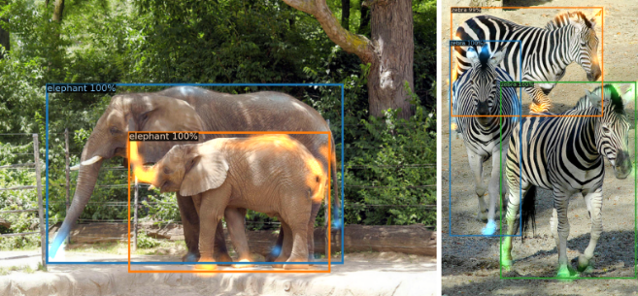
DEtection TRansformer (DETR)
[Architecture of DETR: Output]
Decoder attends to object extremities, such as legs and heads.

Slide 16
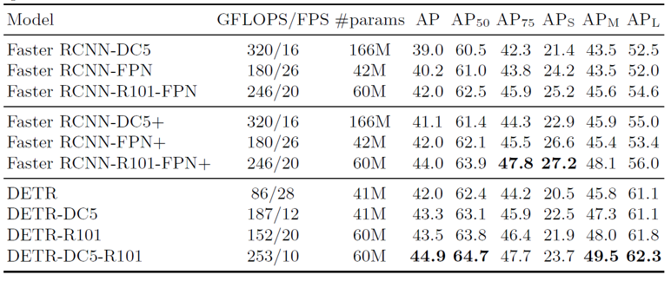
DEtection TRansformer (DETR)
[Pros and cons of DETR]
Better accuracy than SOTA R-CNN
Flexible Transformer architecture
Simple implementation
Improved large object detection performance
No custom layers; better reproduction
Too long training time
Optimization problems
Worse small object detection performance
Not desirable for small amounts of data

Slide 17
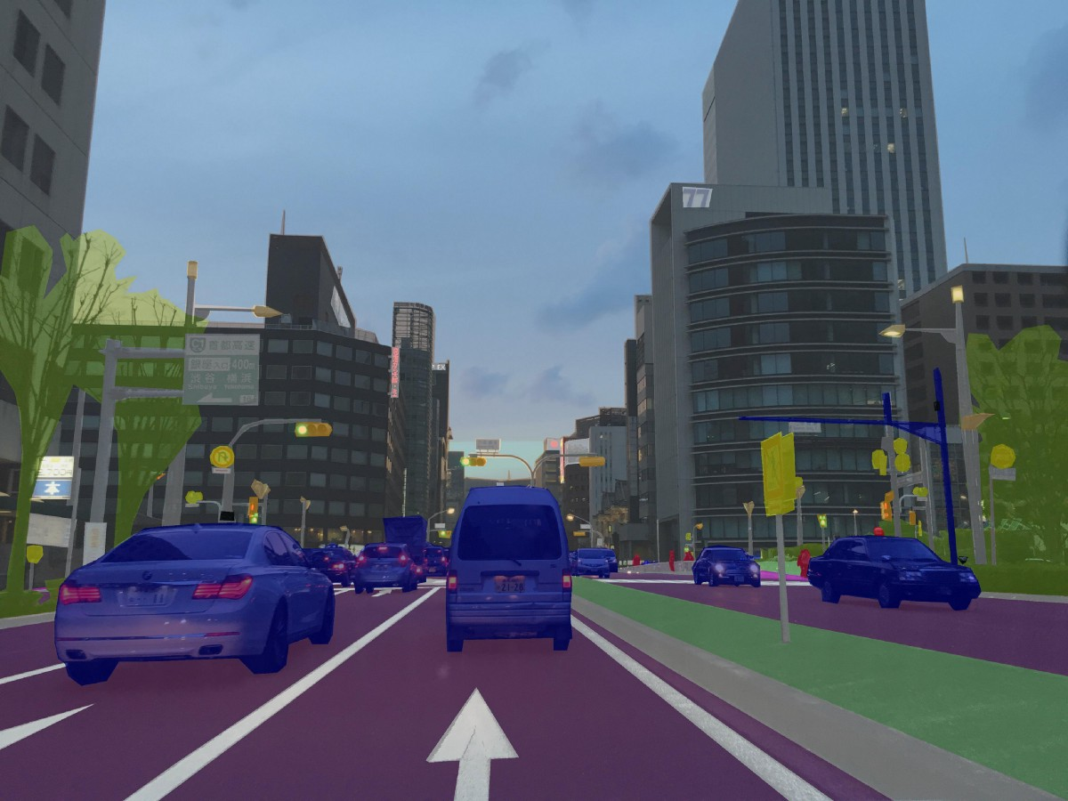
DEtection TRansformer (DETR)
Improved large object detection performance

Slide 18
Segmenter: Transformer for semantic segmentation (2021)
Sree Nair
Notes:
Hello everybody my name is Sree and I have researched the paper “Segmenter: Transformer for semantic segmentation” as part of my literature review.

Slide 19
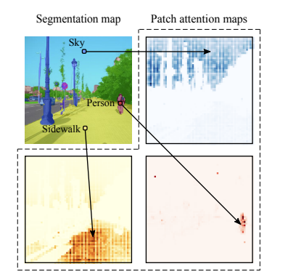
Background – What is semantic Segmentation
Assign each image pixel to a category label.
Must map to corresponding underlying object
Provide high level
Notes:
semantic segmentation is the process of assigning each image pixel to a category label corresponding to the underlying object and to provide high-level image representations for target tasks, e.g. detecting the boundaries of people, cars on the street, tarmac, etc ..

Slide 20
Traditional Segmentor vs Transformer Segmentor
Tradiontal Segmentor | Transformer Segmentor
Use CNN – local context | Use transformer – global context
Global context capturing difficult | Global context captured in first layer
Context fed in later | Context leveraged at every layer -transformer
Specialized layers needed to capture context | Not needed.
Notes:
Tradional Segmentors use Convolutional neural nets and are only able to pick up on trends that are in the vicinity of the pixels part of the convolution and often need information fed in externally from other structures to capture global context. Use of transformer helps with capturing global context.
No specialized layers are needed to capture context in the case of transformers

Slide 21
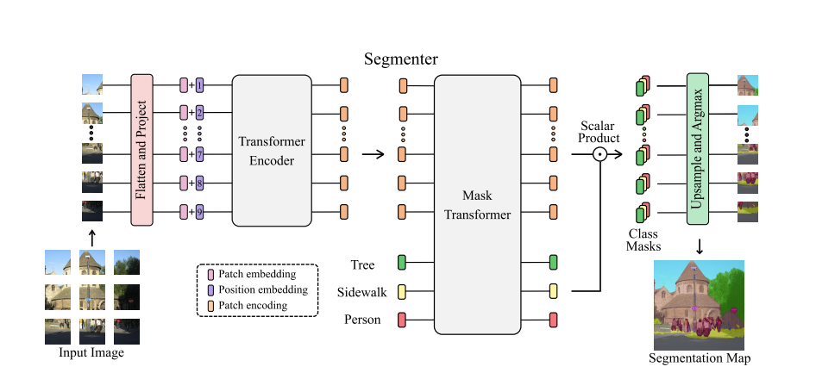
Segmenter - Architecture
Built off Vision Transformer (ViT)
Image classification models → semantic segmentation models.
Linear decoder + mask transformer used for generating class masks.
Notes:
The architecture in question is built off vision transformer and was extended for semantic segmentation
To do so, they relied on the output embeddings corresponding to image patches and obtain class labels from these embeddings with a point-wise linear decoder or a mask transformer decoder
Linear decoder in concert with mask transformer used for generating class masks.

Slide 22
Applications to CARLA
Traditional models use CNN – miss global context
Outperforms traditional Segmentors on Pascal Contect datasets and ADE20K datasets
Highly effective on cityscpaes
Effective on City terrain, High speed – applications for Carla
Notes:
The local nature of convolutional filters limits the access to the global information in the image. this information is particularly important for segmentation where the labeling of local patches often depends on the global image context. The transformer segemntor introduce feature aggregation with dilated convolutions and spatial pyramid pooling. This allows to enlarge the receptive fields of convolutional networks and to obtain multi-scale features.
The transformer segementor out performs traditional segmentos on the Pascal Contect datasets and ADE20K datasets.
It is highly effective on city scapes and trains quickly which means it is really usefule for the CARLA project where vehicles are being trained to drive on city terrain and segmentation would come in handy.

Slide 23
Toward Hierarchical Self-Supervised Monocular Absolute Depth Estimation for Autonomous Driving Applications
Linbo Tang

Slide 24
Problem to Solve
Imprecise object-level depth inference -> Cause vague boundaries
Uncertain scale factor -> Require additional sensor
Notes:
The local nature of convolutional filters limits the access to the global information in the image. this information is particularly important for segmentation where the labeling of local patches often depends on the global image context. The transformer segemntor introduce feature aggregation with dilated convolutions and spatial pyramid pooling. This allows to enlarge the receptive fields of convolutional networks and to obtain multi-scale features.
The transformer segementor out performs traditional segmentos on the Pascal Contect datasets and ADE20K datasets.
It is highly effective on city scapes and trains quickly which means it is really usefule for the CARLA project where vehicles are being trained to drive on city terrain and segmentation would come in handy.

Slide 25
Solution -> DNet
Dense connected prediction (DCP) layer:
Depth inference can be made based on multi-scale prediction features
Dense geometrical constrains (DGC) :
Finish per-pixel ground segmentation and estimate a camera height from every ground point
Notes:
The local nature of convolutional filters limits the access to the global information in the image. this information is particularly important for segmentation where the labeling of local patches often depends on the global image context. The transformer segemntor introduce feature aggregation with dilated convolutions and spatial pyramid pooling. This allows to enlarge the receptive fields of convolutional networks and to obtain multi-scale features.
The transformer segementor out performs traditional segmentos on the Pascal Contect datasets and ADE20K datasets.
It is highly effective on city scapes and trains quickly which means it is really usefule for the CARLA project where vehicles are being trained to drive on city terrain and segmentation would come in handy.

Slide 26
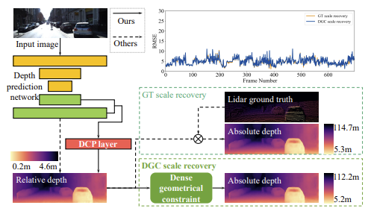
Comparison
Notes:
The local nature of convolutional filters limits the access to the global information in the image. this information is particularly important for segmentation where the labeling of local patches often depends on the global image context. The transformer segemntor introduce feature aggregation with dilated convolutions and spatial pyramid pooling. This allows to enlarge the receptive fields of convolutional networks and to obtain multi-scale features.
The transformer segementor out performs traditional segmentos on the Pascal Contect datasets and ADE20K datasets.
It is highly effective on city scapes and trains quickly which means it is really usefule for the CARLA project where vehicles are being trained to drive on city terrain and segmentation would come in handy.

Slide 27
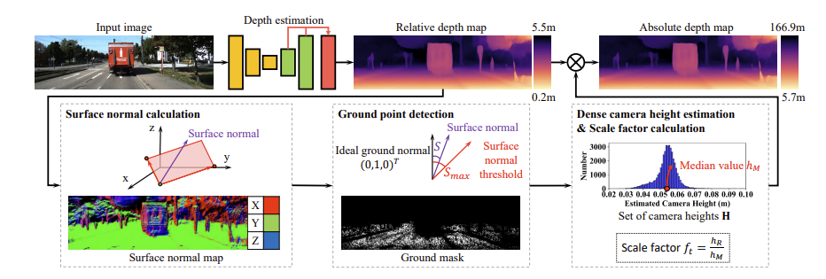
Overview
Notes:
The local nature of convolutional filters limits the access to the global information in the image. this information is particularly important for segmentation where the labeling of local patches often depends on the global image context. The transformer segemntor introduce feature aggregation with dilated convolutions and spatial pyramid pooling. This allows to enlarge the receptive fields of convolutional networks and to obtain multi-scale features.
The transformer segementor out performs traditional segmentos on the Pascal Contect datasets and ADE20K datasets.
It is highly effective on city scapes and trains quickly which means it is really usefule for the CARLA project where vehicles are being trained to drive on city terrain and segmentation would come in handy.

Slide 28
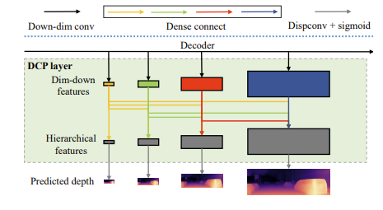
DCP layer
Intuition: low-res layers of decoder network can provide more reliable object-level depth inference and high-res layers focus more on local depth details.
Implementation: Low-res layers are concatenated to higher-res layers
Notes:
The local nature of convolutional filters limits the access to the global information in the image. this information is particularly important for segmentation where the labeling of local patches often depends on the global image context. The transformer segemntor introduce feature aggregation with dilated convolutions and spatial pyramid pooling. This allows to enlarge the receptive fields of convolutional networks and to obtain multi-scale features.
The transformer segementor out performs traditional segmentos on the Pascal Contect datasets and ADE20K datasets.
It is highly effective on city scapes and trains quickly which means it is really usefule for the CARLA project where vehicles are being trained to drive on city terrain and segmentation would come in handy.

Slide 29
DGC -> Scale recovery
1) Surface Normal Calculation (8 neighbors)
Determine the surface normal for each pixel
2) Ground point detection
Using Cosine function to calculate similarity to determine ground point
Notes:
The local nature of convolutional filters limits the access to the global information in the image. this information is particularly important for segmentation where the labeling of local patches often depends on the global image context. The transformer segemntor introduce feature aggregation with dilated convolutions and spatial pyramid pooling. This allows to enlarge the receptive fields of convolutional networks and to obtain multi-scale features.
The transformer segementor out performs traditional segmentos on the Pascal Contect datasets and ADE20K datasets.
It is highly effective on city scapes and trains quickly which means it is really usefule for the CARLA project where vehicles are being trained to drive on city terrain and segmentation would come in handy.

Slide 30

DGC -> Scale recovery
3) Camera height estimation (median)
OP: projection vector, N: surface normal
4) Scale factor calculation
Real Height of camera / median height estimation
Notes:
The local nature of convolutional filters limits the access to the global information in the image. this information is particularly important for segmentation where the labeling of local patches often depends on the global image context. The transformer segemntor introduce feature aggregation with dilated convolutions and spatial pyramid pooling. This allows to enlarge the receptive fields of convolutional networks and to obtain multi-scale features.
The transformer segementor out performs traditional segmentos on the Pascal Contect datasets and ADE20K datasets.
It is highly effective on city scapes and trains quickly which means it is really usefule for the CARLA project where vehicles are being trained to drive on city terrain and segmentation would come in handy.

Slide 31

Absolute Depth Estimation
Notes:
The local nature of convolutional filters limits the access to the global information in the image. this information is particularly important for segmentation where the labeling of local patches often depends on the global image context. The transformer segemntor introduce feature aggregation with dilated convolutions and spatial pyramid pooling. This allows to enlarge the receptive fields of convolutional networks and to obtain multi-scale features.
The transformer segementor out performs traditional segmentos on the Pascal Contect datasets and ADE20K datasets.
It is highly effective on city scapes and trains quickly which means it is really usefule for the CARLA project where vehicles are being trained to drive on city terrain and segmentation would come in handy.

Slide 32
Thank you

