Slide 1


Market Intelligence data delivered by the Nielsen Portfolio
prepared for Myungin Baek from Innocean Seoul on 20/04/2020
"Understand the advertising around you to improve your own"

Slide 2
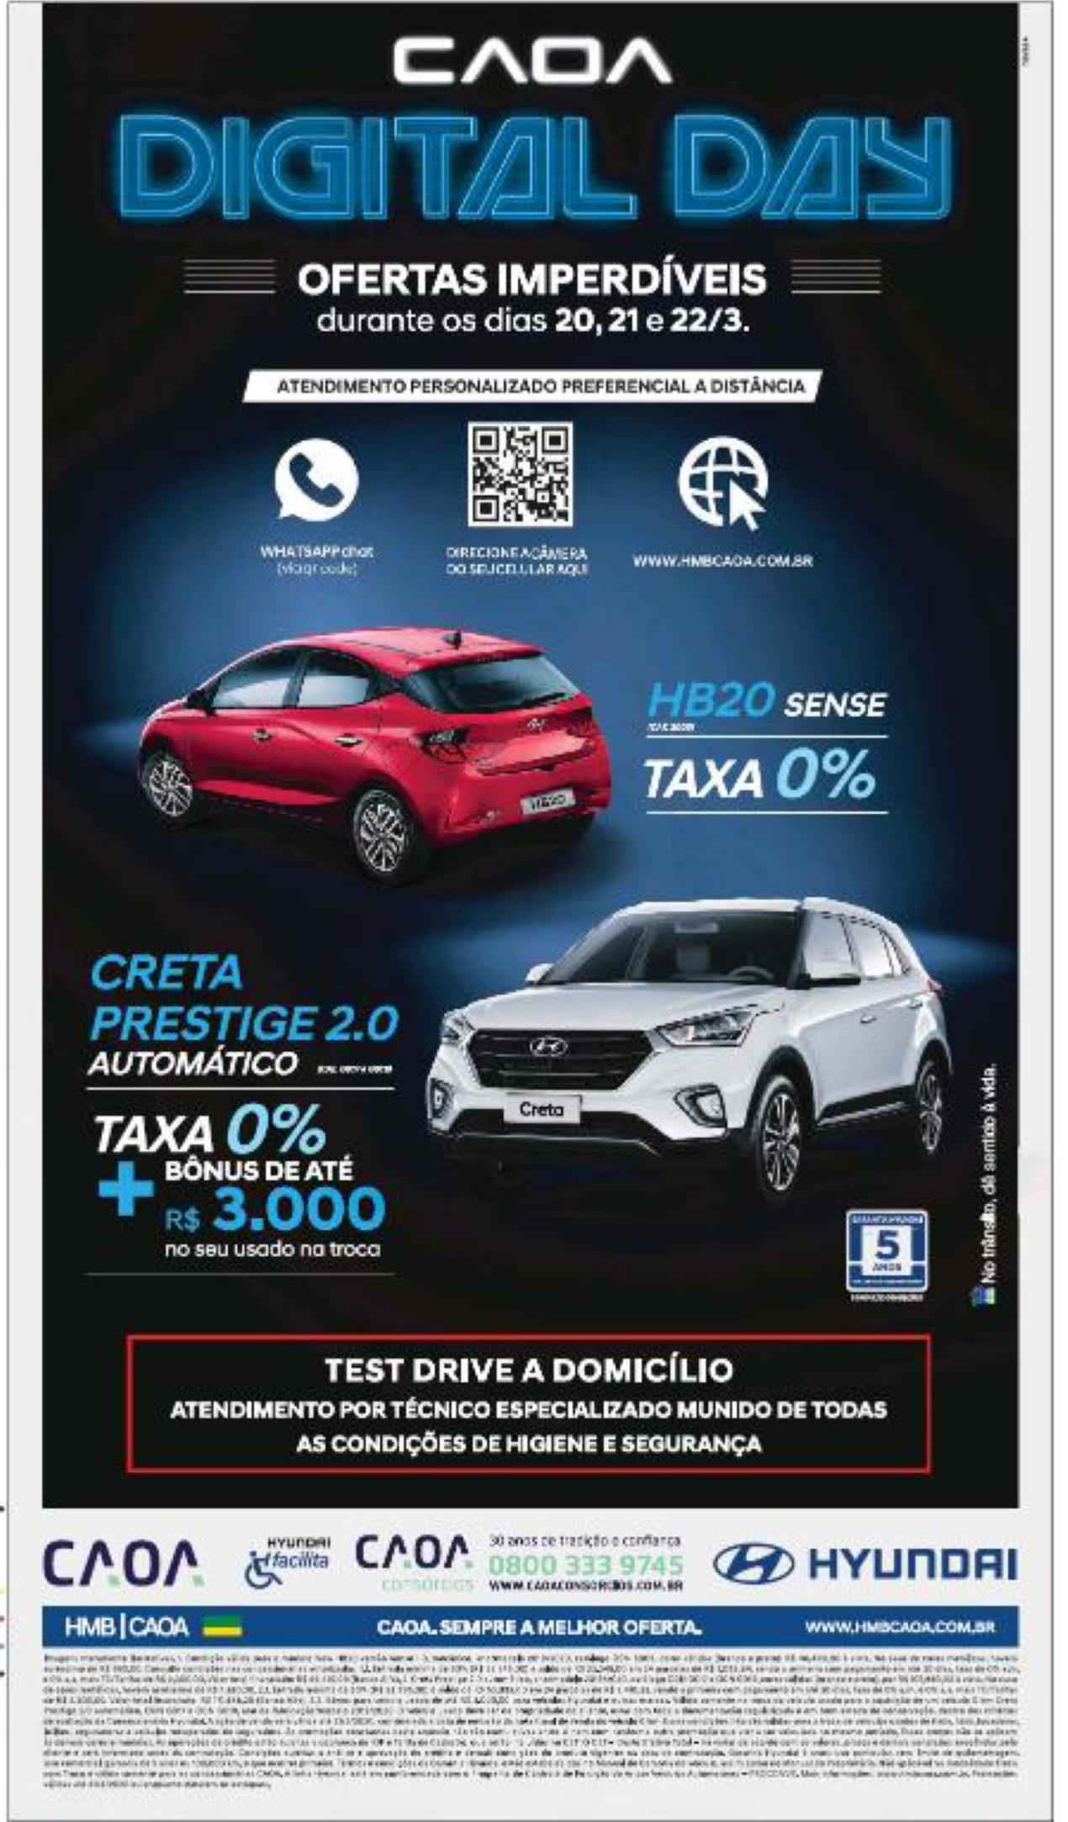
Hyundai Motors
Title: | Caoa digital day
Media: | Press
Description: | Offer - 0% interest. Savings.
Country: | Brazil
Product: | car range/corporate
Category (Full Hierarchy): | AUTOMOTIVE | Cars | Cars Corporate/Range
Duration: | 1 image/s
Date From/To: | 22/03/2020
Publication: | ESTADO DE SAO PAULO, O
Endline: | -
Creative ID: | 1248913601

