Slide 1


Market Intelligence data delivered by the Nielsen Portfolio
prepared for Myungin Baek from Innocean Seoul on 20/04/2020
"Understand the advertising around you to improve your own"

Slide 2
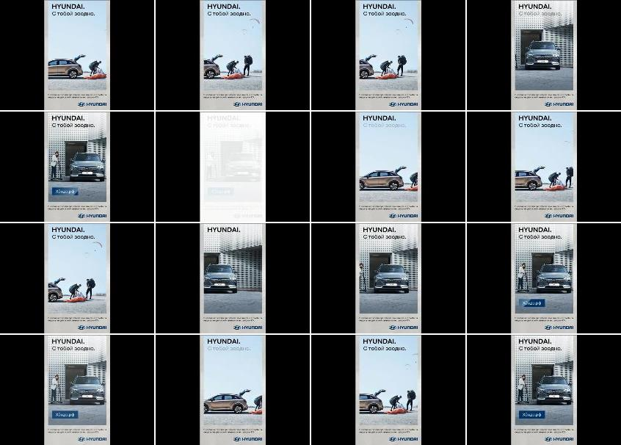
Hyundai Motors
Title: | The future of travel
Media: | Desktop
Description: | Not Available
Country: | Russia
Product: | Nexo hydrogen offroader/SUV
Category (Full Hierarchy): | AUTOMOTIVE | Cars | Cars Offroad Vehicle/SUV/4x4
Duration: | 1 image/s
Date From/To: | 14/04/2020
First URL: | mk.ru
Endline:
Creative ID: | 1249890601

