Slide 1
Static Analysis for Security
Amir Bazine
Per Rehnberg

Slide 2
Content
Background
Static Analysis tools
Our resarch and tests
Test results
Conclusion

Slide 3
Background
Increase of reported vulnerabilities
Dynamic analysis not enough
Developed new static analysis tools
  Ease the auditing process

Slide 4
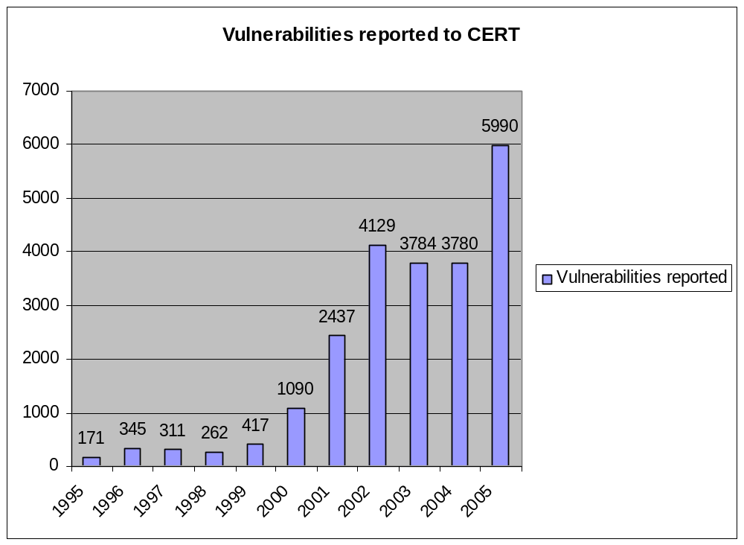
!!!

Slide 5
Static analys tools
How they work
  Brake the code into stream of tokens
  Compare with database
What they prevent
  TOCTTOU, Overflows, bad randomizations, format string attacks, file descriptor leakage…
Sort risks
Problems

Slide 6
Some analysis tools
ITS4
RATS
Flawfinder
Splint
  Enhanced lint
  Lightweight static analysis
  Annotations

Slide 7
Splint Example
char *strcpy (char *s1, char *s2)
/*@requires maxSet(s1) >= maxRead(s2) @*/
/*@ensures maxRead(s1) == maxRead (s2) @*/

Slide 8
Survey
Our survey was about finding out how static analysis tools works and what they can do.

Slide 9
Buffer overflow example
13 void add_alias(char *ip, char *hostname, char *alias) {
14 char formatbuffer[256];
15 FILE *file;
16
17 sprintf(formatbuffer, "%s\t%s\t%s\n", ip, hostname, alias);
18
19 file = fopen(HOSTFILE, "a");
20 if (file == NULL) {
21 perror("fopen");
22 exit(EXIT_FAILURE);
23 }
24
25 fprintf(file, formatbuffer);
26 if (fclose(file) != 0) {
27 perror("close");
28 exit(EXIT_FAILURE);
29 }
30 }

Slide 10
Result
flawfinder
Examining vuln_lab2.c
vuln_lab2.c:17: [4] (buffer) sprintf:
Does not check for buffer overflows. Use snprintf or vsnprintf.
vuln_lab2.c:25: [4] (format) fprintf:
If format strings can be influenced by an attacker, they can be exploited. Use a constant for the format specification.
vuln_lab2.c:14: [2] (buffer) char:
Statically-sized arrays can be overflowed. Perform bounds checking, use functions that limit length, or ensure that the size is larger than the maximum possible length.
ITS4
vuln_lab2.c:25:(Urgent) fprintf
Non-constant format strings can often be attacked.
Use a constant format string.
----------------
vuln_lab2.c:17:(Very Risky) sprintf
This function is high risk for buffer overflows
Use snprintf if available, or precision specifiers, if available.
Splint
vuln_lab2.c: (in function add_alias)
vuln_lab2.c:17:3: Buffer overflow possible with sprintf. Recommend using
snprintf instead: sprintf
Use of function that may lead to buffer overflow. (Use –bufferoverflow high to inhibit warning)
RATS
Analyzing vuln_lab2.c
vuln_lab2.c:14: High: fixed size local buffer
Extra care should be taken to ensure that character arrays that are allocated on the stack are used safely. They are prime targets for buffer overflow attacks.
vuln_lab2.c:17: High: sprintf
Check to be sure that the format string passed as argument 2 to this function call does not come from an untrusted source that could have added formatting characters that the code is not prepared to handle. Additionally, the format string could contain `%s' without precision that could result in a buffer overflow.
vuln_lab2.c:25: High: fprintf
Check to be sure that the non-constant format string passed as argument 2 to
this function call does not come from an untrusted source that could have added
formatting characters that the code is not prepared to handle.

Slide 11
Format string example
5 int main(int argc,char **argv) {
6 char buf[256];
7 snprintf(buf,sizeof buf,argv[1]);
8 }

Slide 12
Result
Splint
Finished checking --- no warnings
ITS4
fs1.c:7:(Urgent) snprintf
Non-constant format strings can often be attacked.
Use a constant format string.
RATS
fs1.c:6: High: fixed size local buffer
Extra care should be taken to ensure that character arrays that are allocated on the stack are used safely. They are prime targets for buffer overflow attacks.
flawfinder
fs1.c:7: [4] (format) snprintf:
If format strings can be influenced by an attacker, they can be
exploited, and note that sprintf variations do not always \0-terminate. Use a
constant for the format specification.
fs1.c:6: [2] (buffer) char:
Statically-sized arrays can be overflowed. Perform bounds checking,
use functions that limit length, or ensure that the size is larger than
the maximum possible length.

Slide 13
Integer overflow example
1 int my_string_copy(char *dest, const char *src, int len)
2 {
3 if (len > MAX_LENGTH)
4 return -1;
5
6 memcpy(dest, src, len);
7
8 return len;
9 }

Slide 14
Result
ITS4
-- no warnings
RATS
-- no warnings
Flawfinder
my_func.c:6: [2] (buffer) memcpy:
Does not check for buffer overflows when copying to destination. Make sure destination can always hold the source data.
Splint
my_func.c:6:21: Function memcpy expects arg 3 to be size_t gets int: len To allow arbitrary integral types to match long unsigned

Slide 15
Limitations of the tools
Predefined vulnerability database
Can’t handle pre-processing statements
Generates much false positivies
Doesn’t do any deeper analysis

Slide 16
Conclusions
These tools gives you a starting point for performing manual security audits
You have to do a deeper manual audit by our self
They are simple and one can achieve they same result with common source navigation tools

Slide 17
Our recommendations
Check the warnings that your compiler gives you!
Use static/dynamic tools to check your source code for flaws
Do manual security audits!

Slide 18

Questions?

