Slide 1

A Security Analysis of the PHP language
By
Jonas Heineson
Mattias Österberg

Slide 2
The PHP language
Common script language for web applications
Platform independent
Runs on the Zend VM
The Zend VM is implemented in C

Slide 3
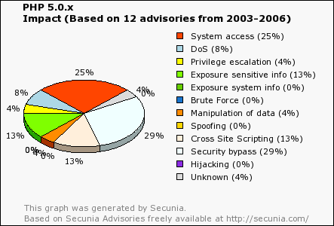
PHP Vulnerabilities
Different versions, different distributions
Open source gives good security
Top 5 vulnerabilities investigated
http://cve.mitre.org

Slide 4
Security Bypass
Ability to pass restrictions set by code
Goal is to get access to restricted information
Information gained depends on the vulnerable function

Slide 5
Security Bypass; Example attack
Vulnerable mail packages
mb_send_mail()
safe_mode, open_basedir
imap_open, _body, _list, _createmailbox, _deletemailbox

Slide 6
System Access
Attack with highest gain
Goal is to be able to run arbitrary code with the same privileges as the local user
Always existed in top of vulnerability top 5
Mostly based around buffer overflows

Slide 7
Cross Site Scripting
Embedded scripts
Retrieve confidential information, manipulate cookies, execute arbitrary code on end user
Server not compromised – used as a tool
Solution: Validate user input

Slide 8
Cross Site Scripting; Example
include(“modules/$name/$file.php”);
http://host.com/modules.php?op=modload&name=XForum&file=[hostile_javascript]&fid=2
Generates Error:
Warning: Failed opening 'modules/XForum/.php' for inclusion
(include_path=´´) in /home/foo/htdocs/modules.php on line 27
Error message prints the offending filename and the browser then parses the javascript (part of the filename), i.e. executes the script on the viewers computer

Slide 9
Denial of Service
Most DoS attacks targets badly implemented library functions
An example; specially crafted JPEG image (changed image header) gets called by getimagesize(), which call php_handle_jpeg() and php_handle_iff()
Causes an infinite loop, which consume all CPU resources
Solution: Don't use vulnerable functions, apply patches frequently

Slide 10
Results
Problem is in most cases unvalidated user input
Different injection attacks
Example: http://www.victim.com/index.php?p=about.htm changed to http://www.victim.com/index.php?p=../../../etc/passwd
When vulnerabilities in PHP are discovered, patches are quick to appear
PHP is mostly no more insecure than its user

