Slide 1
Windows XP SP2 Stack Protection
Jimmy Hermansson
Johan Tibell
Notes:
Johan

Slide 2
Overview
Goals
Stack Smashing in 30 Seconds
Use Protection…
Attacks!
Windows XP SP2
Demo
We can do better!
Conclusions

Slide 3
Goals
Most common vulnerability according to CERT
Study stack protection mechanisms in general
Look at Windows XP SP2’s implementation
Write a proof-of-concept exploit

Slide 4
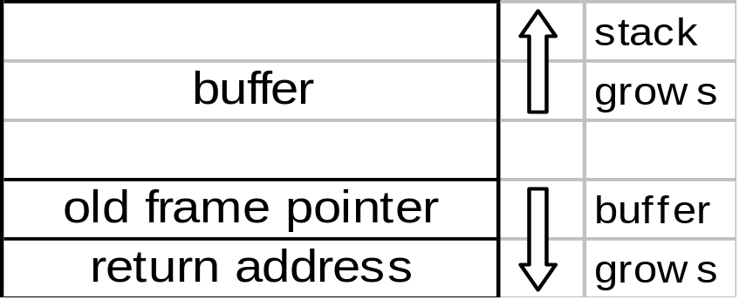
Stack Smashing in 30 Seconds
void f(char *arg)
{
char buf[128];
strcpy(buf, arg);
}
Notes:
Jimmy

Slide 5
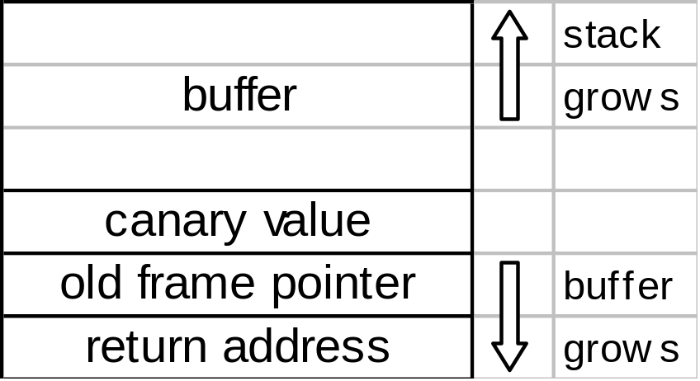
A Cure?
Place a value between the return address and the buffers
Check it before returning from the function

Slide 6
Any Value?
If the attacker knows or can predict the value we might run into problems
Terminator canaries
Random canaries
Random XOR canaries

Slide 7
Function-Pointer Clobbering
Problem: Only the return address is protected
All calls, jumps and returns need protection
This is what we used in our exploit
void f(char *arg)
{
char buf[128];
void (*fp)();
strcpy(buf, arg);
/* … */
fp();
}
Notes:
Johan

Slide 8
Data-Pointer Modification
void f(char *arg)
{
char buf[128];
int val;
int *ptr;
strcpy(buf, arg);
/* … */
*ptr = val;
}
Canary value protection relies on a check against a global value
Overwrite both the local and the global value
Or something else…

Slide 9
Method
Compile with Visual Studio 7.1 and /GS flag
OllyDbg
Notes:
Jimmy

Slide 10
Windows XP SP2
PUSH EBP
MOV EBP, ESP
SUB ESP, 88
MOV EAX, [__security_cookie]
MOV [EBP-4], EAX
MOV EAX, [EBP+8]
PUSH EAX
LEA ECX, [EBP-88]
PUSH ECX
CALL strcpy
ADD ESP, 8
MOV ECX, [EBP-4]
CALL __security_check_cookie
MOV ESP, EBP
POP EBP
RETN

Slide 11

Demo

Slide 12
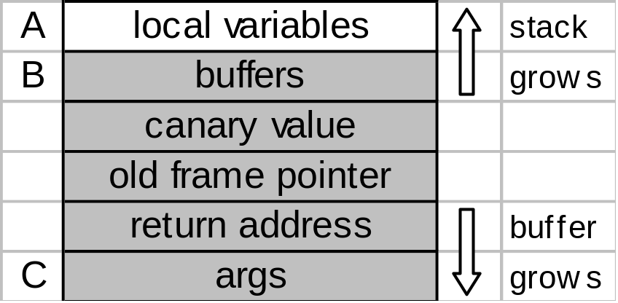
Safe Stack Usage Model
A contains no buffers but has pointer variables
B contains only buffers
C doesn’t contain buffers nor pointer variables
Notes:
Johan

Slide 13
Conclusions
Windows XP SP2 has some stack protection…
…probably not enough (weakest link argument)
The root cause remains, no bounds checking!
We didn’t have time to talk about DEP

