Slide 1
Internet Explorer Exploit
Christian O. Andersson
Jonas Stiborg Andén

Slide 2
What we wanted to do
”Real” attack on a ”real” program
  Internet Explorer is one of the most used programs in the world
Recent vulnerability
  works on current systems
  exploit a ”new” bug
Give us access to remote machine

Slide 3
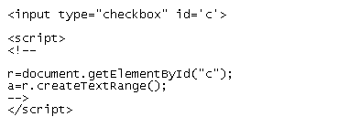
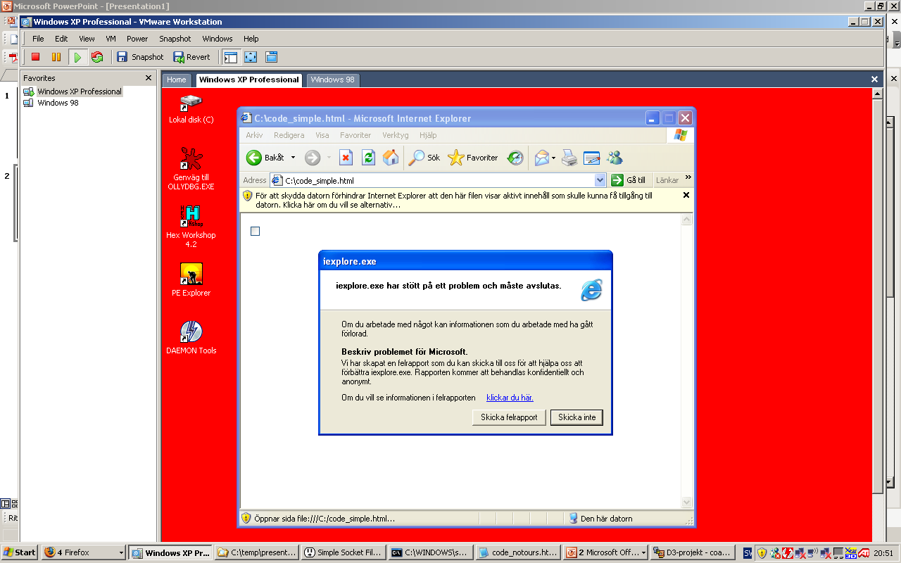
The Vulnerability
createTextRange()
  JavaScript-method
  crashes when used on a HTML-checkbox
Rated critical
Platform
  Internet Explorer 6.0
  Windows XP
  Service Pack 2

Slide 4
Where to start?
What did we know/have?
  the code that triggered the bug
  OllyDbg
    debugger for windows-binaries
What did we not know/have?
  no source code
  why it crashed

Slide 5
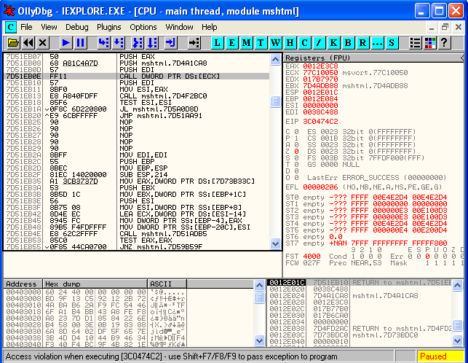
Debugger
Access violation when executing [3C0474C2]
Jumps from module mshtml to unallocated address

Slide 6
Strategy
Flooding the heap with NOPs
  NOP slide
  similar to lab2, but heap instead of stack
Make large global variable
  global variables are saved on heap
Shellcode at the end of NOP slide

Slide 7
Problems
Finding the heap in memory
  yes, this was actually a problem
  couldn’t see what we were doing at first

Slide 8
Problems
The heap had to be extremely large
  NOP slide ≈ 1 GB
  create on the fly
  first attempt: 10 minutes
  better algorithms: 65 seconds

Slide 9
Problems
One heap block couldn’t grow larger than 384 MB
  don’t know why
  solution
    array structure
    each element gets own heap block

Slide 10
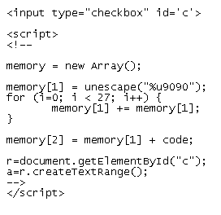
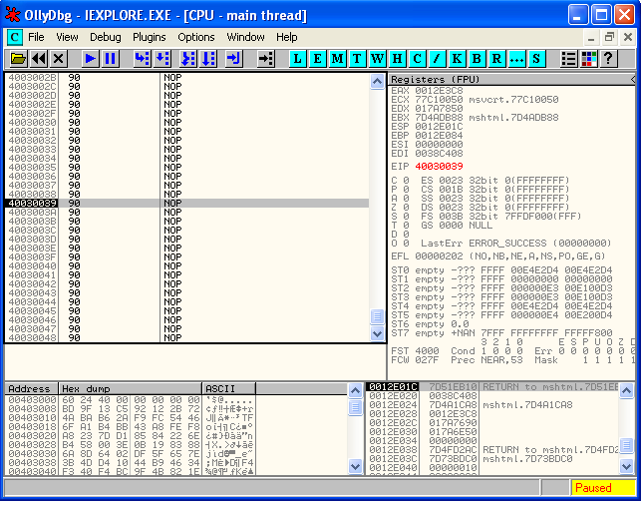
EIP owned

Slide 11
Shellcode
Requirements
  start WinSOCK
  listen on port 1337
  spawn command shell and bind stdin/stdout to the socket
  attacker can then connect

Slide 12
Shellcode
Written in win32 assembly
Could not use static addresses
  had to fetch all APIs/DLLs dynamically
    e.g. kernel32.dll, ws2_32.dll

Slide 13
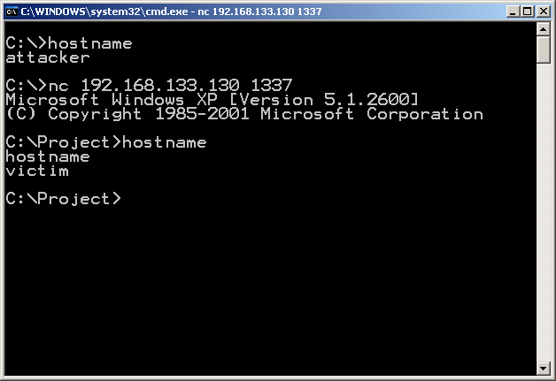
Results

Slide 14
Current Limitations
JMP address must be less than 0x40000000
  not always the case in different versions of IE
Still very slow
  Normal user would probably kill IE after 1-2 minutes

Slide 15
Possible improvements
Efficiency
  SkyLined’s heap spraying algorithm
Shellcode
  escape the internet explorer process
    write itself to disk and execute automatically on startup
  optimization
    hashes instead of strings when fetching APIs/DLLs
  polymorphism (encryption)
    To hide from pattern scanners
  callback instead of listening
    To bypass firewalls

Slide 16
Internet Explorer Exploit
Christian O. Andersson
Jonas Stiborg Andén

