Slide 1
Security in IP telephony (VoIP)
David Andersson
Erik Martinsson

Slide 2
Background
VoIP is becoming very popular
- money to be saved!
- new features
Not trivial to implement (QoS, availability, security)
Services released with focus only on functionality

Slide 3
Goals
Get an overview of VoIP
Find out about the security threats
Relevance to language-based security?
Study some attacks against VoIP

Slide 4
What we have done
Learned about VoIP technology
- common network setups
- protocols
Evaluation of VoIP threats
Studying and testing some attacks
Skype

Slide 5
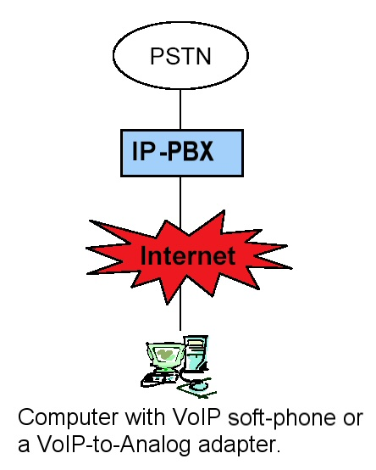
A Network Setup

Slide 6
Protocols
SIP and RTP most common
Both open and defined by IETF
RTP flexible media transfer protocol
SIP is an initialization protocol
SIP uses text based messages
SIP reuses many existing standards

Slide 7
Security: VoIP vs POTS
Very different networks trying to achieve the same goals
POTS is physically difficult to attack
VoIP has more security features but is open for attacks over the entire world through the Internet

Slide 8
Security: Threats
VOIPSA (VoIP Security Alliance) has made an extensive list of threats
A mixture of threats in POTS and in IP-networks

Slide 9
Security: Language-Based?
VoIP is a complex system
Secure networking has well known solutions, but…
…end-devices are hard to control
The key to securing VoIP is to secure the clients!

Slide 10
Attacks
SIP-attacks:
- Bombing
- Cancel/Bye
- Call hijacking
RTP eavesdropping

Slide 11
Attacks: SIP
Possible to generate SIP packets with i.e. SiVus (The VoIP Vulnerability Scanner)
Attacks must be done within timeframe of a call or sometimes during the initial handshake
Software for real-time attack is needed

Slide 12
Attacks: sniffing RTP
Ethereal can analyze RTP and find media streams
Open codecs are easily decoded
We could playback entire conversations!

Slide 13
Skype
Most popular VoIP software today
Proprietary protocol
Information sent without using the software
Secure channel (VoIP, IM, File transfer)
Impossible to distinguish betweem VoIP, IM or File transfers

Slide 14
Evaluation
VoIP is usually not very secure!!
Use with caution until otherwise is proved
Our goals reached

