Slide 1
DeepXplore: Automated Whitebox Testing of Deep Learning Systems
Kexin Pei¹, Yinzhi Cao², Junfeng Yang¹, Suman Jana¹
¹Columbia University, ²Lehigh University

Slide 2


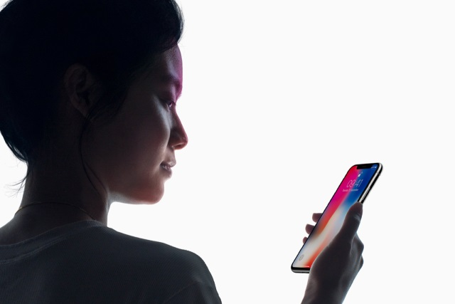
Deep learning (DL) has matched human performance!
Image recognition, speech recognition, machine translation, intrusion detection...
Wide deployment in real-world systems

Slide 3
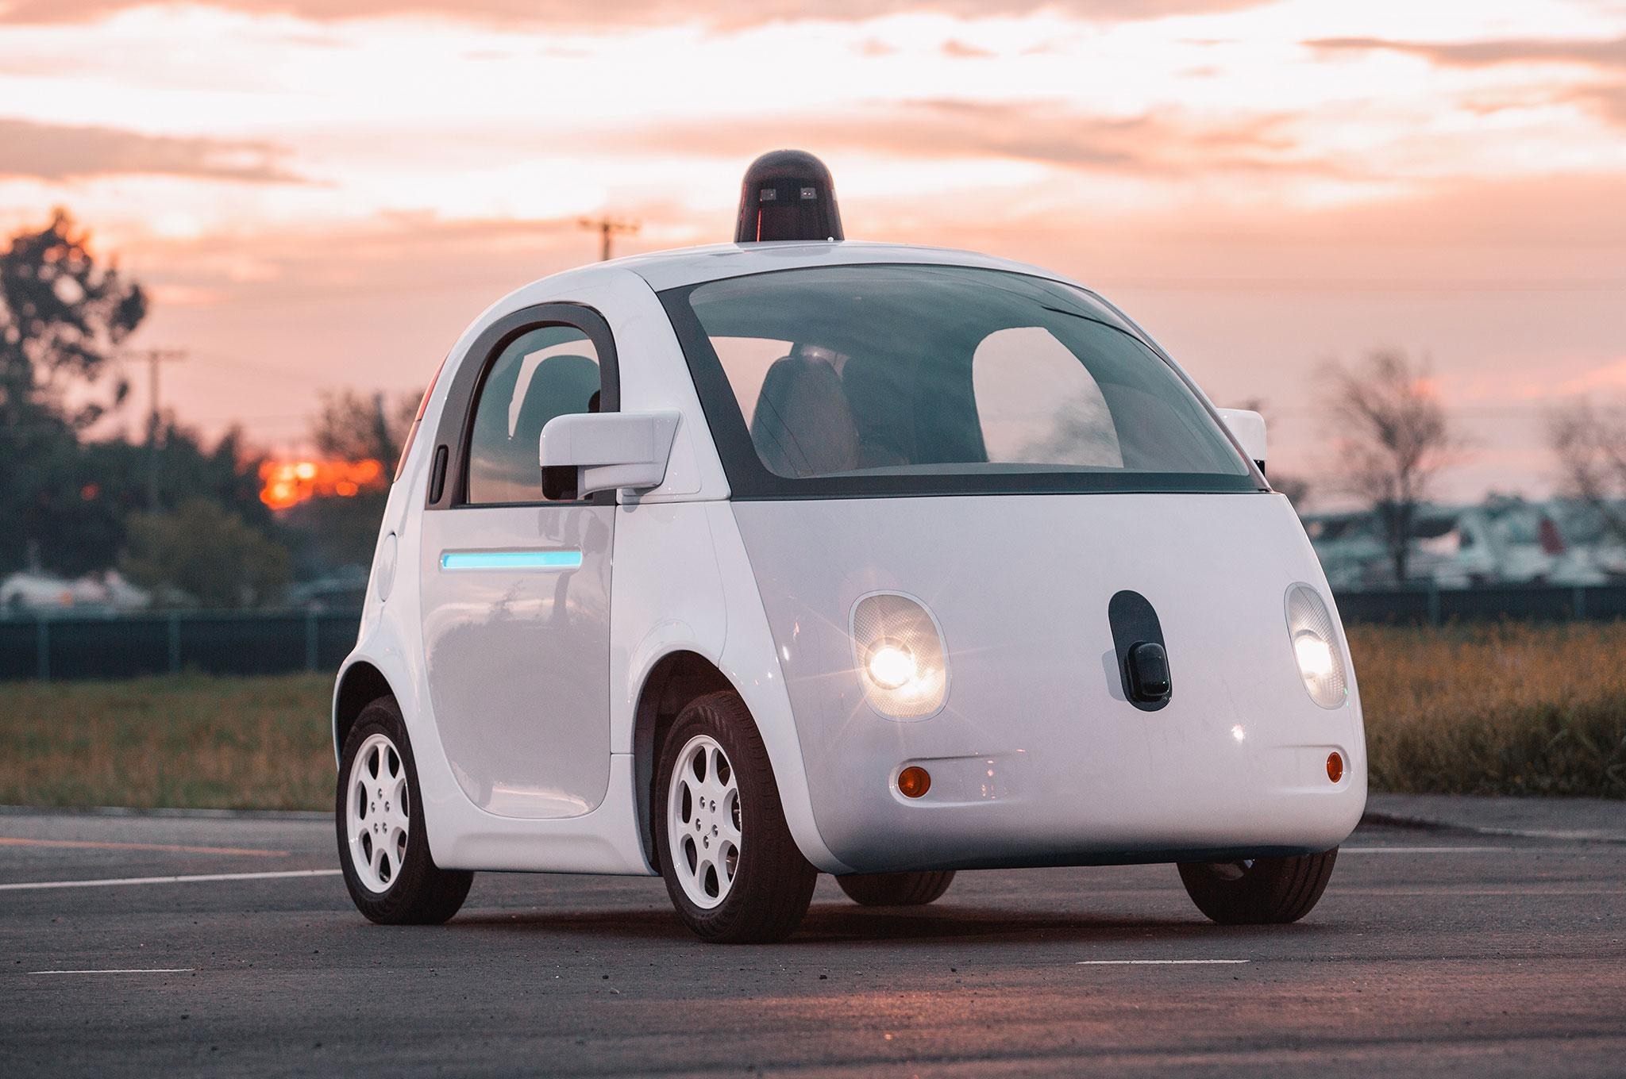
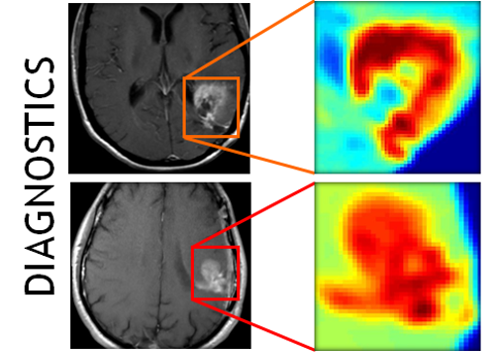

Deep learning is increasingly used in safety-critical systems
Deep learning correctness and security is crucial
Self-driving car
Medical diagnosis
Malware detection

Slide 4
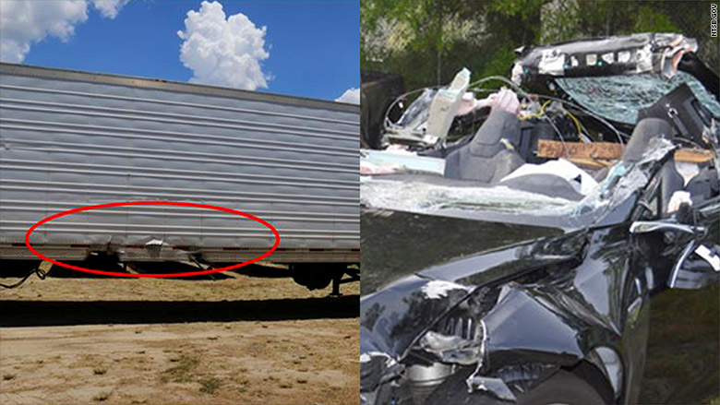
Unreliable deep learning contributed to Tesla fatal crash
Tesla autopilot failed to recognize a white truck against bright sky leading to fatal crash

Slide 5
Existing DL testing methods are seriously limited
Common practice: measure accuracy on a test input set of randomly chosen data
Problem 1: how good is the coverage of the test set?
DL decision logic is incredibly complex
More fundamentally, what is testing coverage metric for DL?
Problem 2: it requires expensive labeling effort
Data in test set must be manually labelled
To enlarge the test set, we need to manually label more data

Slide 6
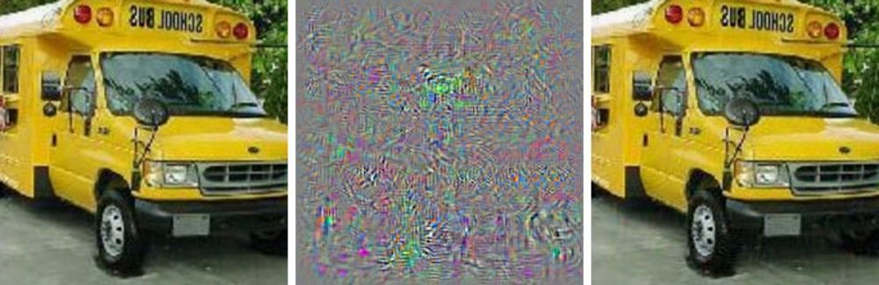
Existing DL testing methods are seriously limited (cont.)
Adversarial testing (Szegedy et al. ICLR’14): find corner-case inputs imperceptible to human but induce errors
Problem 1: how good is the coverage of the test set?
Problem 2: it requires expensive labeling effort
Problem 3: Not realistic. (Theoretical, assumes a very powerful adversary. [Sharif et al. CCS’16])
School bus
Carefully crafted noise
Ostrich

Slide 7
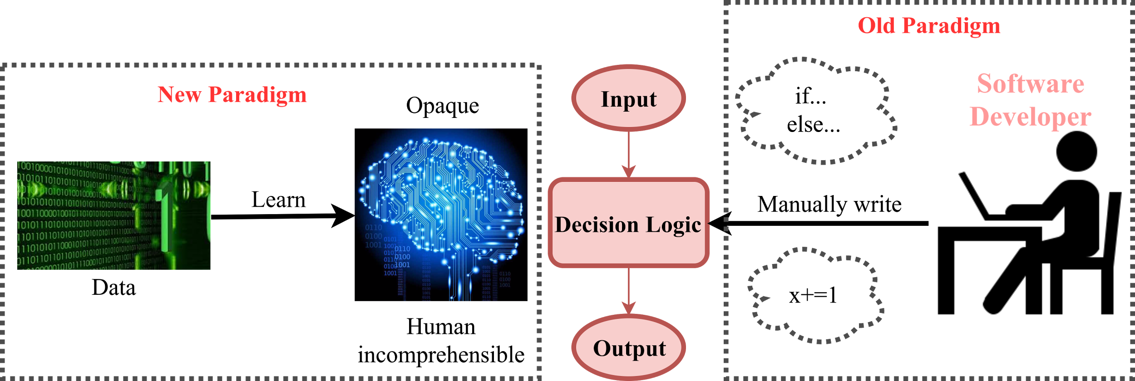
Many traditional software testing techniques don’t apply to DL
DL decision logic is embedded in neurons and layers, not in code
x=0
If (x==8)
x+=1
x+=2
Neural network
Traditional program
(control flow graph)

Slide 8
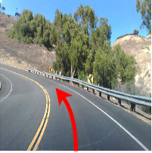

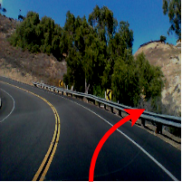
Quick Summary of DeepXplore
No accident
The first step towards systematic testing of Deep Neural Nets (DNNs)
Neuron coverage: first testing coverage metric for deep nerual net
Automated: cross-check multiple DNNs
Realistic: physically realizable transformations
Effective:
15 State-of-the-art DNNs on 5 large datasets (ImageNet, Self-driving cars, PDF/Android malware)
Numerous corner-case errors
50% more neuron coverage than existing testing
DeepXplore
Darker: Accident

Slide 9
Outline
Quick deep learning primer
Workflow of DeepXplore
Design
Detail of Neuron coverage
Implementation
Evaluation setup and results summary

Slide 10
Outline
Quick deep learning primer
Workflow of DeepXplore
Design
Detail of Neuron coverage
Implementation
Evaluation setup and results summary

Slide 11
Deep learning primer
A neural network is a function f(X) → Y
Trainable parameters (W_{i}) on each edge and nonlinear activation function at each neuron
DNN learns the weights during training
Inference: Simply propagates X through layers (fast)
Training: Given training set (X,Y), adjust W to minimize the prediction error (slow)
W₂
W₁
W₃
X
Y
Input layer
Output layer
Hidden layers

Slide 12
Outline
Quick deep learning primer
Workflow of DeepXplore
Design
Detail of Neuron coverage
Implementation
Evaluation setup and results summary

Slide 13

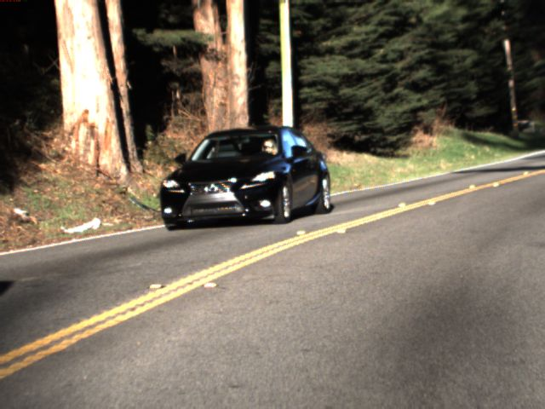
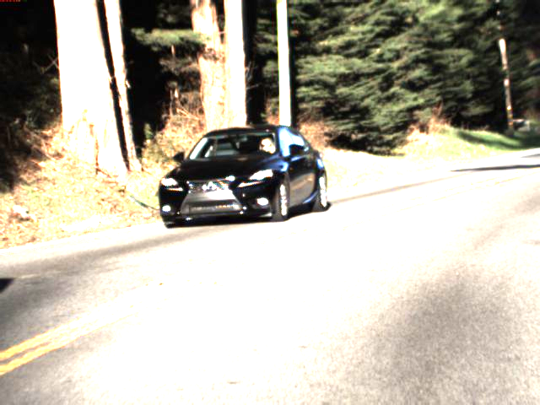
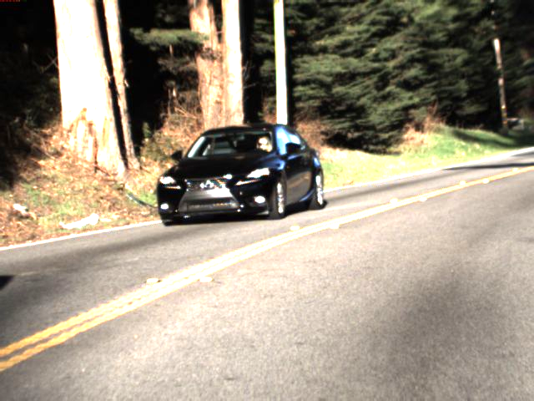
How DeepXplore works?
Feed into multiple DNNs
DNN1
Seed inputs without labels
Right
23^{O}
Testing as an optimization problem
25^{O}
20^{O}
DNN2
Objectives:
Maximize differences & neuron coverage
under realistic constraints
(e.g., lighting)
Right
22^{O}
24^{O}
20^{O}
DNN3
Mutate using gradient descent (DNNs are differentiable)
Right
Left
12^{O}
21^{O}
10^{O}
On new input, activate different neurons

Slide 14
How to achieve multiple goals simultaneously
Goal 1: systematically find corner cases
Generate inputs that maximize neuron coverage
Goal 2: find DNN errors without manual labels
Differential testing: use multiple DNNs as cross-referencing oracles
Goal 3: generate realistic test inputs
Domain-specific constraints
DNNs are differentiable → use gradient descent to solve the optimization problem
Apply mutation w.r.t input with realistic constraints
See paper for details
Objectives:
Maximize corner-case differences & neuron coverage
under realistic constraints
(e.g., lighting)
Testing DNNs is an optimization problem

Slide 15
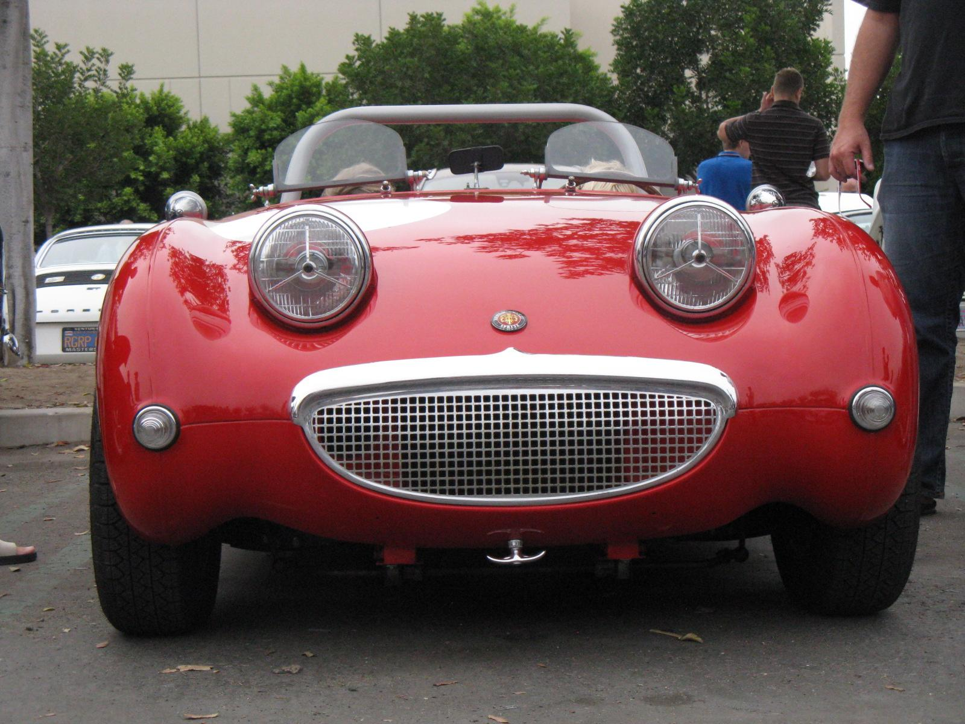
Neuron coverage → how much decision logic exercised
Neuron coverage = # neurons activated / # total neurons
Intuition: layerwise feature detection (Lee et al. ICML’09)
Nose
f: ReLU max(x,0)
3
hedge
...
Car
2
f(1)
...
Eyes
...
1
-11
1
1
vedge
...
Face
3
Activation threshold=0.75
2
Wheel
.
Neuron coverage: 4/7=57%
[3,1,2] [2,-11,1]^{T}=1

Slide 16
Outline
Quick deep learning primer
Workflow of DeepXplore
Design
Detail of Neuron coverage
Implementation
Evaluation setup and results summary

Slide 17
Implementation
DeepXplore
Keras 2.0.3
Efficient gradient computation &
support for intercepting outputs of intermediate neurons for calculating neuron coverage
TensorFlow 1.0.1
CPU
GPU
Linux

Slide 18
Outline
Quick deep learning primer
Workflow of DeepXplore
Design
Detail of Neuron coverage
Implementation
Evaluation setup and results summary

Slide 19
Evaluation setup and results summary
Dataset | Description | DNNs | Original random testing accuracy | Avg. neuron coverage improvement over random/adversarial | Avg. Violations found by DeepXplore (2000 seeds)
MNIST | Handwritten digits | LeNet variants | 98.63% | 30.5% → 70% | 1,289
ImageNet | General Images in 1000 categories | VGG16, VGG19, ResNet15 | 93.91% | 1% → 69% | 1,980
Driving | Udacity self-driving car competition dataset | Nvidia Dave-2 variants | 99.94% | 3.2% → 59% | 1,839
Contagio/VirusTotal | PDF malware | Fully connected | 96.29% | 18% → 70% | 1,048
Drebin | Android malware | Fully connected | 96.03% | 18.5% → 40% | 2,000

Slide 20
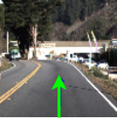
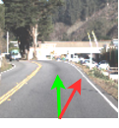
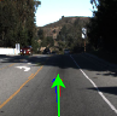
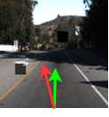
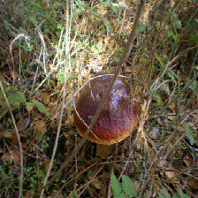
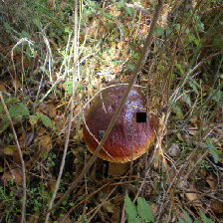
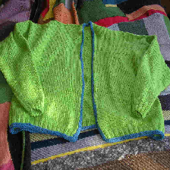
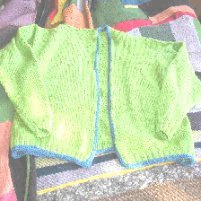
Sample corner-case errors for images
Driving:
Driving:
Go straight
Turn right
Go straight
Turn left
ImageNet:
ImageNet:
Light cardigan
Diaper
bolete
buckeye
MNIST:
MNIST:
6
2
5
3

Slide 21
Sample corner-case errors for malware
Android malware: mutations only add features to the manifest file
 | feature::bluetooth | permission::call_phone | prediction
Before | 0 | 0 | Malicious
After | 1 | 1 | Benign

Slide 22
Sample corner-case errors for malware (cont.)
PDF malware: Mutations that do not change functionality (Srndic & Laskov Oakland’14)
 | size | count_font | author_num | prediction
Before | 1 | 1 | 10 | Malicious
After | 34 | 15 | 5 | Benign

Slide 23
Conclusions and future work
Systematically testing DL for realistic corner cases is a hard problem
DeepXplore is the first step for systematic DL testing
Neuron coverage: first testing coverage metric for deep nerual net
Automated: differential testing by cross-checking multiple DNNs
Realistic: physically realizable transformations
Effective: find neumerous unexpected corner-case errors
A lot of exciting new research problems!
Build analysis tools for testing and verification of ML
Build better debugging support for opaque ML

Slide 24
Check the paper for more results!
Source code: https://github.com/peikexin9/deepxplore
Play demo at: www.deepxplore.org
Thank you!
Questions?

