Slide 1
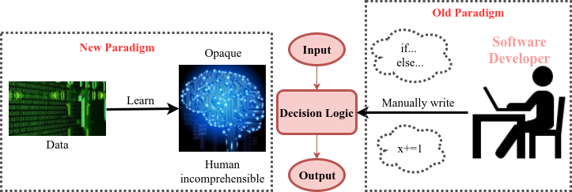
DeepXplore: Automated Whitebox Testing of Deep Learning Systems
Paradigm shift in developing software: traditional vs. ML
Traditional software developer manually write the decision logic
ML Decision logic learned from data
ML components are increasingly used in real systems
Key challenges
1. How much testing is enough? No coverage metirc
2. Labeling efforts are expensive
Notes:
Future system will have ML component

Slide 2



DeepXplore: Automated Whitebox Testing of Deep Learning Systems
2. Feed into multiple DNNs
Key insight: testing can be modeled as an optimization problem and solved using gradient descent because DNNs are differentiable
F1
1. Retrieve seed Inputs without labels
Go straight ahead
3. Define joint objective function
F2
Objectives:
Different behavior
Neuron coverage
Code: https://github.com/peikexin9/deepxplore
Go straight ahead
F3
Input changed brighter
Go straight ahead
Turn right
4. Maximize objective function w.r.t input using gradient descent

