Slide 1
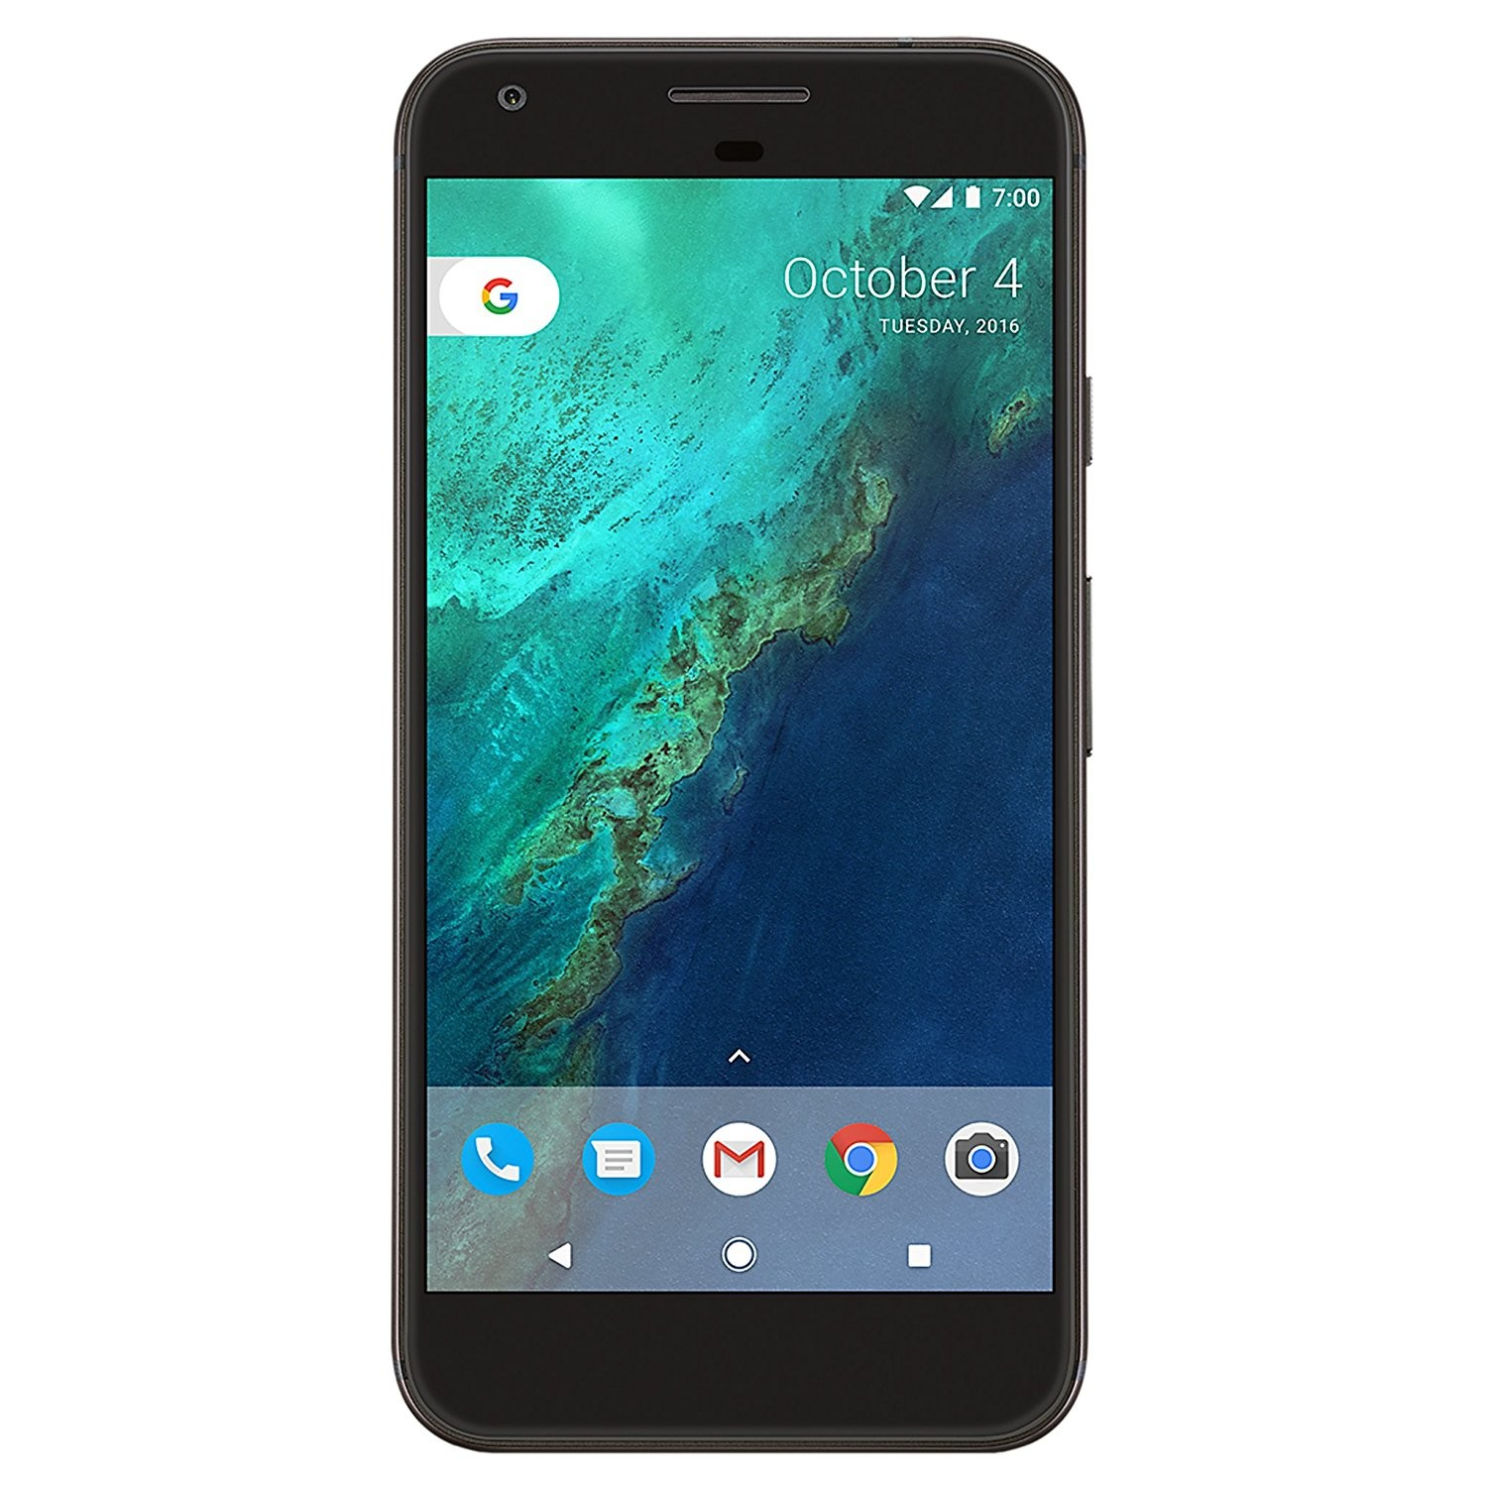
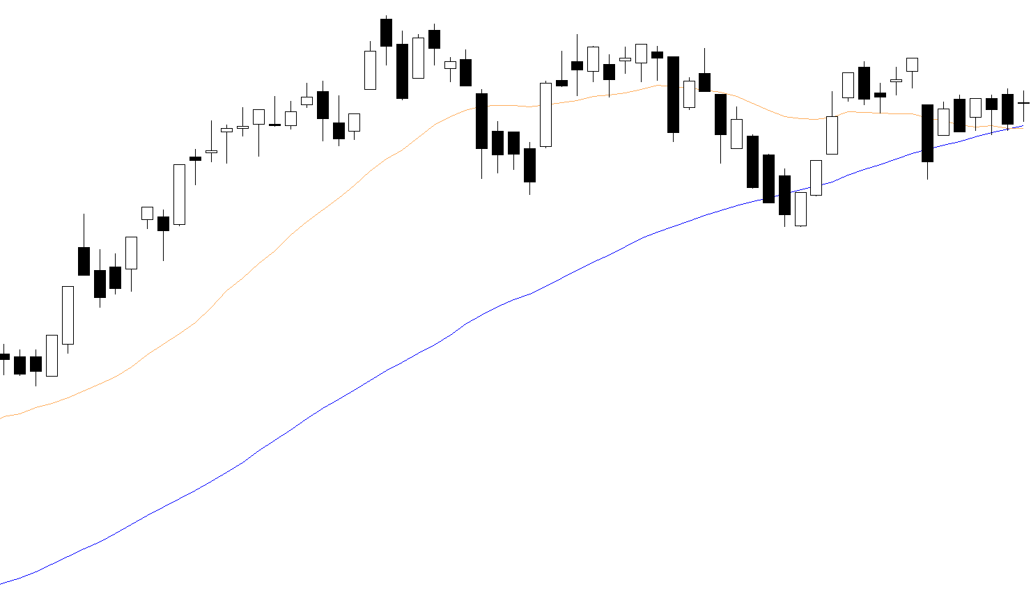
MOST
IHSG
IHSG
6467.06
+17.46
0.3%
MEDC: Medco targetkan akuisisi Ophir ...
BYAN: Bayan Dapat Fasilitas Perbankan ...
GMFI: GMF Garap Perawatan 11 ...
MEDC: Medco targetkan akuisisi Ophir ...
MEDC: Medco targetkan akuisisi Ophir ...

Slide 2





MOST
IHSG
STOCK
MUTUAL FUNDS
Your Portfolio at a Glance
Menus
Order
Automatic Order
Portofolio
Watchlist
Fast Order

Slide 3
MOST
IHSG

