Slide 1
UIST 2012
Submission #432
CrashAlert
Enhancing Peripheral Alertness for Eyes-Busy Interaction while Walking
Notes:
Submission #432

Slide 2
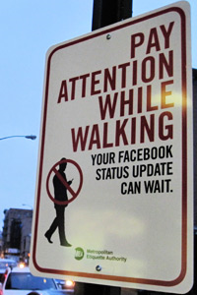

Eyes-busy interaction, such as text-entry while walking can be dangerous and life-threatening.

Slide 3
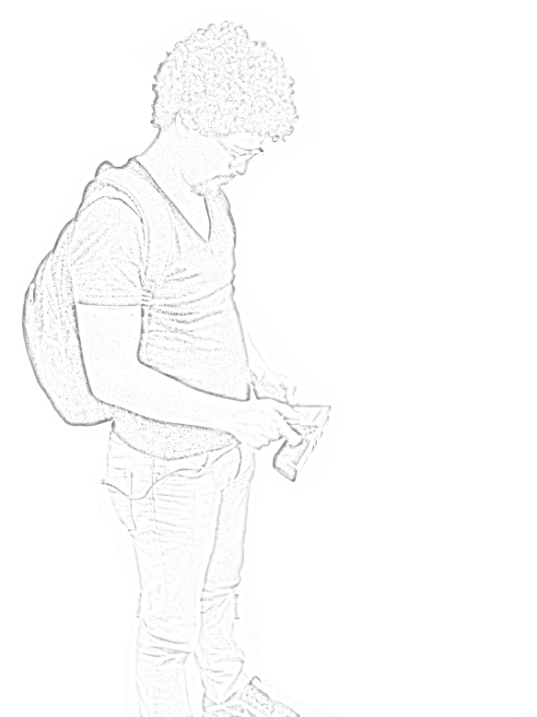
When people walk and multi-task much of their field-of-view attends to the display.
This has motivated eyes-free interaction but also warrants investigation into methods for assisting with eyes-busy interaction while walking.
User FoV

Slide 4
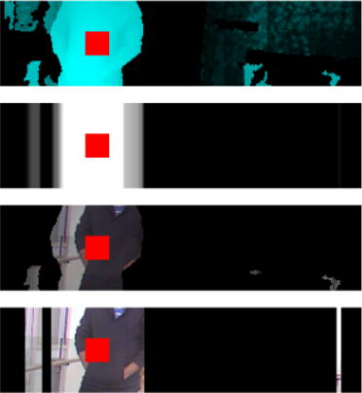
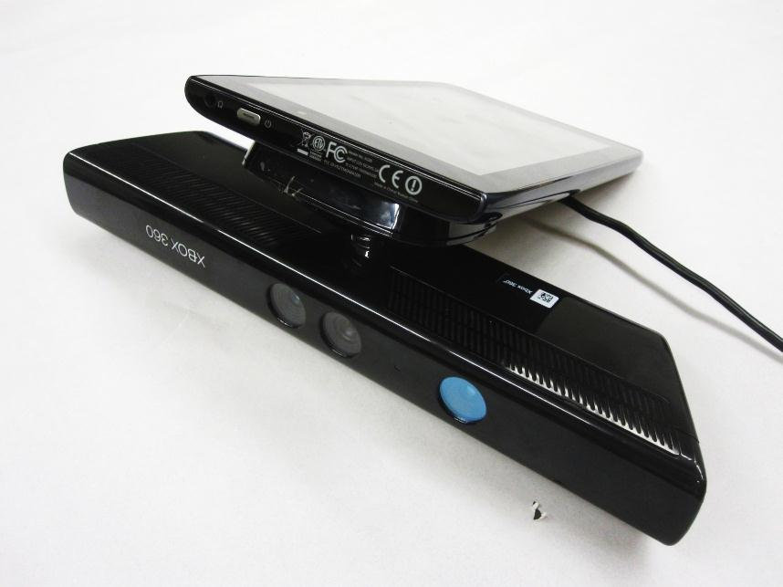
CrashAlert
We introduce
CrashAlert brings peripheral content from the environment into the user’s field-of-view, on the mobile device

Slide 5

We process information from a depth camera attached to the mobile device to show relevant bits of information.

Slide 6
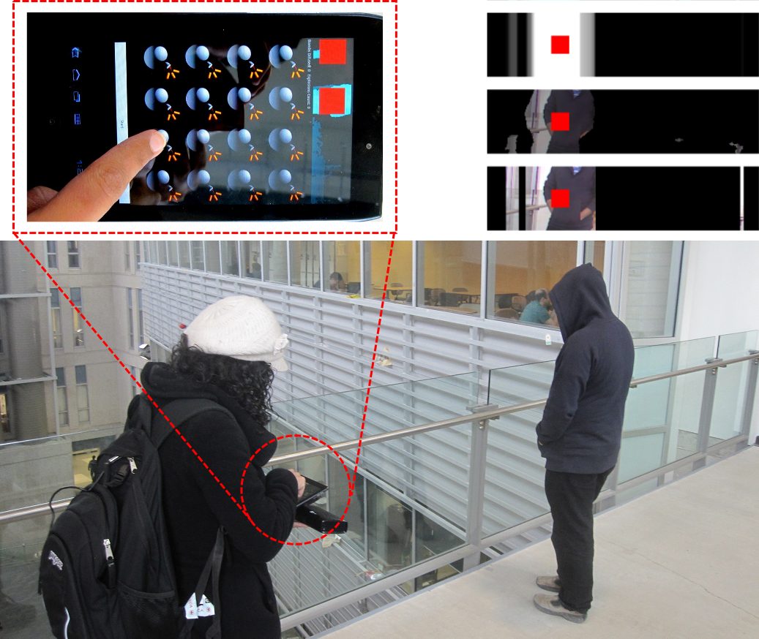

Slide 7
Video in the park

Slide 8
Transformed Depth Slice Image
Camera FoV
Depth Slice
User FoV

Slide 9
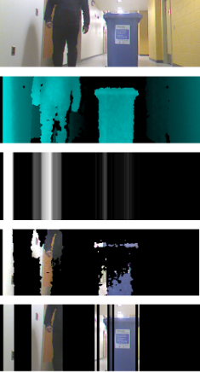
Depth Images
Masked Images

Slide 10
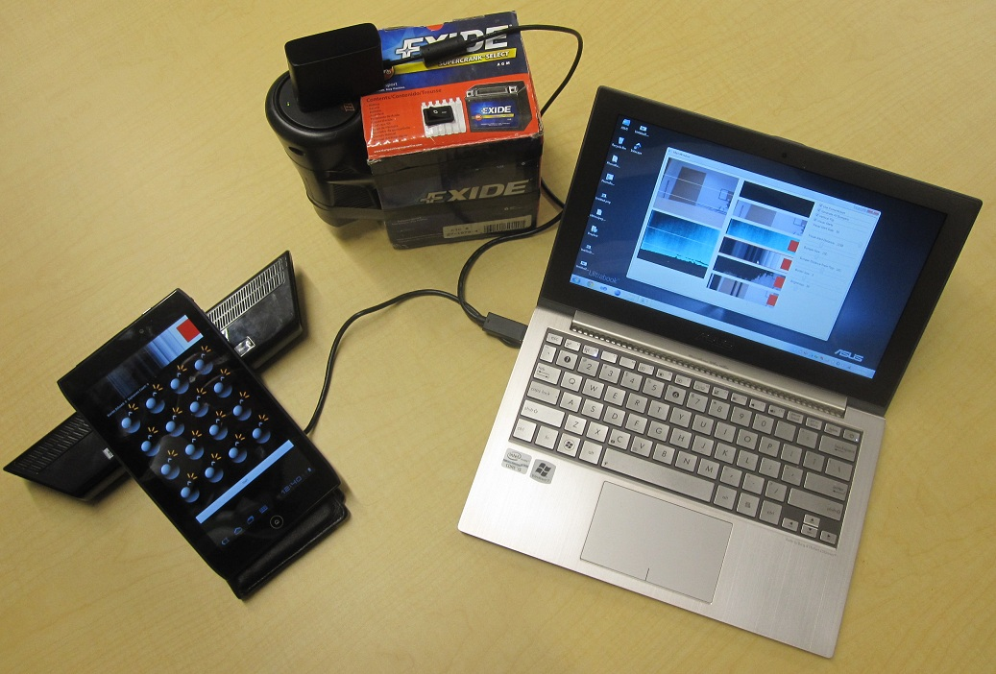

Slide 11
Video in the cafeteria

Slide 12
Our results show that users feel safe with CrashAlert, handling collisions in a smooth manner and can focus on their task
Their performance is not affected by the ambient display

