Slide 1
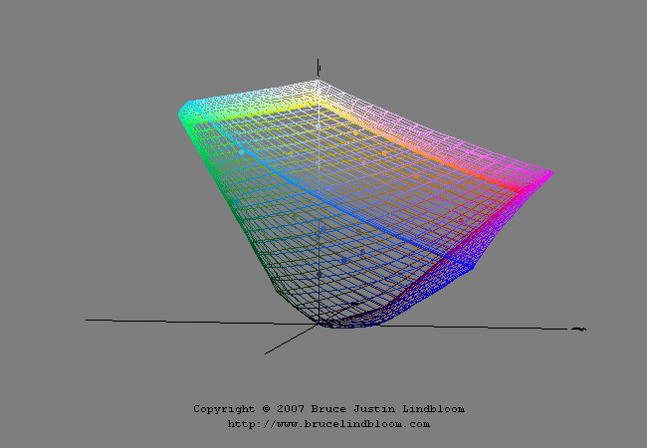

Slide 2
L
(a|b)

Slide 3
+
=
L
(a|b)
background
display

Slide 4
+
=
?
L
(a|b)
background
display

Slide 5
+
=
?
L
(a|b)
background
display

Slide 6
+
=
L
(a|b)
background
display

