Slide 1
What to Expect CPSC 502/503
http://hcitang.org/502 - http://hcitang.org/503
Tony Tang

Slide 2
Outline
Why 502/503?
Course expectations – responsibilities
Assessment
How to do well in this course

Slide 3
Why CPSC 502/503?

Slide 4
Why CPSC 502/503? – Prof Perspective
Recruitment
Comfort
Experience

Slide 5
Course Expectations - Responsibilities
Research: try on this pair of pants
» doing the work – thinking through the work
» communicating what you have done

Slide 6
Course Expectations - Responsibilities
Your Supervisor
» support your research process
» help you identify related work
» help you identify fruitful approaches
» help you when you are stuck
» help you with articulating your work
Me
» remind you that readers are often non-experts
» coach you on communication skills
» assess the clarity of your writing
» help mediate if conflicts arise
You
» be curious
» meet with your supervisor each week – have something to talk about
» do the work & go beyond the expectations – surprise your supervisor with ideas or knowledge
» embrace the opportunity

Slide 7
Course Expectations - Responsibilities
Your Supervisor
» the research
Me
» communication
You
» practice doing the research
» practice doing communication

Slide 8
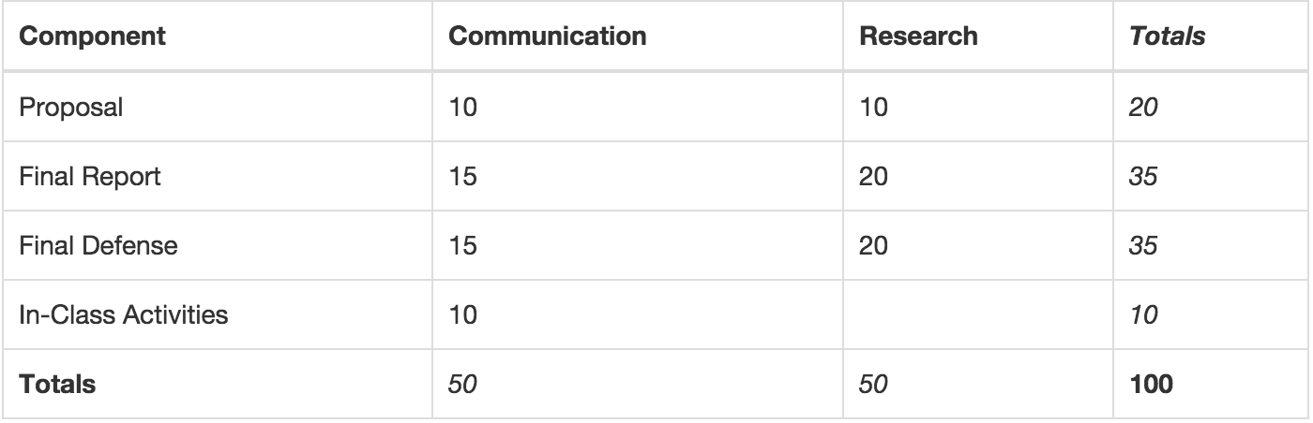
Assessment - 503

Slide 9
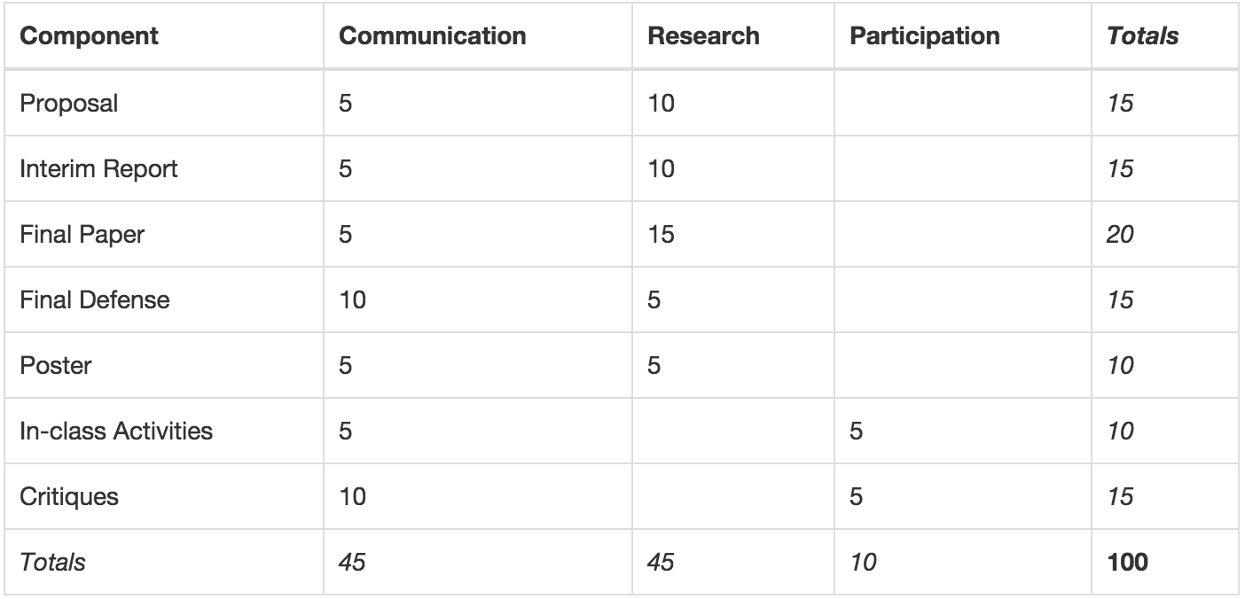
Assessment - 502

Slide 10
How to do well in this course
» meet with your supervisor weekly – come with questions and ideas
» engage seriously with the assignments—many of these, you can do in advance
» use this as an opportunity to jump-start a career in research

Slide 11
Assignments & Components
See the schedule page
Usually, due by noon (11:59am) or EOD (5:00pm)
Submissions are usually done through a post on Piazza
» on occasion, you will submit via email to me and your supervisor, and perhaps as a paper copy
PDFs

Slide 12
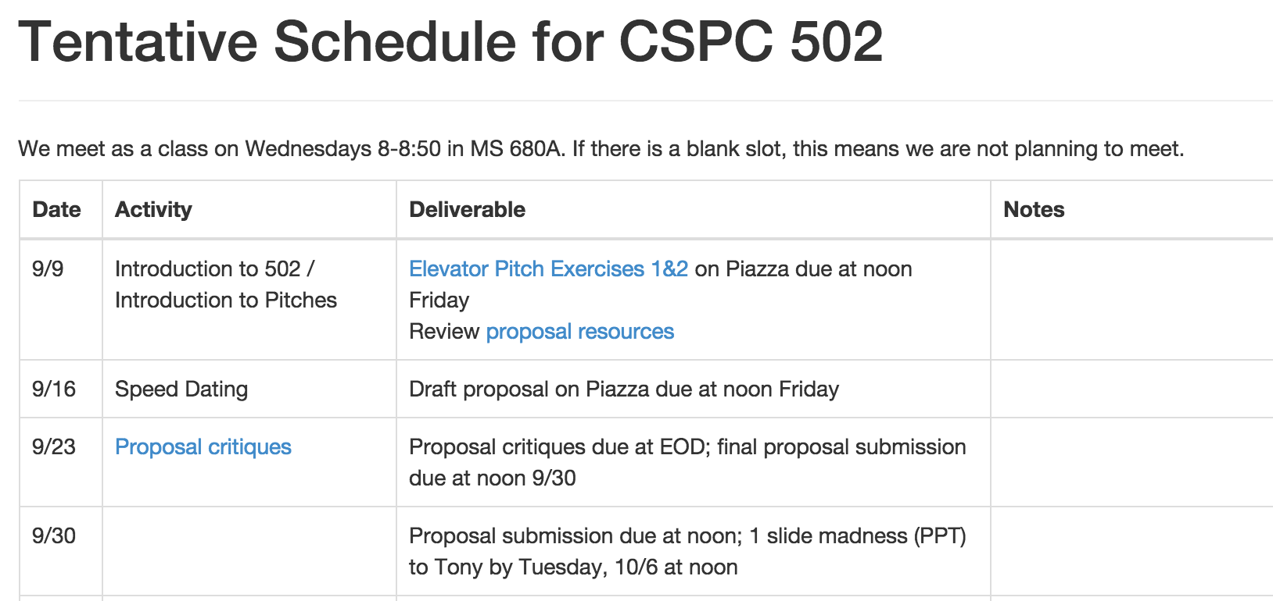

Slide 13
Outline
Why 502/503?
Course expectations – responsibilities
Assessment
How to do well in this course

